Slide 1

Creating a Healing Home:
Risking
Connection®
for
Foster Parents
Notes:
SLIDE 1

Slide 2
Module One
The Impact of Trauma and Trauma-Informed Care
Notes:
Welcome/Introduction
Materials
Module One PowerPoint Slides
White Board or Newsprint and Markers
Agenda Written on Newsprint and Posted
Video: Star Trek Next Generation
Video: Weathering: The Impact of Racism on Pregnant Mothers https://www.youtube.com/watch?v=NhtpU-aSGwI
Video: In Brief: The Science of Resilience https://www.youtube.com/watch?v=1r8hj72bfGo
Participant Handouts for Module One
Participant PowerPoint Slides
Objectives
Participants will:
Recognize the connection between trauma and both mental health and physical health.
Understand the differences between the traditional model and the trauma-informed model of healing trauma.
Use role plays to demonstrate understanding.
Introduce the concept of “Treaters”. The term used throughout the modules to describe everyone who interacts with the child to heal their wounds. We all can have a positive therapeutic impact on the children and youth we work with, not just clinical staff.
Time for Module
90 minutes
Module One: Impact of Trauma and Trauma Informed-Care
90 Minutes
Welcome and Introductions: Slides 2-6 (20 Minutes)
Definitions: Slides 7-8
(5 Minutes)
Impact of Trauma: Slides 9-22 (35 Minutes)
Underlying Assumptions: Slides 23-29 (10 minutes)
Paradigm Shift Role Play and Closing: Slides 30-31 (20 minutes)
SLIDE 2

Slide 3

Welcome
Introductions
  Name
  One thing you need from this training
Heads up! We’re talking about trauma.
Agenda
Notes:
Welcome and Introduction
Review the slide above:
Trainer introduces themselves
Participants introduce themselves and describes one thing they need from the training
Tell participants that, in any room of people, there are people who have had their own experiences of trauma and adversity. If the training triggers a strong reaction in you, be sure to take care of yourself – take a break, talk to your case manager, check in with the trainer after the session, etc.
Trainer reviews agenda
Module One: Impact of Trauma and Trauma Informed-Care
90 Minutes
Welcome and Introductions: Slides 2-6 (20 Minutes)
Definitions: Slides 7-8
(5 Minutes)
Impact of Trauma: Slides 9-22 (35 Minutes)
Underlying Assumptions: Slides 23-29 (10 minutes)
Paradigm Shift Role Play and Closing: Slides 30-31 (20 minutes)
SLIDE 3

Slide 4

Agreements
Notes:
Welcome and Introduction
Review the slide using the information below.
Explain to the group that they will be a learning community. What agreements do they need to enhance their learning experience?
If not mentioned, name these:
Ask people to put cell phones on vibrate and leave the room if they need to take a call.
Urge them to follow the basic rule of confidentiality. Encourage them to talk with others about the training, but they should not share any of the personal information that participants share in the training.
Remind them that all participation is voluntary. People can choose the level of information they will share in the training.
Acknowledge that people may be mandated to be at the training.
State that we all do this work for a reason, often related to our own personal history. Studies show that there are a higher percentage of people in the helping professions with histories of trauma than the general population; it is likely that there are people in the audience with a trauma history. Encourage them to take care of themselves.
We believe that every adult who comes into contact with foster youth can provide a healing role. Therefore, we use the word “treater” to describe foster parents and all adults in their support team.
Module One: Impact of Trauma and Trauma Informed-Care
90 Minutes
Welcome and Introductions: Slides 2-6 (20 Minutes)
Definitions: Slides 7-8
(5 Minutes)
Impact of Trauma: Slides 9-22 (35 Minutes)
Underlying Assumptions: Slides 23-29 (10 minutes)
Paradigm Shift Role Play and Closing: Slides 30-31 (20 minutes)
SLIDE 4

Slide 5

Your Turn!
Exercise: Listening Pairs
How did you decide to be a foster parent?
What is an especially rewarding moment being a foster parent?
Notes:
Welcome and Introduction
Exercise: Listening Pairs
Invite participants to find a partner that they do not know well.
Tell participants that each person will have 2 or 3 minutes to share their answers to the questions on the slide. The other person will listen attentively as the speaker talks, using their best active listening skills. Try to resist jumping in with your own stories – they will get their chance. The trainer will tell them to switch and the other person will talk while their partner listens.
Tell the first person to start while the other listens. Switch after about 3 or 4 minutes.
Discuss:
How was it to just listen? Were there moments when you were pulled to jump in with what you were thinking? What was it like to not jump in?
How might this be parallel to interactions with your foster child?
What stood out for you about people’s decisions to be a foster parent?
Would anyone like to briefly share their especially rewarding moment?
SLIDE 5
Module One: Impact of Trauma and Trauma Informed-Care
90 Minutes
Welcome and Introductions: Slides 2-6 (20 Minutes)
Definitions: Slides 7-8
(5 Minutes)
Impact of Trauma: Slides 9-22 (35 Minutes)
Underlying Assumptions: Slides 23-29 (10 minutes)
Paradigm Shift Role Play and Closing: Slides 30-31 (20 minutes)

Slide 6
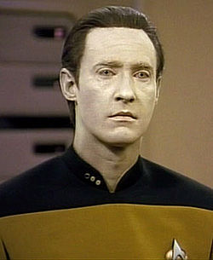
Video
Star Trek: The Next Generation
Notes:
Welcome and Introduction
The Name Risking Connection – Star Trek Video
Ask participants why they think the program was named, “Risking Connection?” What’s risky about relationships? Given the risks, why do people still pursue relationships? What’s risky for us (as parents) about engaging in relationships with people we help?
Explain that this brief video clip from Star Trek captures the dilemmas of being in relationships. Data and Captain Riker are talking about the betrayal of a crew member named Ashara. Data, an android, is baffled by the world of relationships.
Show the video clip from Star Trek: The Next Generation.
Ask: How does this video illustrate the central challenge of relationships for the children we work with?
SLIDE 6
Module One: Impact of Trauma and Trauma Informed-Care
90 Minutes
Welcome and Introductions: Slides 2-6 (20 Minutes)
Definitions: Slides 7-8
(5 Minutes)
Impact of Trauma: Slides 9-22 (35 Minutes)
Underlying Assumptions: Slides 23-29 (10 minutes)
Paradigm Shift Role Play and Closing: Slides 30-31 (20 minutes)

Slide 7
What is psychological trauma?
Trauma is the unique individual experience of an event or enduring conditions in which:
The individual’s ability to integrate his or her emotional experience is overwhelmed and
The individual experiences it as physically or emotionally harmful and/or life threatening.
Notes:
Impact of Trauma
Review the slide using the information below.
Review the definition, stressing that while there is the objective facts of trauma, the individual’s subjective experience is most important.
Two people (even in the same family) can experience the same trauma and have very different, short and long-term reactions.
You can give the example of two people driving in a car together and having an accident. For one person, it feels very traumatic. For the other, no big deal. Ask what factors could influence these different reactions. They could include:
age it occurred
experiences of accidents or other traumas in the past
history of attachment
current support systems
temperament
what was happening at the time of the accident
other stressors in the person’s life or family
Etc.
SLIDE 7
Module One: Impact of Trauma and Trauma Informed-Care
90 Minutes
Welcome and Introductions: Slides 2-6 (20 Minutes)
Definitions: Slides 7-8
(5 Minutes)
Impact of Trauma: Slides 9-22 (35 Minutes)
Underlying Assumptions: Slides 23-29 (10 minutes)
Paradigm Shift Role Play and Closing: Slides 30-31 (20 minutes)

Slide 8
What is Adversity?
Difficult life circumstances or events that may be extremely stressful and can have negative health outcomes.
“Childhood adversity” – When they happen in childhood, they can be especially harmful.
These circumstances or events may or may not be traumatic.
Notes:
Impact of Trauma
Review the slide using the information below.
Most people experience some adversity in their life. Some difficult things can be more impactful than others, and when many difficult things happen to children, they can be particularly impactful.
In our next section, we are going to look at an important study that identifies the impact of childhood adversity and trauma on the emotional and physical health of individuals.
SLIDE 8
Module One: Impact of Trauma and Trauma Informed-Care
90 Minutes
Welcome and Introductions: Slides 2-6 (20 Minutes)
Definitions: Slides 7-8
(5 Minutes)
Impact of Trauma: Slides 9-22 (35 Minutes)
Underlying Assumptions: Slides 23-29 (10 minutes)
Paradigm Shift Role Play and Closing: Slides 30-31 (20 minutes)

Slide 9
Lifelong Impact of
Adversity and Trauma
Adverse Childhood
Experiences (ACE) Study
  “The most important study you never heard of.”
  Jane Stevens, Acesconnection.com
Notes:
Impact of Trauma
Review the slide using the information below.
Ask: How many people have heard of the ACE study?
This was often described as “the most important study you never heard of” because for almost 20 years after it was published, no one knew about it. This IS now changing and many more people know about it.
We include it because the findings are remarkable AND the findings have helped foster the international movement for trauma-informed care.
Alert people that this can be upsetting information to listen to since so many of us have had our own history of adversity – certainly some more serious than others. Many people also find the information validating because it shows how common childhood adversity and trauma is and confirms the hurt it can cause.
It is important to note that, although this study talks about the profound impact of adversity and trauma in childhood, it does not talk about resilience and all the factors that help people bounce back from trauma.
SLIDE 9
Module One: Impact of Trauma and Trauma Informed-Care
90 Minutes
Welcome and Introductions: Slides 2-6 (20 Minutes)
Definitions: Slides 7-8
(5 Minutes)
Impact of Trauma: Slides 9-22 (35 Minutes)
Underlying Assumptions: Slides 23-29 (10 minutes)
Paradigm Shift Role Play and Closing: Slides 30-31 (20 minutes)

Slide 10
Story of the ACE Study
Very large sample -- 17,000 patients at Kaiser Permanente health maintenance organization (HMO)
Average age: 57
High-functioning
  All insured
  Middle and upper middle class
  74% attended college
Anda et al., 2006
Notes:
Impact of Trauma
Review the slide using the information below.
Explain in advance that sometimes this section triggers questions about details related to the study. Be honest that you are not an expert on the study and may not be able to answer them in detail. For more information, refer people to www.acestoohigh.com and www.acesconnection.com.
In the 1990s, a researcher at the California health organization Kaiser Permanente and a researcher at the Center for Disease Control got together and sent out a questionnaire to a huge sample of patients who were members of the HMO. The sample represented a very mainstream, middle and upper-middle class portion of society – all were insured, middle income or above, and 75% attended college.
SLIDE 10
Module One: Impact of Trauma and Trauma Informed-Care
90 Minutes
Welcome and Introductions: Slides 2-6 (20 Minutes)
Definitions: Slides 7-8
(5 Minutes)
Impact of Trauma: Slides 9-22 (35 Minutes)
Underlying Assumptions: Slides 23-29 (10 minutes)
Paradigm Shift Role Play and Closing: Slides 30-31 (20 minutes)

Slide 11
ACE Categories
ABUSE AND NEGLECT
Emotional abuse
Physical abuse
Sexual abuse
Emotional neglect
Physical neglect
HOUSEHOLD DYSFUNCTION
Mother Treated Violently
Household Substance Abuse
Household Mental Illness
Parental Separation or Divorce
Incarcerated Household Member
Notes:
Impact of Trauma
Review the slide using the information below.
In their questionnaire, they asked about the patient’s experience with 10 different categories of adverse experiences in their childhood. Depending on the answers, the patients got an “ACE Score” of 0 to 10. If you experienced none, you got an ACE Score of 0; if you experienced 1, a score of 1, etc.
Ask: Take a minute to calculate what your ACE Score would be. We’re not going to talk about it. As we said before, studies tend to show that there is a higher rate of adverse childhood experiences and trauma among people in our field than the general public.
It is important to note that these kinds of events are not experienced by ALL people as traumatic. People have very individualized reactions to these kinds of events. It also does not reflect the protective or resilience factors that people have in their lives.
SLIDE 11
Module One: Impact of Trauma and Trauma Informed-Care
90 Minutes
Welcome and Introductions: Slides 2-6 (20 Minutes)
Definitions: Slides 7-8
(5 Minutes)
Impact of Trauma: Slides 9-22 (35 Minutes)
Underlying Assumptions: Slides 23-29 (10 minutes)
Paradigm Shift Role Play and Closing: Slides 30-31 (20 minutes)

Slide 12
Findings: High Prevalence
64% at least 1 ACE
12% 4+ ACEs
25% households with substance abuse
25% physical abuse
Anda et al., 2006
Notes:
Impact of Trauma
Review the slide using the information below.
When the researchers analyzed the responses, they were surprised by the prevalence of adverse childhood experiences in this generally privileged sample of people.
Click -- 36% had no ACEs, but…
Click -- 64% (the next 4 blue bars added together) had a least 1 ACE and 12.5 % (1/8th) had 4 or more ACEs.
In 25% of households there was substance abuse, and 25% of people said they were physically abused. Remember this was a well-to-do sample, very different from most people who, for example, grew up in the foster care system.
SLIDE 12
Module One: Impact of Trauma and Trauma Informed-Care
90 Minutes
Welcome and Introductions: Slides 2-6 (20 Minutes)
Definitions: Slides 7-8
(5 Minutes)
Impact of Trauma: Slides 9-22 (35 Minutes)
Underlying Assumptions: Slides 23-29 (10 minutes)
Paradigm Shift Role Play and Closing: Slides 30-31 (20 minutes)

Slide 13
Findings: 4+ ACEs vs. 0 ACEs
  6x more likely to attempt suicide
  7x more likely to be alcoholic
  7x more like to have sex by 15
  46x more like to use injected drugs
Felitti et al., 1998
Notes:
Impact of Trauma
Review the slide using the information below.
Click – Then they compared the difference between people having a lot of ACES (4 or more) with 0 ACES.
Click -- (bars 1, 2, and 3 ACES fall away) – When you just look at 4+ as compared to 0, the risk for these problems skyrockets.
People with 4 or more ACEs were 6x more likely to attempt suicide, 7x more likely to be alcoholic, 7x more likely to have sex by age 15, 46x more likely to use injected street drugs.
SLIDE 13
Module One: Impact of Trauma and Trauma Informed-Care
90 Minutes
Welcome and Introductions: Slides 2-6 (20 Minutes)
Definitions: Slides 7-8
(5 Minutes)
Impact of Trauma: Slides 9-22 (35 Minutes)
Underlying Assumptions: Slides 23-29 (10 minutes)
Paradigm Shift Role Play and Closing: Slides 30-31 (20 minutes)

Slide 14
Findings: 4+ ACES vs. 0 ACES
  2x more likely to have cancer
  2x more likely to have heart disease
  < 2x more likely to be obese
Felitti et al., 1998
Notes:
Impact of Trauma
Review the slide using the information below.
What was also unique about this study is that since they had the health records of these people, they looked at the impact of ACES on their physical health. These findings also astounded them. The graphs looked the same – the higher the ACES, the higher the risk of MANY negative health outcomes. We show heart disease, lung disease, and obesity here, but we could show the exact same pattern of graphs for cancer, diabetes, high blood pressures, etc.
Click -- Then, with physical health issues they compared people with 4+ ACES to 0 ACES.
Click – (bars 1, 2, and 3 ACES fall away). They are 2 times more likely to have cancer, 2 times more likely to have heart disease, and more than 2 times more likely to be obese.
SLIDE 14
Module One: Impact of Trauma and Trauma Informed-Care
90 Minutes
Welcome and Introductions: Slides 2-6 (20 Minutes)
Definitions: Slides 7-8
(5 Minutes)
Impact of Trauma: Slides 9-22 (35 Minutes)
Underlying Assumptions: Slides 23-29 (10 minutes)
Paradigm Shift Role Play and Closing: Slides 30-31 (20 minutes)

Slide 15
Original Study vs.
Women Raised in Foster Care
Anda et al., 2006
Bruskas, 2013
Notes:
Impact of Trauma
Review the slide using the information below.
Click – Here is the original Kaiser sample compared to adult women raised in the foster care system. As you can see, the number of women with four or more ACES is extremely high, over 70%.
Again, we can assume that for the populations commonly served in the public mental health system, the negative health outcomes are numerous.
SLIDE 15
Module One: Impact of Trauma and Trauma Informed-Care
90 Minutes
Welcome and Introductions: Slides 2-6 (20 Minutes)
Definitions: Slides 7-8
(5 Minutes)
Impact of Trauma: Slides 9-22 (35 Minutes)
Underlying Assumptions: Slides 23-29 (10 minutes)
Paradigm Shift Role Play and Closing: Slides 30-31 (20 minutes)

Slide 16
Newest Thinking on ACEs
ABUSE AND NEGLECT
Emotional abuse
Physical abuse
Sexual abuse
Emotional neglect
Physical neglect
HOUSEHOLD DYSFUNCTION
Mother Treated Violently
Household Substance Abuse
Household Mental Illness
Parental Separation or Divorce
Incarcerated Household Member
ACES PLUS 5
Experiencing racism
Witnessing violence
Living in an unsafe neighborhood
Living in foster care
Experiencing bullying
Notes:
Impact of Trauma
Review the slide using the information below.
The newest thinking and research about ACEs has expanded the ACE categories to include 5 more areas of adverse experiences.
It is likely that these issues are as impactful, if not more impactful, than some of the original 10 ACE categories like divorce.
It is really important that these are added because many of them solely or especially impact people of color. You can’t talk about childhood adversity without recognizing that things like racism, living in unsafe neighborhoods, or witnessing violence are highly stressful and often traumatic.
The ACE study shows that adversity and trauma impact everyone. It is also true that because of issues like racism, the impact may be greater on people of color. Therefore, trauma-informed care goes hand in hand with work on equity and multicultural issues.
SLIDE 16
Module One: Impact of Trauma and Trauma Informed-Care
90 Minutes
Welcome and Introductions: Slides 2-6 (20 Minutes)
Definitions: Slides 7-8
(5 Minutes)
Impact of Trauma: Slides 9-22 (35 Minutes)
Underlying Assumptions: Slides 23-29 (10 minutes)
Paradigm Shift Role Play and Closing: Slides 30-31 (20 minutes)

Slide 17
Social Inequities and Adversity/Trauma
The adversity and trauma inherent in racism, homophobia, sexism, poverty, etc. cannot be underestimated
    People with “white sounding” names are 50% more likely to be called back for job interviews than those with “black sounding” names even when all credentials are equal. (Wise, 2008)
    Though African-Americans and Hispanics make up approximately 32% of the US population, they comprise 56% of all incarcerated people. (NAACP, 2015)
Video: Weathering: The Impact of Racism on Pregnant Mothers https://www.youtube.com/watch?v=NhtpU-aSGwI
Notes:
Impact of Trauma
Review the slide using the information below.
A true understanding of adversity and trauma must be linked to awareness of the impact on health outcomes of systematic racism, homophobia, sexism, poverty, etc. Persistent subtle and not so subtle discrimination are chronic stressors that accumulate over time. It’s like lifelong “wear and tear” on the mind and body.
Tell participants that this video talks about one example of how racism, regardless of education and income status, impacts pregnant mothers.
Show video. https://www.youtube.com/watch?v=NhtpU-aSGwI
Ask for reactions to the video.
SLIDE 17
Module One: Impact of Trauma and Trauma Informed-Care
90 Minutes
Welcome and Introductions: Slides 2-6 (20 Minutes)
Definitions: Slides 7-8
(5 Minutes)
Impact of Trauma: Slides 9-22 (35 Minutes)
Underlying Assumptions: Slides 23-29 (10 minutes)
Paradigm Shift Role Play and Closing: Slides 30-31 (20 minutes)

Slide 18
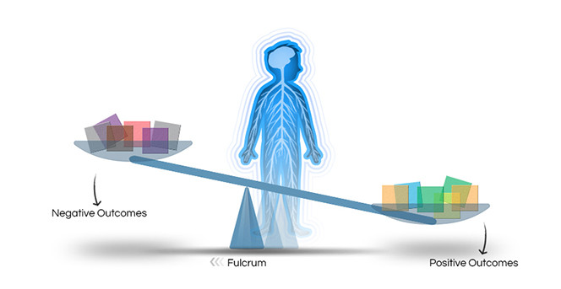
Resilience Trumps ACEs
Resiliency Factors
A stable and committed relationship with a supportive parent, caregiver, or other adult
Feeling of efficacy and control
Opportunities to strengthen self-regulation skills
Access to sources of faith, hope, and cultural traditions
Harvard Center of the Developing Child
Notes:
Impact of Trauma
Review the slide using the information below.
The thing that the ACE study doesn’t talk about -- that is SO important -- is resiliency. Resiliency describes all the factors that strengthen well-being and help people endure adversity and trauma.
Research has identified a common set of factors that predispose children to positive outcomes in the face of significant adversity. Ask if the audience can identify others.
Notice that one factor is the existence of at least one committed relationship with an adult. Many adults later in life say “If it wasn’t for my…(coach, teacher, neighbor, my friend’s mother, etc.)…I wouldn’t be who I am today.”
Especially with the help of supportive relationships, people generally are able to overcome the impact of trauma and adversity and have lives worth living.
During this training, we want you to think about BOTH addressing trauma and strengthening resiliency.
SLIDE 18
Module One: Impact of Trauma and Trauma Informed-Care
90 Minutes
Welcome and Introductions: Slides 2-6 (20 Minutes)
Definitions: Slides 7-8
(5 Minutes)
Impact of Trauma: Slides 9-22 (35 Minutes)
Underlying Assumptions: Slides 23-29 (10 minutes)
Paradigm Shift Role Play and Closing: Slides 30-31 (20 minutes)

Slide 19

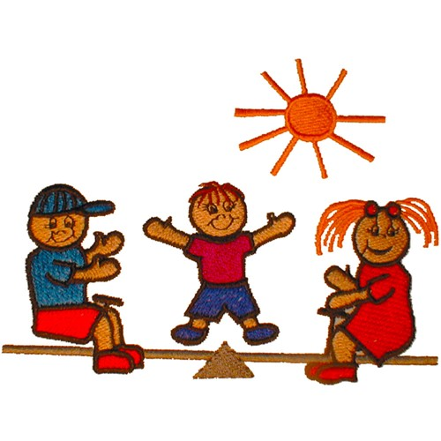
Video
Resilience
Notes:
Impact of Trauma
Introduce the video on resilience.
Ask participants to be thinking about the characteristics of resilient people as they watch the video.
Play video called “In Brief: The Science of Resilience” https://www.youtube.com/watch?v=1r8hj72bfGo
Ask participants for their reaction to the video.
Ask: what characteristic of resilience can you most relate to?
SLIDE 19
Module One: Impact of Trauma and Trauma Informed-Care
90 Minutes
Welcome and Introductions: Slides 2-6 (20 Minutes)
Definitions: Slides 7-8
(5 Minutes)
Impact of Trauma: Slides 9-22 (35 Minutes)
Underlying Assumptions: Slides 23-29 (10 minutes)
Paradigm Shift Role Play and Closing: Slides 30-31 (20 minutes)

Slide 20
If child abuse ended today…
If child abuse ended today, in 10 years the jails would be empty and the DSM would be a pamphlet. – adapted from John Briere, Ph.D.
Notes:
Impact of Trauma
Review the slide using the information below.
This is a quote adapted from a well-known trauma researcher, John Briere.
It is interesting to think about what would change if child abuse was greatly reduced or eliminated.
SLIDE 20
Module One: Impact of Trauma and Trauma Informed-Care
90 Minutes
Welcome and Introductions: Slides 2-6 (20 Minutes)
Definitions: Slides 7-8
(5 Minutes)
Impact of Trauma: Slides 9-22 (35 Minutes)
Underlying Assumptions: Slides 23-29 (10 minutes)
Paradigm Shift Role Play and Closing: Slides 30-31 (20 minutes)

Slide 21
Why So Important?
Trauma is a public health epidemic
Roots of poor health in childhood trauma are unrecognized
Physiological impact of chronic stress/trauma
Addressing trauma and promoting resiliency prevents health problems throughout life span
TRAUMA-INFORMED CARE!!!!
Notes:
Impact of Trauma
Review the slide using the information below.
The sheer number of ACEs and childhood trauma are vast, making it a public health epidemic.
It is often at the root of poor health and this is rarely seen.
ACEs and trauma have a physiological impact that can be broad and lifelong. This can help to take the blame off of survivors.
Implementation of trauma-informed care across service sectors is critical – mental health, medical, corrections, police, courts, education, first responders, etc.
Providing support and healing for foster kids through a trauma-informed lens helps Foster Parents take behaviors less personally and provides hope for both kids and parents.
SLIDE 21
Module One: Impact of Trauma and Trauma Informed-Care
90 Minutes
Welcome and Introductions: Slides 2-6 (20 Minutes)
Definitions: Slides 7-8
(5 Minutes)
Impact of Trauma: Slides 9-22 (35 Minutes)
Underlying Assumptions: Slides 23-29 (10 minutes)
Paradigm Shift Role Play and Closing: Slides 30-31 (20 minutes)

Slide 22
What Is Trauma-Informed Care?
An approach where all of those providing care:
  REALIZE the pervasive impact of ACEs and trauma
  RECOGNIZE the signs of trauma in clients
  RESPOND by applying the principles of TIC to all areas of the system
  RESIST RE-TRAUMATIZATION - provide care that heals rather than makes things worse
(SAMHSA, 2014)
An approach where all providing care:
  STRENGTHENS RESILIENCY FACTORS
Notes:
Impact of Trauma
Review the slide using the information below.
Trauma-informed care has become a buzzword that everyone uses, but the definition is often vague and varied.
Therefore, we like to define it. Here is probably the most broadly used definition of trauma-informed care created by SAMHSA (The Substance Abuse and Mental Health Services Administration).
Review “The 4 Rs.”
Stress again that trauma-informed care also stresses building resiliency.
foster parents are in a great position as treaters to practice the 4 R’s stated in the slide.
Ask: What are ways that you can avoid re-traumatization of the foster children you work with?
Module One: Impact of Trauma and Trauma Informed-Care
90 Minutes
Welcome and Introductions: Slides 2-6 (20 Minutes)
Definitions: 7-8 (5 Minutes)
Impact of Trauma: Slides 9-22 (35 Minutes)
Underlying Assumptions: Slides 23-29 (10 minutes)
Paradigm Shift Role Play and Closing: Slide 30-31 (20 minutes)
SLIDE 22

Slide 23
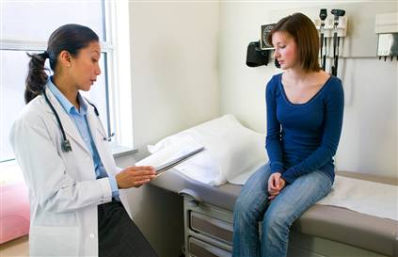
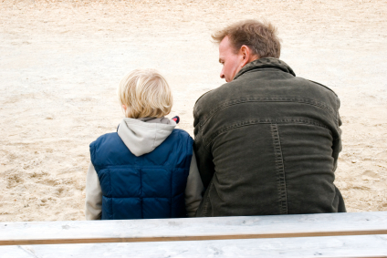
Trauma-Informed Care:
A Paradigm Shift
Traditional Model
Trauma-Informed Model
Notes:
Underlying Assumptions
Review the slide using the information below.
A trauma-informed model represents a paradigm shift from traditional models, often used in human services like a medical model or behavior modification model.
A paradigm shift means a fundamentally different worldview of how to approach something, like when Galileo asserted that the sun, rather than the earth, was the center of the universe.
This paradigm shift also is relevant to those who don’t do direct service with the youth. For example, you can apply this to how foster parents interact with agency staff.
We will now take a look at the differences between a “traditional” model and a trauma-informed model.
SLIDE 23
Module One: Impact of Trauma and Trauma Informed-Care
90 Minutes
Welcome and Introductions: Slides 2-6 (20 Minutes)
Definitions: Slides 7-8
(5 Minutes)
Impact of Trauma: Slides 9-22 (35 Minutes)
Underlying Assumptions: Slides 23-29 (10 minutes)
Paradigm Shift Role Play and Closing: Slides 30-31 (20 minutes)

Slide 24
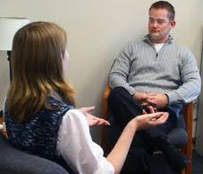
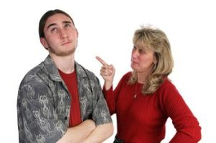
Underlying Assumptions
Traditional Model
Trauma-Informed Model
What happened to you?
What’s wrong with you?
Notes:
Underlying Assumptions
Review the slide using the information below.
Some describe the change as a shift from “What’s wrong with you?” to “What happened to you?” A traditional model is “power over” and trauma model is “power with.”
SLIDE 24
Module One: Impact of Trauma and Trauma Informed-Care
90 Minutes
Welcome and Introductions: Slides 2-6 (20 Minutes)
Definitions: Slides 7-8
(5 Minutes)
Impact of Trauma: Slides 9-22 (35 Minutes)
Underlying Assumptions: Slides 23-29 (10 minutes)
Paradigm Shift Role Play and Closing: Slides 30-31 (20 minutes)

Slide 25
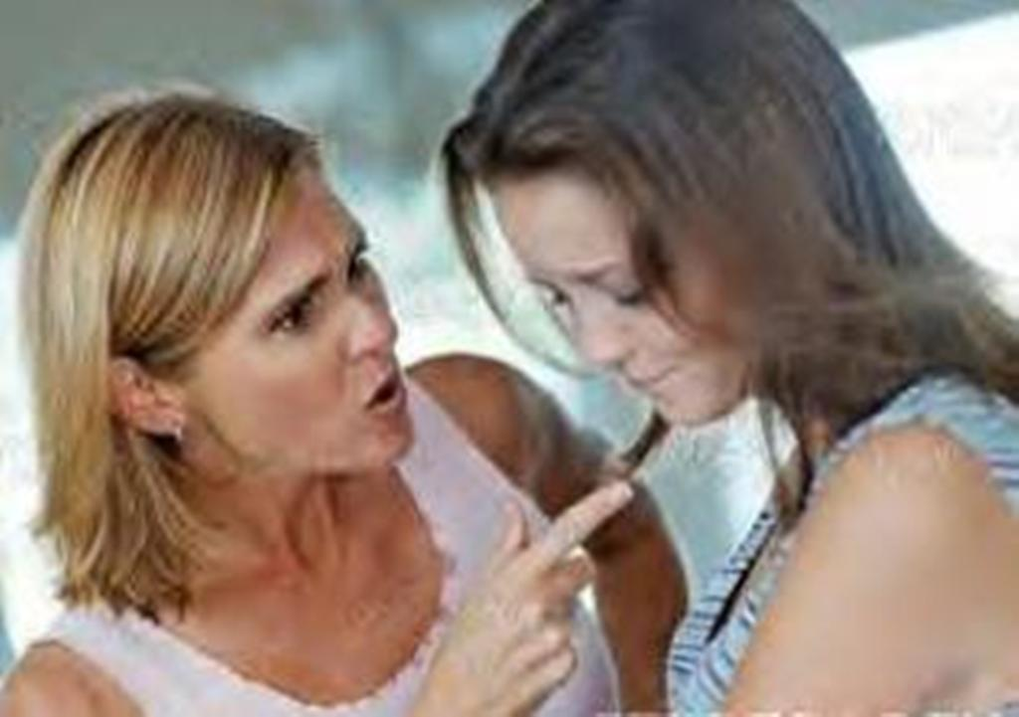
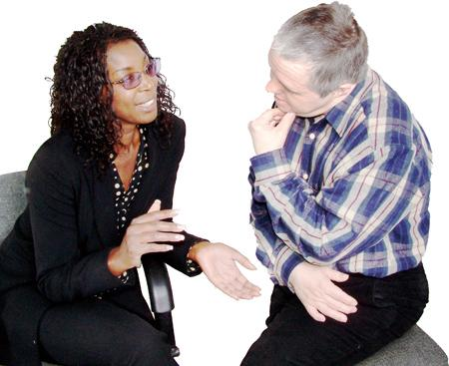
Underlying Assumptions
Traditional Model
Trauma-Informed Model
Priority on collaboration. Balancing safety and collaboration.
Priority on Control.
Notes:
Underlying Assumptions
Review the slide using the information below.
A traditional model puts emphasis on controlling dangerous, unusual or problem behavior -- get people to stop doing what they are doing; “If you are not able to control your behavior, we will need to take control of the behavior.”
A trauma-informed model stresses collaboration, inviting collaboration whenever possible -- “We’re on the same side of the fence with you, looking to solve your challenges together.”
SLIDE 25
Module One: Impact of Trauma and Trauma Informed-Care
90 Minutes
Welcome and Introductions: Slides 2-6 (20 Minutes)
Definitions: Slides 7-8
(5 Minutes)
Impact of Trauma: Slides 9-22 (35 Minutes)
Underlying Assumptions: Slides 23-29 (10 minutes)
Paradigm Shift Role Play and Closing: Slides 30-31 (20 minutes)

Slide 26

Underlying Assumptions (cont’d)
Traditional Model
Negative behavior viewed as needing
to be changed.
Trauma-Informed Model
Negative behavior viewed as adaptive. Exists for a reason, which we need to figure out.
Notes:
Underlying Assumptions
Review the slide using the information below.
A traditional model stresses changing the behavior, often as quickly as possible.
A trauma-informed model also has the goal of changing behavior, but it stresses taking a step back and seeing the behavior as adaptive, existing for a reason, and meeting a need.
If we move too quickly to eliminating the behavior, we often don’t think about what need it serves. If we don’t understand what need it serves, we don’t know how to help that person meet that need with less negative consequences.
SLIDE 26
Module One: Impact of Trauma and Trauma Informed-Care
90 Minutes
Welcome and Introductions: Slides 2-6 (20 Minutes)
Definitions: Slides 7-8
(5 Minutes)
Impact of Trauma: Slides 9-22 (35 Minutes)
Underlying Assumptions: Slides 23-29 (10 minutes)
Paradigm Shift Role Play and Closing: Slides 30-31 (20 minutes)

Slide 27

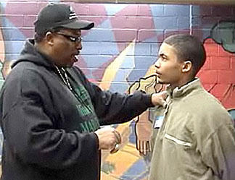
Underlying Assumptions (cont’d)
Traditional Model
Primary agent of change is punishment and reward.
Trauma-Informed Model
Primary agent of change is relationships.
Notes:
Underlying Assumptions
Review the slide using the information below.
A traditional model tends to rely on punishments and rewards to get rid of problem behavior.
A trauma-informed model stresses relationships as the primary agent of change; since people are hurt in relationships, the healing happens in relationships and a strong relationship provides relationship-based rewards and consequences that are much more powerful than a restriction.
SLIDE 27
Module One: Impact of Trauma and Trauma Informed-Care
90 Minutes
Welcome and Introductions: Slides 2-6 (20 Minutes)
Definitions: Slides 7-8
(5 Minutes)
Impact of Trauma: Slides 9-22 (35 Minutes)
Underlying Assumptions: Slides 23-29 (10 minutes)
Paradigm Shift Role Play and Closing: Slides 30-31 (20 minutes)

Slide 28
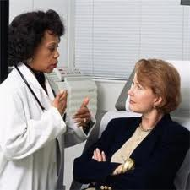

Underlying Assumptions (cont’d)
Traditional Model
Treater as authority and expert.
Trauma-informed Model
Treater as collaborator.
Notes:
Underlying Assumptions
Review the slide using the information below.
In a traditional model, the treater has knowledge and wisdom that they impart to the person, who then uses it to change.
While in a trauma-informed model, parents recognize that the people they help know important things about themselves, their family, and what they have been through. We invite them to bring that knowledge and combine it with what we know about healing.
SLIDE 28
Module One: Impact of Trauma and Trauma Informed-Care
90 Minutes
Welcome and Introductions: Slides 2-6 (20 Minutes)
Definitions: Slides 7-8
(5 Minutes)
Impact of Trauma: Slides 9-22 (35 Minutes)
Underlying Assumptions: Slides 23-29 (10 minutes)
Paradigm Shift Role Play and Closing: Slides 30-31 (20 minutes)

Slide 29


Underlying Assumptions (cont’d)
Traditional Model
Treater expected to be invulnerable. Strong feelings about the work viewed as unprofessional and weak.
Trauma-Informed Model
Treater expected to be impacted by the work. Strong feelings inevitable.
Notes:
Underlying Assumptions
Review the slide using the information below.
In a traditional model, strong reactions to the work is often viewed as weak, unprofessional, a sign that work is getting to you too much, and that you need to toughen up. If you have strong feelings, you certainly shouldn’t show them, much less talk about them.
In a trauma-informed model, the culture stresses that of course one is going to have strong feelings.
Ask: How can one do this difficult work and NOT have these feelings? Organizations need to create climates where parents can admit, talk about, and manage these feelings. Parents need to develop strategies to address these feelings.
SLIDE 29
Module One: Impact of Trauma and Trauma Informed-Care
90 Minutes
Welcome and Introductions: Slides 2-6 (20 Minutes)
Definitions: Slides 7-8
(5 Minutes)
Impact of Trauma: Slides 9-22 (35 Minutes)
Underlying Assumptions: Slides 23-29 (10 minutes)
Paradigm Shift Role Play and Closing: Slides 30-31 (20 minutes)

Slide 30
Your Turn!
Exercise: Paradigm Shift Role Play
Notes:
Underlying Assumptions
Paradigm Shift – Role Play Exercise: Meeting a child for the first time.
Trainers may want to model the role play before asking participants to do the role play.
Ask participants to partner with someone sitting near them.
Explain that the RC model stresses the use of role play because it is one of the best ways of really understanding how a trauma-informed model contrasts with ways of interacting with children that are not trauma-informed. Tell them you do understand that some people find role play difficult AND you are going to ask them to stretch their comfort zone.
Ask pairs to decide who will be the child and who will be the parent.
Explain that they will role play an initial dialogue between a parent and a child two times – first in a traditional (but realistic) way and second in a more trauma-informed way.
Explain to the participants that they are role playing meeting and getting to know their child.
Explain that as parents they are meeting with a child for the first time and all they know is
that the child has a history of abuse, neglect and trauma. Ask them to role play the traditional
way and tell them you will stop them after 2-3 minutes.
Ask them to switch to role playing the trauma-informed way and tell them you will stop them after 2-3 minutes.
Discuss:
For the child, how did the two scenarios feel different for you? What did you notice about how you reacted in your body – did the interaction activate you further or help you stay more calm?
For parents, how does the role of parent feel different in the two models? Are there particular situations that call for one model as opposed to the other? (i.e., life threatening crisis)
What are examples of questions you asked using a traditional model lens? A trauma-informed model lens?
What are the advantages and disadvantages of each model?
SLIDE 30
Module One: Impact of Trauma and Trauma Informed-Care
90 Minutes
Welcome and Introductions: Slides 2-6 (20 Minutes)
Definitions: Slides 7-8
(5 Minutes)
Impact of Trauma: Slides 9-22 (35 Minutes)
Underlying Assumptions: Slides 23-29 (10 minutes)
Paradigm Shift Role Play and Closing: Slides 30-31 (20 minutes)

Slide 31
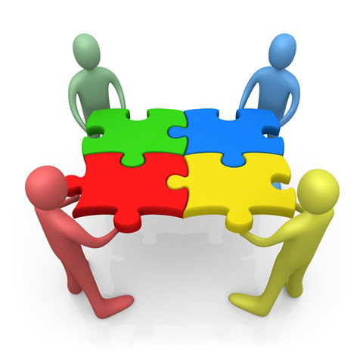
Closing Activity
Notes:
Closing
Ask participants to reflect on moments of joy in their life.
Ask participants to share one of their moments of joy with one other person.
Ask participants to state how they will remember that moment of joy in the weeks ahead.
Ask for a few volunteers to share their moment of joy with the larger group.
SLIDE 31
Module One: Impact of Trauma and Trauma Informed-Care
90 Minutes
Welcome and Introductions: Slides 2-6 (20 Minutes)
Definitions: Slides 7-8
(5 Minutes)
Impact of Trauma: Slides 9-22 (35 Minutes)
Underlying Assumptions: Slides 23-29 (10 minutes)
Paradigm Shift Role Play and Closing: Slides 30-31 (20 minutes)

Slide 32
Module Two
Introduction to Trauma Framework
Notes:
Welcome/Introduction
Materials
Module Two PowerPoint Slides
White Board or Newsprint and Markers
Agenda Written on Newsprint and Posted
Video: Weathering: The Impact of Racism on Pregnant Mothers https://www.youtube.com/watch?v=NhtpU-aSGwI
Video :”Still Face Experiment” (Use either video of mother or father but not both)
Video: “Brain Builders”
Participant’s Handouts for Module Two
Participant PowerPoint Slides
“Worksheet: If Feeling Skills Could Speak.”
Objectives
Participants will:
Learn how trauma impacts attachment, body and brain, and feeling skill development
Understand the importance of co-regulation.
Demonstrate understanding by applying concepts to exercises and discussion.
Remind participants of the concept of “Treaters”. The term used throughout the modules to describe everyone who interacts with the child to heal their wounds. We all can have a positive therapeutic impact on the children and youth we work with, not just clinical staff.
Time for Module
90 minutes
Module Two: Introduction to Trauma Framework
90 Minutes
Welcome and Introduction: Slides 32-33 (15 minutes)
Intro to the Trauma Framework: Slide 34 (5 minutes)
Impact of Trauma on Attachment: Slides 35-43 (15 minutes)
Impact of Trauma on the Body and Brain: Slides 44-52 (20 minutes)
Impact of Trauma on Feelings Skills: Slides 53-65 (20 minutes)
Your Turn: Slide 66 (10 minutes)
Closing: Slide 67 (5 minutes)
SLIDE 32

Slide 33

Welcome
Introductions
  Name
  Opening Activity
Review Agreements
Heads up! We’re talking about trauma.
Agenda
Notes:
Welcome and Introductions
Review the slide above.
Trainers introduce themselves.
Participants introduce themselves and share one thing they did this past week that made them smile.
Review the agreement that the group compiled last session. Ask if anyone would like to make additions.
Tell participants that in any room of people, there are people who have had their own experiences of trauma and adversity. If the training triggers a strong reaction in you, be sure to take care of yourself – take a break, talk to your case manager, check in with the trainer after the session, etc.
Trainer review agenda.
SLIDE 33
Module Two: Introduction to Trauma Framework
90 Minutes
Welcome and Introduction: Slides 32-33 (15 minutes)
Intro to the Trauma Framework: Slide 34 (5 minutes)
Impact of Trauma on Attachment: Slides 35-43 (15 minutes)
Impact of Trauma on the Body and Brain: Slides 44-52 (20 minutes)
Impact of Trauma on Feelings Skills: Slides 53-65 (20 minutes)
Your Turn: Slide 66 (10 minutes)
Closing: Slide 67 (5 minutes)

Slide 34
Risking Connection® Trauma Framework
Childhood Traumatic Events/ACEs
Disrupted Development
Attachment
Body and Brain
Feelings Skills
Current Stressor
Intolerable Feelings
Acts to Relieve Feelings
Retreats, hurts self, or hurts others
Adaptive: Helps in the moment, hurts in the long run
Notes:
Introduction to the RC Trauma Framework
Do a quick overview of the entire trauma framework using the information below.
Childhood traumatic events and ACEs, especially when they are chronic, disrupt the trajectory of a child’s development.
It does so in 3 critical areas, which we will discuss in a lot more detail. It impacts attachment and how they connect with other people. It impacts their body and brain on a physiological level. And it impacts what we call their “feelings skills.”
This history and reality is what comes in our doors when a child enters our home.
Then, in the present, some current trigger or stressor happens, sometimes big, but more often very small. But the trigger leads to a cascade of feelings that feel intolerable. They feel intolerable because youth don’t trust others to help them with these feelings (attachment), their body and brain are jangled and supercharged to begin with (body and brain), and their feelings skills are impaired.
Nobody wants to feel that way, so people turn to things, often anything they can find, that will make the intolerable feelings tolerable -- at least in the moment. These are the behaviors we “know and love” – retreating: such as staying by themselves, becoming depressed, playing video games constantly; hurting themselves: such as risky sex, cutting, substance abuse, driving fast; and hurting others: such as fighting, sexual offending, gang violence.
These extreme behaviors or symptoms actually work -- in the short term. They are adaptive by helping the person survive in the moment, although the behaviors have many negative long-term consequences.
This RC Trauma Framework helps us see that we need to spend most of our time on the top part of the chart for longstanding change rather than at the bottom of the chart stamping out behavior in the short-term. This is because the more youth can trust relationships, calm their nervous system, and learn feelings skills, then the feelings that before felt intolerable now feel tolerable and they no longer need to resort to extreme behaviors.
SLIDE 34
Module Two: Introduction to Trauma Framework
90 Minutes
Welcome and Introduction: Slides 32-33 (15 minutes)
Intro to the Trauma Framework: Slide 34 (5 minutes)
Impact of Trauma on Attachment: Slides 35-43 (15 minutes)
Impact of Trauma on the Body and Brain: Slides 44-52 (20 minutes)
Impact of Trauma on Feelings Skills: Slides 53-65 (20 minutes)
Your Turn: Slide 66 (10 minutes)
Closing: Slide 67 (5 minutes)

Slide 35
The Impact of Trauma on Attachment
Notes:
Impact of Trauma on Attachment
Review the slide above
Tell participants that this is the topic you will be discussing next.
SLIDE 35
Module Two: Introduction to Trauma Framework
90 Minutes
Welcome and Introduction: Slides 32-33 (15 minutes)
Intro to the Trauma Framework: Slide 34 (5 minutes)
Impact of Trauma on Attachment: Slides 35-43 (15 minutes)
Impact of Trauma on the Body and Brain: Slides 44-52 (20 minutes)
Impact of Trauma on Feelings Skills: Slides 53-65 (20 minutes)
Your Turn: Slide 66 (10 minutes)
Closing: Slide 67 (5 minutes)

Slide 36
Risking Connection® Trauma Framework
Childhood Traumatic Events/ACEs
Disrupted Development
Attachment
Body and Brain
Feelings Skills
Current Stressor
Intolerable Feelings
Acts to Relieve Feelings
Retreats, hurts self, or hurts others
Adaptive: Helps in the moment, hurts in the long run
Notes:
Impact of Trauma on Attachment
1. Show where Attachment fits into the Trauma Framework.
SLIDE 36
Module Two: Introduction to Trauma Framework
90 Minutes
Welcome and Introduction: Slides 32-33 (15 minutes)
Intro to the Trauma Framework: Slide 34 (5 minutes)
Impact of Trauma on Attachment: Slides 35-43 (15 minutes)
Impact of Trauma on the Body and Brain: Slides 44-52 (20 minutes)
Impact of Trauma on Feelings Skills: Slides 53-65 (20 minutes)
Your Turn: Slide 66 (10 minutes)
Closing: Slide 67 (5 minutes)

Slide 37

Attachment Under Normative Conditions
Attachment is an essential part of being human.
Attachment is the foundation for regulation and management of stress.
From early relationships, children develop expectations (templates) about the nature of relationships.
37
Notes:
37
Impact of Trauma on Attachment
Review the slide using the information below:
Attachment is part of what makes us uniquely human and it is primarily through these critical attachment relationships that we learn about how to regulate and manage stress in our lives.
Templates are developed when the person is a child, even before the child has speech.
In normal child rearing, the appearance of an adult is usually associated with pleasure. They feed you, change you, love you. The child forms a template that people are good and people make you feel better.
But what if in early life adults hurt you or they don’t come at all? The child forms a template that people are of no use, bad, painful. This template is pre-verbal and just feels like a fact of how the world is, like gravity.
So when the child is older and is approached by a person, the client expects pain. He may respond with hostility, thus distressing the person. The interaction does not go well, thus confirming the person’s expectations.
SLIDE 37
Module Two: Introduction to Trauma Framework
90 Minutes
Welcome and Introduction: Slides 32-33 (15 minutes)
Intro to the Trauma Framework: Slide 34 (5 minutes)
Impact of Trauma on Attachment: Slides 35-43 (15 minutes)
Impact of Trauma on the Body and Brain: Slides 44-52 (20 minutes)
Impact of Trauma on Feelings Skills: Slides 53-65 (20 minutes)
Your Turn: Slide 66 (10 minutes)
Closing: Slide 67 (5 minutes)

Slide 38
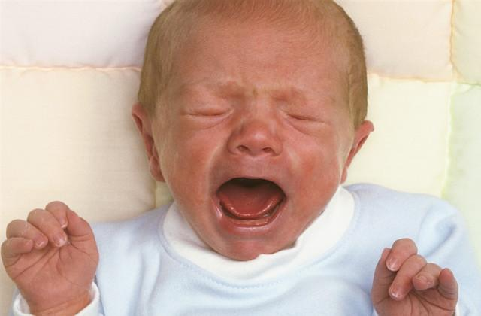

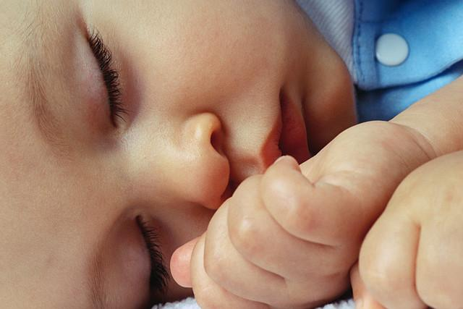
Attachment under Ordinary Conditions
Attachment is an innate biological response to stress.
  Danger/vulnerability
  Physiological arousal
  Heightens attachment needs
  Child sends distress signal
  Draws attention of caregiver who re-establishes closeness and protection
  Reunion reduces physiological arousal and emotional distress
  Return to regulated calm state
Notes:
Impact of Trauma on Attachment
1. Review the slide using the information below.
We are biologically programmed to seek attachment. It is hard-wired into our brains. This begins in infancy and continues throughout life.
Use a concrete normative example, like a toddler falling down and scraping her knee to explain this multiple step process. So many critical parts of development are happening through an interaction like this.
Ask where this process breaks down with less ideal caretaking – caretaker does not notice distress, ignores child altogether, punishes child for showing distress, etc.
SLIDE 38
Module Two: Introduction to Trauma Framework
90 Minutes
Welcome and Introduction: Slides 32-33 (15 minutes)
Intro to the Trauma Framework: Slide 34 (5 minutes)
Impact of Trauma on Attachment: Slides 35-43 (15 minutes)
Impact of Trauma on the Body and Brain: Slides 44-52 (20 minutes)
Impact of Trauma on Feelings Skills: Slides 53-65 (20 minutes)
Your Turn: Slide 66 (10 minutes)
Closing: Slide 67 (5 minutes)

Slide 39
Attachment under Ordinary Conditions
This process happens thousands and thousands of times during normal development.
Children, over time, begin to learn to regulate their own distress.
Adult distress regulation rooted in childhood.
Inevitable “Rupture and Repair” of Relationship Is Critical to Secure Attachment
Notes:
Impact of Trauma on Attachment
1. Review the slide using the information below.
Ask: What happens with good or “good enough” caretakers?
Possible Answers:
Over time, because of the thousands of times a parent calms the child, the child internalizes a mental representation of others being loving and caring and can begin to regulate their own distress – master their own soothing skills. Give examples here.
The growing ability to tolerate separation never replaces the need for reunion.
Securely attached children use caretakers as a “secure base.” They come back when distressed, but then are able to “refuel” and go out and explore their world.
Constant rupture and repair cycle creates a template that when there are problems in relationships, they can be fixed. Caretakers will make it better.
b. Ask: What happens to the child with less than ideal caretakers?
Possible Answers:
Child does not learn to calm himself.
Insecurely attached children tend to either cling to the caretaker or ignore the caretaker altogether because the caretaker is not a resource to them.
Child internalizes mental representations of others being hostile and critical.
SLIDE 39
Module Two: Introduction to Trauma Framework
90 Minutes
Welcome and Introduction: Slides 32-33 (15 minutes)
Intro to the Trauma Framework: Slide 34 (5 minutes)
Impact of Trauma on Attachment: Slides 35-43 (15 minutes)
Impact of Trauma on the Body and Brain: Slides 44-52 (20 minutes)
Impact of Trauma on Feelings Skills: Slides 53-65 (20 minutes)
Your Turn: Slide 66 (10 minutes)
Closing: Slide 67 (5 minutes)

Slide 40

Attachment and Attunement
Babies grow and develop connections in their brains through attunement
Necessary at all stages of life
Sense of being seen and known
Matching of affect, tone, pace, distance
Promotes calming and soothing
Develops ability to know self
and to self-regulate
Notes:
Impact of Trauma on Attachment
Review the slide using the information below.
A critical aspect of the attachment relationship is attunement. It refers to how aware and responsive the adult is to the child’s needs.
This begins in the early days of life when the primary caretaker says – “Oh, why are you crying? Are you hungry, do you have gas? Do you need a new diaper?” Attunement happens at all stages of life.
The ultimate example of this is a mother’s cooing back and forth with her baby. Each affects the other. If the baby frowns, the mother frowns and asks what’s the matter. If the baby smiles, the mother smiles.
No one can coo with a baby for eighteen years. There are always breaks in the attunement. But then it is re-established. Through this process of rupture and repair the baby learns that separation is not permanent, and the problems can be resolved. However, if there is a lot of rupture and little repair (as in the lives of youth) the baby develops a more pessimistic view of relationships.
Again, the experience of attunement in childhood shapes the ability to calm strong feelings as a teen or adult.
Ask: How can parents be unresponsive to their children? What could make a foster parent unresponsive to their child?
SLIDE 40
Module Two: Introduction to Trauma Framework
90 Minutes
Welcome and Introduction: Slides 32-33 (15 minutes)
Intro to the Trauma Framework: Slide 34 (5 minutes)
Impact of Trauma on Attachment: Slides 35-43 (15 minutes)
Impact of Trauma on the Body and Brain: Slides 44-52 (20 minutes)
Impact of Trauma on Feelings Skills: Slides 53-65 (20 minutes)
Your Turn: Slide 66 (10 minutes)
Closing: Slide 67 (5 minutes)

Slide 41
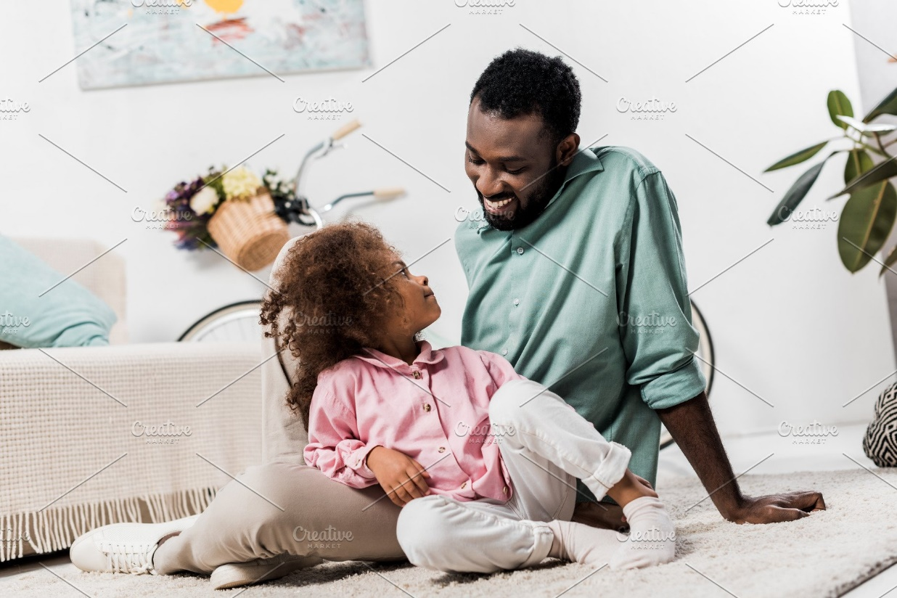
Your Turn!
Exercise: Attunement
Notes:
Impact of Trauma on Attachment
1. Exercise: Attunement
Ask participants to get into pairs.
Explain that Person A will talk to Person B about something mildly stressful. Person B will listen in an attentive and attuned way. Then, when the trainer says, “Now,” Person B will look over the shoulder of Person A, no longer attending to Person A.
Discuss:
What did you notice about how you felt or reacted when your “listener” no longer looked at you?
Did you feel anything in your body physiologically?
What does it tell you about the experience of the youth we work with?
SLIDE 41
Module Two: Introduction to Trauma Framework
90 Minutes
Welcome and Introduction: Slides 32-33 (15 minutes)
Intro to the Trauma Framework: Slide 34 (5 minutes)
Impact of Trauma on Attachment: Slides 35-43 (15 minutes)
Impact of Trauma on the Body and Brain: Slides 44-52 (20 minutes)
Impact of Trauma on Feelings Skills: Slides 53-65 (20 minutes)
Your Turn: Slide 66 (10 minutes)
Closing: Slide 67 (5 minutes)

Slide 42
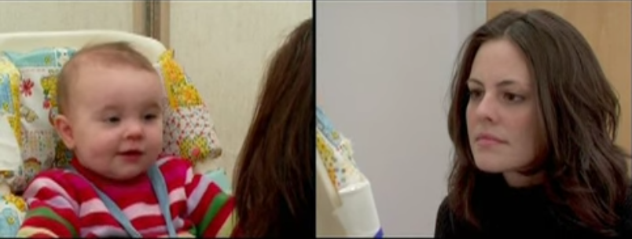
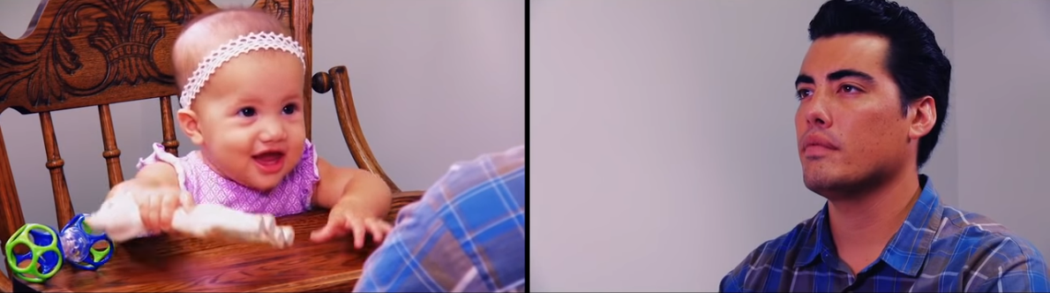
Video
“Still Face Experiment”
Dr. Edward Tronick, Harvard University
Notes:
Impact of Trauma on Attachment
Video: Still Face Experiment
Explain that this video is about a famous experiment related to the importance of attunement. As participants watch it, they should think about what it is like for a child when the caretaker, unlike this video, is NOT attuned much of the time.
Show “Still Face Experiment” video. (You can show the “Still Face” video of a mother or the “Still Face” video of a father).
Discuss:
What was it like to watch the video?
How long did it take the baby to become distressed?
What would happen if a caretaker was frozen or still much of the time because of their own mental health issues, stress of poverty, substance abuse, etc.?
What strategies might the baby use to deal with this reality?
SLIDE 42
Module Two: Introduction to Trauma Framework
90 Minutes
Welcome and Introduction: Slides 32-33 (15 minutes)
Intro to the Trauma Framework: Slide 34 (5 minutes)
Impact of Trauma on Attachment: Slides 35-43 (15 minutes)
Impact of Trauma on the Body and Brain: Slides 44-52 (20 minutes)
Impact of Trauma on Feelings Skills: Slides 53-65 (20 minutes)
Your Turn: Slide 66 (10 minutes)
Closing: Slide 67 (5 minutes)

Slide 43
Healing Attachment
Moment-to-moment attuned interactions
Hanging in there when the going gets rough
Being thoughtful and planful about separations
Interactions that are BOTH firm and kind/compassionate
Willingness to individualize
Notes:
Impact of Trauma on Attachment
Review the slide using the information below.
Explain: Healing attachment is during the moment-to-moment interactions you have with your child everyday. It is voice tone, patience, problem solving and taking the time to listen to the child that develops healthy attachment.
When it is challenging, remember to hang in there and assure the child you are there for them.
Remember—you can be firm and still be compassionate, understanding, empathetic with the child’s distress, disappointment, or anger.
SLIDE 43
Module Two: Introduction to Trauma Framework
90 Minutes
Welcome and Introduction: Slides 32-33 (15 minutes)
Intro to the Trauma Framework: Slide 34 (5 minutes)
Impact of Trauma on Attachment: Slides 35-43 (15 minutes)
Impact of Trauma on the Body and Brain: Slides 44-52 (20 minutes)
Impact of Trauma on Feelings Skills: Slides 53-65 (20 minutes)
Your Turn: Slide 66 (10 minutes)
Closing: Slide 67 (5 minutes)

Slide 44
The Impact of Trauma on the Body and the Brain
Notes:
Impact of Trauma on the Body and Brain
Review the slide above
Tell participants that this is the topic you will be discussing next.
SLIDE 44
Module Two: Introduction to Trauma Framework
90 Minutes
Welcome and Introduction: Slides 32-33 (15 minutes)
Intro to the Trauma Framework: Slide 34 (5 minutes)
Impact of Trauma on Attachment: Slides 35-43 (15 minutes)
Impact of Trauma on the Body and Brain: Slides 44-52 (20 minutes)
Impact of Trauma on Feelings Skills: Slides 53-65 (20 minutes)
Your Turn: Slide 66 (10 minutes)
Closing: Slide 67 (5 minutes)

Slide 45
Risking Connection® Trauma Framework
Childhood Traumatic Events/ACEs
Disrupted Development
Attachment
Body and Brain
Feelings Skills
Current Stressor
Intolerable Feelings
Acts to Relieve Feelings
Adaptive: Helps in the moment, hurts in the long run
Retreats, hurts self, or hurts others
Notes:
Impact of Trauma on the Body and Brain
Review the slide using the information below.
Show where “Body and Brain” fit within the trauma framework.
SLIDE 45
Module Two: Introduction to Trauma Framework
90 Minutes
Welcome and Introduction: Slides 32-33 (15 minutes)
Intro to the Trauma Framework: Slide 34 (5 minutes)
Impact of Trauma on Attachment: Slides 35-43 (15 minutes)
Impact of Trauma on the Body and Brain: Slides 44-52 (20 minutes)
Impact of Trauma on Feelings Skills: Slides 53-65 (20 minutes)
Your Turn: Slide 66 (10 minutes)
Closing: Slide 67 (5 minutes)

Slide 46
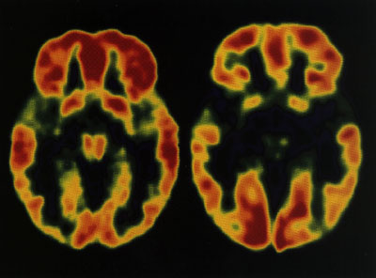
Bad News:
Trauma Harms the Brain
Images of Brain
Activity
    Non-institutionalized Institutionalized
    Child Orphan
http://web.snf.org/content/Publications/BrainBriefings/work.outs.html
Notes:
Impact of Trauma on the Body and Brain
Review the slide using the information below.
Traumatized individual’s brains are different.
These are two pictures of the brain using neuroimaging technology, one was raised in a Romanian orphanage and the other outside of an institution. The large, black in the middle shows significantly less brain activity in the child raised in the Romanian orphanage.
Another study for example, found that brain weights of maltreated males with Post Traumatic Stress Disorder (PTSD) were 7-8% smaller than brains of non-abused males.
SLIDE 46
Module Two: Introduction to Trauma Framework
90 Minutes
Welcome and Introduction: Slides 32-33 (15 minutes)
Intro to the Trauma Framework: Slide 34 (5 minutes)
Impact of Trauma on Attachment: Slides 35-43 (15 minutes)
Impact of Trauma on the Body and Brain: Slides 44-52 (20 minutes)
Impact of Trauma on Feelings Skills: Slides 53-65 (20 minutes)
Your Turn: Slide 66 (10 minutes)
Closing: Slide 67 (5 minutes)

Slide 47
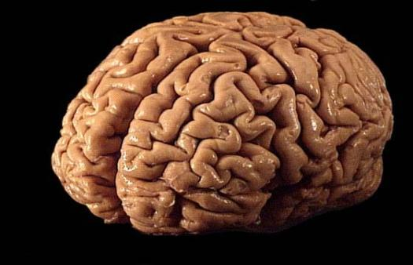
Good News:
The Brain Can Adapt and Heal
Experiencing caring, attuned
relationships causes the brain to
change and recover.
Notes:
Impact of Trauma on the Body and Brain
Review the slide using the information below.
The brain is capable of creating new neurons, new connections between neurons and new pathways at any age.
Treatment, including attuned, caring relationships with parents like us, can change the brain, reverse the damage – not necessarily to the point of restoring the brain to where it would have been without early trauma – but enough to make a significant difference.
We’re not just chatting with youth, we’re sculpting their brains, almost as if we were brain surgeons without the scalpel.
Within relationships, people build connections between various parts of their brain. This allows them to integrate data together from the outside world, their bodies, their memories, their emotions, and their thinking in order to make the best possible decisions.
SLIDE 47
Module Two: Introduction to Trauma Framework
90 Minutes
Welcome and Introduction: Slides 32-33 (15 minutes)
Intro to the Trauma Framework: Slide 34 (5 minutes)
Impact of Trauma on Attachment: Slides 35-43 (15 minutes)
Impact of Trauma on the Body and Brain: Slides 44-52 (20 minutes)
Impact of Trauma on Feelings Skills: Slides 53-65 (20 minutes)
Your Turn: Slide 66 (10 minutes)
Closing: Slide 67 (5 minutes)

Slide 48
Normal Response To a Threat
Hyper-arousal (Fear, Anxiety, Rage, Panic) INTOLERABLE
Window of Tolerance
________________________________
________________________________
Current Stressor
}
Activation
Calm
Hypo-arousal (Numb, Depressed, Cut-off, Withdrawn)
INTOLERABLE
Levine; Ogden
Notes:
Impact of Trauma on the Body and Brain
Review the slide using the information below.
Here is a helpful way to describe the difference between a normal response to a threat or stressor and a malfunctioning response to a threat.
Click - The “window of tolerance” describes the level of stress, emotion and activation that we can tolerate without moving into an over-activated, hyper-aroused state that is not tolerable OR a numb hypo-aroused state that also often feels intolerable. Notice that the window for this child is wide.
Click - With a healthy nervous system, there is a constant, but smooth rise and fall in one’s activation. But it always stays within the window.
Click - If a child thought there was danger but then realized they were safe—it was just a false alarm, the child may initially be highly activated, but it doesn’t spike way out of the window and returns relatively quickly to a normal up and down flow. The nervous system is resilient and can manage the stress and stay within the window.
SLIDE 48
Module Two: Introduction to Trauma Framework
90 Minutes
Welcome and Introduction: Slides 32-33 (15 minutes)
Intro to the Trauma Framework: Slide 34 (5 minutes)
Impact of Trauma on Attachment: Slides 35-43 (15 minutes)
Impact of Trauma on the Body and Brain: Slides 44-52 (20 minutes)
Impact of Trauma on Feelings Skills: Slides 53-65 (20 minutes)
Your Turn: Slide 66 (10 minutes)
Closing: Slide 67 (5 minutes)

Slide 49
Malfunctioning Response To a Threat
Stuck on “ON” {
} Stuck on “OFF”
Fear
Anxiety
Rage
Panic
Hyperarousal (INTOLERABLE)
Window of Tolerance
Current Stressor
}
Numb
Depressed
Cut-off
Withdrawn
Hypoarousal (INTOLERABLE)
Levine; Ogden
Notes:
Impact of Trauma on the Body and Brain
Review the slide using the information below.
With a malfunctioning threat response, the situation is very different.
The window itself is much narrower so it doesn’t take as much stress or activation to go out of the window. These children tend not to have trusting relationships to rely on, making their window narrow.
Click -- Instead of a smooth rise and fall of the activation level staying inside the window, a current stressor causes abrupt rises and falls outside of the window of tolerance.
Click – Again they are stuck in “on” or stuck in “off” or roller coasting between the two. This helps us understand why children engage in extreme problem behaviors, like using drugs, fighting, cutting – to get relief, at least momentarily, from these intolerable feeling.
When a person is stuck in a state of fear, for example, it is easier to understand how they can overreact to someone accidentally bumping into them in the hall at school, or to a negative comment by a peer, or a limit set by a foster parent.
SLIDE 49
Module Two: Introduction to Trauma Framework
90 Minutes
Welcome and Introduction: Slides 32-33 (15 minutes)
Intro to the Trauma Framework: Slide 34 (5 minutes)
Impact of Trauma on Attachment: Slides 35-43 (15 minutes)
Impact of Trauma on the Body and Brain: Slides 44-52 (20 minutes)
Impact of Trauma on Feelings Skills: Slides 53-65 (20 minutes)
Your Turn: Slide 66 (10 minutes)
Closing: Slide 67 (5 minutes)

Slide 50
Survival (Protective) Fight, Flight,
Freeze Responses
FIGHT
Anger and rage
Aggression toward self or other
Need to blame or judge
OR
FLIGHT
Panic and anxiety
Emotional withdrawal
Avoidance
Running away
If you can’t fight or flee, you…
FREEZE
          Numb, shutdown
          Dissociated
          Terror
          Agitated yet flat
Notes:
Impact of Trauma on the Body and Brain
Review the slide using the information below.
In response to a serious threat, our bodies instinctually respond by fighting, fleeing or getting away. When we can’t fight or get away, our body often freezes. Children experiencing trauma often use freeze because it is not safe to fight back or get away.
When children live with chronic dangers and threats, their bodies learn to always be ready to fight, flee, or freeze. It’s as if their bodies are supercharged, seeing threats everywhere, and ready to respond.
Therefore, their bodies can respond to very small triggers (raised voice, a look, a disappointment, a smell) with what seems like an extreme fight, flight, or freeze response.
This slide shows what FIGHT, FLIGHT, and FREEZE can look like in a child’s behavior.
Youth tend to display behavior that fits with fight, flight, or freeze depending on what they used to survive during the traumatic events they experienced, but, some don’t fit neatly into these categories.
SLIDE 50
Module Two: Introduction to Trauma Framework
90 Minutes
Welcome and Introduction: Slides 32-33 (15 minutes)
Intro to the Trauma Framework: Slide 34 (5 minutes)
Impact of Trauma on Attachment: Slides 35-43 (15 minutes)
Impact of Trauma on the Body and Brain: Slides 44-52 (20 minutes)
Impact of Trauma on Feelings Skills: Slides 53-65 (20 minutes)
Your Turn: Slide 66 (10 minutes)
Closing: Slide 67 (5 minutes)

Slide 51
Healing Body and Brain
Recognize that problem behavior is partly the result of an injured brain
Understand that children can overreact to small triggers
Many, many, repetitions of attuned, healing interactions rewire and calm the brain
Mindfulness, meditation, yoga, breathing
Exercise and good nutrition
Notes:
Impact of Trauma on the Body and Brain
Review the slide using the information below.
Explain: Problem behavior can be the result of years of neglect and abuse.
Remember that children are hurt through relationships, so relationships are the healing tool. Attuned, healing relationships calm the brain.
Mindfulness and yoga are great ways to heal the brain.
SLIDE 51
Module Two: Introduction to Trauma Framework
90 Minutes
Welcome and Introduction: Slides 32-33 (15 minutes)
Intro to the Trauma Framework: Slide 34 (5 minutes)
Impact of Trauma on Attachment: Slides 35-43 (15 minutes)
Impact of Trauma on the Body and Brain: Slides 44-52 (20 minutes)
Impact of Trauma on Feelings Skills: Slides 53-65 (20 minutes)
Your Turn: Slide 66 (10 minutes)
Closing: Slide 67 (5 minutes)

Slide 52
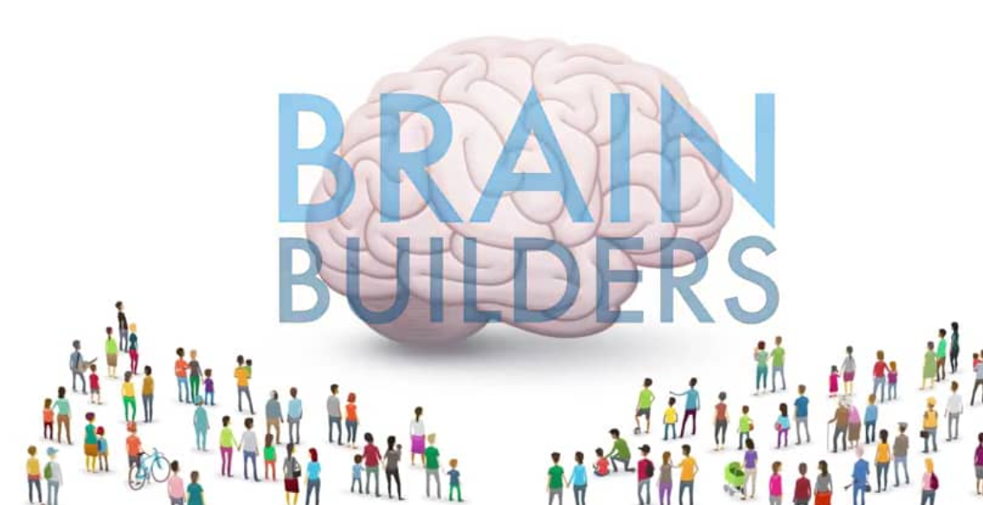
Video
“How Brains Are Built: The Core Story of Brain Development”
Alberta Family Wellness Initiative, Alberta, Canada
Notes:
Impact of Trauma on the Body and Brain
Explain that this is a brief video that reinforces what we have been talking about.
SLIDE 52
Module Two: Introduction to Trauma Framework
90 Minutes
Welcome and Introduction: Slides 32-33 (15 minutes)
Intro to the Trauma Framework: Slide 34 (5 minutes)
Impact of Trauma on Attachment: Slides 35-43 (15 minutes)
Impact of Trauma on the Body and Brain: Slides 44-52 (20 minutes)
Impact of Trauma on Feelings Skills: Slides 53-65 (20 minutes)
Your Turn: Slide 66 (10 minutes)
Closing: Slide 67 (5 minutes)

Slide 53
The Impact of Trauma on Feelings Skills
Notes:
The Impact of Trauma on Feeling Skills
Review the slide above
Tell participants that this is the topic you will be discussing next.
SLIDE 53
Module Two: Introduction to Trauma Framework
90 Minutes
Welcome and Introduction: Slides 32-33 (15 minutes)
Intro to the Trauma Framework: Slide 34 (5 minutes)
Impact of Trauma on Attachment: Slides 35-43 (15 minutes)
Impact of Trauma on the Body and Brain: Slides 44-52 (20 minutes)
Impact of Trauma on Feelings Skills: Slides 53-65 (20 minutes)
Your Turn: Slide 66 (10 minutes)
Closing: Slide 67 (5 minutes)

Slide 54
Risking Connection® Trauma Framework
Childhood Traumatic Events/ACEs
Disrupted Development
Attachment
Body and Brain
Feelings Skills
Current Stressor
Intolerable Feelings
Acts to Relieve Feelings
Retreats, hurts self, or hurts others
Adaptive: Helps in the moment, hurts in the long run
Notes:
Trauma Framework: Feelings Skills
Show where Attachment fits into the Trauma Framework.
SLIDE 54
Module Two: Introduction to Trauma Framework
90 Minutes
Welcome and Introduction: Slides 32-33 (15 minutes)
Intro to the Trauma Framework: Slide 34 (5 minutes)
Impact of Trauma on Attachment: Slides 35-43 (15 minutes)
Impact of Trauma on the Body and Brain: Slides 44-52 (20 minutes)
Impact of Trauma on Feelings Skills: Slides 53-65 (20 minutes)
Your Turn: Slide 66 (10 minutes)
Closing: Slide 67 (5 minutes)

Slide 55
Feelings Skills
Definition: The ability to stay connected to and grounded in one’s sense of self, even when one is experiencing strong feelings.
The fundamental building blocks of the self.
Three Kinds of Feelings Skills
  Inner Connection
  Managing Shame
  Skills to Soothe Strong Feelings
Notes:
Trauma Framework: Feelings Skills
1. Review the slide using the information below.
Feelings Skills are the fundamental structures of the self that enable us to deal with the stress in our lives.
Remember, they develop and become strong, largely as a result of those thousands and thousands of interactions with early loving caretakers.
In the children we work with, they are usually greatly impaired or don’t exist at all, but they can be learned and rebuilt over time.
SLIDE 55
Module Two: Introduction to Trauma Framework
90 Minutes
Welcome and Introduction: Slides 32-33 (15 minutes)
Intro to the Trauma Framework: Slide 34 (5 minutes)
Impact of Trauma on Attachment: Slides 35-43 (15 minutes)
Impact of Trauma on the Body and Brain: Slides 44-52 (20 minutes)
Impact of Trauma on Feelings Skills: Slides 53-65 (20 minutes)
Your Turn: Slide 66 (10 minutes)
Closing: Slide 67 (5 minutes)

Slide 56
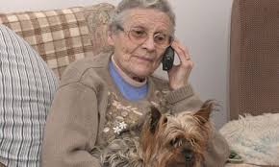
Feeling Skills – Inner Connection
The ability to hold onto a connection with a loving person and use it to calm strong feelings when the person is not present.
Notes:
The Impact of Trauma on Feelings Skills
1. Review the slide using the information below.
Inner connection to others is the ability to think of someone who cares for you when they are not there and feel soothed by it.
There are neurons in our brains that make it so that every person with whom we are emotionally connected becomes part of us. If those people are positive, when we are separated from them, we still feel okay, connected, grounded.
This is a capacity many of us take for granted.
When we say, ”My father died last year. When I get upset, I still think of what he’d say to me and it makes me feel better,” this is the inner connection.
Ask: If you are a parent and leaving your child to go on vacation, what do you do to help them when you are away? (A picture, special objects called transitional objects, talk on the phone.) By doing these things, you are helping them to develop the capacity of inner connection to others.
SLIDE 56
Module Two: Introduction to Trauma Framework
90 Minutes
Welcome and Introduction: Slides 32-33 (15 minutes)
Intro to the Trauma Framework: Slide 34 (5 minutes)
Impact of Trauma on Attachment: Slides 35-43 (15 minutes)
Impact of Trauma on the Body and Brain: Slides 44-52 (20 minutes)
Impact of Trauma on Feelings Skills: Slides 53-65 (20 minutes)
Your Turn: Slide 66 (10 minutes)
Closing: Slide 67 (5 minutes)

Slide 57
Feelings Skills – Inner Connection
When Weak
When Strong
Can’t tolerate being alone
Avoid separations because painful and seen as forever
Must get and hold attention of others
Can be alone without being lonely
When separated, can think of someone who cares and gain comfort
Don’t need to hold attention because can hold onto other’s love when not there
Notes:
The Impact of Trauma on Feelings Skills
Review the slide using the information below.
People engage in a whole range of extreme behaviors to prevent separation, hold onto attention of others, or deal with the intolerable feelings that occur when separation happens.
Examples:
A parent goes on vacation and the child has a major meltdown.
A woman stays in an abusive relationship because enduring abuse feel preferable to being alone.
A teacher is out unexpected for a school day and the student gets in a fight.
A helper leaves their job and the client has huge setbacks in their treatment.
A teenager stands in front of the door or begins to cut on Monday at 8 am before a parent is supposed to leave for work.
A youth’s behavior becomes more extreme when leaving approaches.
A child engages in cutting or extreme sexualized behavior that causes parents to always be with them and rarely separate.
When Inner Connection is strong
Being alone is more tolerable.
They have less of a need to engage in disruptive behaviors to hold your attention.
SLIDE 57
Module Two: Introduction to Trauma Framework
90 Minutes
Welcome and Introduction: Slides 32-33 (15 minutes)
Intro to the Trauma Framework: Slide 34 (5 minutes)
Impact of Trauma on Attachment: Slides 35-43 (15 minutes)
Impact of Trauma on the Body and Brain: Slides 44-52 (20 minutes)
Impact of Trauma on Feelings Skills: Slides 53-65 (20 minutes)
Your Turn: Slide 66 (10 minutes)
Closing: Slide 67 (5 minutes)

Slide 58
Feelings Skills – Managing Shame
The ability to hold onto a sense of oneself as deserving and worthwhile.
Notes:
The Impact of Trauma on Feelings Skills
Review the slide using the information below.
We will now look at feelings of worthiness and how to help children heal the shame that they feel.
SLIDE 58
Module Two: Introduction to Trauma Framework
90 Minutes
Welcome and Introduction: Slides 32-33 (15 minutes)
Intro to the Trauma Framework: Slide 34 (5 minutes)
Impact of Trauma on Attachment: Slides 35-43 (15 minutes)
Impact of Trauma on the Body and Brain: Slides 44-52 (20 minutes)
Impact of Trauma on Feelings Skills: Slides 53-65 (20 minutes)
Your Turn: Slide 66 (10 minutes)
Closing: Slide 67 (5 minutes)

Slide 59
Feelings Skills – Managing Shame
GUILT - feeling that you are a worthwhile person who has done something wrong.
SHAME - feeling that you are, at your core, a worthless person, without redemption.
Notes:
The Impact of Trauma on Feelings Skills
1. Review the slide using the information below.
This feelings skill involves the concept of shame which is a very important thing to understand when it comes to the youth.
Shame is different from guilt.
Guilt is a generally healthy and useful emotion (though we can have too much of it).
Extreme or toxic shame is a solely destructive emotion and generally unhealthy.
Guilt is feeling, “I made a mistake.” Shame is feeling, “I AM a mistake”
Guilt helps us choose different behavior. It’s the feeling “I made a mistake.” It’s a situation which can be set right, where repair can be made. Guilt makes you want to move towards the other person to fix the wrong.
Shame is the feeling of being unworthy, defective, and flawed. When a “shame attack” occurs, the feeling is “I AM a mistake” – it’s a spiraling down that makes a person withdraw and go within. It makes you want to move away from the other person, become invisible, or hurt them to make them feel as bad as you do. It often leads to aggression.
SLIDE 59
Module Two: Introduction to Trauma Framework
90 Minutes
Welcome and Introduction: Slides 32-33 (15 minutes)
Intro to the Trauma Framework: Slide 34 (5 minutes)
Impact of Trauma on Attachment: Slides 35-43 (15 minutes)
Impact of Trauma on the Body and Brain: Slides 44-52 (20 minutes)
Impact of Trauma on Feelings Skills: Slides 53-65 (20 minutes)
Your Turn: Slide 66 (10 minutes)
Closing: Slide 67 (5 minutes)

Slide 60
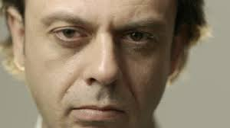
Feelings Skills – Managing Shame
A Shame-based person…
Acts to display or confirm the image of themselves.
Invites rejection. Distrust affection (“If you knew the real me, you wouldn’t like me”).
Is paralyzed when there are problems in relationships
Attacks weakness wherever they see it
Notes:
The Impact of Trauma on Feelings Skills
1. Review the slide using the information below.
These are other common behaviors that stem from shame. They stem from the belief that the more you know me, the less you will like me.
Youth with shame often act as if to communicate, “I am bad so of course I do bad things” since it’s consistent with how they see themselves.
Youth often have experienced relationships where the relationship suddenly ends (they are fired from a job, moved to a new foster home, kicked out of a program). If they make a mistake, they expect the relationship to end. They have very little experience of working through a problem and resolving it. This is an essential skill in life, so we have to teach it to them. The idea of making amends is a way of teaching this skill.
Many dangerous, aggressive behaviors can be understood from the perspective that a person has been badly hurt when they were small, weak, afraid, and could not fight back.
So when they feel scared, confused, or sad their body immediately experiences that as a sign that pain is coming, and the person does something to make themselves feel powerful again, such as acting aggressive.
Weakness in others reminds them of what they hate in themselves, so they often want to lash out at those they see as weak.
If parents can reach for the fear and uncertainty underneath aggression and show the person that now their circumstances are different, they can allow the person to feel afraid and ask for help. They do not have to resort to aggression.
They avoid taking responsibility because doing so exposes their badness which is intolerable.
SLIDE 60
Module Two: Introduction to Trauma Framework
90 Minutes
Welcome and Introduction: Slides 32-33 (15 minutes)
Intro to the Trauma Framework: Slide 34 (5 minutes)
Impact of Trauma on Attachment: Slides 35-43 (15 minutes)
Impact of Trauma on the Body and Brain: Slides 44-52 (20 minutes)
Impact of Trauma on Feelings Skills: Slides 53-65 (20 minutes)
Your Turn: Slide 66 (10 minutes)
Closing: Slide 67 (5 minutes)

Slide 61

The antidote to shame is:
Feelings Skills – Managing Shame
Connection
Be aware of shame triggering situations and respond with empathy.
Notes:
The Impact of Trauma on Feelings Skills
Review the slide using the information below.
Understanding shame can make a huge difference in how parents work with youth.
Children imagine that if you see who they really are or know what they really did, you’d want nothing to do with them. We must communicate that we can hear the worst and still see them as human and worthy of love. We must recognize that we need to demonstrate exceptional consistency of caring.
Exposing the rotten self or sharing the secret takes time and a strong, trusting relationship.
People imagine that if you see who they really are or know what they really did, you’d want nothing to do with them.
SLIDE 61
Module Two: Introduction to Trauma Framework
90 Minutes
Welcome and Introduction: Slides 32-33 (15 minutes)
Intro to the Trauma Framework: Slide 34 (5 minutes)
Impact of Trauma on Attachment: Slides 35-43 (15 minutes)
Impact of Trauma on the Body and Brain: Slides 44-52 (20 minutes)
Impact of Trauma on Feelings Skills: Slides 53-65 (20 minutes)
Your Turn: Slide 66 (10 minutes)
Closing: Slide 67 (5 minutes)

Slide 62
Feelings Skills – Soothing Strong Feelings
Feelings Awareness…
  Awareness of the bodily signs and sensations of distress and calm
Feelings Identification…
  Learning the words associated with feelings
Feelings Modulation…
  Using strategies to move from high to low distress
Feelings Expression…
  Using skills to express feelings constructively
Notes:
The Impact of Trauma on Feelings Skills
1. Review the slide using the information below.
We can think of soothing strong feels as breaking down into these four skill areas.
Feelings awareness means noticing our bodily sensations that, when we notice them, are usually the first clue that we are having a feeling. Youth often get good at ignoring their sensations because why tune into them when there is no one to help you manage them and you don’t have the skills to calm yourself. Examples of sensations are: hot face, tightening stomach, fuzziness in the head, pressure on the chest, and many, many others.
Feelings identification describes the ability to attach a feeling word to the sensation as a way of capturing and expressing the feeling.
Feeling modulation is the ability to use strategies to make extreme feelings feel less extreme. Often described as “coping skills,” these are things such as: deep or “belly” breathing; writing feelings in a journal; going for a walk; meditating; listening to music; taking a cold shower if numb.
Feeling expression is the skill of putting your feelings into words and expressing them constructively to another person to help resolve the feeling.
Putting these all together, a person who is angry needs to learn to: recognize the sensations in their body that are signs of anger, know to attach the word “anger” to the sensation, use strategies to bring the intensity of anger to a manageable level, and then constructively express anger to the person who is making you angry. These are all important skills to learn that many youth don’t have.
SLIDE 62
Module Two: Introduction to Trauma Framework
90 Minutes
Welcome and Introduction: Slides 32-33 (15 minutes)
Intro to the Trauma Framework: Slide 34 (5 minutes)
Impact of Trauma on Attachment: Slides 35-43 (15 minutes)
Impact of Trauma on the Body and Brain: Slides 44-52 (20 minutes)
Impact of Trauma on Feelings Skills: Slides 53-65 (20 minutes)
Your Turn: Slide 66 (10 minutes)
Closing: Slide 67 (5 minutes)

Slide 63

Co-regulation
Specific feelings management skills are taught -- usually within relationships.
Person becomes regulated in the presence of regulated others.
Parents must keep themselves calm.
Parents model feelings management.
Notes:
The Impact of Trauma on Feelings Skills
1. Review the slide using the information below.
The idea that feelings management skills are taught through caring relationships is called “co-regulation.” This means people learn how to stay calm and regulated by being in the presence of regulated parents.
So it is a critical skill for parents to have strategies to keep themselves calm on the job. This could mean – using calming self-talk, remembering to breath, getting someone to tap you out, practicing self-care in and outside of work.
When you do this, you are modeling these skills for youth. You are giving them what they didn’t get from their caregivers.
SLIDE 63
Module Two: Introduction to Trauma Framework
90 Minutes
Welcome and Introduction: Slides 32-33 (15 minutes)
Intro to the Trauma Framework: Slide 34 (5 minutes)
Impact of Trauma on Attachment: Slides 35-43 (15 minutes)
Impact of Trauma on the Body and Brain: Slides 44-52 (20 minutes)
Impact of Trauma on Feelings Skills: Slides 53-65 (20 minutes)
Your Turn: Slide 66 (10 minutes)
Closing: Slide 67 (5 minutes)

Slide 64
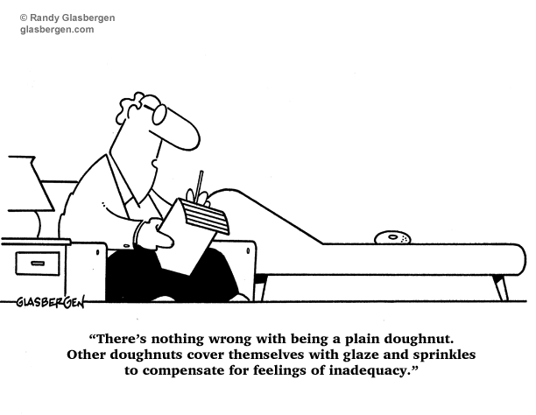
Your Turn!
Exercise: If Feelings Skills Could Speak, What Would They Say?
Notes:
The Impact of Trauma on Feelings Skills
Exercise: If Self-Capacities Could Speak, What Would They Say?
Direct people to the Exercise: If Feelings Skills Could Speak, What Would They Say?
Divide the audience into 2 halves. One half will imagine they have IMPAIRED feelings skills. The other half will imagine they have STRONG feelings skills.
Ask for 2 volunteers, 1 from each half of the room, to read (with passion) the statements on the worksheet for the 3 self-capacities. Begin with “IMPAIRED INNER CONNECTION” then have the volunteer read the contrasting “STRONG INNER CONNECTION.” Alternate back and forth with the other 2 self-capacities.
Discuss:
What was it like to imagine yourself with this feelings skill impaired? Strong? How did your body feel?
What kinds of things would be challenging and less challenging depending on the strength of this feelings skill?
What behaviors might these beliefs lead to – positive and negative?
SLIDE 64
Module Two: Introduction to Trauma Framework
90 Minutes
Welcome and Introduction: Slides 32-33 (15 minutes)
Intro to the Trauma Framework: Slide 34 (5 minutes)
Impact of Trauma on Attachment: Slides 35-43 (15 minutes)
Impact of Trauma on the Body and Brain: Slides 44-52 (20 minutes)
Impact of Trauma on Feelings Skills: Slides 53-65 (20 minutes)
Your Turn: Slide 66 (10 minutes)
Closing: Slide 67 (5 minutes)

Slide 65
Healing Feelings Skills
Children learn to calm themselves when interacting with calm adults
Avoid situations the child might find shaming
Don’t take the bait when children “invite” us to shame them
Teach skills to manage feelings (seeking out trusted others, deep breathing, taking space, using words to express feelings, etc.)
Notes:
The Impact of Trauma on Feelings Skills
Review the slide using the information below.
Children use adults as role models. Calming is a skill they can learn from regulated adults in their life.
Remember—children will bait you to shame them as that is what is familiar to them and what they recognize. It takes great patience to not take the bait but respond in a way that begins to build those new neuro pathways in the brain.
SLIDE 65
Module Two: Introduction to Trauma Framework
90 Minutes
Welcome and Introduction: Slides 32-33 (15 minutes)
Intro to the Trauma Framework: Slide 34 (5 minutes)
Impact of Trauma on Attachment: Slides 35-43 (15 minutes)
Impact of Trauma on the Body and Brain: Slides 44-52 (20 minutes)
Impact of Trauma on Feelings Skills: Slides 53-65 (20 minutes)
Your Turn: Slide 66 (10 minutes)
Closing: Slide 67 (5 minutes)

Slide 66
Your Turn!
Exercise: Strengthening Feelings Skills
Notes:
The Impact of Trauma on Feelings Skills
Introduce the closing activity.
Ask participants: How do you regulate your own strong emotions? How did you LEARN do to that?
Provide time for them to reflect on their answers independently.
Ask them to come up with at least four different strategies to teach youth how to regulate strong feelings.
Ask for a few examples from participants.
Write down the examples shared on newsprint.
Discuss how they learned the skills to calm their strong emotions.
SLIDE 66
Module Two: Introduction to Trauma Framework
90 Minutes
Welcome and Introduction: Slides 32-33 (15 minutes)
Intro to the Trauma Framework: Slide 34 (5 minutes)
Impact of Trauma on Attachment: Slides 35-43 (15 minutes)
Impact of Trauma on the Body and Brain: Slides 44-52 (20 minutes)
Impact of Trauma on Feelings Skills: Slides 53-65 (20 minutes)
Your Turn: Slide 66 (10 minutes)
Closing: Slide 67 (5 minutes)

Slide 67
Closing Activity
Notes:
Closing
Ask each participant to identify one place they would go if they had a magic carpet to get there.
Ask participants to find a partner and describe the place.
Ask for one or two volunteers to share their place with the larger group.
Encourage participants to think of that place throughout the week.
SLIDE 67
Module Two: Introduction to Trauma Framework
90 Minutes
Welcome and Introduction: Slides 32-33 (15 minutes)
Intro to the Trauma Framework: Slide 34 (5 minutes)
Impact of Trauma on Attachment: Slides 35-43 (15 minutes)
Impact of Trauma on the Body and Brain: Slides 44-52 (20 minutes)
Impact of Trauma on Feelings Skills: Slides 53-65 (20 minutes)
Your Turn: Slide 66 (10 minutes)
Closing: Slide 67 (5 minutes)

Slide 68
Module Three
The Value of Healing Relationships and RICH
Notes:
Welcome/Introduction
Materials
Module three PowerPoint Slides
White Board or Newsprint and Markers
Agenda Written on Newsprint and Posted
Video: “Christian The Lion”
Video :”RICH In Action”
Participant’s Handouts for Module Three
Participant PowerPoint Slides
Worksheet: “My Healing Home – Indicators of a Trauma-Informed Foster Care Home.”
Index Cards or Scrap Paper and Pens/Pencils
Objectives
Participants will:
Understand why and how healthy relationships are key to healing trauma.
Recognize characteristics of a RICH relationship.
Identify indicators of a Trauma-Informed Foster Home.
Introduce the concept of “Treaters.” The term used throughout the modules to describe everyone who interacts with the child to heal their wounds. We all can have a positive therapeutic impact on the children and youth we work with, not just clinical staff.
Time for Module
90 minutes
Module Three: The Value of Healing Relationships and RICH
90 Minutes
Welcome/Introduction: Slides 68-70 (10 minutes)
Trauma Framework/Video: Slides 71-74 (15 minutes)
Healing Relationships
RICH/Video/Your Turn: Slides 75-82 (45 minutes)
Relationship Challenges: Slides 83-87 (15 minutes)
Closing: Slide 88 (5 minutes)
SLIDE 68

Slide 69

Welcome
Introductions
  Name
  Opening Activity
Review Agreements
Agenda
Notes:
Welcome/ Introduction
Review the slide above.
Trainers introduce themselves.
Participants introduce themselves and describes one characteristic about themselves that makes them a trusted friend.
Trainer reviews agenda.
SLIDE 69
Module Three: The Value of Healing Relationships and RICH
90 Minutes
Welcome/Introduction: Slides 68-70 (10 minutes)
Trauma Framework/Video: Slides 71-74 (15 minutes)
Healing Relationships
RICH/Video/Your Turn: Slides 75-82 (45 minutes)
Relationship Challenges: Slides 83-87 (15 minutes)
Closing: Slide 88 (5 minutes)

Slide 70
Your Turn!
Think:
…about a difficult time in your life.
Who helped you through that time? Give us one word describing their role.
…and now one word about how that time would have been without this person.
Think about all those words—how does this compare to what foster children experience?
Notes:
Welcome/Introduction
Exercise
Ask participants the questions on the slide above.
Provide time for reflection between questions.
Ask for volunteers to share a few of their responses to the questions.
SLIDE 70
Module Three: The Value of Healing Relationships and RICH
90 Minutes
Welcome/Introduction: Slides 68-70 (10 minutes)
Trauma Framework/Video: Slides 71-74 (15 minutes)
Healing Relationships
RICH/Video/Your Turn: Slides 75-82 (45 minutes)
Relationship Challenges: Slides 83-87 (15 minutes)
Closing: Slide 88 (5 minutes)

Slide 71
RC® Trauma Framework - HURT
Childhood Traumatic Events/ACEs
Disrupted Development
Attachment
Body and Brain
Feelings Skills
Current Stressor
Intolerable Feelings
Acts to Relieve Feelings
Retreats, hurts self, or hurts others
Adaptive: Helps in the moment, hurts in the long run
Notes:
Trauma Framework Review and Video
Note: If you are not doing the modules in succession, use the talking points below.
Do a quick overview of the entire trauma framework using the information below.
Childhood traumatic events and ACEs, especially when they are chronic, disrupt the trajectory of a child’s development.
It does so in 3 critical areas, which we will discuss in a lot more detail. It impacts attachment and how they connect with other people. It impacts their body and brain on a physiological level, and it impacts what we call their “feelings skills.”
This history and reality is what comes in our doors when a child enters our home.
Then, in the present, some current trigger or stressor happens, sometimes big, but more often very small. The trigger leads to a cascade of feelings that feel intolerable. They feel intolerable because youth don’t trust others to help them with these feelings (attachment), their body and brain are jangled and supercharged to begin with (body and brain), and their feelings skills are impaired.
Nobody wants to feel that way, so people turn to things, often anything they can find, that will make the intolerable feelings tolerable -- at least in the moment. These are the behaviors we “know and love” – retreating: such as staying by themselves, becoming depressed, playing video games constantly; hurting themselves: such as risky sex, cutting, substance abuse, driving fast; and hurting others: such as fighting, sexual offending, gang violence.
These extreme behaviors or symptoms actually work -- in the short term. They are adaptive by helping the person survive in the moment, although the behaviors have many negative long-term consequences.
This RC Trauma Framework helps us see that we need to spend most of our time on the top part of the chart for longstanding change, rather than at the bottom of the chart stamping out behavior in the short-term. This is because the more youth can trust relationships, calm their nervous system, and learn feelings skills, then the feelings that before felt intolerable now feel tolerable and they no longer need to resort to extreme behaviors.
If you are doing the modules in succession, use the talking points below.
Review the slide with the information below.
In the last session, we talked about the Trauma Framework to discuss the impact of adversity and trauma on children. Review the entire Framework quickly.
When attachment, the body and brain, and feelings skills are weak and vulnerable, stressors feel intolerable which often leads to the extreme behaviors we so often see in survivors.
So, we need to work continually to make all three areas stronger.
When we do, healing begins and the Trauma Framework begins to transform to look like this (next slide).
SLIDE 71
Module Three: The Value of Healing Relationships and RICH
90 Minutes
Welcome/Introduction: Slides 68-70 (10 minutes)
Trauma Framework/Video: Slides 71-74 (15 minutes)
Healing Relationships
RICH/Video/Your Turn: Slides 75-82 (45 minutes)
Relationship Challenges: Slides 83-87 (15 minutes)
Closing: Slide 88 (5 minutes)

Slide 72
RC® Trauma Framework - HEALING
Childhood Traumatic Events/ACEs
Disrupted Development but Healing
Attachment
Body and Brain
Feelings Skills
Current Stressor
Tolerable Feelings
Fewer Extreme Acts to Relieve Feelings
Calm down, ground, lower distress
Adaptive: Helps in the moment AND in the long run
Notes:
Trauma Framework Review and Video
Review slide with information below.
If attachment, body and brain, and feelings skills start to heal gradually over time (and it takes time), when a current stress happens, the stress feels more tolerable. It feels tolerable because the child trusts people more and therefore can get help to deal with the stress, their body and brain are less activated, and they have more feelings skills to calm down. So they can calm down and don’t need the extreme behaviors as much. They start to use behavior that help in the moment to calm down AND they don’t have negative long term consequences.
Give a quick example to illustrate this point.
Today we’re going to talk about healing attachment through healthy relationships (point out “Attachment” in Trauma Framework).
SLIDE 72
Module Three: The Value of Healing Relationships and RICH
90 Minutes
Welcome/Introduction: Slides 68-70 (10 minutes)
Trauma Framework/Video: Slides 71-74 (15 minutes)
Healing Relationships
RICH/Video/Your Turn: Slides 75-82 (45 minutes)
Relationship Challenges: Slides 83-87 (15 minutes)
Closing: Slide 88 (5 minutes)

Slide 73
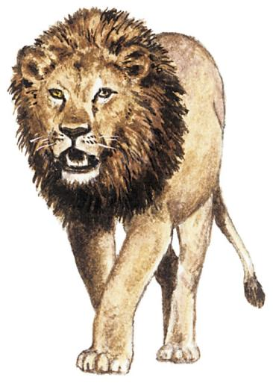
The Story of
Christian the Lion
Video
Notes:
Trauma Framework and Video
Show video clip of “Christian the Lion.”
Move to the Your Turn slide next for participant reactions to the video.
SLIDE 73
Module Three: The Value of Healing Relationships and RICH
90 Minutes
Welcome/Introduction: Slides 68-70 (10 minutes)
Trauma Framework/Video: Slides 71-74 (15 minutes)
Healing Relationships
RICH/Video/Your Turn: Slides 75-82 (45 minutes)
Relationship Challenges: Slides 83-87 (15 minutes)
Closing: Slide 88 (5 minutes)

Slide 74
Your Turn!
How did this video make you
feel and why?
What does it say about the power and influence of caretakers?
How do you understand how lions (or people) internalize and carry love in this way?
How does what you learned from the video relate to being a foster parent?
Notes:
Trauma Framework Review and Video
Review the questions on the slide.
Provide participants time to reflect on the questions.
Ask for volunteers to share reactions.
SLIDE 74
Module Three: The Value of Healing Relationships and RICH
90 Minutes
Welcome/Introduction: Slides 68-70 (10 minutes)
Trauma Framework/Video: Slides 71-74 (15 minutes)
Healing Relationships
RICH/Video/Your Turn: Slides 75-82 (45 minutes)
Relationship Challenges: Slides 83-87 (15 minutes)
Closing: Slide 88 (5 minutes)

Slide 75
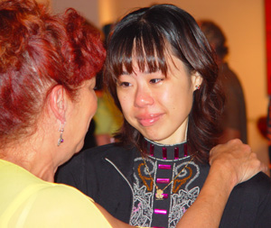
Why is a healthy relationship so important?
Healthy relationships:
Model what we want for our own
children
Show another type of relationship
Helps the child feel less alone in the world
Helps heal wounds and develop strengths for future challenges
Notes:
Healing Relationships
Review the slide using the information below.
Positive, connected, healthy relationships teach that:
The present is different from the past
Inevitable breaks in relationships can be repaired
Healthy relationships are the most powerful source of influence with any child.
People with histories of adversity and trauma form early templates or patterns of what the world and other people are like based on what their early experiences are. Then this is what they expect and often experience from the world from then on.
Provide an example of how someone expecting to be treated badly could draw that response from others.
Our job is to provide new and different experiences in which people are helpful, safe and trustworthy so that those early templates can change.
Brain PET scans now show us that repetitive, healthy interactions with treaters can quite literally change the wiring of peoples' brains. Treaters can think of themselves almost as moment-to-moment, day-to-day brain surgeons.
Survivors will often say that what was worse than the abuse itself was the fact that they were all alone with the trauma, that they couldn’t tell anyone, like they were the only one.
SLIDE 75
Module Three: The Value of Healing Relationships and RICH
90 Minutes
Welcome/Introduction: Slides 68-70 (10 minutes)
Trauma Framework/Video: Slides 71-74 (15 minutes)
Healing Relationships
RICH/Video/Your Turn: Slides 75-82 (45 minutes)
Relationship Challenges: Slides 83-87 (15 minutes)
Closing: Slide 88 (5 minutes)

Slide 76
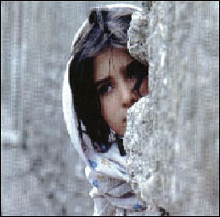
Help Children Feel Safe
Can you form a relationship when
you feel threatened or in danger?
Do you think children can?
What about being in foster
care could make children
feel unsafe?
What makes your home safe?
What in your home might feel dangerous?
Notes:
Healing Relationships
Review the slide above using the information below.
Ask participants the questions on the slide.
Provide time for reflection between each question.
Ask for volunteers to share their responses to the questions.
SLIDE 76
Module Three: The Value of Healing Relationships and RICH
90 Minutes
Welcome/Introduction: Slides 68-70 (10 minutes)
Trauma Framework/Video: Slides 71-74 (15 minutes)
Healing Relationships
RICH/Video/Your Turn: Slides 75-82 (45 minutes)
Relationship Challenges: Slides 83-87 (15 minutes)
Closing: Slide 88 (5 minutes)

Slide 77

Be Attuned to What Your
Child Needs
Have fun together
Acknowledge and respond to
your child’s feelings
Know your child’s likes,
dislikes, what soothes them,
what upsets them, bad/good
dates of the year, hopes and fears
Sharpen your antennae for signs of your child’s physical or emotional safety
Notes:
Healing Relationships
Review the slide above using the information below.
Here are ways to be attuned, intuitive, and responsive to your child’s needs.
Ask: Can you think of other ways?
SLIDE 77
Module Three: The Value of Healing Relationships and RICH
90 Minutes
Welcome/Introduction: Slides 68-70 (10 minutes)
Trauma Framework/Video: Slides 71-74 (15 minutes)
Healing Relationships
RICH/Video/Your Turn: Slides 75-82 (45 minutes)
Relationship Challenges: Slides 83-87 (15 minutes)
Closing: Slide 88 (5 minutes)

Slide 78
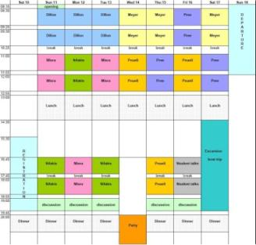
Create Predictability
Structure is different from control and power-over—it’s about predictability and planning
Predictability supports safety
and builds trust
Plan for success
Identify and consider patterns
Be willing to change
Notes:
Healing Relationships
Review the slide above using the information below.
As you get to know your child, you may notice patterns of behavior that provide clues as to what the child needs, how they respond to successes and challenges.
Be willing to be flexible and change your responses and interactions to provide consistency and support.
SLIDE 78
Module Three: The Value of Healing Relationships and RICH
90 Minutes
Welcome/Introduction: Slides 68-70 (10 minutes)
Trauma Framework/Video: Slides 71-74 (15 minutes)
Healing Relationships
RICH/Video/Your Turn: Slides 75-82 (45 minutes)
Relationship Challenges: Slides 83-87 (15 minutes)
Closing: Slide 88 (5 minutes)

Slide 79
The RICH® Relationships
Positive, connected, healthy relationships-- whether they last five minutes or five years—are marked by:
Respect
Information
Connection
Hope
Notes:
RICH Relationships
Review the slide with the information below.
Summarize RICH.
Respect encompasses all the ways we view people in their full humanity, worthy of our care and attention, and generally doing the best they can.
Information encompasses the ways we provide information and resources that people need to make the best use of services.
Connection is about opening our hearts, working to form and sustain relationships with survivors.
Hope means ways we try to hold onto hope for survivors that so often feel hopeless.
You can give the example of how an emergency room doctor, who you only interact with for ten minutes, can treat you with respect or not, and how much of a difference it makes.
SLIDE 79
Module Three: The Value of Healing Relationships and RICH
90 Minutes
Welcome/Introduction: Slides 68-70 (10 minutes)
Trauma Framework/Video: Slides 71-74 (15 minutes)
Healing Relationships
RICH/Video/Your Turn: Slides 75-82 (45 minutes)
Relationship Challenges: Slides 83-87 (15 minutes)
Closing: Slide 88 (5 minutes)

Slide 80
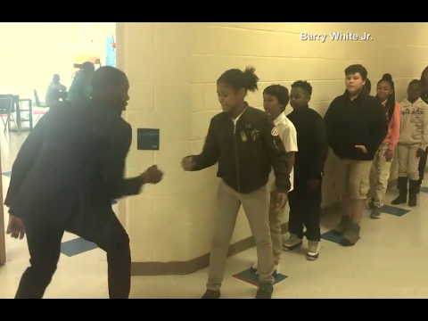
Video: RICH in Action
Teacher Barry White Jr: https://www.youtube.com/watch?v=VctaUNJpT6U
Notes:
RICH Relationships
Show video (ABC News: Teacher and Personalized Handshakes)
Introduce video by saying the video is about a teacher named Barry White Jr. who teaches elementary school in North Carolina. He does this ritual every single morning with his students.
Ask how this video demonstrates Respect? Information? Connection? Hope?
SLIDE 80
Module Three: The Value of Healing Relationships and RICH
90 Minutes
Welcome/Introduction: Slides 68-70 (10 minutes)
Trauma Framework/Video: Slides 71-74 (15 minutes)
Healing Relationships
RICH/Video/Your Turn: Slides 75-82 (45 minutes)
Relationship Challenges: Slides 83-87 (15 minutes)
Closing: Slide 88 (5 minutes)

Slide 81
Your Turn!
Exercise: RICH Relationships
Respect
Information
Connection
Hope
Notes:
RICH Relationships
Exercise
Break into small groups of 3 or 4.
Give each group a letter (R, I, C, or H). It is okay if more than one group has the same letter.
For their letter, each group should brainstorm the ways in which they are already displaying respect, information, connection, or hope with their foster child. Then, brainstorm the way they and their support team are displaying these qualities with each other.
With a large group, write the groups responses to each letter on the flip chart.
Discuss:
What makes it difficult to stay RICH at times?
What helps you stay RICH during times of a challenge?
How did the RICH list about your foster children compare to the one about your support team?
SLIDE 81
Module Three: The Value of Healing Relationships and RICH
90 Minutes
Welcome/Introduction: Slides 68-70 (10 minutes)
Trauma Framework/Video: Slides 71-74 (15 minutes)
Healing Relationships
RICH/Video/Your Turn: Slides 75-82 (45 minutes)
Relationship Challenges: Slides 83-87 (15 minutes)
Closing: Slide 88 (5 minutes)

Slide 82
Your Turn!
Exercise: Our Healing Home
Notes:
Healing Relationships
Introduce the closing activity.
Direct participants to the Worksheet: “Our Healing Home – Indicators of a Trauma-Informed Foster Care Home.”
Ask participants to complete the handout by rating their own home.
Ask participants to gather in small groups and discuss their answers.
Discuss as a large group participant’s responses. Some possible discussion points:
What was your reaction to the items on this Worksheet? Did they resonate with you? D you tend to agree with them? Disagree?
Which items come easiest to you?
What items reflect things you might want to work on or strengthen?
How would you describe a foster home that is healing? What other characteristics would it have?
SLIDE 82
Module Three: The Value of Healing Relationships and RICH
90 Minutes
Welcome/Introduction: Slides 68-70 (10 minutes)
Trauma Framework/Video: Slides 71-74 (15 minutes)
Healing Relationships
RICH/Video/Your Turn: Slides 75-82 (45 minutes)
Relationship Challenges: Slides 83-87 (15 minutes)
Closing: Slide 88 (5 minutes)

Slide 83
Relationship Challenges
History of multiple care givers
Understandable trust issues
Unknown length of relationship
Involvement of the child’s biological family
Other children in the home
Notes:
Relationship Challenges
Review the slide using the information below.
Say: Being a Foster Parent has built in challenges.
Ask participants about which of these challenges they can relate to?
Say: As Foster Parents you juggle a lot of interests and demands.
Examples:
Not always getting reliable information about previous placements.
Getting a child to trust you, after they have been hurt through relationships and often hurt by the very people who should have protected them—takes patience and tolerance.
The child usually remains loyal to the biological family. You are another person in their life to love them and support them, not to replace their biological family. It can be difficult to see the child continue to be hurt or disappointed by their biological family and you may feel helpless to do anything about that.
You have the demands and unique needs of your own biological children that can often feel like you are being stretched thinly.
SLIDE 83
Module Three: The Value of Healing Relationships and RICH
90 Minutes
Welcome/Introduction: Slides 68-70 (10 minutes)
Trauma Framework/Video: Slides 71-74 (15 minutes)
Healing Relationships
RICH/Video/Your Turn: Slides 75-82 (45 minutes)
Relationship Challenges: Slides 83-87 (15 minutes)
Closing: Slide 88 (5 minutes)

Slide 84
Temporary Relationships
Neither child nor adult knows how long this relationship will last
The child finds ways to cope with that uncertainty
Give kids control where possible since so much is out of their control
Makes identifying beginning and endings more important
Notes:
Relationship Challenges
Review the slide using the information below.
Children with trauma histories have difficulty with a lack of predictability. Not knowing how long they will be with you can trigger anger, insecurity and fear.
It is hard for both you and the child to truly embrace a relationship when it may end without much notice.
Providing kids with opportunities to have control when they do something, where they do it or who they do it with, can be one way to provide some control when they often feel they do not have any in a new situation.
Being as predictable as possible with beginnings and endings of outings, chore time, study time and play time can be very helpful.
SLIDE 84
Module Three: The Value of Healing Relationships and RICH
90 Minutes
Welcome/Introduction: Slides 68-70 (10 minutes)
Trauma Framework/Video: Slides 71-74 (15 minutes)
Healing Relationships
RICH/Video/Your Turn: Slides 75-82 (45 minutes)
Relationship Challenges: Slides 83-87 (15 minutes)
Closing: Slide 88 (5 minutes)

Slide 85
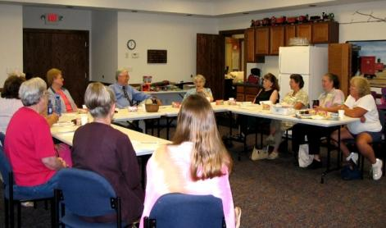
Relationship with the Support Team
Foster children are supported by a variety of professionals
Opinions may differ, personalities may clash
How do you develop a RICH®
relationship with all team
members?
We can only treat the children as well
as we treat each other.
Notes:
Relationship Challenges
Review the slide using the information below.
Often you do not have much choice or control over who you have to interact with on behalf of the child.
It can feel like you are being challenged by team members if they disagree with what you think the child may need.
Ask: How do you develop a RICH relationship with the team who is involved in your child’s life?
Process as a large group.
SLIDE 85
Module Three: The Value of Healing Relationships and RICH
90 Minutes
Welcome/Introduction: Slides 68-70 (10 minutes)
Trauma Framework/Video: Slides 71-74 (15 minutes)
Healing Relationships
RICH/Video/Your Turn: Slides 75-82 (45 minutes)
Relationship Challenges: Slides 83-87 (15 minutes)
Closing: Slide 88 (5 minutes)

Slide 86
Why is it Hard to Own Mistakes?
Belief or fear that
Only bad or inept people make mistakes
We might appear unskilled, lose face
Others may judge us badly
if they know
Information about the mistake might be used as ammunition
Notes:
Relationship Challenges
Review the slide with the information below.
Ask: Why is it hard to own our mistakes?
Possible responses:
We might get in trouble.
The potential consequences would hurt.
Child’s anger or agency’s criticism could cost us something.
Fear of losing your own kids.
We should have known better or been able to avoid mistakes.
We are expected to be “perfect” and that we should think this work is easy.
SLIDE 86
Module Three: The Value of Healing Relationships and RICH
90 Minutes
Welcome/Introduction: Slides 68-70 (10 minutes)
Trauma Framework/Video: Slides 71-74 (15 minutes)
Healing Relationships
RICH/Video/Your Turn: Slides 75-82 (45 minutes)
Relationship Challenges: Slides 83-87 (15 minutes)
Closing: Slide 88 (5 minutes)

Slide 87

The Result of Owning Mistakes
Owning your
mistakes creates
greater respect,
safety, and trust,
not less.
Notes:
Relationship Challenges
Read the slide.
Ask participants for their reactions to what the slide says.
Process responses as a large group.
SLIDE 87
Module Three: The Value of Healing Relationships and RICH
90 Minutes
Welcome/Introduction: Slides 68-70 (10 minutes)
Trauma Framework/Video: Slides 71-74 (15 minutes)
Healing Relationships
RICH/Video/Your Turn: Slides 75-82 (45 minutes)
Relationship Challenges: Slides 83-87 (15 minutes)
Closing: Slide 88 (5 minutes)

Slide 88
Closing Activity
Notes:
Closing Activity
Pass out an index card or small piece of paper and pens to each person.
Ask participants to write a statement of HOPE that they are having after today’s session on one side of the paper. Tell them you will collect the papers and redistribute them to the group.
Collect the papers, mix them up, and redistribute a paper to everyone.
Ask the group to go around and read all of the statements.
Thank everyone for participating.
SLIDE 88
Module Three: The Value of Healing Relationships and RICH
90 Minutes
Welcome/Introduction: Slides 68-70 (10 minutes)
Trauma Framework/Video: Slides 71-74 (15 minutes)
Healing Relationships
RICH/Video/Your Turn: Slides 75-82 (45 minutes)
Relationship Challenges: Slides 83-87 (15 minutes)
Closing: Slide 88 (5 minutes)

Slide 89
Module Four
Strengthening Attachment, the Body and Brain, and Feelings Skills
Notes:
Welcome/Introduction
Materials
Module Four PowerPoint Slides
White Board or Newsprint and Markers
Agenda Written on Newsprint and Posted
Participants Handouts for Module Four
Participant PowerPoint slides
Worksheet: Assessing and Strengthening Feeling Skills
Objectives
Participants will:
Learn strategies to strengthen Attachment
Learn strategies to strengthen the Body and Brain
Recognize strategies to strengthen the feelings skills of Inner Connection, Worthiness, and Feelings Management.
Review concept of “Treaters.” The term used throughout the modules to describe everyone who interacts with the child to heal their wounds. We all can have a positive therapeutic impact on the children and youth we work with, not just clinical staff.
Time for Module
90 minutes
Module Four: Healing and Strengthening Attachment, Body and Brain and Feelings Management
90 minutes
Welcome/Introduction/Trauma Framework Review: Slides 89-92 (5 minutes)
Healing Attachment: Slides 93-96
(5 minutes)
Healing Body and Brain: Slides 97-104
(20 minutes)
Strengthening Feelings Skills
Inner Connection: Slides 105-110 (10 minutes)
Ability to Manage Shame: Slides 111-114 (10 minutes)
Ability to Soothe Strong Feelings: Slides 115-122 (20 minutes)
Your Turn: Assessing and Strengthening Feelings Skills: Slide 123 (15 minutes)
Closing: Slide 124 (5 minutes)
SLIDE 89

Slide 90

Welcome
Introductions
  Name
  Opening Activity
Review Agreements
Agenda
Notes:
Welcome/Introduction/Trauma Framework Review
Review the slide above.
Trainers introduce themselves.
Participants introduce themselves and identify one skill or behavior that they find most rewarding to see a child learn or master.
Trainer reviews agenda.
SLIDE 90
Module Four: Healing and Strengthening Attachment, Body and Brain and Feelings Management
90 minutes
Welcome/Introduction/Trauma Framework Review: Slides 89-92 (5 minutes)
Healing Attachment: Slides 93-96
(5 minutes)
Healing Body and Brain: Slides 97-104
(20 minutes)
Strengthening Feelings Skills
Inner Connection: Slides 105-110 (10 minutes)
Ability to Manage Shame: Slides 111-114 (10 minutes)
Ability to Soothe Strong Feelings: Slides 115-122 (20 minutes)
Your Turn: Assessing and Strengthening Feelings Skills: Slide 123 (15 minutes)
Closing: Slide 124 (5 minutes)

Slide 91
RC® Trauma Framework - HURT
Childhood Traumatic Events/ACEs
Disrupted Development But Healing
Attachment
Body and Brain
Feelings Skills
Current Stressor
Tolerable Feelings
Fewer Extreme Acts to Relieve Feelings
Calm down, ground, lower distress
Adaptive: Helps in the moment AND in the long run
Notes:
Welcome/Introduction/Trauma Framework Review
Note: If you are not doing the modules in succession, use the talking points below.
Do a quick overview of the entire trauma framework using the information below.
Childhood traumatic events and ACEs, especially when they are chronic, disrupt the trajectory of a child’s development.
It does so in 3 critical areas, which we will discuss in a lot more detail. It impacts attachment and how they connect with other people. It impacts their body and brain on a physiological level, and it impacts what we call their “feelings skills.”
This history and reality is what comes in our doors when a child enters our home.
Then, in the present, some current trigger or stressor happens, sometimes big, but more often very small. But the trigger leads to a cascade of feelings that feel intolerable. They feel intolerable because youth don’t trust others to help them with these feelings (attachment), their body and brain are jangled and supercharged to begin with (body and brain), and their feelings skills are impaired.
Nobody wants to feel that way, so people turn to things, often anything they can find, that will make the intolerable feelings tolerable -- at least in the moment. These are the behaviors we “know and love” – retreating: such as staying by themselves, becoming depressed, playing video games constantly; hurting themselves: such as risky sex, cutting, substance abuse, driving fast; and hurting others: such as fighting, sexual offending, gang violence.
These extreme behaviors or symptoms actually work -- in the short term. They are adaptive by helping the person survive in the moment, although the behaviors have many negative long-term consequences.
This RC Trauma Framework helps us see that we need to spend most of our time on the top part of the chart for longstanding change, rather than at the bottom of the chart stamping out behavior in the short-term. This is because the more youth can trust relationships, calm their nervous system, and learn feelings skills, then the feelings that before felt intolerable now feel tolerable and they no longer need to resort to extreme behaviors.
If you are doing the modules in succession, use the talking points below.
Review slide above with the information below.
In the last session, we talked about the Trauma Framework to discuss the impact of adversity and trauma on children. Review the entire Framework quickly.
When attachment, the body and brain, and feelings skills are weak and vulnerable, stressors feel intolerable which often leads to the extreme behaviors we so often see in survivors.
So, we need to work continually to make all three areas stronger.
When we do, healing begins and the Trauma Framework begins to transform to look like this (next slide)
SLIDE 91
Module Four: Healing and Strengthening Attachment, Body and Brain and Feelings Management
90 minutes
Welcome/Introduction/Trauma Framework Review: Slides 89-92 (5 minutes)
Healing Attachment: Slides 93-96
(5 minutes)
Healing Body and Brain: Slides 97-104
(20 minutes)
Strengthening Feelings Skills
Inner Connection: Slides 105-110 (10 minutes)
Ability to Manage Shame: Slides 111-114 (10 minutes)
Ability to Soothe Strong Feelings: Slides 115-122 (20 minutes)
Your Turn: Assessing and Strengthening Feelings Skills: Slide 123 (15 minutes)
Closing: Slide 124 (5 minutes)

Slide 92
RC® Trauma Framework - HEALING
Childhood Traumatic Events/ACEs
Disrupted Development but Healing
Attachment
Body and Brain
Feelings Skills
Current Stressor
Tolerable Feelings
Fewer Extreme Acts to Relieve Feelings
Calm down, ground, lower distress
Adaptive: Helps in the moment AND in the long run
Notes:
Welcome/Introduction/Trauma Framework Review
Review the slide with the information below.
If attachment, body and brain, and feelings skills start to heal gradually over time (and it takes time), when a current stress happens, the stress feels more tolerable. It feels tolerable because the child trusts people more and therefore can get help to deal with the stress, their body and brain are less activated, and they have more feelings skills to calm down. So they can calm down and don’t need the extreme behaviors as much. They start to use behavior that helps in the moment to calm down AND they don’t have negative long- term consequences.
Give a quick example to illustrate this point.
Today we’re going to talk more about strengthening the three areas of Attachment, Body and Brain, and Feelings Skills.
SLIDE 92
Module Four: Healing and Strengthening Attachment, Body and Brain and Feelings Management
90 minutes
Welcome/Introduction/Trauma Framework Review: Slides 89-92 (5 minutes)
Healing Attachment: Slides 93-96
(5 minutes)
Healing Body and Brain: Slides 97-104
(20 minutes)
Strengthening Feelings Skills
Inner Connection: Slides 105-110 (10 minutes)
Ability to Manage Shame: Slides 111-114 (10 minutes)
Ability to Soothe Strong Feelings: Slides 115-122 (20 minutes)
Your Turn: Assessing and Strengthening Feelings Skills: Slide 123 (15 minutes)
Closing: Slide 124 (5 minutes)

Slide 93
Healing Attachment
Notes:
Healing Attachment
Review the slide above.
Tell participants that this is the topic you will be discussing next.
SLIDE 93
Module Four: Healing and Strengthening Attachment, Body and Brain and Feelings Management
90 minutes
Welcome/Introduction/Trauma Framework Review: Slides 89-92 (5 minutes)
Healing Attachment: Slides 93-96
(5 minutes)
Healing Body and Brain: Slides 97-104
(20 minutes)
Strengthening Feelings Skills
Inner Connection: Slides 105-110 (10 minutes)
Ability to Manage Shame: Slides 111-114 (10 minutes)
Ability to Soothe Strong Feelings: Slides 115-122 (20 minutes)
Your Turn: Assessing and Strengthening Feelings Skills: Slide 123 (15 minutes)
Closing: Slide 124 (5 minutes)

Slide 94
RC® Trauma Framework - HEALING
Childhood Traumatic Events/ACEs
Disrupted Development but Healing
Attachment
Body and Brain
Feelings Skills
Current Stressor
Tolerable Feelings
Fewer Extreme Acts to Relieve Feelings
Calm down, ground, lower distress
Adaptive: Helps in the moment AND in the long run
Notes:
Healing Attachment
Review the slide with the information below.
If you attended the last session, the entire session was about how to heal attachment wounds from the past via healing relationships with adult caretakers and other caring adults in the child’s world.
As a quick review, we talked a lot about the importance of safety and RICH relationships.
SLIDE 94
Module Four: Healing and Strengthening Attachment, Body and Brain and Feelings Management
90 minutes
Welcome/Introduction/Trauma Framework Review: Slides 89-92 (5 minutes)
Healing Attachment: Slides 93-96
(5 minutes)
Healing Body and Brain: Slides 97-104
(20 minutes)
Strengthening Feelings Skills
Inner Connection: Slides 105-110 (10 minutes)
Ability to Manage Shame: Slides 111-114 (10 minutes)
Ability to Soothe Strong Feelings: Slides 115-122 (20 minutes)
Your Turn: Assessing and Strengthening Feelings Skills: Slide 123 (15 minutes)
Closing: Slide 124 (5 minutes)

Slide 95
Why is a healthy relationship so important?
Healthy relationships:
Model what we want for our own
children
Show another type of relationship
Helps the child feel less alone in the world
Helps heal wounds and develop strengths for future challenges
Notes:
Healing Attachment
Review the slide using the information below.
Positive, connected, healthy relationships teach that:
The present is different from the past.
Inevitable breaks in relationships can be repaired.
Healthy relationships are the most powerful source of influence with any child.
People with ACE histories form early templates or patterns of what the world and other people are like based on what their early experiences are. Then this is what they expect and often experience from the world from then on.
Provide an example of how someone expecting to be treated badly could draw that response from others.
Our job is to provide new and different experiences in which people are helpful, safe, and trustworthy so that those early templates can change.
Brain PET scans now show us that repetitive, healthy interactions with treaters can quite literally change the wiring of people’s brains. Treaters can think of themselves almost as moment-to-moment, day-to-day brain surgeons.
Survivors will often say that what was worse than the abuse itself was the fact that they were all alone with the trauma, that they couldn’t tell anyone, like they were the only one.
SLIDE 95
Module Four: Healing and Strengthening Attachment, Body and Brain and Feelings Management
90 minutes
Welcome/Introduction/Trauma Framework Review: Slides 89-92 (5 minutes)
Healing Attachment: Slides 93-96
(5 minutes)
Healing Body and Brain: Slides 97-104
(20 minutes)
Strengthening Feelings Skills
Inner Connection: Slides 105-110 (10 minutes)
Ability to Manage Shame: Slides 111-114 (10 minutes)
Ability to Soothe Strong Feelings: Slides 115-122 (20 minutes)
Your Turn: Assessing and Strengthening Feelings Skills: Slide 123 (15 minutes)
Closing: Slide 124 (5 minutes)

Slide 96
The RICH® Relationships
Positive, connected, healthy relationships-- whether they last five minutes or five years—are marked by:
Respect
Information
Connection
Hope
Notes:
Healing Attachment
Review the slide with the information below.
Summarize RICH.
Respect encompasses all the ways we view people in their full humanity, worthy of our care and attention, and generally doing the best they can.
Information encompasses the ways we provide information and resources that people need to make the best use of services.
Connection is about opening our hearts and working to form and sustain relationships with survivors.
Hope means ways we try to hold onto hope for survivors that so often feel hopeless.
You can give the example of how an emergency room doctor, who you only interact with for ten minutes, can treat you with respect or not, and how much of a difference it makes.
SLIDE 96
Module Four: Healing and Strengthening Attachment, Body and Brain and Feelings Management
90 minutes
Welcome/Introduction/Trauma Framework Review: Slides 89-92 (5 minutes)
Healing Attachment: Slides 93-96
(5 minutes)
Healing Body and Brain: Slides 97-104
(20 minutes)
Strengthening Feelings Skills
Inner Connection: Slides 105-110 (10 minutes)
Ability to Manage Shame: Slides 111-114 (10 minutes)
Ability to Soothe Strong Feelings: Slides 115-122 (20 minutes)
Your Turn: Assessing and Strengthening Feelings Skills: Slide 123 (15 minutes)
Closing: Slide 124 (5 minutes)

Slide 97
Strategies for Healing Body and Brain
Notes:
Healing Body and Brain
Review the slide above.
Tell participants that this is the topic you will be discussing next.
SLIDE 97
Module Four: Healing and Strengthening Attachment, Body and Brain and Feelings Management
90 minutes
Welcome/Introduction/Trauma Framework Review: Slides 89-92 (5 minutes)
Healing Attachment: Slides 93-96
(5 minutes)
Healing Body and Brain: Slides 97-104
(20 minutes)
Strengthening Feelings Skills
Inner Connection: Slides 105-110 (10 minutes)
Ability to Manage Shame: Slides 111-114 (10 minutes)
Ability to Soothe Strong Feelings: Slides 115-122 (20 minutes)
Your Turn: Assessing and Strengthening Feelings Skills: Slide 123 (15 minutes)
Closing: Slide 124 (5 minutes)

Slide 98
RC® Trauma Framework - HEALING
Childhood Traumatic Events/ACEs
Disrupted Development but Healing
Attachment
Body and Brain
Feelings Skills
Current Stressor
Tolerable Feelings
Fewer Extreme Acts to Relieve Feelings
Calm down, ground, lower distress
Adaptive: Helps in the moment AND in the long run
Notes:
Healing Body and Brain
Review the slide with the information below.
Now, we are going to talk about some strategies for healing and regulating the body and brain.
SLIDE 98
Module Four: Healing and Strengthening Attachment, Body and Brain and Feelings Management
90 minutes
Welcome/Introduction/Trauma Framework Review: Slides 89-92 (5 minutes)
Healing Attachment: Slides 93-96
(5 minutes)
Healing Body and Brain: Slides 97-104
(20 minutes)
Strengthening Feelings Skills
Inner Connection: Slides 105-110 (10 minutes)
Ability to Manage Shame: Slides 111-114 (10 minutes)
Ability to Soothe Strong Feelings: Slides 115-122 (20 minutes)
Your Turn: Assessing and Strengthening Feelings Skills: Slide 123 (15 minutes)
Closing: Slide 124 (5 minutes)

Slide 99
Normal Response To a Threat
Hyper-arousal (Fear, Anxiety, Rage, Panic) INTOLERABLE
Window of Tolerance
________________________________
________________________________
Current Stressor
}
Activation
Calm
Hypo-arousal (Numb, Depressed, Cut-off, Withdrawn)
INTOLERABLE
Levine; Ogden
Notes:
Healing Body and Brain
Review the slide using the information below.
If you remember, a healthy body and brain functions like this. There is a smooth up and down of activation. Even with a stressor, a person’s nervous system stays in the tolerable or manageable range which is called the “window of tolerance.”
The body does not get over-activated when one feels intense anxiety, fear, panic, or rage. It also is not under-activated when one feels intensely numb, withdrawn, even deadened.
SLIDE 99
Module Four: Healing and Strengthening Attachment, Body and Brain and Feelings Management
90 minutes
Welcome/Introduction/Trauma Framework Review: Slides 89-92 (5 minutes)
Healing Attachment: Slides 93-96
(5 minutes)
Healing Body and Brain: Slides 97-104
(20 minutes)
Strengthening Feelings Skills
Inner Connection: Slides 105-110 (10 minutes)
Ability to Manage Shame: Slides 111-114 (10 minutes)
Ability to Soothe Strong Feelings: Slides 115-122 (20 minutes)
Your Turn: Assessing and Strengthening Feelings Skills: Slide 123 (15 minutes)
Closing: Slide 124 (5 minutes)

Slide 100
Malfunctioning Threat Response
Stuck on “ON” {
} Stuck on “OFF”
Fear
Anxiety
Rage
Panic
Hyperarousal (INTOLERABLE)
Window of Tolerance
Current Stressor
}
Numb
Depressed
Cut-off
Withdrawn
Hypoarousal (INTOLERABLE)
Levine; Ogden
Notes:
Healing the Body and Brain
Review the slide using the information below.
The body and brain of many foster children responds more like this.
The window itself is much narrower, so it doesn’t take as much stress or activation to go out of the window. These children tend not to have trusting relationships to rely on making their window narrow.
Instead of a smooth rise and fall of the activation level staying inside the window, a current stressor causes abrupt rises and falls outside of the window of tolerance.
Again they are stuck in “on” or stuck in “off” or roller coasting between the two. This helps us understand why children engage in extreme problem behaviors, like using drugs, fighting, cutting – to get relief, at least momentarily, from these intolerable feeling.
So, we need to employ strategies to rewire their brains and calm their nervous systems. Again, this is not a short-term fix. It takes time for this to happen.
SLIDE 100
Module Four: Healing and Strengthening Attachment, Body and Brain and Feelings Management
90 minutes
Welcome/Introduction/Trauma Framework Review: Slides 89-92 (5 minutes)
Healing Attachment: Slides 93-96
(5 minutes)
Healing Body and Brain: Slides 97-104
(20 minutes)
Strengthening Feelings Skills
Inner Connection: Slides 105-110 (10 minutes)
Ability to Manage Shame: Slides 111-114 (10 minutes)
Ability to Soothe Strong Feelings: Slides 115-122 (20 minutes)
Your Turn: Assessing and Strengthening Feelings Skills: Slide 123 (15 minutes)
Closing: Slide 124 (5 minutes)

Slide 101

Strategies to Heal
Body and Brain
Sensory Interventions
Rhythmic activities that are rewarding and relational
Mindfulness, meditation, yoga, breathing
Exercise and nutrition
Notes:
Healing the Body and Brain
Review the slide using the information below.
These are different kinds of strategies that should be used to strengthen the body, brain, and nervous system.
Sensory interventions are things people can do related to the various senses to decrease or prevent distress. Youth often find these strategies immensely helpful to calm, ground, and regulate their extreme emotions.
For many youth, especially hurt when very young, the deep primitive parts of their brain are damaged. The same way parents of very young children soothe kids by rocking, bouncing, singing, etc., experts are learning we can do similar things with youth to help heal these parts of the brain.
Mindfulness, meditation, yoga, and deep breathing operate on brain structure. Mindfulness and meditation, for example, are practices to help people become more in control of their mind instead of their mind controlling them.
Exercise and nutrition are also very important to changing the brain over time.
SLIDE 101
Module Four: Healing and Strengthening Attachment, Body and Brain and Feelings Management
90 minutes
Welcome/Introduction/Trauma Framework Review: Slides 89-92 (5 minutes)
Healing Attachment: Slides 93-96
(5 minutes)
Healing Body and Brain: Slides 97-104
(20 minutes)
Strengthening Feelings Skills
Inner Connection: Slides 105-110 (10 minutes)
Ability to Manage Shame: Slides 111-114 (10 minutes)
Ability to Soothe Strong Feelings: Slides 115-122 (20 minutes)
Your Turn: Assessing and Strengthening Feelings Skills: Slide 123 (15 minutes)
Closing: Slide 124 (5 minutes)

Slide 102
Sensory Interventions to Prevent or Decrease Distress
TOUCH (TOUCHING)
Weighted blanket
Chewing ice
Using stress ball or fidget toy
Brushing skin
AUDITORY (LISTENING)
Sound of white noise, waves, rain
Music
Singing
Guided meditation
SIGHT (LOOKING)
Sunsets and sunrises
Picture books
Looking through colored sunglasses
Candle flame
SMELL (SMELLING)
Scented candles
Essential oils
Herbs/Spices
Herbal tea or coffee
MOVEMENT
Lifting weights
Rocking in rocker
Bouncing on exercise ball
Cleaning
TASTE (TASTING)
Sucking sour candy or mints
Eating lollipop
Chewing straw
Chewing gum
Notes:
Healing the Body and Brain
Review the slide using the information below.
Every one of us has particular sensory areas that are especially sensitive and make us vulnerable to feeling anxious, irritated, and on edge. We ALSO have sensory areas that are especially soothing, comforting, and calming. We each have a sensory profile of what activates us and what we find soothing. Give an example of what areas soothe you and which do not.
Sensory interventions, such as the ones listed above, have been found to be extremely helpful when used to calm people feeling distressed. We can help youth identify the areas that are most soothing to them and explore things they can do in that area to calm down when they are activated or distressed. This helps them move back into the window of tolerance. This is only a very small list.
SLIDE 102
Module Four: Healing and Strengthening Attachment, Body and Brain and Feelings Management
90 minutes
Welcome/Introduction/Trauma Framework Review: Slides 89-92 (5 minutes)
Healing Attachment: Slides 93-96
(5 minutes)
Healing Body and Brain: Slides 97-104
(20 minutes)
Strengthening Feelings Skills
Inner Connection: Slides 105-110 (10 minutes)
Ability to Manage Shame: Slides 111-114 (10 minutes)
Ability to Soothe Strong Feelings: Slides 115-122 (20 minutes)
Your Turn: Assessing and Strengthening Feelings Skills: Slide 123 (15 minutes)
Closing: Slide 124 (5 minutes)

Slide 103
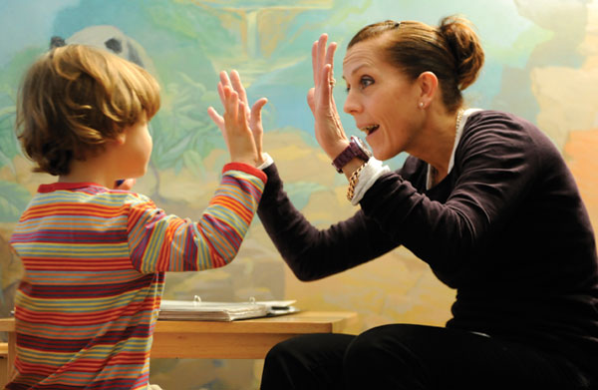
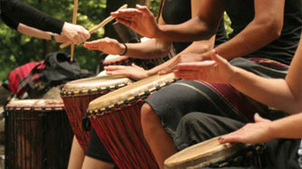
Strategies to Heal the Body and Brain
Rhythmic Activities
EXAMPLES
Patty cake
Swings – one pushing or side-by-side
Bouncing on exercise ball
Hula hoop
Playing two square
Drumming together
Jump rope
PARENT’S ROLE
Structure activity for success
Maximize pleasure and joy
Keep the beat
Stay interactive
Notes:
Healing Body the and Brain
Review the slide using the information below.
We are learning that use of rhythmic activities can be critical to the healing of people with severe trauma. There is more evidence that healing of the more primitive parts of the brain through rhythmic activities often needs to come before talking or thinking interventions which involve the thinking brain.
Here are some examples of rhythmic activities. To be healing, however, they must be fun and pleasurable and interactive with a caring treater. A person doing it by herself will not have the same effect.
Parents can build this into family life.
SLIDE 103
Module Four: Healing and Strengthening Attachment, Body and Brain and Feelings Management
90 minutes
Welcome/Introduction/Trauma Framework Review: Slides 89-92 (5 minutes)
Healing Attachment: Slides 93-96
(5 minutes)
Healing Body and Brain: Slides 97-104
(20 minutes)
Strengthening Feelings Skills
Inner Connection: Slides 105-110 (10 minutes)
Ability to Manage Shame: Slides 111-114 (10 minutes)
Ability to Soothe Strong Feelings: Slides 115-122 (20 minutes)
Your Turn: Assessing and Strengthening Feelings Skills: Slide 123 (15 minutes)
Closing: Slide 124 (5 minutes)

Slide 104
Your Turn
Compassion Meditation
Notes:
Strengthening the Body and Brain
As an example of mindfulness and meditation, lead the following exercise using the directives below. Be sure to pause between each part of the directions to allow people time to feel, think, and reflect. It is easy to go too fast. You have 5 minutes for the meditation.
Find a quiet and comfortable position in your seat as much as possible.
Identify a current (or recent) difficulty you are experiencing. Choose a difficulty that is of moderate or low intensity.
I am now going to ask you to reflect on 3 parts of self-compassion related to your difficulty. We will spend one minute on each.
I am experiencing suffering. Notice the nature of your suffering (e.g., what has happened, how does it feel, how is it difficult). Say to yourself (silently or out loud) phrases that simply acknowledge, without judgement, that you are suffering. Examples include: “This hurts,” “This is really hard for me right now,” or “I’m really struggling.” (Pause)
Suffering is part of life. Locate yourself and your suffering as part of the human condition. Say to yourself phrases such as: “It’s not abnormal to feel this way,” “I’m not alone,” “We all struggle in our lives,” or “My suffering is part of being human.” (Pause)
May I be kind to myself. Use gestures and thoughts of self-kindness. Place your hand or hands on your heart. Feel the connection between your heart beats and your hand/s. Say to yourself phrases you would say to a struggling friend such as: “I’m so sorry for your suffering,” “I’m here for you and care about you,” or “I can give myself the compassion I need.” (Pause)
Notice how your body feels. Notice your thoughts and the state of your emotions. Accept yourself just as you are in this very moment.
Briefly discuss:
What was this short meditation like for you?
How could you imagine using this with survivors?
To hear this and other meditations being led, visit: https://self-compassion.org/guided-self-compassion-meditations-mp3-2/.
SLIDE 104
Module Four: Healing and Strengthening Attachment, Body and Brain and Feelings Management
90 minutes
Welcome/Introduction/Trauma Framework Review: Slides 89-92 (5 minutes)
Healing Attachment: Slides 93-96
(5 minutes)
Healing Body and Brain: Slides 97-104
(20 minutes)
Strengthening Feelings Skills
Inner Connection: Slides 105-110 (10 minutes)
Ability to Manage Shame: Slides 111-114 (10 minutes)
Ability to Soothe Strong Feelings: Slides 115-122 (20 minutes)
Your Turn: Assessing and Strengthening Feelings Skills: Slide 123 (15 minutes)
Closing: Slide 124 (5 minutes)

Slide 105
Strategies for Strengthening Feelings Skills
Notes:
Strengthening Feelings Skills
Review the slide above.
Tell participants you are now going to look at strengthening the Feelings Skills.
SLIDE 105
Module Four: Healing and Strengthening Attachment, Body and Brain and Feelings Management
90 minutes
Welcome/Introduction/Trauma Framework Review: Slides 89-92 (5 minutes)
Healing Attachment: Slides 93-96
(5 minutes)
Healing Body and Brain: Slides 97-104
(20 minutes)
Strengthening Feelings Skills
Inner Connection: Slides 105-110 (10 minutes)
Ability to Manage Shame: Slides 111-114 (10 minutes)
Ability to Soothe Strong Feelings: Slides 115-122 (20 minutes)
Your Turn: Assessing and Strengthening Feelings Skills: Slide 123 (15 minutes)
Closing: Slide 124 (5 minutes)

Slide 106
RC® Trauma Framework - HEALING
Childhood Traumatic Events/ACEs
Disrupted Development but Healing
Attachment
Body and Brain
Feelings Skills
Current Stressor
Tolerable Feelings
Fewer Extreme Acts to Relieve Feelings
Calm down, ground, lower distress
Adaptive: Helps in the moment AND in the long run
Notes:
Strengthening Feelings Skills
Review the slide with the information below.
Again, point out where Feelings Skills fit in the Trauma Framework.
SLIDE 106
Module Four: Healing and Strengthening Attachment, Body and Brain and Feelings Management
90 minutes
Welcome/Introduction/Trauma Framework Review: Slides 89-92 (5 minutes)
Healing Attachment: Slides 93-96
(5 minutes)
Healing Body and Brain: Slides 97-104
(20 minutes)
Strengthening Feelings Skills
Inner Connection: Slides 105-110 (10 minutes)
Ability to Manage Shame: Slides 111-114 (10 minutes)
Ability to Soothe Strong Feelings: Slides 115-122 (20 minutes)
Your Turn: Assessing and Strengthening Feelings Skills: Slide 123 (15 minutes)
Closing: Slide 124 (5 minutes)

Slide 107
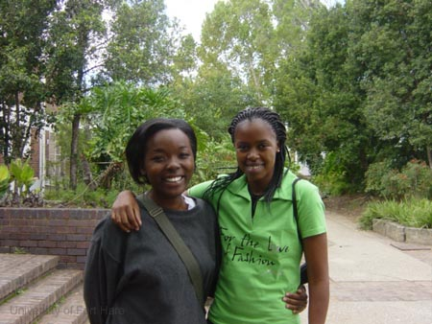
Feelings Skills
The stronger they are
… the less people depend
on extreme behaviors to
cope and
…the more they will be able
to manage life and relationships
Strength comes from practice
Notes:
Strengthening Feelings Skills
Review the slide above using the information below.
Children with trauma histories have used extreme behaviors for a very long time. Learning new responses takes time and trust.
They will learn over time to depend less on the extreme behaviors and more on the relationship.
SLIDE 107
Module Four: Healing and Strengthening Attachment, Body and Brain and Feelings Management
90 minutes
Welcome/Introduction/Trauma Framework Review: Slides 89-92 (5 minutes)
Healing Attachment: Slides 93-96
(5 minutes)
Healing Body and Brain: Slides 97-104
(20 minutes)
Strengthening Feelings Skills
Inner Connection: Slides 105-110 (10 minutes)
Ability to Manage Shame: Slides 111-114 (10 minutes)
Ability to Soothe Strong Feelings: Slides 115-122 (20 minutes)
Your Turn: Assessing and Strengthening Feelings Skills: Slide 123 (15 minutes)
Closing: Slide 124 (5 minutes)

Slide 108

Feeling Skills - Strengthening Inner Connection
Notes:
Strengthening Feeling Skills- Inner Connection
Review the slide using the information below.
Love is imperative to one’s mental and physical welfare, therefore we must be able to establish a positive inner connection to others.
It is important to provide a safe relationship that children can internalize over time, to help children practice holding onto a connection with caring others even when they are not there.
To do this, we often use concrete transitional objects to symbolize the connection.
Possible examples:
Provide a pictures of loved ones to refer to.
Send postcards from vacations.
Reference the child’s favorite movie and say that when you watch it you will think of them when they are on a home visit.
Other examples?
SLIDE 108
Module Four: Healing and Strengthening Attachment, Body and Brain and Feelings Management
90 minutes
Welcome/Introduction/Trauma Framework Review: Slides 89-92 (5 minutes)
Healing Attachment: Slides 93-96
(5 minutes)
Healing Body and Brain: Slides 97-104
(20 minutes)
Strengthening Feelings Skills
Inner Connection: Slides 105-110 (10 minutes)
Ability to Manage Shame: Slides 111-114 (10 minutes)
Ability to Soothe Strong Feelings: Slides 115-122 (20 minutes)
Your Turn: Assessing and Strengthening Feelings Skills: Slide 123 (15 minutes)
Closing: Slide 124 (5 minutes)

Slide 109
Feelings Skills - Strengthening
Inner Connection
In response, our goals are to:
Become an inner resource/secure base for the child through a safe relationship the child internalizes over time
Help the child hold on to a feeling of connection with us even when we are away from them
Notes:
Strengthening Feelings Skills- Inner Connection
Review the slide using the information below.
This process is a slow process that requires lots of repetition.
SLIDE 109
Module Four: Healing and Strengthening Attachment, Body and Brain and Feelings Management
90 minutes
Welcome/Introduction/Trauma Framework Review: Slides 89-92 (5 minutes)
Healing Attachment: Slides 93-96
(5 minutes)
Healing Body and Brain: Slides 97-104
(20 minutes)
Strengthening Feelings Skills
Inner Connection: Slides 105-110 (10 minutes)
Ability to Manage Shame: Slides 111-114 (10 minutes)
Ability to Soothe Strong Feelings: Slides 115-122 (20 minutes)
Your Turn: Assessing and Strengthening Feelings Skills: Slide 123 (15 minutes)
Closing: Slide 124 (5 minutes)

Slide 110
Your Turn!
Strategies for Building Inner Connection
How can you help the child internalize connections with positive others?
Come up with at least four different strategies
Be prepared to share
Notes:
Strengthening Feelings Skills- Inner Connection
Review the questions on the slide.
Provide time for reflection.
Process as a large group.
SLIDE 110
Module Four: Healing and Strengthening Attachment, Body and Brain and Feelings Management
90 minutes
Welcome/Introduction/Trauma Framework Review: Slides 89-92 (5 minutes)
Healing Attachment: Slides 93-96
(5 minutes)
Healing Body and Brain: Slides 97-104
(20 minutes)
Strengthening Feelings Skills
Inner Connection: Slides 105-110 (10 minutes)
Ability to Manage Shame: Slides 111-114 (10 minutes)
Ability to Soothe Strong Feelings: Slides 115-122 (20 minutes)
Your Turn: Assessing and Strengthening Feelings Skills: Slide 123 (15 minutes)
Closing: Slide 124 (5 minutes)

Slide 111

Feelings Skills – Strengthening the Ability to Manage Shame
Notes:
Strengthening Feelings Skills – Ability to Manage Shame
Introduce the next feelings skills
Children with histories of trauma often carry shame.
Survivors often feel that they are unworthy, unlovable, or untouchable.
Connection and empathy diminish shame.
SLIDE 111
Module Four: Healing and Strengthening Attachment, Body and Brain and Feelings Management
90 minutes
Welcome/Introduction/Trauma Framework Review: Slides 89-92 (5 minutes)
Healing Attachment: Slides 93-96
(5 minutes)
Healing Body and Brain: Slides 97-104
(20 minutes)
Strengthening Feelings Skills
Inner Connection: Slides 105-110 (10 minutes)
Ability to Manage Shame: Slides 111-114 (10 minutes)
Ability to Soothe Strong Feelings: Slides 115-122 (20 minutes)
Your Turn: Assessing and Strengthening Feelings Skills: Slide 123 (15 minutes)
Closing: Slide 124 (5 minutes)

Slide 112
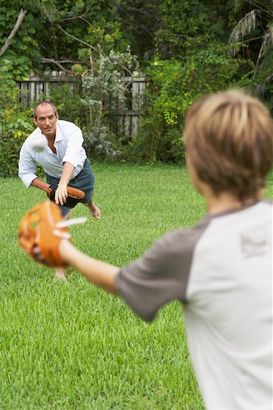
Feelings Skills – Strengthening Ability to Manage Shame
Make opportunities for the child to participate in activities he enjoys and does well.
Catch her doing things well - even very small things.
Set goal of making 5 affirming comments for every limit-setting one.
Notes:
Strengthening Feelings Skills – Ability to Manage Shame
Review the slide above using the information below.
Encourage the child to do something that makes her feel better about herself.
Plan ways for child to get involved helping others.
Remind the child of his successes you’ve witnessed.
In response, our goals are to:
Communicate in every way that she is worthy and lovable
Avoid situations the child finds shaming
Talk directly about things that happen between us
Encourage sharing what is shameful
Challenge and help the child challenge negative ideas about self
Module Four
90 minutes
Welcome/Introduction/Trauma Framework Review: Slides 89-92 (5 minutes)
Healing Attachment: Slides 93-96
(5 minutes)
Healing Body and Brain: Slides 97-104
(20 minutes)
Strengthening Feeling Skills
Inner Connection: Slides 105-110 (10 minutes)
Ability to Manage Shame: Slides 111-114 (10 minutes)
Ability to Soothe Strong Feelings: Slides 115-122 (20 minutes)
Your Turn: Assessing and Strengthening Feeling Skills: Slide 123 (15 minutes)
Closing: Slide 124 (5 min)
SLIDE 112

Slide 113
Feelings Skills – Strengthening Ability to Manage Shame
Communicate in every way that she is worthy and lovable.
Avoid situations the child finds shaming.
Talk directly about things that happen between us.
Encourage sharing what is shameful.
Challenge and help the child challenge negative ideas about self.
Notes:
Strengthening Feelings Skills – Ability to Manage Shame
Review the slide using the information below.
Ask: Can you think of other ways to strengthen feelings of worthiness?
SLIDE 113
Module Four: Healing and Strengthening Attachment, Body and Brain and Feelings Management
90 minutes
Welcome/Introduction/Trauma Framework Review: Slides 89-92 (5 minutes)
Healing Attachment: Slides 93-96
(5 minutes)
Healing Body and Brain: Slides 97-104
(20 minutes)
Strengthening Feelings Skills
Inner Connection: Slides 105-110 (10 minutes)
Ability to Manage Shame: Slides 111-114 (10 minutes)
Ability to Soothe Strong Feelings: Slides 115-122 (20 minutes)
Your Turn: Assessing and Strengthening Feelings Skills: Slide 123 (15 minutes)
Closing: Slide 124 (5 minutes)

Slide 114
Your Turn!
Strategies that help to manage shame and build feelings of worthiness
How can you help the child feel worthy of living? What can you do?
Come up with at least four different strategies.
Be prepared to share.
Notes:
Strengthening Feelings Skills – Ability to Manage Shame
Review the slide above.
Ask participants to reflect on their answers independently.
Ask for a few examples from participants.
Write down the examples shared on newsprint.
SLIDE 114
Module Four: Healing and Strengthening Attachment, Body and Brain and Feelings Management
90 minutes
Welcome/Introduction/Trauma Framework Review: Slides 89-92 (5 minutes)
Healing Attachment: Slides 93-96
(5 minutes)
Healing Body and Brain: Slides 97-104
(20 minutes)
Strengthening Feelings Skills
Inner Connection: Slides 105-110 (10 minutes)
Ability to Manage Shame: Slides 111-114 (10 minutes)
Ability to Soothe Strong Feelings: Slides 115-122 (20 minutes)
Your Turn: Assessing and Strengthening Feelings Skills: Slide 123 (15 minutes)
Closing: Slide 124 (5 minutes)

Slide 115
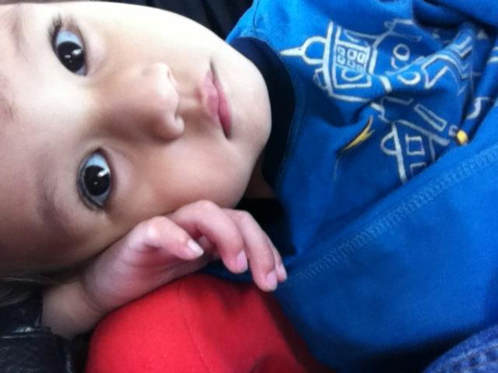
Feelings Skills: Strengthening Ability to Soothe Strong Feelings
Notes:
Strengthening Feelings Skills – Ability to Soothe Strong Feelings
Review the slide above with the information below.
Almost all children who come into care were not taught how to calm down and self-soothe.
They often associate strong feelings with danger.
Their body’s natural alarm system may be malfunctioning.
SLIDE 115
Module Four: Healing and Strengthening Attachment, Body and Brain and Feelings Management
90 minutes
Welcome/Introduction/Trauma Framework Review: Slides 89-92 (5 minutes)
Healing Attachment: Slides 93-96
(5 minutes)
Healing Body and Brain: Slides 97-104
(20 minutes)
Strengthening Feelings Skills
Inner Connection: Slides 105-110 (10 minutes)
Ability to Manage Shame: Slides 111-114 (10 minutes)
Ability to Soothe Strong Feelings: Slides 115-122 (20 minutes)
Your Turn: Assessing and Strengthening Feelings Skills: Slide 123 (15 minutes)
Closing: Slide 124 (5 minutes)

Slide 116
Feelings Skills: Strengthening Ability to Soothe Strong Feelings
Feelings Awareness…
  Awareness of the bodily signs and sensations of distress and calm
Feelings Identification…
  Learning the words associated with feelings
Feelings Modulation…
  Using strategies to move from high to low distress
Feelings Expression…
  Using skills to express feelings constructively
Notes:
Strengthening Feelings Skills – Ability to Soothe Strong Feelings
Review the slide above using the information below.
Feelings Management is broken down into four categories.
Review the four categories on the slide.
Tell participants you will now look at each category separately.
SLIDE 116
Module Four: Healing and Strengthening Attachment, Body and Brain and Feelings Management
90 minutes
Welcome/Introduction/Trauma Framework Review: Slides 89-92 (5 minutes)
Healing Attachment: Slides 93-96
(5 minutes)
Healing Body and Brain: Slides 97-104
(20 minutes)
Strengthening Feelings Skills
Inner Connection: Slides 105-110 (10 minutes)
Ability to Manage Shame: Slides 111-114 (10 minutes)
Ability to Soothe Strong Feelings: Slides 115-122 (20 minutes)
Your Turn: Assessing and Strengthening Feelings Skills: Slide 123 (15 minutes)
Closing: Slide 124 (5 minutes)

Slide 117
Feelings Skills: Strengthening Ability to Soothe Strong Feelings
1. Feelings Awareness
Teach children the language of body sensation
Help the child to identify the body sensations connected to being calm, getting upset, and very upset
Notes:
Strengthening Feelings Skills – Ability to Soothe Strong Feelings
Review the slide above using the information below.
In this culture, we tend not to be aware of our body sensations and don’t have words for them, but often our body sensations are some of the very early cues that we are distressed.
If we get to know the sensations that are associated with distress, we can notice that we are getting activated sooner and have more control to calm ourselves down.
Parents can ask about sensation using some of the following questions.
What do you notice in your body right now?
As you’re telling me about your frustration with your friend, how does that register in your body? Where do you feel it? What temperature is it? Is it dull or sharp? If you had to give it a color, what would it be?
As you keep your attention on the feeling, what happens next?
SLIDE 117
Module Four: Healing and Strengthening Attachment, Body and Brain and Feelings Management
90 minutes
Welcome/Introduction/Trauma Framework Review: Slides 89-92 (5 minutes)
Healing Attachment: Slides 93-96
(5 minutes)
Healing Body and Brain: Slides 97-104
(20 minutes)
Strengthening Feelings Skills
Inner Connection: Slides 105-110 (10 minutes)
Ability to Manage Shame: Slides 111-114 (10 minutes)
Ability to Soothe Strong Feelings: Slides 115-122 (20 minutes)
Your Turn: Assessing and Strengthening Feelings Skills: Slide 123 (15 minutes)
Closing: Slide 124 (5 minutes)

Slide 118
Feelings Skills: Strengthening Ability to Soothe Strong Feelings
1. Feelings Awareness
  Language of Sensation
  Solid, relaxed, warm, calm, grounded, alive, energized, open, free, unstruck, smooth, settled
  Tight, dizzy, burning, fuzzy, hot, numb, dull, shaky, nothing, cold, sharp, clammy, sweaty, foggy, nauseous, goose bumpy, blocked, tense, butterflies, wobbly, tired, stuck, thick, itchy, fidgety, suffocated, frozen, breathless, blank, floaty, empty, hollow, deadened, absent, heart pumping
Notes:
Strengthening Feelings Skills – Ability to Soothe Strong Feelings
Review the slide above using information below.
Here is a list you could give youth to help them find the words to describe their bodily sensation.
Example: If I were to ask you to direct your attention to a noticeable sensation in your body, what would it be? If you say tired, what are the sensations associated with feeling tired? Where do you feel the tired feeling in your body?
SLIDE 118
Module Four: Healing and Strengthening Attachment, Body and Brain and Feelings Management
90 minutes
Welcome/Introduction/Trauma Framework Review: Slides 89-92 (5 minutes)
Healing Attachment: Slides 93-96
(5 minutes)
Healing Body and Brain: Slides 97-104
(20 minutes)
Strengthening Feelings Skills
Inner Connection: Slides 105-110 (10 minutes)
Ability to Manage Shame: Slides 111-114 (10 minutes)
Ability to Soothe Strong Feelings: Slides 115-122 (20 minutes)
Your Turn: Assessing and Strengthening Feelings Skills: Slide 123 (15 minutes)
Closing: Slide 124 (5 minutes)

Slide 119

Worksheet: Catch It Early!
What are 3 situations that set you off (trigger you)?
__________________________________________
__________________________________________
__________________________________________
10
8
6
4
2
0
Situation 1 Situation 2 Situation 3
What do you feel in your body when you are more upset? At a 6/7?
________________
________________
________________
What would parents see looking at you when you are more upset? At a 6/7?
________________
________________
________________
What strategies help you when you are more upset? At a 6/7?
________________
________________
________________
What do you feel in your body when you are first getting upset? At a 4/5?
________________
________________
________________
What would parents see looking at you when you are first getting upset? At a 4/5?
________________
________________
________________
What strategies help you when you are first getting upset? At a 4/5?
________________
________________
________________
What do you feel in your body when you are calm? At a 1/2?
________________
________________
________________
What would parents see looking at you when you are calm? At a 1/2?
________________
________________
________________
What strategies help you stay calm when you are calm? At a 1/2?
________________
________________
________________
Notes:
Strengthening Feelings Skills – Ability to Soothe Strong Feelings
This is an example of a worksheet that helps people think about body sensations at different levels of distress.
Briefly review the worksheet.
SLIDE 119
Module Four: Healing and Strengthening Attachment, Body and Brain and Feelings Management
90 minutes
Welcome/Introduction/Trauma Framework Review: Slides 89-92 (5 minutes)
Healing Attachment: Slides 93-96
(5 minutes)
Healing Body and Brain: Slides 97-104
(20 minutes)
Strengthening Feelings Skills
Inner Connection: Slides 105-110 (10 minutes)
Ability to Manage Shame: Slides 111-114 (10 minutes)
Ability to Soothe Strong Feelings: Slides 115-122 (20 minutes)
Your Turn: Assessing and Strengthening Feelings Skills: Slide 123 (15 minutes)
Closing: Slide 124 (5 minutes)

Slide 120
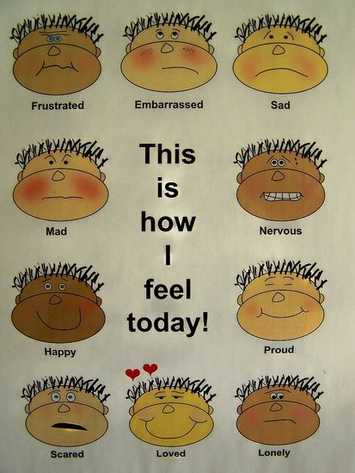
Feelings Skills: Strengthening Ability to Soothe Strong Feelings
2. Feelings Identification
Help child to learn feelings words and connect them to sensations in her body.
Teach children that feelings are different from actions.
Notes:
Strengthening Feelings Skills – Ability to Soothe Strong Feelings
Review the slide above using the information below.
Identifying feelings can be challenging for youth.
Identifying feelings is a first step to regulating emotions.
If you can’t name it—you can’t regulate it.
SLIDE 120
Module Four: Healing and Strengthening Attachment, Body and Brain and Feelings Management
90 minutes
Welcome/Introduction/Trauma Framework Review: Slides 89-92 (5 minutes)
Healing Attachment: Slides 93-96
(5 minutes)
Healing Body and Brain: Slides 97-104
(20 minutes)
Strengthening Feelings Skills
Inner Connection: Slides 105-110 (10 minutes)
Ability to Manage Shame: Slides 111-114 (10 minutes)
Ability to Soothe Strong Feelings: Slides 115-122 (20 minutes)
Your Turn: Assessing and Strengthening Feelings Skills: Slide 123 (15 minutes)
Closing: Slide 124 (5 minutes)

Slide 121
Feelings Skills: Strengthening Ability to Soothe Strong Feelings
3. Feelings Modulation:
Use sensory objects related to: touch, hearing, seeing, smelling, tasting/chewing.
Continually work on strategies to make strong feelings more tolerable (draw feelings, distract oneself, use physical activity, etc.)
Designate a “Chill Room” or “Sensory Room.”
Help client create a “Calm Down Kit” or “Sensory Kit”
Dialectical Behavior Therapy (DBT)
skills.
Notes:
Strengthening Feelings Skills – Ability to Soothe Strong Feelings
Review the slide using the information below.
These are strategies for making big feelings feel smaller or more manageable.
This includes the whole area of sensory intervention, which has proven to be very effective in helping youth modulate feelings. More and more programs are using the skills of Occupational Therapists to help them design individualized sensory options for youth.
Give an example of how using feelings skills is a process with youth.
Example: You may identify strategies with a survivor to use to calm down. Then, in a crisis when parents suggest the strategy, they say, “F that.” This will often happen many times, but once they say, “Okay, give me that f..ing music,” this is a triumph. It shows that they are beginning to be able to be aware of distress, pause enough to use strategy, and maybe use it more often. Once they do it once or ten times, it does not necessarily mean they will always be able to do it.
SLIDE 121
Module Four: Healing and Strengthening Attachment, Body and Brain and Feelings Management
90 minutes
Welcome/Introduction/Trauma Framework Review: Slides 89-92 (5 minutes)
Healing Attachment: Slides 93-96
(5 minutes)
Healing Body and Brain: Slides 97-104
(20 minutes)
Strengthening Feelings Skills
Inner Connection: Slides 105-110 (10 minutes)
Ability to Manage Shame: Slides 111-114 (10 minutes)
Ability to Soothe Strong Feelings: Slides 115-122 (20 minutes)
Your Turn: Assessing and Strengthening Feelings Skills: Slide 123 (15 minutes)
Closing: Slide 124 (5 minutes)

Slide 122
Feelings Skills: Strengthening Ability to Soothe Strong Feelings
4. Feelings Expression
Help children to use words, not actions, to express their feelings
Teach child the difference between constructive and destructive expression of feelings
Help the child to use “I” statements
Notes:
Strengthening Feelings Skills – Ability to Soothe Strong Feelings
Review the slide using the information below.
This is often difficult for traumatized children because they assume that if they express their feelings, they will get hurt, rejected, or humiliated.
Often the only way they use their words to express feelings is blowing up at someone, which results in relationships being ruptured. They have little experience with constructive expression of feelings and believing that working through conflict can actually strengthen relationships.
“I” statements:
When you yell at me
I feel stupid.
I need more time to do my chores.
SLIDE 122
Module Four: Healing and Strengthening Attachment, Body and Brain and Feelings Management
90 minutes
Welcome/Introduction/Trauma Framework Review: Slides 89-92 (5 minutes)
Healing Attachment: Slides 93-96
(5 minutes)
Healing Body and Brain: Slides 97-104
(20 minutes)
Strengthening Feelings Skills
Inner Connection: Slides 105-110 (10 minutes)
Ability to Manage Shame: Slides 111-114 (10 minutes)
Ability to Soothe Strong Feelings: Slides 115-122 (20 minutes)
Your Turn: Assessing and Strengthening Feelings Skills: Slide 123 (15 minutes)
Closing: Slide 124 (5 minutes)

Slide 123

Your Turn!
Exercise: Assessing and Strengthening Feelings Skills.
Notes:
Strengthening Feelings Skills – Ability to Soothe Strong Feelings
Exercise:
Direct participants to the Worksheet: Assessing and Strengthening Feelings Skills.
Ask participants to work together at their tables or divide people up into even groups to discuss.
Ask participants to decide on a foster child’s difficult behavior to discuss.
Work together to answer the questions on the worksheet.
Write down the examples shared on newsprint.
SLIDE 123
Module Four: Healing and Strengthening Attachment, Body and Brain and Feelings Management
90 minutes
Welcome/Introduction/Trauma Framework Review: Slides 89-92 (5 minutes)
Healing Attachment: Slides 93-96
(5 minutes)
Healing Body and Brain: Slides 97-104
(20 minutes)
Strengthening Feelings Skills
Inner Connection: Slides 105-110 (10 minutes)
Ability to Manage Shame: Slides 111-114 (10 minutes)
Ability to Soothe Strong Feelings: Slides 115-122 (20 minutes)
Your Turn: Assessing and Strengthening Feelings Skills: Slide 123 (15 minutes)
Closing: Slide 124 (5 minutes)

Slide 124
Closing Activity
Notes:
Closing Activity
Closing:
Ask participants to identify one tool they will utilize at home to strengthen their child’s Feelings Skills.
Ask: What makes a good day for you?
SLIDE 124
Module Four: Healing and Strengthening Attachment, Body and Brain and Feelings Management
90 minutes
Welcome/Introduction/Trauma Framework Review: Slides 89-92 (5 minutes)
Healing Attachment: Slides 93-96
(5 minutes)
Healing Body and Brain: Slides 97-104
(20 minutes)
Strengthening Feelings Skills
Inner Connection: Slides 105-110 (10 minutes)
Ability to Manage Shame: Slides 111-114 (10 minutes)
Ability to Soothe Strong Feelings: Slides 115-122 (20 minutes)
Your Turn: Assessing and Strengthening Feelings Skills: Slide 123 (15 minutes)
Closing: Slide 124 (5 minutes)

Slide 125
Module Five
Symptoms as Adaptations
Notes:
Module Five: Symptoms as Adaptations 90 minutes
Welcome/Introduction: Slides 125-128
(5 minutes)
Symptoms as Adaptations and Worksheet #1: Slides 129-133
(25 minutes)
Video Removed: Slide 134-135
(25 minutes)
More Symptoms as Adaptations and Worksheet #2: Slides 136-137
(15 minutes)
Rethinking Manipulation: Slides 138-142 (15 minutes)
Closing: Slide 143 (5 minutes)
Welcome/Introduction
Materials
Module Five PowerPoint Slides
White Board or Newsprint and Markers
Agenda Written on Newsprint and Posted
Video: “Removed”
Participant’s Packet for Module Five
Participant PowerPoint Slides.
Worksheet: “Symptoms as Adaptations” Worksheets 1 and 2
Objectives
Participants will:
Understand how behaviors are adaptive.
Recognize the importance of asking “What need is this child trying to get met?”
Identify ways a child can get needs met in a less disruptive way.
Introduce the concept of “Treaters.” The term used throughout the modules to describe everyone who interacts with the child to heal their wounds. We all can have a positive therapeutic impact on the children and youth we work with, not just clinical staff.
Time for Module
90 minutes
SLIDE 125

Slide 126

Welcome
Introductions
  Name
  Opening Activity
Review Agreements
Agenda
Notes:
Welcome/Introduction
Review the slide above.
Trainers introduces themselves
Participants introduce themselves:
Give their name.
State one truth about themselves and one untruth.
Others guess which is the true statement.
Discuss: Sometimes what we see on the surface of a person is not what is true about who that person is or what their interests are. In this module we are going to talk about Symptoms as Adaptations and how the behaviors children may present are often not about who they are, but about what need they are trying to meet.
Review agreements
Trainer reviews agenda.
SLIDE 126
Module Five: Symptoms as Adaptations 90 minutes
Welcome/Introduction: Slides 125-128
(5 minutes)
Symptoms as Adaptations and Worksheet #1: Slides 129-133
(25 minutes)
Video Removed: Slide 134-135
(25 minutes)
More Symptoms as Adaptations and Worksheet #2: Slides 136-137
(15 minutes)
Rethinking Manipulation: Slides 138-142 (15 minutes)
Closing: Slide 143 (5 minutes)

Slide 127
RC® Trauma Framework - HURT
Childhood Traumatic Events/ACEs
Disrupted Development
Attachment
Body and Brain
Feelings Skills
Current Stressor
Intolerable Feelings
Acts to Relieve Feelings
Retreats, hurts self, or hurts others
Adaptive: Helps in the moment, hurts in the long run
Notes:
Symptoms as Adaptations
Note: If you are not doing the modules in succession, use the talking points below.
Do a quick overview of the entire trauma framework using the information below.
Childhood traumatic events and ACEs, especially when they are chronic, disrupt the trajectory of a child’s development.
It does so in 3 critical areas, which we will discuss in a lot more detail. It impacts attachment and how they connect with other people. It impacts their body and brain on a physiological level. And it impacts what we call their “feelings skills.”
This history and reality is what comes in our doors when a child enters our home.
Then, in the present, some current trigger or stressor happens, sometimes big, but more often very small, but the trigger leads to a cascade of feelings that feel intolerable. They feel intolerable because youth don’t trust others to help them with these feelings (attachment), their body and brain are jangled and supercharged to begin with (body and brain), and their feelings skills are impaired.
Nobody wants to feel that way, so people turn to things, often anything they can find, that will make the intolerable feelings tolerable -- at least in the moment. These are the behaviors we “know and love” – retreating: such as staying by themselves, becoming depressed, playing video games constantly; hurting themselves: such as risky sex, cutting, substance abuse, driving fast; and hurting others: such as fighting, sexual offending, gang violence.
These extreme behaviors or symptoms actually work -- in the short term. They are adaptive by helping the person survive in the moment, although the behaviors have many negative long-term consequences.
This RC Trauma Framework helps us see that we need to spend most of our time on the top part of the chart for longstanding change, rather than at the bottom of the chart stamping out behavior in the short-term. This is because the more youth can trust relationships, calm their nervous system, and learn feelings skills, then the feelings that before felt intolerable now feel tolerable and they no longer need to resort to extreme behaviors.
Note: If you are doing the modules in succession, use the talking points below.
Review the slide using the information below.
Remember that because people who don’t trust relationships have a “cranked up” body and brain and weak feeling skills, when a current stress happens, it often leads to an intolerable cascade of feelings.
No one likes to feel this way so they DO something to relieve the feeling. This often takes the form of extreme behaviors.
RC holds that these symptoms are adaptations.
SLIDE 127
Module Five: Symptoms as Adaptations 90 minutes
Welcome/Introduction: Slides 125-128
(5 minutes)
Symptoms as Adaptations and Worksheet #1: Slides 129-133
(25 minutes)
Video Removed: Slide 134-135
(25 minutes)
More Symptoms as Adaptations and Worksheet #2: Slides 136-137
(15 minutes)
Rethinking Manipulation: Slides 138-142 (15 minutes)
Closing: Slide 143 (5 minutes)

Slide 128
RC® Trauma Framework - HEALING
Childhood Traumatic Events/ACEs
Disrupted Development but Healing
Attachment
Body and Brain
Feelings Skills
Current Stressor
Tolerable Feelings
Fewer Extreme Acts to Relieve Feelings
Calm down, ground, lower distress
Adaptive: Helps in the moment AND in the long run
Notes:
Symptoms as Adaptations
Review the slide with the information below.
We want to foster healing so that the Trauma Framework looks like this.
Attachment, the Body and Brain, and Feelings Skills are getting stronger.
So when a stressor happens, what previously felt intolerable feels more tolerable.
They don’t need extreme behaviors as much to calm down.
Their behaviors to cope with the stressor help in the moment AND help in the long run.
SLIDE 128
Module Five: Symptoms as Adaptations 90 minutes
Welcome/Introduction: Slides 125-128
(5 minutes)
Symptoms as Adaptations and Worksheet #1: Slides 129-133
(25 minutes)
Video Removed: Slide 134-135
(25 minutes)
More Symptoms as Adaptations and Worksheet #2: Slides 136-137
(15 minutes)
Rethinking Manipulation: Slides 138-142 (15 minutes)
Closing: Slide 143 (5 minutes)

Slide 129
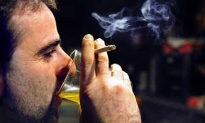
Symptoms/Behaviors as
Adaptations
Symptoms/behaviors are ways youth have learned to adapt to (survive) intolerable feelings and memories.
Symptoms/behaviors help the person in the moment -- despite long-term negative consequences.
Notes:
Symptoms as Adaptations
Review the slide using the information below.
This is a central premise of Risking Connection.
The behavior that we view as a problem are solutions for youth, ways they have developed to survive past abuse. So, behavior in the present actually represents a learned survival skill to deal with abuse in the past.
The behavior solves a problem, it serves some important function for the person that we need to find out.
If we find out the purpose it serves and the need it meets, then we are in the best position to help the person come up with other ways of meeting those needs that don’t have so many negative consequences.
SLIDE 129
Module Five: Symptoms as Adaptations 90 minutes
Welcome/Introduction: Slides 125-128
(5 minutes)
Symptoms as Adaptations and Worksheet #1: Slides 129-133
(25 minutes)
Video Removed: Slide 134-135
(25 minutes)
More Symptoms as Adaptations and Worksheet #2: Slides 136-137
(15 minutes)
Rethinking Manipulation: Slides 138-142 (15 minutes)
Closing: Slide 143 (5 minutes)

Slide 130

Behavior as Adaptation
Children respond to intolerable feelings, memories, and
situations with behavior that does three things:
Helps them relieve the
intolerable feelings
Gets their needs met
Provides short term relief
often with longer-
term negative consequences
Notes:
Symptoms as Adaptations
Review the slide using the information below.
When we look at behaviors as adaptive, it is easier to not take the child’s behavior personally.
Children with trauma histories have been engaging in adaptive behaviors for most of their life. They will have difficulty giving these behaviors up and trusting that there is a less destructive way to get their needs met.
SLIDE 130
Module Five: Symptoms as Adaptations 90 minutes
Welcome/Introduction: Slides 125-128
(5 minutes)
Symptoms as Adaptations and Worksheet #1: Slides 129-133
(25 minutes)
Video Removed: Slide 134-135
(25 minutes)
More Symptoms as Adaptations and Worksheet #2: Slides 136-137
(15 minutes)
Rethinking Manipulation: Slides 138-142 (15 minutes)
Closing: Slide 143 (5 minutes)

Slide 131
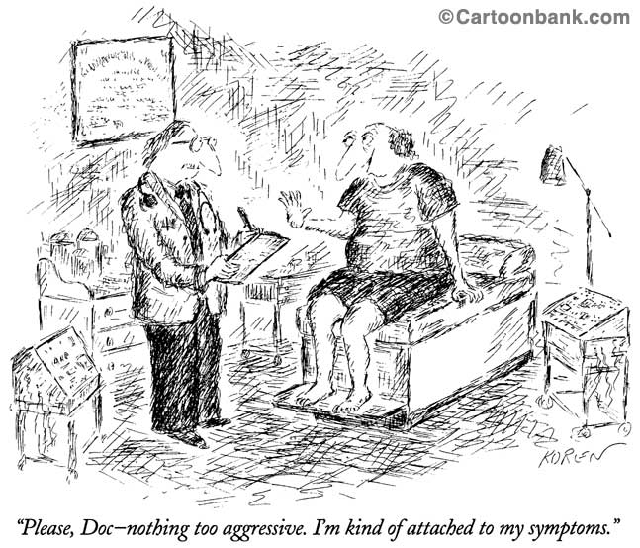
Notes:
Symptoms as Adaptations
Review the slide using the information below.
None of us gives up old patterns easily. It is unrealistic for us to expect that youth will either if the behaviors have been critical to their survival.
Give an example or a problem behavior that has been difficult for you to give up. Someone telling you to stop or giving you a reward is not likely to make you give it up in any permanent way.
Before a person gives it up, they need to be very sure that whatever alternative they do instead is going to work well.
SLIDE 131
Module Five: Symptoms as Adaptations 90 minutes
Welcome/Introduction: Slides 125-128
(5 minutes)
Symptoms as Adaptations and Worksheet #1: Slides 129-133
(25 minutes)
Video Removed: Slide 134-135
(25 minutes)
More Symptoms as Adaptations and Worksheet #2: Slides 136-137
(15 minutes)
Rethinking Manipulation: Slides 138-142 (15 minutes)
Closing: Slide 143 (5 minutes)

Slide 132
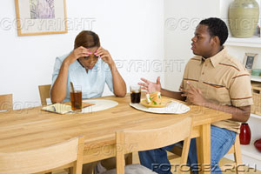
Why We View
Symptoms as Adaptations
Assumes child is doing the best they can
Reduces risk of taking problem behaviors personally
Connects you and child
Reduces shame / blame
Strength-based
Notes:
Symptoms as Adaptations
Review the slide using the information below.
Strength-based means we hold the perspective that there’s an important reason children do what they do; it makes sense on some level.
If a parent believes that the behavior is adaptive, they are less likely to take it personally. Even if it is directed at the parent, it’s not about the parent.
Survivors expect to be blamed, so it’s often shocking to them when we ask them how the behavior helped them in the moment. It’s also very comforting to children to know that there are understandable reasons why they do things. Their behaviors are not crazy and off-the-wall, they make sense.
This perspective says, “Let’s look at this behavior together and figure out why you do what you do” – as opposed to, “You are doing this bad behavior and my job is to stop you from doing it.” We’re trying to get “on the same side of the fence.” This reduces power struggles.
It comes from a fundamental belief that a child is doing the best they can.
SLIDE 132
Module Five: Symptoms as Adaptations 90 minutes
Welcome/Introduction: Slides 125-128
(5 minutes)
Symptoms as Adaptations and Worksheet #1: Slides 129-133
(25 minutes)
Video Removed: Slide 134-135
(25 minutes)
More Symptoms as Adaptations and Worksheet #2: Slides 136-137
(15 minutes)
Rethinking Manipulation: Slides 138-142 (15 minutes)
Closing: Slide 143 (5 minutes)

Slide 133
Your Turn!
Worksheet: Symptoms as Adaptations #1
Notes:
Symptoms as Adaptations
Direct participants to the Worksheet: “Symptoms as Adaptations #1.”
Read the directions and have participants complete the Worksheet individually first.
Ask participants to get into small groups and discuss their answers and why the answer illustrates the concept of symptoms as adaptation.
Provide 5-7 minutes for the small group.
Review the answers that we believe best reflects the symptoms as adaptations (ANSWERS: b, d, c, b)
Discuss:
Are there particular questions that people want to discuss? Ones where they chose a different answer or were torn between the choices?
If you compare the answers we were hoping you’d choose (b, d, c, b) with the other choices, what’s the difference?
Have you found yourself saying things to yourself that have a blaming tone to them?
Are there situations or circumstances under where are more likely to think of blaming explanations for children’s problem behavior?
How does viewing symptoms as adaptations help strengthen the connection between you and your foster child?
SLIDE 133
Module Five: Symptoms as Adaptations 90 minutes
Welcome/Introduction: Slides 125-128
(5 minutes)
Symptoms as Adaptations and Worksheet #1: Slides 129-133
(25 minutes)
Video Removed: Slide 134-135
(25 minutes)
More Symptoms as Adaptations and Worksheet #2: Slides 136-137
(15 minutes)
Rethinking Manipulation: Slides 138-142 (15 minutes)
Closing: Slide 143 (5 minutes)

Slide 134
Video…
ReMoved
Intense content: take care of yourself
Activity for self-soothing
Debrief
Notes:
Video: ReMoved
Introduce the video “ReMoved.” If foster parents have seen Removed 1, use Removed 3.
Let participants know that the subject matter in the video can be intense.
Remind participants to take care of themselves as they watch the video.
Debrief
Provide participants a few moments to return to their awareness and presence.
Say: It is not uncommon for people to have a range of emotions after watching this video. Some feelings of sadness, anger, numbness.
Model deliberate breathing or raising arms to the sky while inhaling.
Proceed to the next slide for discussion questions.
SLIDE 134
Module Five: Symptoms as Adaptations 90 minutes
Welcome/Introduction: Slides 125-128
(5 minutes)
Symptoms as Adaptations and Worksheet #1: Slides 129-133
(25 minutes)
Video Removed: Slide 134-135
(25 minutes)
More Symptoms as Adaptations and Worksheet #2: Slides 136-137
(15 minutes)
Rethinking Manipulation: Slides 138-142 (15 minutes)
Closing: Slide 143 (5 minutes)

Slide 135
Your Turn!
…Video Debrief
What struck you that you had not thought of before?
Were there kids that you had worked with that came to your mind?
How do we understand Zoe’s behavior as adaptive?
What implications are there for what we do as foster parents?
Notes:
Video ReMoved
Ask participants the questions on the slide.
Provide time for reflection between questions.
Ask a few participants to share their responses.
Process as a large group.
SLIDE 135
Module Five: Symptoms as Adaptations 90 minutes
Welcome/Introduction: Slides 125-128
(5 minutes)
Symptoms as Adaptations and Worksheet #1: Slides 129-133
(25 minutes)
Video Removed: Slide 134-135
(25 minutes)
More Symptoms as Adaptations and Worksheet #2: Slides 136-137
(15 minutes)
Rethinking Manipulation: Slides 138-142 (15 minutes)
Closing: Slide 143 (5 minutes)

Slide 136
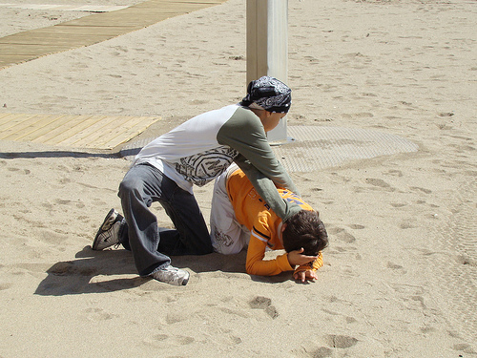
When Children’s Behavior is Problematic
Ask yourself and your support team:
What problem might this
behavior solve?
How does this behavior
serve or help the child in the moment?
How can I help this child solve problems like this one (or meet their needs) in a more positive way?
Notes:
More Symptoms as Adaptations and Worksheet #2
Review the slide using the information below.
Say: These questions are so important. Try to remember these questions so that you can call on them when you’re in the middle of a child’s “meltdown.”
Post it somewhere visible so you see it daily to remind yourself to think of this first instead of last.
Provide a couple of mini examples and have the participants practice asking these questions.
Examples:
Your teen wants to go out with friends. As you are telling them what time their curfew is, they throw a dish cloth at you and they scream “All the kids think I’m a baby! I hate you!”
It is bedtime and the child hides in a closet and makes you look for them. When you put them to bed, they ask for numerous things like a drink of water, another blanket, they forgot to brush their teeth.
SLIDE 136
Module Five: Symptoms as Adaptations 90 minutes
Welcome/Introduction: Slides 125-128
(5 minutes)
Symptoms as Adaptations and Worksheet #1: Slides 129-133
(25 minutes)
Video Removed: Slide 134-135
(25 minutes)
More Symptoms as Adaptations and Worksheet #2: Slides 136-137
(15 minutes)
Rethinking Manipulation: Slides 138-142 (15 minutes)
Closing: Slide 143 (5 minutes)

Slide 137
Your Turn!
Worksheet: Symptoms as Adaptations #2
Notes:
More Symptoms as Adaptations and Worksheet #2
Direct participants to the Worksheet: “Symptoms as Adaptations #2.”
Ask participants to find one or two other people to work with.
Provide a one-minute warning after 6 minutes.
Discuss as a large group. Possible discussion points:
What was it like for you to complete the worksheet?
What section did you find challenging?
What section was easier for you to complete?
How might this worksheet be helpful to you when addressing the need of your foster child?
SLIDE 137
Module Five: Symptoms as Adaptations 90 minutes
Welcome/Introduction: Slides 125-128
(5 minutes)
Symptoms as Adaptations and Worksheet #1: Slides 129-133
(25 minutes)
Video Removed: Slide 134-135
(25 minutes)
More Symptoms as Adaptations and Worksheet #2: Slides 136-137
(15 minutes)
Rethinking Manipulation: Slides 138-142 (15 minutes)
Closing: Slide 143 (5 minutes)

Slide 138
Rethinking Manipulation
Notes:
Rethinking Manipulation
Review the slide using the information below.
Tell participants you are now going to look at manipulation.
SLIDE 138
Module Five: Symptoms as Adaptations 90 minutes
Welcome/Introduction: Slides 125-128
(5 minutes)
Symptoms as Adaptations and Worksheet #1: Slides 129-133
(25 minutes)
Video Removed: Slide 134-135
(25 minutes)
More Symptoms as Adaptations and Worksheet #2: Slides 136-137
(15 minutes)
Rethinking Manipulation: Slides 138-142 (15 minutes)
Closing: Slide 143 (5 minutes)

Slide 139
Rethinking Manipulation
  What distinguishes manipulative behavior from other behavior?
    Trying to get what you want…
    In an indirect, deceitful or dishonest way…
    Without regard for the needs or feelings of the other person.
Notes:
Rethinking Manipulation
Review the slide using the information below.
Ask participants what distinguishes manipulative behavior from other behavior. Discuss the various qualities and the assumptions, often negative assumptions, in the answers.
Click - Tell participants that this is our definition of behavior that is labelled as manipulative.
Trying to get what you want….
In an indirect, deceitful or dishonest way….
Without regard for the needs or feelings of the other person.
Ask participants whether they (or anyone they know ) ever engages in manipulative behavior.
Provide an example of what you yourself have done, such as getting out of a speeding ticket, trying to persuade your agency maintenance to fix something without going through the proper procedures, asking for something from your spouse at a time s/he is most likely to say yes. We all use manipulation.
SLIDE 139
Module Five: Symptoms as Adaptations 90 minutes
Welcome/Introduction: Slides 125-128
(5 minutes)
Symptoms as Adaptations and Worksheet #1: Slides 129-133
(25 minutes)
Video Removed: Slide 134-135
(25 minutes)
More Symptoms as Adaptations and Worksheet #2: Slides 136-137
(15 minutes)
Rethinking Manipulation: Slides 138-142 (15 minutes)
Closing: Slide 143 (5 minutes)

Slide 140

Rethinking Manipulation
How do we feel when we have been successfully manipulated- especially if it is public?
Angry! Stupid! Foolish! Played! Never again!
Who else feels that way much of the time?
Notes:
Rethinking Manipulation
Review the slide using the information below.
Ask participants to remember a time when they were successfully manipulated and others knew about it. How did they feel? What did they say to themselves? What did they imagine others were saying about them?
Click – Show answers (Angry! Stupid! Etc.)
Click – Ask: Who else feels that way much of the time?
This directly parallels how youth often feel in response to being taken advantage of over and over again. They repeatedly have let their guard down and trusted someone, only to be used and burned by people who were meeting their own needs.
When we say to ourselves “I am never going to believe what these people say ever again,” we can understand how youth feel a lot of the time.
SLIDE 140
Module Five: Symptoms as Adaptations 90 minutes
Welcome/Introduction: Slides 125-128
(5 minutes)
Symptoms as Adaptations and Worksheet #1: Slides 129-133
(25 minutes)
Video Removed: Slide 134-135
(25 minutes)
More Symptoms as Adaptations and Worksheet #2: Slides 136-137
(15 minutes)
Rethinking Manipulation: Slides 138-142 (15 minutes)
Closing: Slide 143 (5 minutes)

Slide 141
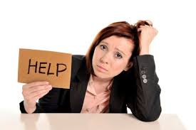
Rethinking Manipulation
Why can it be difficult for youth to ask directly for what they want?
It hasn’t worked in the past.
Our programs/systems often say “no” to reasonable, direct requests.
It feels vulnerable and weak.
You have to trust the other person.
Notes:
Rethinking Manipulation
Review the slide using the information below.
Ask participants, “Why is it difficult for youth to ask directly for what they want?” Discuss answers.
Click – Show answers on the slide.
It hasn’t worked in the past.
Our programs/systems often say “no” to reasonable direct requests.
It feels vulnerable and weak.
You have to trust the other person.
Reinforce by saying it can be hard for anyone. How good are we at it? If you were tired and having a bad day, could you ask other family members to do extra for you? Or would that make you feel weak and unprofessional? It’s worse if asking for what you want has rarely worked out in the past and has at times resulted in things getting worse and you being blamed.
Also in our systems, youth often cannot get what they want by asking directly. For example, asking to delay leaving because you feel unsafe would often be denied, so youth will engage in extreme behavior like cutting in order to delay leaving. The system has taught them to get what they need by acting up.
If we want youth to ask for things directly we have to say “yes” whenever possible.
SLIDE 141
Module Five: Symptoms as Adaptations 90 minutes
Welcome/Introduction: Slides 125-128
(5 minutes)
Symptoms as Adaptations and Worksheet #1: Slides 129-133
(25 minutes)
Video Removed: Slide 134-135
(25 minutes)
More Symptoms as Adaptations and Worksheet #2: Slides 136-137
(15 minutes)
Rethinking Manipulation: Slides 138-142 (15 minutes)
Closing: Slide 143 (5 minutes)

Slide 142
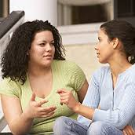
Rethinking Manipulation
What can we do when we feel manipulated?
Talk over our feelings with another adult.
What needs was the survivor trying to meet?
Use RICH® to talk with the client.
Notes:
Rethinking Manipulation
Review the slide using the information below.
Ask participants, “What we can do when we feel manipulated?” Discuss answers briefly.
Click - When we first realize we have been tricked, we are often extremely angry.
We can talk to another adult about our feelings before talking with the person.
We can ask ourselves: What needs was the person was trying to meet? What got in the way of him asking directly? How could he meet his needs without deception? For example, if the person deceptively got an extra phone call, her need was to talk to her boyfriend, but what underlying need did that meet? A need for love, for someone special, for individual attention, for normalcy.
Use RICH® to talk with the person. Validate the need and that the person has a right to meet her needs. Discuss how she can do so without hurting other people. Talk about the relationship and consequences of tricking someone - they no longer trust you. Always infuse hope, i.e., “I’m sure we can rebuild our trust by telling each other the truth.”
SLIDE 142
Module Five: Symptoms as Adaptations 90 minutes
Welcome/Introduction: Slides 125-128
(5 minutes)
Symptoms as Adaptations and Worksheet #1: Slides 129-133
(25 minutes)
Video Removed: Slide 134-135
(25 minutes)
More Symptoms as Adaptations and Worksheet #2: Slides 136-137
(15 minutes)
Rethinking Manipulation: Slides 138-142 (15 minutes)
Closing: Slide 143 (5 minutes)

Slide 143
Closing Activity
Notes:
Closing
Say: As individuals, write down one soothing activity you will commit to practice between now and the next time we gather.
If you have a small group, ask for volunteers to share their ideas. If have a larger group, have them find one other person to share with.
Ask for a few examples.
SLIDE 143
Module Five: Symptoms as Adaptations 90 minutes
Welcome/Introduction: Slides 125-128
(5 minutes)
Symptoms as Adaptations and Worksheet #1: Slides 129-133
(25 minutes)
Video Removed: Slide 134-135
(25 minutes)
More Symptoms as Adaptations and Worksheet #2: Slides 136-137
(15 minutes)
Rethinking Manipulation: Slides 138-142 (15 minutes)
Closing: Slide 143 (5 minutes)

Slide 144
Module Six
Collaborative Crisis Management
Notes:
Welcome/Introduction
Materials
Module Six PowerPoint Slides
White Board or Newsprint and Markers
Agenda Written on Newsprint and Posted
Participant’s Packet for Module Six
Participant PowerPoint slides
Sample Crisis Plans
Objectives
Participants will:
Learn the three phases of Collaborative Crisis Management
Demonstrate effective collaborative crisis intervention
Recognize the rupture and repair cycle and practice repair techniques
Introduce the concept of “Treaters.” The term used throughout the modules to describe everyone who interacts with the child to heal their wounds. We all can have a positive therapeutic impact on the children and youth we work with, not just clinical staff.
Time for Module
90 minutes
Module Six: Collaborative Crisis Management 90 minutes
Welcome/Introduction: Slides 144-145 (10 minutes)
Overview of Collaborative Crisis Management: Slides 146-149
(5 minutes)
Before the Storm: Slides 150-154
(20 minutes)
During the Storm: Slides 155-164
(35 minutes)
After the Storm: Slides 165-168
(15 minutes)
Closing: Slide 169 (5 minutes)
SLIDE 144

Slide 145
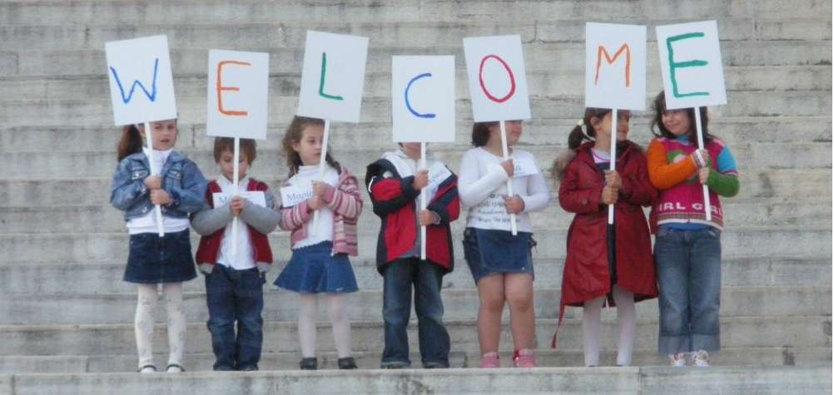
Welcome
Introductions
  Name
  Opening Activity
Review Agreements
Agenda
Notes:
Welcome/Introduction
Review the slide above.
Trainers introduce themselves
Ask participants to introduce themselves and describe one thing they do when they are really upset to calm themselves.
Review agreements
Trainer reviews agenda
Module Six: Collaborative Crisis Management 90 minutes
Welcome/Introduction: Slides 144-145 (10 minutes)
Overview of Collaborative Crisis Management: Slides 146-149
(5 minutes)
Before the Storm: Slides 150-154
(20 minutes)
During the Storm: Slides 155-164
(35 minutes)
After the Storm: Slides 165-168
(15 minutes)
Closing: Slide 169 (5 minutes)
SLIDE 145

Slide 146

Crisis Management
Though the sea be deep and rough, the coral rock remains standing..
~Hawaiian Proverb
Notes:
Overview of Collaborative Crisis Management
Ask for a volunteer to read the caption on the slide.
Say: It is when we are in the middle of a crisis that we must have keen awareness, a calm demeanor, and stand strong against the “rough seas” of the crisis at hand.
Module Six: Collaborative Crisis Management 90 minutes
Welcome/Introduction: Slides 144-145 (10 minutes)
Overview of Collaborative Crisis Management: Slides 146-149
(5 minutes)
Before the Storm: Slides 150-154
(20 minutes)
During the Storm: Slides 155-164
(35 minutes)
After the Storm: Slides 165-168
(15 minutes)
Closing: Slide 169 (5 minutes)
SLIDE 146

Slide 147
A Collaborative Model for Crisis Management
Many of the major failures in services with youth occur in our responses to crises.
The youth’s participation in -- and anticipation of -- crisis is essential.
Notes:
Overview Collaborative Crisis Management
Review the slide using the information below.
The big idea of this crisis management module is that when managing crisis, don’t forget about what we’ve learned so far: symptoms are adaptations and the importance of the relationships.
When managing crisis, our anxiety is at its peak. This is the time we often move into control mode. Failures, which can make things worse for youth and parents in crisis, include breaking confidentiality when not necessary, rigid and punitive consequences, shaming and blaming of youth, and sudden discipline with no discussion.
It is when dealing with crisis that the principles of RC are most critical.
The more everyone collaborates with children to anticipate crisis, the less crisis takes us and the child by surprise. As a result---over time, fewer crisis occur.
Module Six: Collaborative Crisis Management 90 minutes
Welcome/Introduction: Slides 144-145 (10 minutes)
Overview of Collaborative Crisis Management: Slides 146-149
(5 minutes)
Before the Storm: Slides 150-154
(20 minutes)
During the Storm: Slides 155-164
(35 minutes)
After the Storm: Slides 165-168
(15 minutes)
Closing: Slide 169 (5 minutes)
SLIDE 147

Slide 148
RC® Trauma Framework - HURT
Childhood Traumatic Events/ACEs
Disrupted Development
Attachment
Body and Brain
Feelings Skills
Current Stressor
Intolerable Feelings
Acts to Relieve Feelings
Retreats, hurts self, or hurts others
Adaptive: Helps in the moment, hurts in the long run
Notes:
Overview of Collaborative Crisis Management
Note: If you are not doing the modules in succession, use the talking points below.
Do a quick overview of the entire trauma framework using the information below.
Childhood traumatic events and ACEs, especially when they are chronic, disrupt the trajectory of a child’s development.
It does so in 3 critical areas, which we will discuss in a lot more detail. It impacts attachment and how they connect with other people. It impacts their body and brain on a physiological level, and it impacts what we call their “feelings skills.”
This history and reality is what comes in our doors when a child enters our home.
Then, in the present, some current trigger or stressor happens, sometimes big, but more often very small. But the trigger leads to a cascade of feelings that feel intolerable. They feel intolerable because youth don’t trust others to help them with these feelings (attachment), their body and brain are jangled and supercharged to begin with (body and brain), and their feelings skills are impaired.
Nobody wants to feel that way, so people turn to things, often anything they can find, that will make the intolerable feelings tolerable -- at least in the moment. These are the behaviors we “know and love” – retreating: such as staying by themselves, becoming depressed, playing video games constantly; hurting themselves: such as risky sex, cutting, substance abuse, driving fast; and hurting others: such as fighting, sexual offending, gang violence.
These extreme behaviors or symptoms actually work -- in the short term. They are adaptive by helping the person survive in the moment, although the behaviors have many negative long-term consequences.
This RC Trauma Framework helps us see that we need to spend most of our time on the top part of the chart for longstanding change, rather than at the bottom of the chart stamping out behavior in the short-term. This is because the more youth can trust relationships, calm their nervous system, and learn feelings skills, then the feelings that before felt intolerable now feel tolerable and they no longer need to resort to extreme behaviors.
Note: If you are doing the modules in succession, use the talking points below.
Review the Risking Connection Framework on the slide.
Remind participants that a crisis occurs when the child is experiencing intolerable feelings and acts to relieve those feelings.
Point to the bottom part of the framework.
Before a crisis we want to be working on the top part—strengthen feelings management.
During the crisis we want to help the child regulate.
After the crisis we want to repair the relationship and continue to strengthen feelings management skills.
Say: Too often we use “consequences” (forms of punishment) to try and get rid of these “adaptive behaviors” that are problematic. Real and lasting change comes from the relationship and improving attachment, regulating the nervous system, and improving feelings skills to make intolerable feelings more tolerable.
Collaborative crisis planning helps the child strengthen their self-capacities.
Module Six: Collaborative Crisis Management 90 minutes
Welcome/Introduction: Slides 144-145 (10 minutes)
Overview of Collaborative Crisis Management: Slides 146-149
(5 minutes)
Before the Storm: Slides 150-154
(20 minutes)
During the Storm: Slides 155-164
(35 minutes)
After the Storm: Slides 165-168
(15 minutes)
Closing: Slide 169 (5 minutes)
SLIDE 148

Slide 149
RC® Trauma Framework - HEALING
Childhood Traumatic Events/ACEs
Disrupted Development but Healing
Attachment
Body and Brain
Feelings Skills
Current Stressor
Tolerable Feelings
Fewer Extreme Acts to Relieve Feelings
Calm down, ground, lower distress
Adaptive: Helps in the moment AND in the long run
Notes:
Overview of Collaborative Crisis Management
Review the slide with the information below.
When we manage crisis collaboratively with children, they gradually learn to manage stressors without extreme behaviors. Over time, there are much less crises to deal with.
Module Six: Collaborative Crisis Management 90 minutes
Welcome/Introduction: Slides 144-145 (10 minutes)
Overview of Collaborative Crisis Management: Slides 146-149
(5 minutes)
Before the Storm: Slides 150-154
(20 minutes)
During the Storm: Slides 155-164
(35 minutes)
After the Storm: Slides 165-168
(15 minutes)
Closing: Slide 169 (5 minutes)
SLIDE 149

Slide 150
Collaborative Crisis Management: Before the Storm
Notes:
Before the Storm
Reference the analogy on the slide “Before the Storm.”
Most people have emergency plans if there is a threat of a major weather event.
Examples: Extra food, water, battery for radios etc.
While there are obvious differences, the analogy of being ready for a storm may help reduce the shame children feel about “losing it,” Help them think about what causes the storm, and how to prevent it.
It may also assist parents in not taking the child’s adaptive behavior personally as you would not take inclement weather personally.
Module Six: Collaborative Crisis Management 90 minutes
Welcome/Introduction: Slides 144-145 (10 minutes)
Overview of Collaborative Crisis Management: Slides 146-149
(5 minutes)
Before the Storm: Slides 150-154
(20 minutes)
During the Storm: Slides 155-164
(35 minutes)
After the Storm: Slides 165-168
(15 minutes)
Closing: Slide 169 (5 minutes)
SLIDE 150

Slide 151
Collaborative Crisis Management:
Including the Child
People respond best to what they help create
Including the child demonstrates and supports feelings of worthiness
Shows you believe the child wants to and can over time manage stronger feelings
Begins to help child internalize adults as helpful and supportive
Notes:
Before the Storm
Review the slide using the information below.
Including the child in the crisis planning increases self-worth and buy in.
It lends some predictability to an unpredictable situation.
It helps the child “dig their well” before they get thirsty.
Module Six: Collaborative Crisis Management 90 minutes
Welcome/Introduction: Slides 144-145 (10 minutes)
Overview of Collaborative Crisis Management: Slides 146-149
(5 minutes)
Before the Storm: Slides 150-154
(20 minutes)
During the Storm: Slides 155-164
(35 minutes)
After the Storm: Slides 165-168
(15 minutes)
Closing: Slide 169 (5 minutes)
SLIDE 151

Slide 152
Before the Crisis:
Collaborative Crisis Prevention
Crisis Plans ask:
What upsets you?
What are the first signs that you are getting upset?
What helps you when you’re upset?
What doesn’t help?
Crisis Prevention Plans are living documents,
continually reviewed and modified with the
child.
Notes:
Before the Storm
Review the slide using the information below.
Tell: Before the crisis, create a prevention and management plan. The Crisis Plan is a set of structured questions that you talk about with the child.
It is a set of questions that focus on the child and a set of questions that focus on the caregiver.
At the initial crisis planning discussion, set appointments on your calendar to review the plan every other month. If the child uses a calendar, help him or her add to it.
Ask: What is the benefit of making a regular appointment and turning conversations about managing crisis into more every day topics? How might this affect the child?
Possible answers:
By normalizing the topic, there is less emotion and anxiety attached to it.
Making it a living document instead of it being a “big deal.” This reduces everyone’s anxiety.
Module Six: Collaborative Crisis Management 90 minutes
Welcome/Introduction: Slides 144-145 (10 minutes)
Overview of Collaborative Crisis Management: Slides 146-149
(5 minutes)
Before the Storm: Slides 150-154
(20 minutes)
During the Storm: Slides 155-164
(35 minutes)
After the Storm: Slides 165-168
(15 minutes)
Closing: Slide 169 (5 minutes)
SLIDE 152

Slide 153
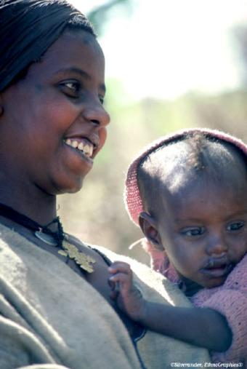
Before the Crisis:
Collaborative Crisis Prevention
To reduce crises, build feelings skills
when life is calm:
Model and teach managing
feelings
Reinforce the child’s strengths
and positive contributions
Identify and use tools to help the
child remember positive connections
even when separated from them
Notes:
Before the Storm
Review the slide using the information below.
Remind participants of the Trauma Framework.
They want to strike while the iron is cold—working on the upper part of the Framework—Strengthening Feelings Skills.
Module Six: Collaborative Crisis Management 90 minutes
Welcome/Introduction: Slides 144-145 (10 minutes)
Overview of Collaborative Crisis Management: Slides 146-149
(5 minutes)
Before the Storm: Slides 150-154
(20 minutes)
During the Storm: Slides 155-164
(35 minutes)
After the Storm: Slides 165-168
(15 minutes)
Closing: Slide 169 (5 minutes)
SLIDE 153

Slide 154
Your Turn!
Sample Crisis Management Plan
Notes:
Before the Storm
Review the slide using the information below.
Direct participants to the sample crisis plan.
Ask participants to look at the sample crisis plan that is completed to see what Bob told the people who care for him and what they told him.
Crisis Plans should include:
What upsets me?
Early signs that I’m getting upset.
What helps/What doesn’t help.
What happens if I get more upset?
Ask: Which would you do first: child or caregiver? Why? Think about how trauma impacts children. Children who are new to your home are not in a position of power to say—”You go first.” Some adults create their own personal crisis plans they can share with the child to model that we all need plans to manage our emotions and stressors.
Tell participants that modeling their crisis plans to the child may feel embarrassing or they may feel shy about it. Ask: Do you think the child may be feeling the same way? The child needs you to normalize this process for them.
Exercise
Direct participants to the blank Crisis Plan.
Crisis plans should be filled out with the child but since the child is not there, have them fill this out for themselves and their child.
Ask for one or two examples.
Module Six: Collaborative Crisis Management 90 minutes
Welcome/Introduction: Slides 144-145 (10 minutes)
Overview of Collaborative Crisis Management: Slides 146-149
(5 minutes)
Before the Storm: Slides 150-154
(20 minutes)
During the Storm: Slides 155-164
(35 minutes)
After the Storm: Slides 165-168
(15 minutes)
Closing: Slide 169 (5 minutes)
SLIDE 154

Slide 155
Collaborative Crisis Management:
During The Storm
Notes:
During the Storm
Review the slide using the information below.
Tell participants you are now going to look at crisis management during the storm.
Module Six: Collaborative Crisis Management 90 minutes
Welcome/Introduction: Slides 144-145 (10 minutes)
Overview of Collaborative Crisis Management: Slides 146-149
(5 minutes)
Before the Storm: Slides 150-154
(20 minutes)
During the Storm: Slides 155-164
(35 minutes)
After the Storm: Slides 165-168
(15 minutes)
Closing: Slides 169 (5 minutes)
SLIDE 155

Slide 156
During the Crisis:
Four Principles
Remember Symptoms are Adaptations
Stay RICH®
Stay Calm
Focus only on resolving the crisis
Notes:
During the Storm
Review the slide using the information below.
We talk about 4 important points for parents to keep in mind during a crisis:
Remembering symptoms are adaptations –even though the symptom or behavior is extreme, it is meeting an important need in the moment and is a way the person learned to survive.
Staying RICH – remember Respect, Information, Connection, Hope.
Stay calm yourself.
Focus only on de-escalating and resolving the crisis – it’s not a time for teaching, skill-building, or discussing consequences.
Module Six: Collaborative Crisis Management 90 minutes
Welcome/Introduction: Slides 144-145 (10 minutes)
Overview of Collaborative Crisis Management: Slides 146-149
(5 minutes)
Before the Storm: Slides 150-154
(20 minutes)
During the Storm: Slides 155-164
(35 minutes)
After the Storm: Slides 165-168
(15 minutes)
Closing: Slide 169 (5 minutes)
SLIDE 156

Slide 157
During the Crisis:
Principle 1
Remember Symptoms are
Adaptations
If you don’t truly believe that problematic behaviors are adaptive, you’re more likely to:
Personalize the child’s behavior
Engage in an avoidable power struggle
Do whatever it takes to hold this belief during a crisis
Notes:
During the Storm
Review the slide using the information below.
Ask: When the child is in an “emotional storm” or having a crisis, what happens if you forget that the behavior you see is an adaptation? Possible Answer: You take the behavior personally.
Keep the mindset by asking yourself: What problem is the person trying to solve? What need is the person trying to meet in this very moment? Why now?
Assume that they, on some level, are trying to cope with feelings that
feel intolerable. It might be a reaction to an event right now. It might
be a reaction to distress that has been building.
Module Six: Collaborative Crisis Management 90 minutes
Welcome/Introduction: Slides 144-145 (10 minutes)
Overview of Collaborative Crisis Management: Slides 146-149
(5 minutes)
Before the Storm: Slides 150-154
(20 minutes)
During the Storm: Slides 155-164
(35 minutes)
After the Storm: Slides 165-168
(15 minutes)
Closing: Slide 169 (5 minutes)
SLIDE 157

Slide 158
During the Crisis:
Principle 2
Stay RICH®
Demonstrate Respect:
  Validate the child’s feeling;
  Watch your tone, inflection, posture, eye contact, etc.
Seek and Offer Information:
  Offer the child assurances that you are there
  State your intentions
  Offer choices and ideas for self-soothing
  Seek information as the child calms
Notes:
During the Storm
1. Review the slide using the information below.
LISTEN.
Validate the person’s feelings.
Do not move too soon to solutions, although you will feel pulled to do so. Stay with validation.
Repeat and rephrase what the person is saying using active listening.
Module Six: Collaborative Crisis Management 90 minutes
Welcome/Introduction: Slides 144-145 (10 minutes)
Overview of Collaborative Crisis Management: Slides 146-149
(5 minutes)
Before the Storm: Slides 150-154
(20 minutes)
During the Storm: Slides 155-164
(35 minutes)
After the Storm: Slides 165-168
(15 minutes)
Closing: Slide 169 (5 minutes)
SLIDE 158

Slide 159

During the Crisis:
Principle 2
Stay RICH®, continued
Be the Child’s Connection:
  Assume the child feels alone
  in her distress.
  Offer yourself as a connection.
  Bring in others who are connected to the child.
Offer Hope:
  Offer hope that together everyone can get through this.
  Remind of problems successfully solved in the past.
Notes:
During the Storm
1. Review slide using the information below.
Be willing to bring in a person or remind the child of a person with whom the child has a particular connection with if necessary.
It is also okay to remove any person with whom the person is particularly upset. They can work it out later.
Express your conviction that the child has a reason to be upset that makes sense to her, even if you do not understand it or agree with it.
Hold onto hope, because people often feel hopeless during a crisis.
Remember that the child can feel very alone during a crisis.
Module Six: Collaborative Crisis Management 90 minutes
Welcome/Introduction: Slides 144-145 (10 minutes)
Overview of Collaborative Crisis Management: Slides 146-149
(5 minutes)
Before the Storm: Slides 150-154
(20 minutes)
During the Storm: Slides 155-164
(35 minutes)
After the Storm: Slides 165-168
(15 minutes)
Closing: Slide 169 (5 minutes)
SLIDE 159

Slide 160
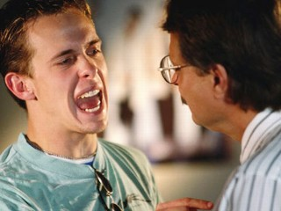
During the Crisis:
Principle 3
Stay Calm
Use calming techniques
Watch your body language
If you can’t stay calm, fake it!
If you can’t fake it, get help
Remember: Don’t take the behavior personally
Children learn to calm by being in the
presence of adults who can stay calm.
Notes:
During the Storm
1. Review the slide using the information below.
Know and practice what calms you down such as deep breathing.
Use other trusted people by asking for help if you are becoming upset.
Accept help if offered by a trusted person. This is not the time for pride, i.e. “He started this with me so I’m going to finish it.”
Don’t take the child’s behavior personally.
Module Six: Collaborative Crisis Management 90 minutes
Welcome/Introduction: Slides 144-145 (10 minutes)
Overview of Collaborative Crisis Management: Slides 146-149
(5 minutes)
Before the Storm: Slides 150-154
(20 minutes)
During the Storm: Slides 155-164
(35 minutes)
After the Storm: Slides 165-168
(15 minutes)
Closing: Slide 169 (5 minutes)
SLIDE 160

Slide 161
During the Crisis:
Principle 4
Focus Only On Resolving the Crisis
Focus on helping the child calm and self-soothe
Validate! Validate! Validate! (doesn’t necessarily mean agreement)
Discuss what happens as a result of the crisis LATER – after the child is calmer and regulated
Notes:
During the Storm
1. Review the slide using the information below.
Remember that when the child is upset, she cannot think. People usually can’t access the part of the brain responsible for problem-solving during a crisis. Do not rely on thinking interventions, i.e. “If you do that, you will not be able to have your outing this weekend.”
Instead, just help the child calm down and get back in control.
Use specific ideas from their crisis prevention plan. Also, things like chitchat, a distraction, sensory objects, properly-timed humor, and physical activity can help.
Humor can help only if properly timed - do not make the person feel you are laughing at him.
Module Six: Collaborative Crisis Management 90 minutes
Welcome/Introduction: Slides 144-145 (10 minutes)
Overview of Collaborative Crisis Management: Slides 146-149
(5 minutes)
Before the Storm: Slides 150-154
(20 minutes)
During the Storm: Slides 155-164
(35 minutes)
After the Storm: Slides 165-168
(15 minutes)
Closing: Slide 169 (5 minutes)
SLIDE 161

Slide 162
During the Crisis:
Principle 4
Focus Only On Resolving the
Crisis
Offer choices
Be as flexible and patient as possible
Help the child recall others with whom they have a positive connection
Notes:
During the Storm
1. Review the slide using the information below.
Escalation to violence often starts when caregivers hurry to resolve a situation. Just sitting with the child can often lead to a resolution.
Offer choices—even if they are small choices—to give the person a sense of some control. For example: “I need to stay with you. Do you want to sit with me here or should we step outside?”
Module Six: Collaborative Crisis Management 90 minutes
Welcome/Introduction: Slides 144-145 (10 minutes)
Overview of Collaborative Crisis Management: Slides 146-149
(5 minutes)
Before the Storm: Slides 150-154
(20 minutes)
During the Storm: Slides 155-164
(35 minutes)
After the Storm: Slides 165-168
(15 minutes)
Closing: Slide 169 (5 minutes)
SLIDE 162

Slide 163
During the Crisis
Role Play
How well does the foster parent display these 4 principles?
Remember Symptoms are Adaptations
Stay RICH®
Stay Calm
Focus only on resolving the crisis
Notes:
During the Storm
Review the slide using the information below.
Say: We are going to role play managing a crisis. Your job is to look for how we do following the 4 principles.
Ask: How did we do? What did you observe in the interaction?
Do: Repeat the role play, this time in a more RICH and relational way.
Ask: How did we do this time? What did you observe that was different from the first role play?
Module Six: Collaborative Crisis Management 90 minutes
Welcome/Introduction: Slides 144-145 (10 minutes)
Overview of Collaborative Crisis Management: Slides 146-149
(5 minutes)
Before the Storm: Slides 150-154
(20 minutes)
During the Storm: Slides 155-164
(35 minutes)
After the Storm: Slides 165-168
(15 minutes)
Closing: Slide 169 (5 minutes)
SLIDE 163

Slide 164
Your Turn!
During the Crisis Role Play
Notes:
During the Storm
Review the slide using the information below.
Role Play
Divide participants into groups of 3.
One person is the child, one is the parent and one is an observer.
The child presents the parent with a crisis. The parent responds as helpfully as possible using the 4 principles we just discussed. Observer just notices what happens.
Time: 5 minutes—GO!
Process
Ask the child: What did the parent do that was helpful?
Ask the observer: What did the parent do that was helpful?
Ask parent: What was the experience like for you? What did you notice?
Module Six: Collaborative Crisis Management 90 minutes
Welcome/Introduction: Slides 144-145 (10 minutes)
Overview of Collaborative Crisis Management: Slides 146-149
(5 minutes)
Before the Storm: Slides 150-154
(20 minutes)
During the Storm: Slides 155-164
(35 minutes)
After the Storm: Slides 165-168
(15 minutes)
Closing: Slide 169 (5 minutes)
SLIDE 164

Slide 165
Collaborative Crisis Management:
After The Storm
Notes:
After the Storm
Review the slide using the information below.
Tell participants you are now going to look at after crisis management.
Module Six: Collaborative Crisis Management 90 minutes
Welcome/Introduction: Slides 144-145 (10 minutes)
Overview of Collaborative Crisis Management: Slides 146-149
(5 minutes)
Before the Storm: Slides 150-154
(20 minutes)
During the Storm: Slides 155-164
(35 minutes)
After the Storm: Slides 165-168
(15 minutes)
Closing: Slide 169 (5 minutes)
SLIDE 165

Slide 166
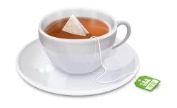
After the Crisis: Self-Care
Take a “time out”
Have a cup of tea
Rock, wrap up, compress
Read through any documents
that will help you remember the trauma which the child has experienced
Write about the experience so you can discuss it during the next home visit
Call your case manager
Talk to your partner or confidante
Notes:
After the Storm
Review the slide using the information below.
Say: The first task for everyone is calming and self-soothing. By calming yourself, you are modeling this for your child. Helping the central nervous systems return to a regulated stage is critical. Only when both of you are regulated can you begin to repair.
Notice that the list on the slide goes from simple responses to more involved responses. The more complex or cognitive responses become possible as the nervous system calms.
Ask: What happens in terms of our own ability to use our feelings skills when we overtly do self-care?
Possible Answers:
We are improving our own and modeling to the child.
The child learns new skills for regulating.
There is an increase in trust as you have stayed connected.
Ask: What about the rest of your biological family and self-care?
Possible Answers:
It shows that they too can recover.
Models skills.
Any time you overtly model good practices in self-care of yourself, your family benefits too.
These are the tools and skills the child never had a chance to learn but are important life skills.
Module Six: Collaborative Crisis Management 90 minutes
Welcome/Introduction: Slides 144-145 (10 minutes)
Overview of Collaborative Crisis Management: Slides 146-149
(5 minutes)
Before the Storm: Slides 150-154
(20 minutes)
During the Storm: Slides 155-164
(35 minutes)
After the Storm: Slides 165-168
(15 minutes)
Closing: Slide 169 (5 minutes)
SLIDE 166

Slide 167
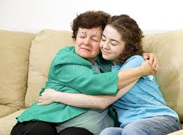
After the Crisis: Reunion
Repair the relationship:
Talk about the effect of the
event on relationships
To avoid further damage to
the relationship, continue to speak to the child, drop grudges and avoid excessive consequences
Work together to fix any damage—this rebuilds the relationship
Notes:
After the Storm
1. Review the slide using the information below.
Remember, just like in early attachment relationships, much of healing and growth comes through rupture and repair of the relationship. We always want to give the message that “Yes there is conflict, but we can work through it.”
To do this, the treater cannot still be in an emotional or reactive place with respect to the incident.
It is important for parents to:
Express your confidence that, despite this rupture, your relationship can be fixed.
Gently insist that this is an important conversation to have even though it’s hard. Often, they feel shame and assume you want to have nothing to do with them or are mad at them. Be careful not to make shame worse.
They may not be ready to talk about what they can learn from the situation yet, but it is important to state that crisis can teach us important lessons
Module Six: Collaborative Crisis Management 90 minutes
Welcome/Introduction: Slides 144-145 (10 minutes)
Overview of Collaborative Crisis Management: Slides 146-149
(5 minutes)
Before the Storm: Slides 150-154
(20 minutes)
During the Storm: Slides 155-164
(35 minutes)
After the Storm: Slides 165-168
(15 minutes)
Closing: Slide 169 (5 minutes)
SLIDE 167

Slide 168
Your Turn!
After the Crisis – Role Plays
Notes:
After the Storm
Review the slide using the information below.
Trainer Role Play
Trainers role-play a discussion (for about 3 minutes) “after the crisis” where you discuss the impact of the crisis on the relationship. You can role-play a discussion that occurred the day after the crisis scenario you role-played earlier (i.e. imagine it was the next day and you wanted to talk with the child about the crisis). In the situation, often the child does not want to talk about or feels shame about what happened. It is important to model gently pushing to have the conversation anyway and attempting not to reinforce shame.
Participant Role Play
Ask participants to find a partner.
One person agrees to be the child and the other the parent.
Role play having a discussion with the child after the crisis.. Give participants 5 minutes for the role play.
Discuss:
How does this compare to what you do after a crisis?
What does such a discussion accomplish?
What do you think about parents having this kind of discussion with youth?
Module Six: Collaborative Crisis Management 90 minutes
Welcome/Introduction: Slides 144-145 (10 minutes)
Overview of Collaborative Crisis Management: Slides 146-149
(5 minutes)
Before the Storm: Slides 150-154
(20 minutes)
During the Storm: Slides 155-164
(35 minutes)
After the Storm: Slides 165-168
(15 minutes)
Closing: Slide 169 (5 minutes)
SLIDE 168

Slide 169
Closing Activity
Notes:
Closing
Review the slide using the information below.
Ask participants to write down one or two ways they will take care of themselves after a crisis.
Ask for one or two volunteers to share their ideas.
Remind participants of how important it is for them to take time after an intense situation to regulate. They can remind the child that what they experienced was difficult, but they made it through together and it is important to find ways to take care of themselves after the crisis.
Module Six: Collaborative Crisis Management 90 minutes
Welcome/Introduction: Slides 144-145 (10 minutes)
Overview of Collaborative Crisis Management: Slides 146-149
(5 minutes)
Before the Storm: Slides 150-154
(20 minutes)
During the Storm: Slides 155-164
(35 minutes)
After the Storm: Slides 165-168
(15 minutes)
Closing: Slide 169 (5 minutes)
SLIDE 169

Slide 170
Module Seven
Noticing Our Reactions
And
Vicarious Trauma
Notes:
Welcome/Introduction
Materials
Module Seven PowerPoint Slides
White Board or Newsprint and Markers
Agenda Written on Newsprint and Posted
Participants packet for Module Seven
Participant PowerPoint Slides
Worksheet: Using Your Reactions to Foster Your Child
Worksheet: 10 Characteristics of a Resilient Treater
Objectives
Participants will:
Understand how noticing their reactions can help their healing relationship with the child.
Recognize when reactions are problematic.
Know how the work they do can impact them negatively and identify ways to counter those impacts.
Understand the characteristics of resiliency and explore how to build it in themselves.
Introduce the concept of “Treaters.” The term used throughout the modules to describe everyone who interacts with the child to heal their wounds. We all can have a positive therapeutic impact on the children and youth we work with, not just clinical staff.
Time for Module
90 minutes
Module Seven: Noticing our Reactions and Vicarious Trauma
90 minutes
Welcome/Introduction: Slides 170-171 (10 minutes)
Noticing Your Reactions: Slides 172-179 (35 minutes)
Introduction to Vicarious Trauma: Slides 180-186 (20 minutes)
Managing Vicarious Trauma: Slides 187-193 (10 minutes)
Building Resilience Against VT: Slides 194-195 (15 minutes)
Closing: Slide 196 (5 minutes)
SLIDE 170

Slide 171

Welcome
Introductions
  Name
  Opening Activity
Review Agreements
Agenda
Notes:
Welcome/Introduction
Review the slide above.
Trainers introduces themselves
Ask participants to think of a difficult time in their past in which they have found some peace with.
Do not ask participants to share the difficult time but instead, ask them to share how the experience changed them or what they learned from it.
Review agreements.
Trainer reviews agenda.
Module Seven: Noticing our Reactions and Vicarious Trauma
90 minutes
Welcome/Introduction: Slides 170-171 (10 minutes)
Noticing Your Reactions: Slides 172-179 (35 minutes)
Introduction to Vicarious Trauma: Slides 180-186 (20 minutes)
Managing Vicarious Trauma: Slides 187-193 (10 minutes)
Building Resilience Against VT: Slides 194-195 (15 minutes)
Closing: Slide 196 (5 minutes)
SLIDE 171

Slide 172
Noticing Your Reactions as a Foster Parent
Notes:
Noticing Your Reactions
Introduce this module as time to think about them as Foster Parents.
Say: We will discuss your reactions to the challenges of being a foster parent.
We will also discuss the impact of being in this role on you.
Module Seven: Noticing our Reactions and Vicarious Trauma
90 minutes
Welcome/Introduction: Slides 170-171 (10 minutes)
Noticing Your Reactions: Slides 172-179 (35 minutes)
Introduction to Vicarious Trauma: Slides 180-186 (20 minutes)
Managing Vicarious Trauma: Slides 187-193 (10 minutes)
Building Resilience Against VT: Slides 194-195 (15 minutes)
Closing: Slide 196 (5 minutes)
SLIDE 172

Slide 173

Notice Your Reactions
Reactions and feelings are a normal part of being a foster parent:
Thoughts, feelings, body
reactions to your child
(positive and negative)
Responses to the uncomfortable responses you have
Notes:
Noticing Your Reactions
Review the slide using the information below.
Say: Your experience of how you react and respond to the children in your care is normal. When some current stressor overwhelms their ability to respond and their feelings become intolerable, your feeling’s management is also tested.
Ask: What kinds of thoughts, feelings, and physical responses do you have in response to particular children for whom you provide care?
Possible responses:
Positive: warm, loving, worry
Negative: anger, fear, disgust
Thoughts: “This story can’t be true”, “This kid is so cute” or “This kid should be in jail”
Say: The conflict between the negative feelings and what we think we “should” feel can be tough. Foster parents sometimes think “I shouldn’t feel this way!” OR “What would my worker say?” OR “It’s the foster child’s fault I feel this way”.
Module Seven: Noticing our Reactions and Vicarious Trauma
90 minutes
Welcome/Introduction: Slides 170-171 (10 minutes)
Noticing Your Reactions: Slides 172-179 (35 minutes)
Introduction to Vicarious Trauma: Slides 180-186 (20 minutes)
Managing Vicarious Trauma: Slides 187-193 (10 minutes)
Building Resilience Against VT: Slides 194-195 (15 minutes)
Closing: Slide 196 (5 minutes)
SLIDE 173

Slide 174
What Fuels Our Reactions?
Feelings about:
The reality of childhood trauma, neglect and abuse
Behaviors children develop in response to their circumstances
How a child’s history and behaviors interact with our own
Experiences with the care system
Responses from our community, family
and friends
Vicarious Trauma
Notes:
Noticing Your Reactions
Review the slide using the information below.
Ask: What contributes to foster parent’s negative reactions and feelings?
Possible answers:
In addition to the exposure to the child’s trauma, there are systemic issues that are part of the job.
By definition, relationships are often temporary and uncertain. The work is done in one’s own home, from which there is no escape, and there is accompanying isolation.
Family and friends may not understand the commitment you chose to make, and they certainly will not have the understanding of your child’s behavior that you do. This can increase the conflicts among various loyalties that compete for your time.
Say: All of these factors also contribute to Vicarious Trauma. And Vicarious Trauma contributes to our reactions which we will talk about more in depth later in this module.
Module Seven: Noticing our Reactions and Vicarious Trauma
90 minutes
Welcome/Introduction: Slides 170-171 (10 minutes)
Noticing Your Reactions: Slides 172-179 (35 minutes)
Introduction to Vicarious Trauma: Slides 180-186 (20 minutes)
Managing Vicarious Trauma: Slides 187-193 (10 minutes)
Building Resilience Against VT: Slides 194-195 (15 minutes)
Closing: Slide 196 (5 minutes)
SLIDE 174

Slide 175

How Does Noticing Your Reactions Help Your Parenting?
You can identify what is fueling your reaction
You can recognize your needs when your reaction comes from your life experiences
It reduces the risk of blaming the child
Helps you see areas where you can support the child in a different way
Notes:
Noticing Your Reactions
Review the slide using the information below.
Say: The truth is that parenting children with histories of trauma brings up hurt, sadness, and disappointments in our own lives. Just as we help children learn to identify areas that are hard for them and why and help them learn different ways to respond, we benefit when we do the same in our life. It helps us separate our lives from the child’s, not take things as personal, and offer the child more compassion.
Ask: When children’s behavior reminds us of our own lives, how might that affect our relationship with them?
Possible responses:
Noone wants to be upset – it makes us do whatever it takes to keep the child from getting upset and therefore from engaging our own emotional reactions.
Certain things the child does become especially stressful for us.
Module Seven: Noticing our Reactions and Vicarious Trauma
90 minutes
Welcome/Introduction: Slides 170-171 (10 minutes)
Noticing Your Reactions: Slides 172-179 (35 minutes)
Introduction to Vicarious Trauma: Slides 180-186 (20 minutes)
Managing Vicarious Trauma: Slides 187-193 (10 minutes)
Building Resilience Against VT: Slides 194-195 (15 minutes)
Closing: Slide 196 (5 minutes)
SLIDE 175

Slide 176

When Your Reactions Can
Be a Problem
When they:
Interfere with your ability to
understand a child’s behavior as
a coping response
Prevent you from responding in
a way that is helpful to your child
Overwhelm you so you can’t stay connected to yourself and your role (feelings management)
Notes:
Noticing Your Reactions
Review the slide using the information below.
Say: Of course, reactions can be problematic too. When your reaction to a child’s behavior makes it hard to remember that the child’s behavior is their best response to intolerable feelings, it’s easy to fall into patterns of response that aren’t helpful.
If reactions prevent responses in ways that are healing for the foster child, this too is problematic.
Ask: How might problematic reaction reflect the challenges to your own feelings management skills?
Possible response:
They can reflect limits in the skills needed to manage and modulate feelings.
Difficulty remembering connection to others when times are stressful.
They can reflect feelings of low self-worth which sometimes shows up as power struggles.
Module Seven: Noticing our Reactions and Vicarious Trauma
90 minutes
Welcome/Introduction: Slides 170-171 (10 minutes)
Noticing Your Reactions: Slides 172-179 (35 minutes)
Introduction to Vicarious Trauma: Slides 180-186 (20 minutes)
Managing Vicarious Trauma: Slides 187-193 (10 minutes)
Building Resilience Against VT: Slides 194-195 (15 minutes)
Closing: Slide 196 (5 minutes)
SLIDE 176

Slide 177
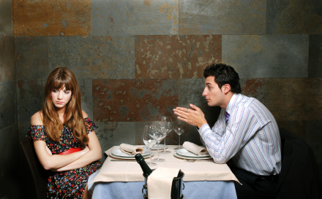
Examples
Over-Identification: “I understand because you’re just like me.”
Blaming: “He doesn’t want to
get better.”
Distancing: “She’s hopeless,
kids like that never change.”
Denial: “What she’s saying couldn’t be true.”
Notes:
Noticing Your Reactions
Review the slide using the information below.
Say: Let’s look at examples of what people say or think that reflect problematic reactions.
Over-identification. This is what happens when we assume that a child’s experience is just like ours without checking assumptions—or remembering that a child who is in care may respond as we need them to in order to protect what they understand to be in their best interest.
Ask: Think of a time when someone has said “I understand because you’re just like me” to you—how did that affect you if it wasn’t true? Did they insist that you believe them?
Possible responses: Made me mad, sad, frustrated and wanted to pull back from them.
Say: Blaming and distancing are two other reactions that are problematic. When adults with more power or authority than kids say things like, “He doesn’t want to get better” or “She’s hopeless.” Adults who say this have quit believing the child can ever learn differently. It is a form of retreat that can reflect stress, feeling overwhelmed, or vicarious trauma which we will discuss. It is also natural to put more energy into children who are rewarding.
Denial—forgetting pieces of the child’s history and not wanting to believe it is true.
Module Seven: Noticing our Reactions and Vicarious Trauma
90 minutes
Welcome/Introduction: Slides 170-171 (10 minutes)
Noticing Your Reactions: Slides 172-179 (35 minutes)
Introduction to Vicarious Trauma: Slides 180-186 (20 minutes)
Managing Vicarious Trauma: Slides 187-193 (10 minutes)
Building Resilience Against VT: Slides 194-195 (15 minutes)
Closing: Slide 196 (5 minutes)
SLIDE 177

Slide 178

Three Steps for
Reducing Problematic Reactions
Recognize your feelings.
Understand them.
Talk them over with someone
Use them to strengthen your relationship.
Notes:
Noticing Your Reactions
Review the slide using the information below.
Say: There are three steps for using your feelings as a tool in your relationships, not only with foster children, but in all relationships. While they appear easy, they require ongoing attention.
First you can only use what you can recognize. Recognition means noticing what you are experiencing and naming it. This requires paying attention to thoughts and feelings and physical reactions. Sometimes people become aware of feelings only when talking to other people which is why it is important to talk to your team.
Second if you understand your feelings, then you can ask: how much of my feelings are about me? About the child? About both? What might my reaction be telling me? Who am I to the child? Am I symbolically being the abusive mother, non-protective father, just another person who will reject or leave him?
Finally, what you recognize and understand you can employ. In general, this means using your feelings to understand the child better, get a glimpse into their inner world, strengthen the connection in some way. This does not necessarily mean disclosing to the child or doing anything in particular – although it might.
Module Seven: Noticing our Reactions and Vicarious Trauma
90 minutes
Welcome/Introduction: Slides 170-171 (10 minutes)
Noticing Your Reactions: Slides 172-179 (35 minutes)
Introduction to Vicarious Trauma: Slides 180-186 (20 minutes)
Managing Vicarious Trauma: Slides 187-193 (10 minutes)
Building Resilience Against VT: Slides 194-195 (15 minutes)
Closing: Slide 196 (5 minutes)
SLIDE 178

Slide 179
Your Turn!
Worksheet: Using Your Reactions to Your Foster Child
Notes:
Noticing Your Reactions
Direct participants to the Worksheet: Using Your Reactions to Your Foster Child.
Provide 10 minutes to work on the worksheet.
Discuss as a large group for 5 minutes.
How could being aware of strong negative feelings be useful? What if they were strong positive feelings?
How could negative or positive feelings be used to help the relationship? How might they harm it?
What gets in the way of being more aware of strong negative or positive feelings?
How could talking about these feelings with someone else help?
Module Seven: Noticing our Reactions and Vicarious Trauma
90 minutes
Welcome/Introduction: Slides 170-171 (10 minutes)
Noticing Your Reactions: Slides 172-179 (35 minutes)
Introduction to Vicarious Trauma: Slides 180-186 (20 minutes)
Managing Vicarious Trauma: Slides 187-193 (10 minutes)
Building Resilience Against VT: Slides 194-195 (15 minutes)
Closing: Slide 196 (5 minutes)
SLIDE 179

Slide 180
Introduction to Vicarious Trauma
Notes:
Introduction to Vicarious Trauma
Review the slide using the information below.
We are now going to look at the impact of being a foster parent on your mental, physical, emotional and spiritual health. This section is Vicarious Trauma.
Module Seven: Noticing our Reactions and Vicarious Trauma
90 minutes
Welcome/Introduction: Slides 170-171 (10 minutes)
Noticing Your Reactions: Slides 172-179 (35 minutes)
Introduction to Vicarious Trauma: Slides 180-186 (20 minutes)
Managing Vicarious Trauma: Slides 187-193 (10 minutes)
Building Resilience Against VT: Slides 194-195 (15 minutes)
Closing: Slide 196 (5 minutes)
SLIDE 180

Slide 181
Vicarious Trauma
How this work will change you
VT refers to the negative changes in the helper as a result of caring about and feeling, or being, responsible for traumatized children.
It can include disrupted spirituality and loss of meaning and/or hope.
181
Notes:
Introduction to Vicarious Trauma
Review the slide using the information below.
Vicarious Traumatization is a term coined in 1990 by Laurie Pearlman who is one of the authors of the RC curriculum. The concept was further developed by Kay Saakvitne, the first author of RC.
At that time, it was very unusual to talk about the impact of trauma work on people who work with children who have trauma histories. In many settings, it still is.
VT is a result of giving our hearts to foster children. If we didn’t invest in those we help and risk our hearts, but instead protected ourselves, we probably wouldn’t have VT AND we wouldn’t be very effective.
Originally, VT was a term that was used to describe treaters that directly cared for survivors, but, now we recognize that other kinds of helpers can also be affected. The VT might not be as intense, but it can have a negative effect.
Examples: A foster parent who gets to know a child can be negatively impacted by finding out that the person is now homeless. Leaders of foster care programs may feel hopeless if they need to cut services due to budget cuts. Support staff may be impacted hearing about survivors at the agency or trying to support foster parents that are injured by a survivor.
VT is really about the cumulative impact on us as treaters over time.
Module Seven: Noticing our Reactions and Vicarious Trauma
90 minutes
Welcome/Introduction: Slides 170-171 (10 minutes)
Noticing Your Reactions: Slides 172-179 (35 minutes)
Introduction to Vicarious Trauma: Slides 180-186 (20 minutes)
Managing Vicarious Trauma: Slides 187-193 (10 minutes)
Building Resilience Against VT: Slides 194-195 (15 minutes)
Closing: Slide 196 (5 minutes)
SLIDE 181

Slide 182

Vicarious Trauma (VT)
Inescapable effect of foster parenting
Not the fault of the
child
Not a result of “weakness”
of foster parent
Damages hope and
optimism required to
foster effectively
Notes:
Introduction to Vicarious Trauma
Review the slide using the information below.
The point is that you can’t avoid experiencing VT. If you are fostering, you are exposed to others‘ painful history and it impacts you—it’s not the child’s fault and it’s not because you are “weak.”
It’s just like going out in the sun. Whether you get a sunburn or not, you are affected by the rays.
The effect of VT is that it damages the hope and optimism you need to foster effectively.
Module Seven: Noticing our Reactions and Vicarious Trauma
90 minutes
Welcome/Introduction: Slides 170-171 (10 minutes)
Noticing Your Reactions: Slides 172-179 (35 minutes)
Introduction to Vicarious Trauma: Slides 180-186 (20 minutes)
Managing Vicarious Trauma: Slides 187-193 (10 minutes)
Building Resilience Against VT: Slides 194-195 (15 minutes)
Closing: Slide 196 (5 minutes)
SLIDE 182

Slide 183
Role of Vicarious Trauma in Success of Foster Care
Most important factor in foster care:
Attention paid to foster parent experience of fostering
Responsiveness to foster parent needs resulting from the wok
Addressing VT is critical.
Notes:
Introduction to Vicarious Trauma
Review the slide using the information below.
We can’t meet the needs of children if we are ignoring the needs of parents. Just like on an airplane, if the oxygen mask falls you put it on yourself first BEFORE your child. We need to take care of ourselves, and our organizations need to help us do so in order to do work that is sustainable and has quality and integrity.
Risking Connection® believes that relationships are the primary agent of change. Those relationships have to have some continuity. These two statements are consistent with our understanding of attachment and of the role of attunement in attachment. If children are moved between foster homes there will be little continuity. If foster parents lose their effectiveness due to VT, there is a higher risk of disrupted foster placements.
So, addressing the VT that foster parents experience is one sure way of reducing the risk of disrupted placements.
Module Seven: Noticing our Reactions and Vicarious Trauma
90 minutes
Welcome/Introduction: Slides 170-171 (10 minutes)
Noticing Your Reactions: Slides 172-179 (35 minutes)
Introduction to Vicarious Trauma: Slides 180-186 (20 minutes)
Managing Vicarious Trauma: Slides 187-193 (10 minutes)
Building Resilience Against VT: Slides 194-195 (15 minutes)
Closing: Slide 196 (5 minutes)
SLIDE 183

Slide 184
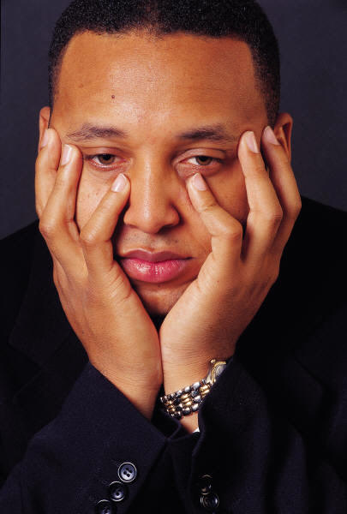
How VT Changes Us
VT can impact:
Our core sense of meaning and hope
Our identity and worldview
Our core beliefs about safety, trust, esteem, control and intimacy
Our own ability to manage feelings
Our bodily feelings including our sexuality
Notes:
Introduction to Vicarious Trauma
Review the slide using the information below.
With survivors of trauma there are certain areas or domains that are impacted. Many of the exact same domains in foster parents are impacted by VT.
A core feature of VT is it’s impact on our basic sense of hope and our belief that our work and life has meaning. For some, this means cynicism about the world and the future. For others, it means a disrupted sense of spirituality,or break in their beliefs about God or a higher power.
Give specific examples (if possible) about the impact of VT in each of these areas.
Module Seven: Noticing our Reactions and Vicarious Trauma
90 minutes
Welcome/Introduction: Slides 170-171 (10 minutes)
Noticing Your Reactions: Slides 172-179 (35 minutes)
Introduction to Vicarious Trauma: Slides 180-186 (20 minutes)
Managing Vicarious Trauma: Slides 187-193 (10 minutes)
Building Resilience Against VT: Slides 194-195 (15 minutes)
Closing: Slide 196 (5 minutes)
SLIDE 184

Slide 185
Your Turn!
Vicarious Trauma Exercise
Write down 3 signs of vicarious traumatization that you experience.
Write down 3 ways in which you are positively impacted by being a foster parent. What benefits do you experience?
Notes:
Introduction to Vicarious Trauma
Say: Now we are going to do an exercise asking you to think about the impact of vicarious trauma on you as a foster parent as well as the rewards of doing this challenging and important job. I am going to give you a piece of paper and ask you to write down responses to the questions on the slide. Do not put your name on your paper. We will then collect the papers and read the responses out loud and then discuss. No one will know who wrote the responses.
Do: Pass out a small piece of blank paper to each person.
Say: Okay, now write down responses to the questions on the slide. Write the signs of VT on one side of the paper and the way you are positively impacted on the other side. Do not write your name.
Do: Allow time for everyone to write. Collect all of the pieces of paper from participants. Alternating back and forth, trainers read the VT (negative impact) list first. (NOTE: Reading these signs of VT usually creates a heavy and sad feeling in the room. This is okay.
Ask:
How did it feel to hear these signs of VT being read?
Was there anyone who felt validated in hearing things that could have been on your list?
People often say, “I thought I was the only one who felt this way.” What gets in the way of us talking more with each other about the difficulty of this work?
Do: In the same manner, trainers read the benefits/rewards list next.
Ask:
How did it feel to hear the list of benefits?
How do you think the 2 lists are related to each other? (ie., It is the fact that the work is challenging that also makes it rewarding. For example, knowing about the trauma children suffer makes us grateful for what we have in our lives).
Point out that we will continue to talk BOTH about the difficulties of this work and its gifts.
Module Seven: Noticing our Reactions and Vicarious Trauma
90 minutes
Welcome/Introduction: Slides 170-171 (10 minutes)
Noticing Your Reactions: Slides 172-179 (35 minutes)
Introduction to Vicarious Trauma: Slides 180-186 (20 minutes)
Managing Vicarious Trauma: Slides 187-193 (10 minutes)
Building Resilience Against VT: Slides 194-195 (15 minutes)
Closing: Slide 196 (5 minutes)
SLIDE 185

Slide 186
The Healing Relationship
Grief wounds more deeply in solitude; tears are less bitter when mingled with other tears.
Agamemnon, by Seneca
Notes:
Introduction to Vicarious Trauma
Ask for a volunteer to read the quote on the slide and ask what the quote means to the group.
Process with the information below.
When we do the VT exercise with people most say that while it is difficult and a bit depressing to hear the signs of VT, they also feel validated that they are not alone.
One of the most powerful messages of this VT exercise is that when we hold the weight of VT as a group, together it is easier to bear. In the same way that trauma survivors often say that “The worst part of what happened to me is that I was all alone with it.” VT is more damaging when people hold it alone thinking they are the only one.
Remember that the impact of trauma on the children with whom you work follows the Risking Connection® Framework, and that sometimes we find ourselves reacting from that same frame.
Module Seven: Noticing our Reactions and Vicarious Trauma
90 minutes
Welcome/Introduction: Slides 170-171 (10 minutes)
Noticing Your Reactions: Slides 172-179 (35 minutes)
Introduction to Vicarious Trauma: Slides 180-186 (20 minutes)
Managing Vicarious Trauma: Slides 187-193 (10 minutes)
Building Resilience Against VT: Slides 194-195 (15 minutes)
Closing: Slide 196 (5 minutes)
SLIDE 186

Slide 187
Vicarious Trauma:
How to Manage It
Notes:
Managing Vicarious Trauma
Say: We have just spent time discussing how vicarious trauma can impact you. Now we are going to explore ways to manage it.
Module Seven: Noticing our Reactions and Vicarious Trauma
90 minutes
Welcome/Introduction: Slides 170-171 (10 minutes)
Noticing Your Reactions: Slides 172-179 (35 minutes)
Introduction to Vicarious Trauma: Slides 180-186 (20 minutes)
Managing Vicarious Trauma: Slides 187-193 (10 minutes)
Building Resilience Against VT: Slides 194-195 (15 minutes)
Closing: Slide 196 (5 minutes)
SLIDE 187

Slide 188
Contributing Factors to VT
Environment
Foster Parent
VT
Notes:
Managing Vicarious Trauma
Review the slide using the information below.
Explain that our level of VT depends on both factors in the environment (our home, the wider system) and factors about us as people.
How those combine at any particular time contribute to how we feel VT.
Module Seven: Noticing our Reactions and Vicarious Trauma
90 minutes
Welcome/Introduction: Slides 170-171 (10 minutes)
Noticing Your Reactions: Slides 172-179 (35 minutes)
Introduction to Vicarious Trauma: Slides 180-186 (20 minutes)
Managing Vicarious Trauma: Slides 187-193 (10 minutes)
Building Resilience Against VT: Slides 194-195 (15 minutes)
Closing: Slide 196 (5 minutes)
SLIDE 188

Slide 189
Contributing Factors to VT
Environment
Examples
Exposure to trauma stories
Support of friends and family
Team that promotes discussion of VT
Wider system failures
Bias (ie., racism, homophobia) in world around you
Foster Parent
Examples
Current life stressors
Parent’s own history of ACEs and trauma
Interests outside of work
Investment in the mission of the work
Self-care
Longevity working with foster youth
VT
Notes:
Managing Vicarious Trauma
Review the slide using the information below.
Click - The factors in our environment include ones like these in our own community, organization, home, and in the wider system.
Discuss:
Which of these factors most impact their VT – either to keep it manageable or make it worse? Ask for specific examples.
What system failures keep you up most at night?
What could they add to the list?
Click - The factors listed under “foster parent” are about what your story is, what you bring with you to the job.
Things in our work as foster parents will inevitably overlap with our own personal history, including our history of trauma. Remember that a significant percentage of foster parents doing this work are trauma survivors themselves. How much work you have done on yourself to heal can greatly impact how much VT you feel.
A lot of people attracted to this field find it easier to take care of others than themselves. This can be a dangerous trap and lead to greater VT.
Life happens to us also. We may have a parent who is sick, be going through a divorce, have kids who are having problems; this can increase VT.
Most believe that to really last in this line of work it has to be a mission on some level – your little part of changing the world for the better.
While we often don’t have control of what life presents us, we do have control of many things on this list that can minimize VT’s toll.
Ask: What else could go on this list?
Module Seven: Noticing our Reactions and Vicarious Trauma
90 minutes
Welcome/Introduction: Slides 170-171 (10 minutes)
Noticing Your Reactions: Slides 172-179 (35 minutes)
Introduction to Vicarious Trauma: Slides 180-186 (20 minutes)
Managing Vicarious Trauma: Slides 187-193 (10 minutes)
Building Resilience Against VT: Slides 194-195 (15 minutes)
Closing: Slide 196 (5 minutes)
SLIDE 189

Slide 190
What To Do About VT
Environment
Examples
Team communicates that VT is normal, inevitable, and should be discussed
Parent recognition and celebration
Opportunity to talk with other foster parents
Regular support
Address bias in organization or team
Foster Parent
Themes to Address
Anticipate VT and build in protection
Address signs of VT when they arise
Transform the pain of VT
Build resilience against VT
VT
Notes:
Managing Vicarious Trauma
Review the slide using the information below.
There are many things our organizations and we as parents can do to address and transform VT.
Click - We put actions by the organization to change the environment first because it is very easy for an organization to say, “Yes, we think VT is important, so go get exercise, eat well, and have a massage.” Research suggests that this alone does not help VT. Organizations must support parents in taking care of themselves. They must also create a climate where parents feel supported and challenged.
Ask: Why might organizations be reluctant to communicate that VT is normal and inevitable?
Ask: To what extent is there a culture at your organizations where parents feel supported and self care is encouraged?
Click – These are the areas where parents can take actions to address their treater factors that contribute to VT. We’re going to talk in more detail about them now.
Module Seven: Noticing our Reactions and Vicarious Trauma
90 minutes
Welcome/Introduction: Slides 170-171 (10 minutes)
Noticing Your Reactions: Slides 172-179 (35 minutes)
Introduction to Vicarious Trauma: Slides 180-186 (20 minutes)
Managing Vicarious Trauma: Slides 187-193 (10 minutes)
Building Resilience Against VT: Slides 194-195 (15 minutes)
Closing: Slide 196 (5 minutes)
SLIDE 190

Slide 191
Anticipating VT and Build In Protection (The ABCs)
Awareness
    Be attuned to one’s needs, limits, emotions, resources
    Heed all sources of information—thoughts, feelings, bodily signs, intuition
    Practice mindfulness and acceptance
Balance
    Among work, play, and rest
Connection
    To oneself, to others, and to something larger
Notes:
Managing Vicarious Trauma
Review the slide using the information below.
First, we must learn how to anticipate VT and build in protection into our lives. We call this the ABC’s.
Awareness. Ask people where in their body do they experience the stress of the job.
What physical signs would they first notice?
What emotional reactions would be a clue that they need a break?
What thoughts might signal cynicism or exhaustion are developing?
Mention that we may get feedback from others before we even notice ourselves that we are being affected by the work. It is important to be open to that feedback.
Balance is important and difficult to achieve because the demands of the work are infinite. There is always something more we can do and it would probably help. We have to set limits and support each other in doing so. The best way to do this is to have things outside of work that are important to us such as relationships and activities that matter so that we will not be sucked up by the work.
Connection can be to oneself - noticing what you are feeling and needing; to other people via the relationships in our lives; to something larger such as a higher power, a political movement, nature, volunteering in your community.
Module Seven: Noticing our Reactions and Vicarious Trauma
90 minutes
Welcome/Introduction: Slides 170-171 (10 minutes)
Noticing Your Reactions: Slides 172-179 (35 minutes)
Introduction to Vicarious Trauma: Slides 180-186 (20 minutes)
Managing Vicarious Trauma: Slides 187-193 (10 minutes)
Building Resilience Against VT: Slides 194-195 (15 minutes)
Closing: Slide 196 (5 minutes)
SLIDE 191

Slide 192
To Vicarious Transformation
Transforming the Pain of VT
From Vicarious Traumatization
Vicarious transformation describes the positive growth and transformation of parents as people, as a result of their role.
Pearlman & Saakvitne, 2015
Notes:
Managing Vicarious Trauma
Review the slide using the information below.
The pain of VT often leads us to search for hope and meaning.
Caring for people who have suffered teaches us about:
Courage and human resilience
The possibility of transformation
Gratitude in our own lives
The power of hope
Creating meaning in our lives and work helps us endure and transform VT.
Module Seven: Noticing our Reactions and Vicarious Trauma
90 minutes
Welcome/Introduction: Slides 170-171 (10 minutes)
Noticing Your Reactions: Slides 172-179 (35 minutes)
Introduction to Vicarious Trauma: Slides 180-186 (20 minutes)
Managing Vicarious Trauma: Slides 187-193 (10 minutes)
Building Resilience Against VT: Slides 194-195 (15 minutes)
Closing: Slide 196 (5 minutes)
SLIDE 192

Slide 193
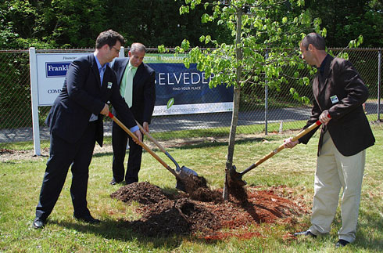
Transforming the Pain of Vicarious Traumatization
Participate in community
Look for and create
meaning
Challenge negative
beliefs and thoughts
Focus on the present and
look for strengths
Nurture your hope
Notes:
Managing Vicarious Trauma
Review the slide using the information below.
Ask: What else can you do?
Module Seven: Noticing our Reactions and Vicarious Trauma
90 minutes
Welcome/Introduction: Slides 170-171 (10 minutes)
Noticing Your Reactions: Slides 172-179 (35 minutes)
Introduction to Vicarious Trauma: Slides 180-186 (20 minutes)
Managing Vicarious Trauma: Slides 187-193 (10 minutes)
Building Resilience Against VT: Slides 194-195 (15 minutes)
Closing: Slide 196 (5 minutes)
SLIDE 193

Slide 194
Building Resilience Against VT
Resilience is successful adaptation in the face of biological challenges and stressful life events. (adapted from Werner, 1992)
  Ability to bounce back from a challenge
  Ability to endure during challenges
  Ability to learn and make meaning out of a challenge (post-traumatic growth)
    (Devereux Center for Resilient Children, Devereux Foundation)
Notes:
Building Resilience Against VT
Review the slide using the information below.
There is a lot of focus now in human services about proactively building resilience to help people manage adversity and stress rather than just treating it after it happens.
Resilience refers to how you adapt to difficult situations like innate biological challenges (disability, illness, few economic resources) AND situational challenges such as accidents, family death, crisis at work, etc.
Resilience pertains to these qualities:
How you bounce back.
How you endure in the face of a challenge – sometimes called “grit” or “stick-to-it-ness.”
How you learn from or make meaning out of a challenge –you may even become better as the result of a challenge.
There is now a term for people or communities that endure trauma and grow as people as a result. It is called “post-traumatic growth.” The parallel for treaters is the concept of vicarious transformation that we were just discussing.
Module Seven: Noticing our Reactions and Vicarious Trauma
90 minutes
Welcome/Introduction: Slides 170-171 (10 minutes)
Noticing Your Reactions: Slides 172-179 (35 minutes)
Introduction to Vicarious Trauma: Slides 180-186 (20 minutes)
Managing Vicarious Trauma: Slides 187-193 (10 minutes)
Building Resilience Against VT: Slides 194-195 (15 minutes)
Closing: Slide 196 (5 minutes)
SLIDE 194

Slide 195
Your Turn!
Worksheet: 10 Characteristics of a Resilient Person
Notes:
Building Resilience Against VT
Exercise: 10 Characteristics of a Resilient Treater
Pass out Worksheet: 10 Characteristics of a Resilient Foster Parent and ask participants to complete the form individually.
In pairs, ask them to discuss what they wrote about the 2 highest scored items and the 2 lowest scored items.
Discuss with large group:
What did you discover about how people acquired or learned these characteristics?
To what extent has your resilience changed over time?
What ideas did you have about how you could build resilience as a foster parent and person?
Module Seven: Noticing our Reactions and Vicarious Trauma
90 minutes
Welcome/Introduction: Slides 170-171 (10 minutes)
Noticing Your Reactions: Slides 172-179 (35 minutes)
Introduction to Vicarious Trauma: Slides 180-186 (20 minutes)
Managing Vicarious Trauma: Slides 187-193 (10 minutes)
Building Resilience Against VT: Slides 194-195 (15 minutes)
Closing: Slide 196 (5 minutes)
SLIDE 195

Slide 196
Closing Activity
Notes:
Closing
Ask participants to say one thing they learned or take-away from today’s session.
Give each person a chance to answer.
Module Seven: Noticing our Reactions and Vicarious Trauma
90 minutes
Welcome/Introduction: Slides 170-171 (10 minutes)
Noticing Your Reactions: Slides 172-179 (35 minutes)
Introduction to Vicarious Trauma: Slides 180-186 (20 minutes)
Managing Vicarious Trauma: Slides 187-193 (10 minutes)
Building Resilience Against VT: Slides 194-195 (15 minutes)
Closing: Slide 196 (5 minutes)
SLIDE 196

Slide 197
Module Eight Restorative Approach
Notes:
Welcome/Introduction
Materials
Module Eight PowerPoint Slides
White Board or Newsprint and Markers
Agenda Written on Newsprint and Posted
Participants packet for Module Eight
Participant PowerPoint Slides
“Worksheet: Making Amends to Restore Relationships at Home”
“Handout: Restorative Tasks for Making Amends”
“Handout: Trauma-Informed Behavior Management in Foster Care”
Training Evaluation
Objectives
Participants will:
Recognize the difference between the traditional versus the restorative approach when addressing the behaviors of children with trauma histories.
Understand the conditions needed to help youth change, including safety and skill building.
Identify ways to help children and youth make amends after they have hurt someone.
Introduce the concept of “Treaters.” The term used throughout the modules to describe everyone who interacts with the child to heal their wounds. We all can have a positive therapeutic impact on the children and youth we work with, not just clinical staff.
Time for Module
90 minutes
Module Eight: Restorative Approach
90 Minutes
Welcome/Introduction: Slides 197-198 (5 minutes)
Your Turn! My Teenage Experience: Slide 199 (10 minutes)
Definition and Assumptions: Slides 200-206 (15 minutes)
What Helps Kids Change?: Slides 207-213 (15 minutes)
Responding After a Child Hurts Others: Slides 214-216 (10 minutes)
Restorative Process: Making Amends: Slides 217-221 (20 minutes)
Training Evaluation: Slide 222
(10 minutes)
Closing: Slide 223 (5 minutes)
SLIDE 197

Slide 198
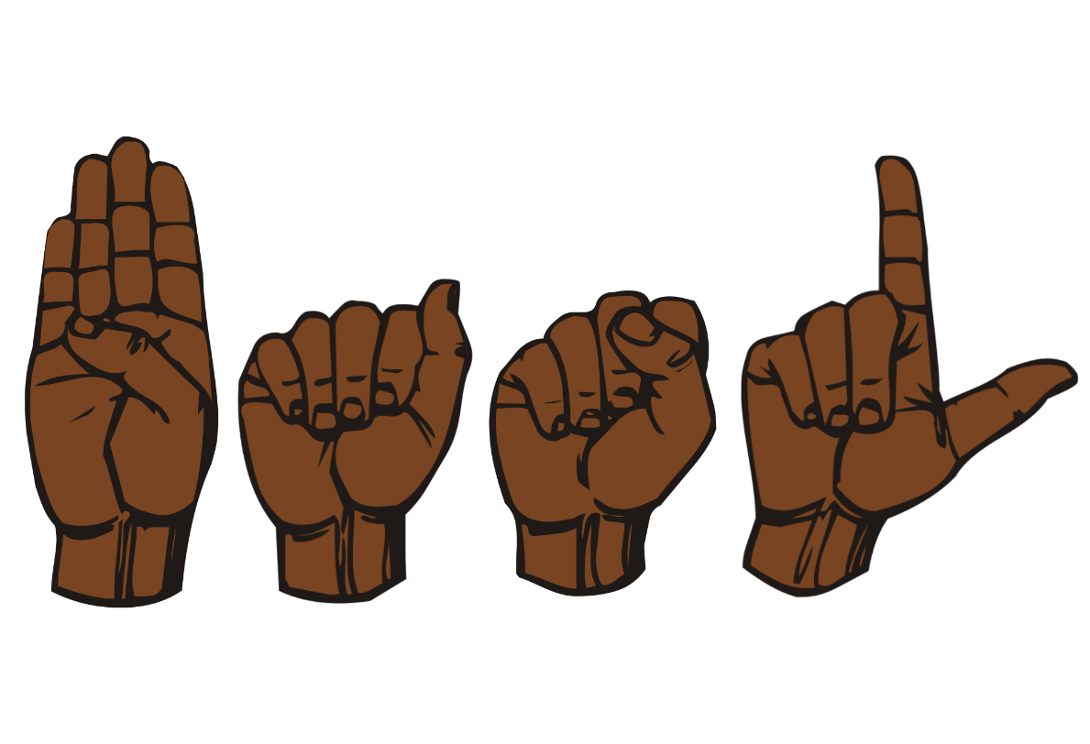
Welcome
Welcome
Introductions
  Name
  Opening Activity
Review Agreements
Agenda
Notes:
Welcome/Introduction
Review the slide above.
Trainers introduce themselves.
Participants introduce themselves and name two words that describe them as an adolescent.
Discuss:
Ask: Do they continue to exhibit behaviors now that would have described them as adolescents?
Ask: Did they have adults in their life who were concerned about their behavior as adolescents?
Ask: Why did you turn out to be productive adults?
Link their responses to the youth we are currently working with.
Points to make: With connection and sincere engagement, these kids can become productive and successful as well.
Review agreements.
Trainer reviews agenda.
Module Eight: Restorative Approach
90 Minutes
Welcome/Introduction: Slides 197-198 (5 minutes)
Your Turn! My Teenage Experience: Slide 199 (10 minutes)
Definition and Assumptions: Slides 200-206 (15 minutes)
What Helps Kids Change?: Slides 207-213 (15 minutes)
Responding After a Child Hurts Others: Slides 214-216 (10 minutes)
Restorative Process: Making Amends: Slides 217-221 (20 minutes)
Training Evaluation: Slide 222
(10 minutes)
Closing: Slide 223 (5 minutes)
SLIDE 198

Slide 199

Your Turn!
My Teenager Exercise
Notes:
Your Turn! My Teenage Experience
Review the slide using the information below.
Write down the name and age of a teenager (yourself, a child, a friend’s child).
Imagine your teenager is hanging out with friends after a school event. Someone throws rocks at the windows. Another begins to spray paint his tag on the wall. “C’mon—have some fun!” they say, inviting your teen to participate.
Ask: What would your teenager do? Say no and leave? Join in? Not sure?
Vote with a show of hands:
Who would say “no” and leave?
Who would join in?
Who doesn’t know for sure what the teen would do?
Ask: What factors in a youth’s life do you think influences whether they would stay or leave?
Possible answers for leaving:
Relationship with someone they don’t want to disappoint.
Interests and involvement in activities, clubs, part time job.
Have been doing well and the adults in his life have noticed and praised him.
Possible answers for staying:
No hope of seeing biological parents as they never show for visits.
Trying to impress new friends.
No outside interests.
No adults invested in him.
Figures he will get grounded anyway so why care.
Say: When trying to change problematic behavior, the very first thing adults often think of is punishment or punitive consequences.
Say: What we are going to talk about in this section is why using mainly punishment is not effective and why it is important to work on building skills in the child so that they don’t have to resort to problem behaviors they’ve used in the past to survive.
Module Eight: Restorative Approach
90 Minutes
Welcome/Introduction: Slides 197-198 (5 minutes)
Your Turn! My Teenage Experience: Slide 199 (10 minutes)
Definition and Assumptions: Slides 200-206 (15 minutes)
What Helps Kids Change?: Slides 207-213 (15 minutes)
Responding After a Child Hurts Others: Slides 214-216 (10 minutes)
Restorative Process: Making Amends: Slides 217-221 (20 minutes)
Training Evaluation: Slide 222
(10 minutes)
Closing: Slide 223 (5 minutes)
SLIDE 199

Slide 200
Definition and Assumptions
Notes:
Definition and Assumptions
Introduce the next section with the information below.
We are now going to look at the definition of Restorative Approach (RA) as well as assumptions.
Module Eight: Restorative Approach
90 Minutes
Welcome/Introduction: Slides 197-198 (5 minutes)
Your Turn! My Teenage Experience: Slide 199 (10 minutes)
Definition and Assumptions: Slides 200-206 (15 minutes)
What Helps Kids Change?: Slides 207-213 (15 minutes)
Responding After a Child Hurts Others: Slides 214-216 (10 minutes)
Restorative Process: Making Amends: Slides 217-221 (20 minutes)
Training Evaluation: Slide 222
(10 minutes)
Closing: Slide 223 (5 minutes)
SLIDE 200

Slide 201
What is the Restorative Approach?
A blueprint for what to do to make your home more trauma-informed
A method to increase the healing power of the daily moments in your home
A system for responding when children hurt others (not minor behaviors)
An alternative to traditional approaches to discipline focused mostly on behavior plans and punishment
Notes:
Definition and Assumptions
Review the slide using the information below.
Emphasize that RA is a way to put trauma-informed care into day-to-day interactions.
It is an alternative to methods of discipline that focus on behavior plans and mostly use punishment to control children’s difficult behavior.
It addresses big behaviors when children hurt others or destroy property. It stresses that minor behaviors should be addressed by redirecting the child or ignoring the smaller behaviors, looking for every chance to praise and reward positive behaviors, even small ones.
Module Eight: Restorative Approach
90 Minutes
Welcome/Introduction: Slides 197-198 (5 minutes)
Your Turn! My Teenage Experience: Slide 199 (10 minutes)
Definition and Assumptions: Slides 200-206 (15 minutes)
What Helps Kids Change?: Slides 207-213 (15 minutes)
Responding After a Child Hurts Others: Slides 214-216 (10 minutes)
Restorative Process: Making Amends: Slides 217-221 (20 minutes)
Training Evaluation: Slide 222
(10 minutes)
Closing: Slide 223 (5 minutes)
SLIDE 201

Slide 202


Assumptions
Traditional vs. Trauma (RA)-Informed
Traditional Model
Restorative Approach
Consequences are essential to changing behavior.
Consequences may increase motivation. Healing relationships change behavior.
Notes:
Definition and Assumptions
Review the slide using the information below.
Traditional Model
Children are less likely to act badly because of fear of punishment.
RA Approach
Children are less likely to act badly when they care about pleasing adults they are close to.
Youth learn new behaviors within relationships.
When children feel seen, that they are cared about, and that they belong, they have less need for extreme behaviors.
Module Eight: Restorative Approach
90 Minutes
Welcome/Introduction: Slides 197-198 (5 minutes)
Your Turn! My Teenage Experience: Slide 199 (10 minutes)
Definition and Assumptions: Slides 200-206 (15 minutes)
What Helps Kids Change?: Slides 207-213 (15 minutes)
Responding After a Child Hurts Others: Slides 214-216 (10 minutes)
Restorative Process: Making Amends: Slides 217-221 (20 minutes)
Training Evaluation: Slide 222
(10 minutes)
Closing: Slide 223 (5 minutes)
SLIDE 202

Slide 203


Assumptions
Traditional vs. Trauma (RA)-Informed
Traditional Model
Restorative Approach
Things children want must be earned through good behavior.
Provide fun and positive activities, soothing toys, and inclusion always -- not just when the child is being “good.”
Notes:
Definition and Assumptions
Review the slide using the information below.
Traditional Model
Things children want must be earned through good behavior.
Rewards and punishments are what make youth behave better.
RA Approach
Children should get nice things, enjoy fun things, and be included in activities as a given. These things don’t need to always be earned to happen.
Inclusion in group activities helps youth feel connected and safe and thus decrease negative behaviors.
Activities help children learn skills and become part of the community.
Module Eight: Restorative Approach
90 Minutes
Welcome/Introduction: Slides 197-198 (5 minutes)
Your Turn! My Teenage Experience: Slide 199 (10 minutes)
Definition and Assumptions: Slides 200-206 (15 minutes)
What Helps Kids Change?: Slides 207-213 (15 minutes)
Responding After a Child Hurts Others: Slides 214-216 (10 minutes)
Restorative Process: Making Amends: Slides 217-221 (20 minutes)
Training Evaluation: Slide 222
(10 minutes)
Closing: Slide 223 (5 minutes)
SLIDE 203

Slide 204


Assumptions
Traditional vs. Trauma (RA)-Informed
Restorative Approach
Traditional Model
If we acknowledge behavior is adaptive, we’re saying it’s ok and not holding them accountable.
Understanding how behavior is adaptive (not excusing it) helps parents figure out effective ways to change it.
Notes:
Definition and Assumptions
Review the slide using the information below.
Traditional Model
Remember trauma-informed care stresses that problem behavior meets a need, it helps the child in some way in the moment, although it has negative long-term consequences. Some people think that this means we are excusing the behavior and saying it is ok.
They tend to stress not letting the kids get one over on you and children needing real world consequences!
RA Approach
RA Approach holds that understanding how the behavior meets a need is NOT excusing it.
Understanding what needs a child is trying to meet gives us more opportunity to help them learn new ways to meet them.
Looking at symptoms as adaptations provides the child with an opportunity to learn skills and make amends in a “real world” way.
Module Eight: Restorative Approach
90 Minutes
Welcome/Introduction: Slides 197-198 (5 minutes)
Your Turn! My Teenage Experience: Slide 199 (10 minutes)
Definition and Assumptions: Slides 200-206 (15 minutes)
What Helps Kids Change?: Slides 207-213 (15 minutes)
Responding After a Child Hurts Others: Slides 214-216 (10 minutes)
Restorative Process: Making Amends: Slides 217-221 (20 minutes)
Training Evaluation: Slide 222
(10 minutes)
Closing: Slide 223 (5 minutes)
SLIDE 204

Slide 205


Assumptions
Traditional vs. Trauma (RA)-Informed
Traditional Model
Restorative Approach
If children feel shame about bad behavior, it will motivate them to change
Children already feel great shame. Shame does not change behavior. It often makes behavior worse.
Notes:
Definition and Assumptions
Review the slide above using the information below.
Traditional Model
Feeling shame feels bad so, if we make them feel shame they will want to behave better
RA Approach
Our children already feel great shame, feel that they have no worth, and that no one could care for them. They blame themselves for everything that has happened to them.
Children are less likely to act badly when they care about pleasing adults they are close to.
Looking at symptoms as adaptations provides the child with an opportunity to learn skills and make amends in a “real world” way.
Module Eight: Restorative Approach
90 Minutes
Welcome/Introduction: Slides 197-198 (5 minutes)
Your Turn! My Teenage Experience: Slide 199 (10 minutes)
Definition and Assumptions: Slides 200-206 (15 minutes)
What Helps Kids Change?: Slides 207-213 (15 minutes)
Responding After a Child Hurts Others: Slides 214-216 (10 minutes)
Restorative Process: Making Amends: Slides 217-221 (20 minutes)
Training Evaluation: Slide 222
(10 minutes)
Closing: Slide 223 (5 minutes)
SLIDE 205

Slide 206
Your Turn: Dahlia and the Milk
It’s a school day and Dahlia is sluggish and half awake. She scatters cereal all over the kitchen counter and leaves the milk out when she goes over to the table to eat. Mary, her foster mother, comes into the kitchen and sees the mess on the counter she just cleaned.
  From a traditional model, what is Mary thinking and what does she say?
  From a trauma (RA)-informed model, what is Mary thinking and what does she say?
Notes:
Definition and Assumptions
Exercise: Dahlia and the Milk
Ask participants to break into pairs with the person sitting next to them.
Read the paragraph aloud.
Say: Think about the Traditional Model and the Restorative Approach slides.
Ask participants to write down answers to the 2 questions on the slide. Pairs should actually write down Mary’s thoughts and a quote of what she says in response to Dahlia.
Ask a number of pairs to read what they wrote down to the first question, and then to the second question.
Discuss:
To what extent did they hear echoes of what is said in their homes – both from the Traditional and Restorative Approach side?
What is appealing about managing behavior using a Traditional model? What’s appealing about a model like the Restorative Approach?
If a home is using or moving toward a Restorative Approach, what kinds of things might contribute to a drift back to a traditional model?
Module Eight: Restorative Approach
90 Minutes
Welcome/Introduction: Slides 197-198 (5 minutes)
Your Turn! My Teenage Experience: Slide 199 (10 minutes)
Definition and Assumptions: Slides 200-206 (15 minutes)
What Helps Kids Change?: Slides 207-213 (15 minutes)
Responding After a Child Hurts Others: Slides 214-216 (10 minutes)
Restorative Process: Making Amends: Slides 217-221 (20 minutes)
Training Evaluation: Slide 222
(10 minutes)
Closing: Slide 223 (5 minutes)
SLIDE 206

Slide 207
What Helps Kids Change?
Notes:
What Helps Kids Change?
Introduce the next section using the information below.
SAY: So we have a sense of what causes children to become destructive towards themselves or others. Let’s look at how we can help them have the option to respond differently.
Module Eight: Restorative Approach
90 Minutes
Welcome/Introduction: Slides 197-198 (5 minutes)
Your Turn! My Teenage Experience: Slide 199 (10 minutes)
Definition and Assumptions: Slides 200-206 (15 minutes)
What Helps Kids Change?: Slides 207-213 (15 minutes)
Responding After a Child Hurts Others: Slides 214-216 (10 minutes)
Restorative Process: Making Amends: Slides 217-221 (20 minutes)
Training Evaluation: Slide 222
(10 minutes)
Closing: Slide 223 (5 minutes)
SLIDE 207

Slide 208
Kids Need Relationships
Relationships:
Build brains
Strengthen Feeling Skills
Are practice grounds for new skills
Offer place for “break and repair” cycle
Notes:
What Helps Kids Change?
Review the slide using the information below.
Notice that what children need—to feel connected, noticed, appreciated, and safe—involves others.
Kids need relationships. We all need relationships.
Relationships build brains: they cause connections to be made in our brains, no matter how young or old we are. The more connected the parts of our brains are, the more we can use information from our senses, our emotions, and our thinking.
Those same relationships are the “practice ground” for new skills that again help us connect, build brains, and strengthen our feelings skills. They are where we can relate to another person, make mistakes in relationships, and recover from them as well as let others recover.
Possible questions to ask to connect relationships and trust:
What do foster children learn about how trustworthy adults are?
How have adults let them down?
What do foster parents do to make up for that?
Module Eight: Restorative Approach
90 Minutes
Welcome/Introduction: Slides 197-198 (5 minutes)
Your Turn! My Teenage Experience: Slide 199 (10 minutes)
Definition and Assumptions: Slides 200-206 (15 minutes)
What Helps Kids Change?: Slides 207-213 (15 minutes)
Responding After a Child Hurts Others: Slides 214-216 (10 minutes)
Restorative Process: Making Amends: Slides 217-221 (20 minutes)
Training Evaluation: Slide 222
(10 minutes)
Closing: Slide 223 (5 minutes)
SLIDE 208

Slide 209
Kids Need to Be/Feel Safe
Do foster children
know what it means
to feel / be safe?
How do you help
children new to your
home feel safe?
How do you help children with safety during their time in your home?
Notes:
What Helps Kids Change?
Review the slide using the information below.
Danger—threat—is such a powerful experience that when we feel it, it is the only thing we can pay attention to.
If someone came into this room and told us there was a murderer loose in the building, as fascinating as our time together may be, the only thing we could think about would be the fact that there is a murderer loose in the building.
No one can learn when they feel threat or danger. People can only learn when they feel safe.
The challenge for children in foster care is that the homes from which they came—where their biological parents or primary caregivers were—is all they know. To them, they were “safe” and often when we ask them if they feel “safe” they have no frame of reference.
ASK: What might make a child feel unsafe (by our definition) when they are first placed in your home?
Possible answers:
Not knowing the stated rules and the real rules; no experience with you or with your family; the anxiety of the unknown; maybe being afraid of consequences they will experience if they do what they know to stay safe (however they understand safety); if what they know to do to fit in is exactly what is not OK.
ASK: What can you do at first and on an ongoing basis to help them feel safer?
Possible answers:
Sit with them when they first come in and visit. Show them their room and explain that it is their space, their private area, and the reasons and circumstances under which you will enter it.
Let them know the degree to which they can change it around and offer to help now or later. Avoid information overload.
Tell them how everyone’s privacy is maintained. Avoid the word “safety” which often has double meaning.
Ask them what helps them feel comfortable and what makes them nervous or afraid. Ask them what is helpful when they are upset.
Remember the importance of a creating a crisis prevention and management plan together.
Module Eight: Restorative Approach
90 Minutes
Welcome/Introduction: Slides 197-198 (5 minutes)
Your Turn! My Teenage Experience: Slide 199 (10 minutes)
Definition and Assumptions: Slides 200-206 (15 minutes)
What Helps Kids Change?: Slides 207-213 (15 minutes)
Responding After a Child Hurts Others: Slides 214-216 (10 minutes)
Restorative Process: Making Amends: Slides 217-221 (20 minutes)
Training Evaluation: Slide 222
(10 minutes)
Closing: Slide 223 (5 minutes)
SLIDE 209

Slide 210

Kids Need Skills
Connection: remembering that you care even when you are not there
Self worth: combating shame
Feelings: regulation skills
...And the skill of knowing what to do when you mess up in a relationship.
Notes:
What Helps Kids Change?
Review the slide using the information below.
SAY: These are the basic skills that are needed to keep a child from resorting to more extreme behaviors.
ASK: If something goes wrong in their life, do they have enough of a connection with you to ask for help? What if they are away from you, like at school? Can they think about you and feel comforted, or remember some advice you have given them?
Say: Do they feel worthless and see their current problem to be just one more example of how hopeless and terrible they are? Does the current problem send them into the depths of fear and despair because they see it as a sign of their own badness?
If they start to feel bad do they have any idea how to soothe themselves or get through the feeling without making it worse?
DO: Pause after asking these rhetorical (and real) questions.
Say: Reflection on these is critical, and if foster parents are unable to recognize and foster these skills in their children (and in themselves) it is likely their levels of frustration and distress are likely to be higher and disruptions more frequent. The ideal response is: how do we help children with these?
These are the feelings skills that help everyone survive the difficulties of life.
Module Eight: Restorative Approach
90 Minutes
Welcome/Introduction: Slides 197-198 (5 minutes)
Your Turn! My Teenage Experience: Slide 199 (10 minutes)
Definition and Assumptions: Slides 200-206 (15 minutes)
What Helps Kids Change?: Slides 207-213 (15 minutes)
Responding After a Child Hurts Others: Slides 214-216 (10 minutes)
Restorative Process: Making Amends: Slides 217-221 (20 minutes)
Training Evaluation: Slide 222
(10 minutes)
Closing: Slide 223 (5 minutes)
SLIDE 210

Slide 211
Executive Functioning
Executive function is responsible for a number of skills, including:
Paying attention.
Organizing, planning and prioritizing.
Inhibiting impulses.
Starting tasks and staying focused on them to completion.
Regulating emotions.
Self-monitoring (keeping track of what you're doing and understanding yourself).
Notes:
What Helps Kids Change?
Review the slide above using the information below.
We just looked at how trauma impacts the development of the emotional and thinking part of the brain.
Executive Functioning happens in the thinking part of the brain. Accessing Executive Functioning for our youth is challenging when they spend the majority of their time in their reactive brain—fight, freeze or flee.
Ask: When you look at the list of skills the Executive Function is responsible for, which of these do our youth struggle with?
Possible answers: All of them!
When we think in terms of skills, it is clear that our youth need support in acquiring these skills. For trauma youth, remember the part of their brain that gets the most workout is the reactive part. We need to help them build the muscle of the thinking brain—to access the thinking part of the brain we need to teach them these skills.
Their behavior is adaptive and through our connection with them we can help them acquire the skills necessary to regulate and navigate the world.
Youth develop thinking skills by connecting with adults who model support and teach those skills until the youth can gradually do them on their own.
Module Eight: Restorative Approach
90 Minutes
Welcome/Introduction: Slides 197-198 (5 minutes)
Your Turn! My Teenage Experience: Slide 199 (10 minutes)
Definition and Assumptions: Slides 200-206 (15 minutes)
What Helps Kids Change?: Slides 207-213 (15 minutes)
Responding After a Child Hurts Others: Slides 214-216 (10 minutes)
Restorative Process: Making Amends: Slides 217-221 (20 minutes)
Training Evaluation: Slide 222
(10 minutes)
Closing: Slide 223 (5 minutes)
SLIDE 211

Slide 212

Your Turn!
Punitive Consequences and the Thinking Brain
Notes:
What Helps Kids Change?
Exercise
Ask participants to find a partner.
Tell them this is a 60 second activity.
Once they find a partner—decide who will be A and who will be B. Tell them that both roles are safe, painless and easy!
Ask A’s to raise their hands.
Tell A’s to think of a number between 1-1000.
Tell B’s they have 60 seconds to guess that number starting NOW!
Time the activity but wait until you see at least a few people get excited that they got the number.
8. Ask those who got the number to raise their hands.
Then ask them how they arrived at the number. Many will have used a plan, system,
or method.
Ask the people who did not guess the number if yelling at them, punishing them, isolating them would have helped?
Point out that the participants were able to access their “higher thinking” executive functioning to problem solve.
Our kids have difficulty because they live in their fight, freeze or flee brain. We have to help them access their thinking brain and gain skills to problem solve, plan ahead, regulate, and ask for help. Punishment does not provide them opportunities to learn new skills.
Module Eight: Restorative Approach
90 Minutes
Welcome/Introduction: Slides 197-198 (5 minutes)
Your Turn! My Teenage Experience: Slide 199 (10 minutes)
Definition and Assumptions: Slides 200-206 (15 minutes)
What Helps Kids Change?: Slides 207-213 (15 minutes)
Responding After a Child Hurts Others: Slides 214-216 (10 minutes)
Restorative Process: Making Amends: Slides 217-221 (20 minutes)
Training Evaluation: Slide 222
(10 minutes)
Closing: Slide 223 (5 minutes)
SLIDE 212

Slide 213
When Children Feel Better, They Act Better
The Restorative Approach assumes that when children feel better (as a result of kind interactions) they act better.
Traditional milieus assume that when children feel worse (as a result of punishment) they will act better.
Notes:
What Helps Kids Change?
1. Review the slide above with the information below.
a. We all act better when we are happier
b. Kinder, relaxed
c. What if our job was to help these kids have a happier day?
d. Do we think of our job like this or about keeping control?
Module Eight: Restorative Approach
90 Minutes
Welcome/Introduction: Slides 197-198 (5 minutes)
Your Turn! My Teenage Experience: Slide 199 (10 minutes)
Definition and Assumptions: Slides 200-206 (15 minutes)
What Helps Kids Change?: Slides 207-213 (15 minutes)
Responding After a Child Hurts Others: Slides 214-216 (10 minutes)
Restorative Process: Making Amends: Slides 217-221 (20 minutes)
Training Evaluation: Slide 222
(10 minutes)
Closing: Slide 223 (5 minutes)
SLIDE 213

Slide 214
Responding After a Child Hurts Others
Notes:
Responding After a Child Hurts Others
Introduce the next section using the slide.
Module Eight: Restorative Approach
90 Minutes
Welcome/Introduction: Slides 197-198 (5 minutes)
Your Turn! My Teenage Experience: Slide 199 (10 minutes)
Definition and Assumptions: Slides 200-206 (15 minutes)
What Helps Kids Change?: Slides 207-213 (15 minutes)
Responding After a Child Hurts Others: Slides 214-216 (10 minutes)
Restorative Process: Making Amends: Slides 217-221 (20 minutes)
Training Evaluation: Slide 222
(10 minutes)
Closing: Slide 223 (5 minutes)
SLIDE 214

Slide 215

When a Child Hurts Someone
How will your response help the child learn
how to solve problems without hurting others?
Children need to:
Recognize “small” feelings
Respond before feelings become
too big
Discover feeling/response patterns
Learn how behavior affects relationships
Learn how to fix mistakes
Notes:
Responding After a Child Hurts Others
Review the slide using the information below.
SAY: Our kids have not had much experience with fixing problems within relationships. People they have known have usually just disappeared when there was a problem. They have just been moved to another family. In their families, people have often used violence to solve problems.
So, they are likely to feel hopeless when they have hurt someone and start talking about wanting to leave, to go to the hospital, to go to detention. They begin to focus on what has always happened before, the disruption of relationships. Remember: we believe that developing skills is what helps and that people develop skills within relationships.
The challenge is this: when a child hurts others, how can we respond in a way that will really make that behavior less likely to happen again? Keep in mind that children can’t learn when they are anxious, or when their body’s alarm system is activated.
The analogy in some ways is like learning a new sport and pursuing a championship: there’s a lot of practice that needs to happen that is tested all along the way. Children must develop these skills, practice them, and also learn and manage feelings when they are tolerable.
Helping children make amends after big, intolerable feelings results in injury to others is a powerful tool. It is a practical and useful way to help them counter the tendency to rely on old, less helpful patterns. It is beneficial to everyone involved and lends to practices the entire family can adopt in situations of far lesser significance than injury to others.
Module Eight: Restorative Approach
90 Minutes
Welcome/Introduction: Slides 197-198 (5 minutes)
Your Turn! My Teenage Experience: Slide 199 (10 minutes)
Definition and Assumptions: Slides 200-206 (15 minutes)
What Helps Kids Change?: Slides 207-213 (15 minutes)
Responding After a Child Hurts Others: Slides 214-216 (10 minutes)
Restorative Process: Making Amends: Slides 217-221 (20 minutes)
Training Evaluation: Slide 222
(10 minutes)
Closing: Slide 223 (5 minutes)
SLIDE 215

Slide 216

How Does Change Happen?
Think of a time in your life in which you successfully made a change (lost weight, stopped smoking, started exercising, did something else in a new way)
What made it hard?
What made it possible?
Notes:
Responding After a Child Hurts Others
Ask participants to think about the questions on the slide above.
What started their change effort?
What factors made it possible to make the change at that time?
What helped?
Ask about the role of other people and relationships in making the change.
Ask about some examples: If you are on a diet does it help to have another person remind you of it? If you go to a restaurant and bread is placed on the table, what is helpful for your companion to do? If you mess up and over eat, what response do you want from another?
Note that different people want different kinds of support. What did you feel about having made this change?
b. Ask: How can you relate these insights to the kids making changes?
c. Ask: What are some of the barriers to change?
Routine.
What others think.
Nothing around you will change—won’t matter.
You like the way it is.
Afraid of unknown.
d. Ask: What are some things that help you change?
Life changing events.
Tired of being miserable.
Baby steps.
Knowledge.
Support of others without judgement.
e. Ask: What kind of involvement from other people made it possible or impossible to change?
Criticize .
Doing in front of you what you are trying to change.
Invalidating how hard it is.
f. Example: You are on a diet. You are going to dinner with a friend. What would make it easier—what can they do to
make it possible to meet your goal? They come with a loaf of bread—what do you need from the person you
are with to make it easier for you?
Turning bread away/Asking what the person would prefer/Do nothing
What if you blew it and ate the bread? What would be helpful for you? What if you ate low cal things?
Some people like to be praised—some not
Later as you were losing weight—what would you need?
g. So if we look at this—what do we learn?
People like different things.
People don’t like others telling them what to do, yet that is what we do with our youth.
And then, if they don’t do it or succeed, we punish!
Module Eight: Restorative Approach
90 Minutes
Welcome/Introduction: Slides 197-198 (5 minutes)
Your Turn! My Teenage Experience: Slide 199 (10 minutes)
Definition and Assumptions: Slides 200-206 (15 minutes)
What Helps Kids Change?: Slides 207-213 (15 minutes)
Responding After a Child Hurts Others: Slides 214-216 (10 minutes)
Restorative Process: Making Amends: Slides 217-221 (20 minutes)
Training Evaluation: Slide 222
(10 minutes)
Closing: Slide 223 (5 minutes)
SLIDE 216

Slide 217
Restorative Processes:
Making Amends
Notes:
Restorative Process: Making Amends
Introduce the next section using the slide.
Here is where we actually help the child repair the relationship after it has been damaged.
Module Eight: Restorative Approach
90 Minutes
Welcome/Introduction: Slides 197-198 (5 minutes)
Your Turn! My Teenage Experience: Slide 199 (10 minutes)
Definition and Assumptions: Slides 200-206 (15 minutes)
What Helps Kids Change?: Slides 207-213 (15 minutes)
Responding After a Child Hurts Others: Slides 214-216 (10 minutes)
Restorative Process: Making Amends: Slides 217-221 (20 minutes)
Training Evaluation: Slide 222
(10 minutes)
Closing: Slide 223 (5 minutes)
SLIDE 217

Slide 218

Use of Restorative Tasks
Restorative tasks:
Make amends
Based on understanding the child’s behavior as a solution to some problem
Offer healing
Build skills
Notes:
Restorative Process: Making Amends
Review the slide using the information below.
The approach to a child who hurt others should start with an understanding of the behavior. What needs was the child trying to meet?
Our youth have had a lot of experience with ruptures or breaks in relationships. They have had little experience with repairing relationships. Making amends helps them learn how to fix problems in relationships.
Traditional punishment leaves youth feeling more shame, more self-loathing, and thus more likely to act out. Making amends leaves them with some hope.
Module Eight: Restorative Approach
90 Minutes
Welcome/Introduction: Slides 197-198 (5 minutes)
Your Turn! My Teenage Experience: Slide 199 (10 minutes)
Definition and Assumptions: Slides 200-206 (15 minutes)
What Helps Kids Change?: Slides 207-213 (15 minutes)
Responding After a Child Hurts Others: Slides 214-216 (10 minutes)
Restorative Process: Making Amends: Slides 217-221 (20 minutes)
Training Evaluation: Slide 222
(10 minutes)
Closing: Slide 223 (5 minutes)
SLIDE 218

Slide 219

Making Amends
Who was hurt by the child’s behavior? Whose life was made more difficult?
What can the child do about it to repair the harm or make the harmed person’s life easier?
Who will be your champion to make sure your requests aren’t punitive (instead of restorative)?
Notes:
Restorative Process: Making Amends
Review the slide using the information below.
The first question explores who was hurt, inconvenienced, upset or insulted. This could be an individual person or a group of people like a whole family or a classroom.
The second question helps you go back to your working theory about this child --what challenges, themes, deficits were revealed by the child’s behavior. If possible, the task should relate to these themes.
Ideally, the child would repair the harm he did -i.e., if he punched a hole in a wall, he should fix it. Often this is not possible. So for example, instead can he do something nice for the maintenance person who did fix it?
Module Eight: Restorative Approach
90 Minutes
Welcome/Introduction: Slides 197-198 (5 minutes)
Your Turn! My Teenage Experience: Slide 199 (10 minutes)
Definition and Assumptions: Slides 200-206 (15 minutes)
What Helps Kids Change?: Slides 207-213 (15 minutes)
Responding After a Child Hurts Others: Slides 214-216 (10 minutes)
Restorative Process: Making Amends: Slides 217-221 (20 minutes)
Training Evaluation: Slide 222
(10 minutes)
Closing: Slide 223 (5 minutes)
SLIDE 219

Slide 220
Your Turn!
Exercise: Making Amends to Restore Relationships at Home
Notes:
Restorative Process: Making Amends
Direct participants to the Worksheet: “Making Amends to Restore Relationships at Home” and Handout: “Restorative Tasks for Making Amends.”
Ask participants to divide into small groups.
One person describe a recent incident in which a foster child did something that hurt others.
As a group, complete the Worksheet: “Making Amends to Restore Relationships at Home” using the Handout: “Restorative Tasks for Making Amends” to generate ideas for how the child could make amends to the people he or she hurt.
Discuss answers as a large group.
Module Eight: Restorative Approach
90 Minutes
Welcome/Introduction: Slides 197-198 (5 minutes)
Your Turn! My Teenage Experience: Slide 199 (10 minutes)
Definition and Assumptions: Slides 200-206 (15 minutes)
What Helps Kids Change?: Slides 207-213 (15 minutes)
Responding After a Child Hurts Others: Slides 214-216 (10 minutes)
Restorative Process: Making Amends: Slides 217-221 (20 minutes)
Training Evaluation: Slide 222
(10 minutes)
Closing: Slide 223 (5 minutes)
SLIDE 220

Slide 221

The Challenge: What If…
..The child refuses to
make amends?
Notes:
Restorative Process: Making Amends
Review the slide using the information below.
No one can make a child do a poster, bake cookies for someone, talk over a problem, or do chores.
Structural supports can be put in place to encourage the child to do the tasks. If a child has an outstanding task, he may have to go to bed early to get more energy for the task. She cannot go on extra trips because she has not re-connected with the family yet.
It is essential not to engage in power struggles around tasks. The parent’s attitude is, “It’s fine if you are not ready. Sometimes it takes time to become ready to work through a problem. I have confidence that you will get there, and I will be here ready to work it through with you when you are ready. In the meantime, we need to keep a closer eye on you and keep you near us, because we have not rebuilt trust between us.”
It is important to remember the reason for the task. The task is not punishment by another name. It is not designed to be difficult, to be a deterrent, to be arduous or unpleasant. The task is genuinely designed to be a vehicle of reconciliation and reconnection. People who have done something wrong or made a mistake want to make things right. Often in children who have experienced repeated trauma and attachment disruption, this impulse is blocked by a feeling that it is impossible to correct mistakes. The parent’s job is to gently challenge that assumption, provide a step-by-step method for fixing mistakes, and to patiently and eagerly await the child’s readiness to engage in the process with them.
Remind participants of the Handout: Behavior Management in Foster Care.
Module Eight: Restorative Approach
90 Minutes
Welcome/Introduction: Slides 197-198 (5 minutes)
Your Turn! My Teenage Experience: Slide 199 (10 minutes)
Definition and Assumptions: Slides 200-206 (15 minutes)
What Helps Kids Change?: Slides 207-213 (15 minutes)
Responding After a Child Hurts Others: Slides 214-216 (10 minutes)
Restorative Process: Making Amends: Slides 217-221 (20 minutes)
Training Evaluation: Slide 222
(10 minutes)
Closing: Slide 223 (5 minutes)
SLIDE 221

Slide 222
Your Turn!
Training Evaluation
Notes:
Training Evaluation
Please ask participants to complete the training evaluation and turn them in before they leave.
Module Eight: Restorative Approach
90 Minutes
Welcome/Introduction: Slides 197-198 (5 minutes)
Your Turn! My Teenage Experience: Slide 199 (10 minutes)
Definition and Assumptions: Slides 200-206 (15 minutes)
What Helps Kids Change?: Slides 207-213 (15 minutes)
Responding After a Child Hurts Others: Slides 214-216 (10 minutes)
Restorative Process: Making Amends: Slides 217-221 (20 minutes)
Training Evaluation: Slide 222
(10 minutes)
Closing: Slide 223 (5 minutes)
SLIDE 222

Slide 223
Closing Activity
Notes:
Closing
Closing Reflection
Distribute paper to participants.
Ask participants in closing to write down an act of kindness they’ve either extended or received.
Ask: How did that act of kindness impact them?
Collect the statements on paper.
Randomly pass out the statements to different individuals so that everyone has someone else's statement. Have them read the statements to the group.
Module Eight: Restorative Approach
90 Minutes
Welcome/Introduction: Slides 197-198 (5 minutes)
Your Turn! My Teenage Experience: Slide 199 (10 minutes)
Definition and Assumptions: Slides 200-206 (15 minutes)
What Helps Kids Change?: Slides 207-213 (15 minutes)
Responding After a Child Hurts Others: Slides 214-216 (10 minutes)
Restorative Process: Making Amends: Slides 217-221 (20 minutes)
Training Evaluation: Slide 222
(10 minutes)
Closing: Slide 223 (5 minutes)
SLIDE 223

