Slide 1
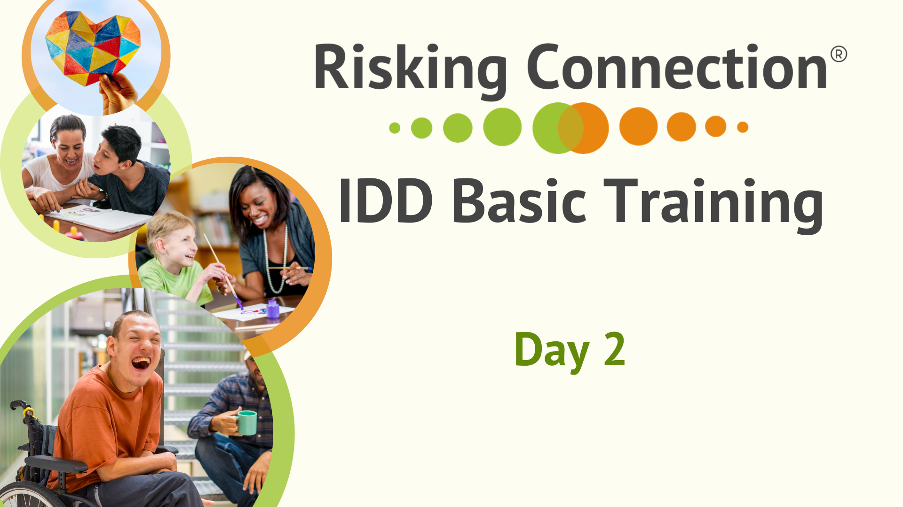
Notes:
RC IDD Basic Manual: Day 2, Slide 108
9:00-9:20 Introduction (Slides 108-109)
No notes.

Slide 2
Introduction
Notes:
Summarize feedback from Day 1 with participants. Point out changes you were able to make as result of the feedback (if any).
Review the Day 2 agenda written on easel paper and post it.
Refer to the community agreements that are posted and ask, how did we do yesterday with these agreements? Would anyone like to suggest any additional agreements?
Explain that in the go-around today you are asking people to share their name, job role, and some FACTOID ABOUT THEMSELVES – something others may not know about you – an interest, a passion, a skill, something from childhood, etc.
Trainers begin to model the type of factoid you are seeking and length of the factoid story. Be sure to make your factoid brief so that participants will also be brief.
RC IDD Basic Manual: Day 2, Slide 109
9:00-9:20 Introduction (Slides 108-109)

Slide 3
Strengthening Domains of the Trauma Framework
Notes:
RC IDD Basic Manual: Day 2, Slide 110
9:20-9:25 Strengthening Domains Overview Slides (110-112)
No notes.

Slide 4
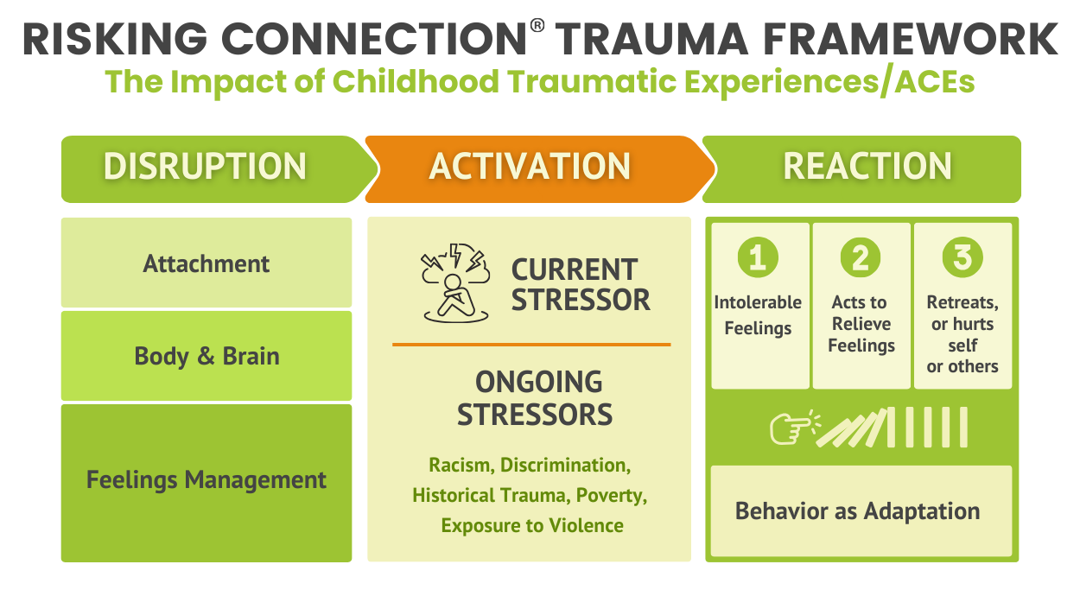
111
Notes:
On Day 1, we used the Trauma Framework to discuss the impact of ACEs and trauma on three domains – attachment, the body and brain, and feelings management. When there are vulnerabilities or problems in these areas, stressors feel intolerable which often leads to the extreme behaviors we so often see in people we support.
And, remember, we tend to spend way too much time at the “Reaction” end of the Framework, trying to stop behaviors when individuals are already dysregulated.
We need to spend much more time at the “Disruption” end of the Framework, strengthening these areas when the individuals are well-regulated during the normal day-to-day of programs.
In the next several sections, we’re going to talk about how to do that.
RC IDD Basic Manual: Day 2, Slide 111
9:20-9:25 Strengthening Domains Overview Slides 110-112)

Slide 5
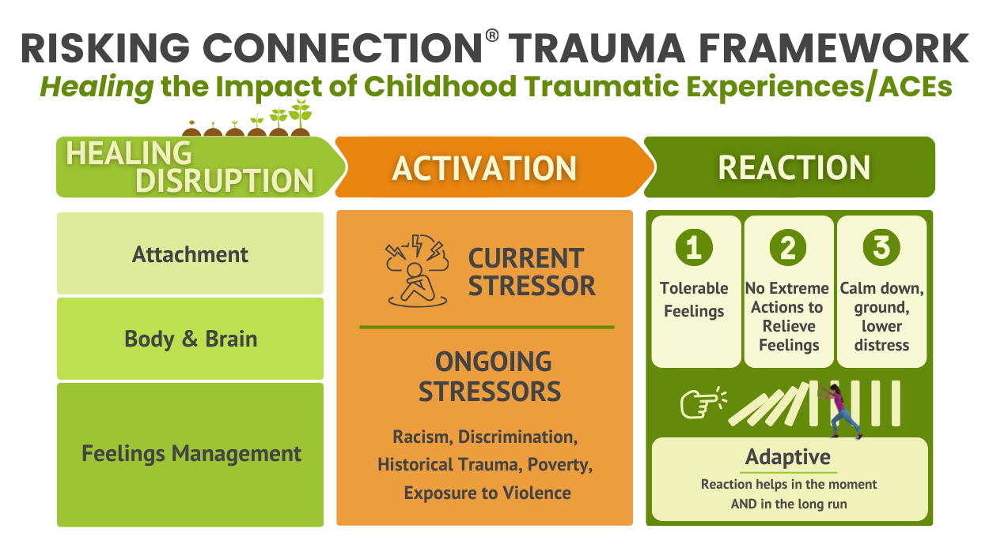
112
Notes:
RC IDD Basic Manual: Day 2, Slide 112
Over time, we want to see the previous Framework change to look more like this.
When healing of the disruptions and impairments start to happen, people we support begin to trust that others can help (attachment). The neural pathways in their brain increase so the nervous system becomes more regulated (body and brain), and they have learned and practiced more feelings management skills.
Then, when current stressors happen, they are more tolerable and people don’t need extreme behaviors to manage, and they can calm down and ground themselves. Their behavior shifts to being adaptive both in the moment and long term – without negative consequences. This makes life feel like it’s more worth living.
9:20-9:25 Strengthening Domains Overview Slides 110-112)

Slide 6
Strengthening Attachment:
The Power of Healing Relationships
Notes:
RC IDD Basic Manual: Day 2, Slide 113
9:25-9:35 Strengthening Attachment (Slides 113-120)
No notes.

Slide 7
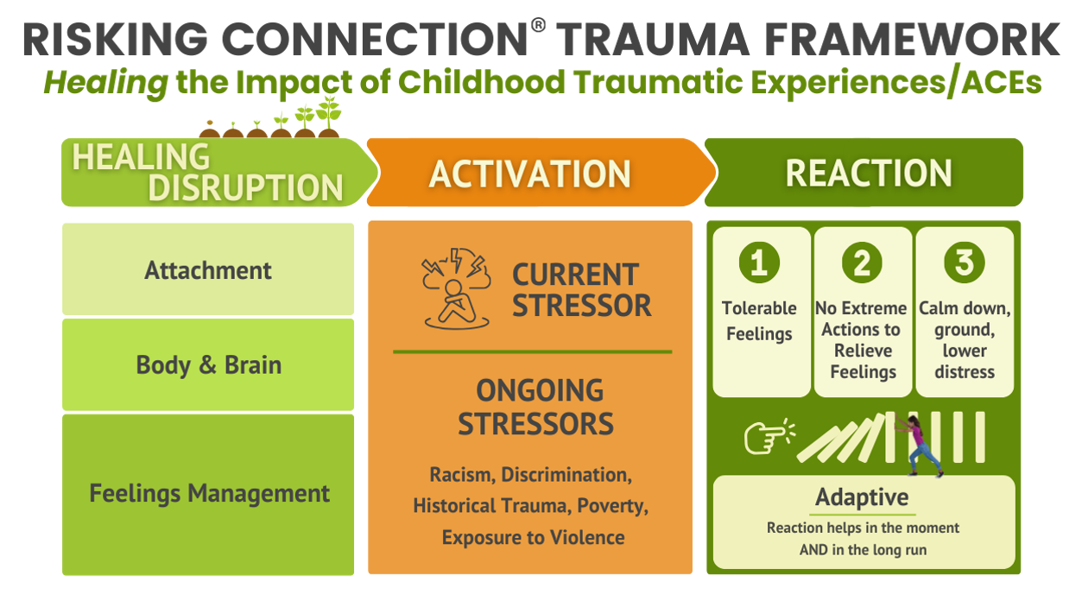
114
Notes:
Healing disrupted attachment is done primarily through helping the people we support feel like they can trust and rely on others.
This can be done through developing healing relationships between support professionals and those they support.
But, as or more importantly, we want to help people build permanent connections with others – not just those that are paid to support and care for them.
RC IDD Basic Manual: Day 2, Slide 114
9:25-9:35 Strengthening Attachment (Slides 113-120)

Slide 8

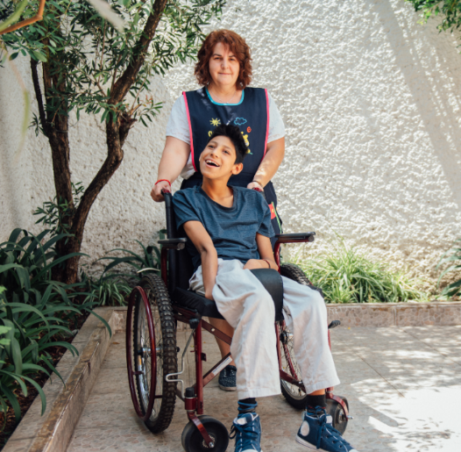
Healing Relationships (with Support Professionals)
The relationship is your major healing tool
Your interaction can be healing
whether the contact is one-time
or long-term, frequent
or infrequent
Without a relationship, behavior support
plans are less effective.
Notes:
RC IDD Basic Manual: Day 2, Slide 115
Since the relationship is the primary agent of change, building and sustaining the relationship is essential.
Give examples of times a support professional was able to diffuse a situation because they had a relationship with the person.
Emphasize that because the person has been hurt within relationships, a critical source of healing is through relationships.
For people with higher support needs, connection doesn’t require words. It requires consistency, predictability, and attunement. Connection is built through rhythm, ritual, and sensory-based interaction – not conversation.
Helping build a person’s connection to their culture and history, especially for those whose ties to their history have been cut off, also strengthens attachment.
Racial bias can be a barrier to support professional’s relationships with those they support. For example, it could lead to a support professional over-reacting out of fear to a large Black man they support.
Racism experienced by people of color often lead them to come into relationships distrusting White people in authority. This is adaptive and White staff need to expect this and work to build trust.
Techniques such as Trauma-focused Cognitive Behavior Therapy (TF-CBT), Dialectical Behavior Therapy (DBT), and others generally don’t work without a relationship.
9:25-9:35 Strengthening Attachment (Slides 113-120)

Slide 9
Healing Relationships (with Others in the Person’s Life)
Friends, family, romantic partners, community members, community organizations, etc.
Building trust with support professionals helps them trust more permanent connections
Avoid overdependence on support professional
Tolerate risk of people connecting to others in community
Notes:
People with IDD and their families can come to feel like people only connect with them because they are paid to do so. For many, paid workers are the only connections they have.
Parents and families of people with IDD often feel isolated and overwhelmed. Connecting them with community resources, other parents in their situation, and mental and physical health care is critically important.
Helping people form more permanent connections increases their web of support, helps them feel integrated into the community, and helps them feel less alone and despairing when support professionals leave.
Support professionals often feel very protective of those they support because of their vulnerability. It can be easy to slip into being overprotective, not allowing or not supporting people to take the risk of forming connections in the community. Programs often tell staff, “This person is vulnerable so we want to make sure we prevent bad things from happening.” This “better safe than sorry” stance does not allow people to take risks and make mistakes when practicing forming relationships.
RC IDD Basic Manual: Day 2, Slide 116
9:25-9:35 Strengthening Attachment (Slides 113-120)

Slide 10



Why is a Healing Relationship So Important?
It contradicts traumatized persons’ basic assumptions about relationships
It rewires brain pathways
It decreases a person’s stigma and isolation
Notes:
RC IDD Basic Manual: Day 2, Slide 117
People with trauma histories form early expectations of what the world and other people are like based on what their early experiences are. This patterning is what they continue to expect – and often experience from – the world.
Give an example of how someone expecting to be treated badly could draw that response from others. For example, if one expects to be treated poorly by the world, they might be withdrawn or aggressive to defend themself. They send a message to others to stay away which makes them feel more alone.
Our job is to provide new and different experiences in which people are helpful, safe, and trustworthy so that those early expectations/patterns can change.
Brain PET scans now show us that repetitive, healthy interactions with support professionals and others can literally change the connections in peoples' brains. Remember the analogy of positive relationships carving out a network of new paths in the woods – these are new neural connections in peoples’ brains.
People will often say that what was worse than the abuse itself was the fact that they were all alone with the trauma, that they couldn’t tell anyone, and felt like they were the only one. The stigma of disability is compounded by having this “bad” and secret thing happen to them. Remember also that people with IDD who are ALSO from another or multiple marginalized groups (person of color, LGBTQ+, immigrant or refugee), may feel even more isolated and cut off from helping others.
9:25-9:35 Strengthening Attachment (Slides 113-120)

Slide 11
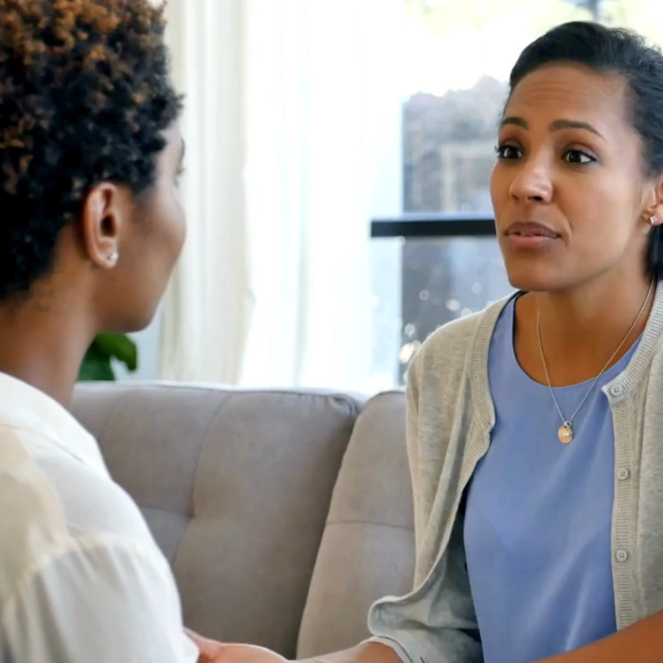
Why is a Healing Relationship So Important?
People with trauma/ACE histories can learn that the present is different from the past
It is the support professional’s most important source of influence
People can learn about Rupture and Repair.
Inevitable breaks in relationships can be repaired.
Notes:
RC IDD Basic Manual: Day 2, Slide 118
We acknowledge that the present is influenced by the past. But, the present doesn’t need to dictate the past. Our relationships give hope that the present can differ from the past.
If a person cares what you think about them, if they care that you’ll be disappointed, if they know you’ll be proud of them – then your close connection supports the person’s behavior change. It makes all aspects of your job easier and the experience of the person supported richer.
We all pay more attention to what someone says when we like them.
When a person is upset, if you know them well, you’ll have a better understanding about what they are going through and what provides them with hope.
It can be a challenge to form relationships with people of IDD because they may not always “give back” the way a neurotypical person does. On top of that, if a person has a trauma history, they may push away more. So, just like with early caretakers, there can be many breaks or ruptures in the relationship and healing comes when we work hard to repair those breaks.
9:25-9:35 Strengthening Attachment (Slides 113-120)

Slide 12
A RICH® Relationship: The Key to Healing
These four components define a relationship that is healing, whether it lasts five minutes or five years.
Respect
Information
Connection
Hope
Notes:
RC IDD Basic Manual: Day 2, Slide 119
Summarize RICH.
Respect encompasses all the ways we view people in their full humanity, worthy of our care and attention, and generally doing the best they can.
Information encompasses the ways we provide information and resources that people need to advance healing and make the best use of services.
Connection is about opening our hearts, working to form and sustain relationships with survivors.
Hope means ways we try to hold onto hope for survivors that so often feel hopeless.
You can give the example of how an emergency room doctor, who you only interact with for ten minutes, can treat you with respect or not, and how much of a difference it makes in a crisis.
When conversations are difficult – including conversations about race and other inequities – staying RICH will help provide connection and foster hope.
Organizations and community institutions can be RICH also. They can do so by, for example, having celebrations, practicing rituals, appreciating community members, honoring leaders, etc.
9:25-9:35 Strengthening Attachment (Slides 113-120)

Slide 13

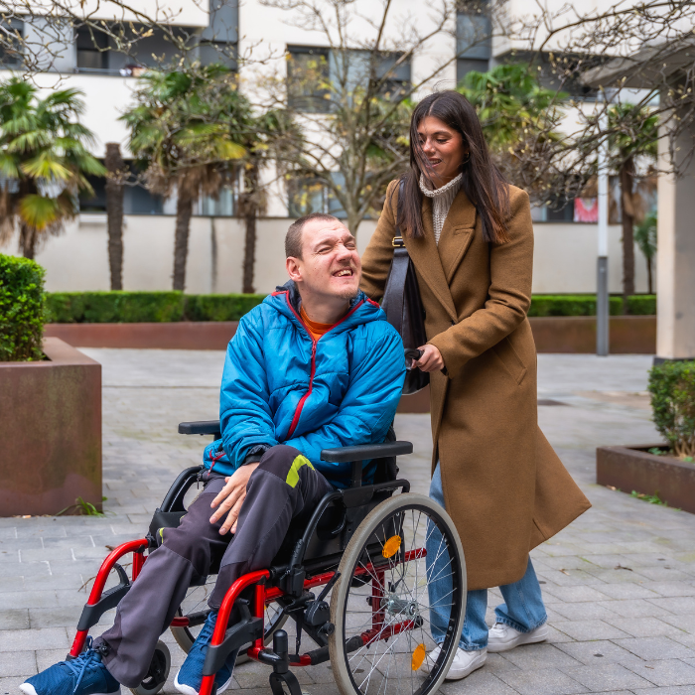
For People with Limited Verbal Skills
Strategies for Building RICH Relationships
Consistency
Narrate transitions
Build sensory rituals
Track how it’s working
Notes:
Consistency. The same routine, the same greeting, and the same staff when possible provides predictability and tells the person’s nervous system “you are safe and trustworthy.”
Narrate transitions. Narrate what’s happening during daily transitions. This reduces the chance for the unexpected that can trigger a threat response.
Build sensory rituals. Find a greeting, goodbye, hand gesture, small dance move that is unique to each person. This communicates the person in uniquely special to you.
Track how it’s working. Tune into to the specifics of their body language and micro behavior. Does their body relax? Do their facial expressions soften? Do they seek you out? These attachment indicators don’t require a single word.
RC IDD Basic Manual: Day 2, Slide 120
9:25-9:35 Strengthening Attachment (Slides 113-120)

Slide 14
Exercise: RICH Relationships
Respect
Information
Connection
Hope
Notes:
RC IDD Basic Manual: Day 2, Slide 121
Break into small groups of 4 or 5.
Give each group a letter (R, I, C, or H). It is okay if more than one group has the same letter.
For their letter, each group should brainstorm the ways in which they are already displaying respect, information, connection, or hope with people they support. Then, brainstorm the way staff are displaying these qualities with each other.
Tell participants to stay sitting with their group while you process with the large group.
Write the responses to each letter on easel paper.
See Discussion Guide below.
Discussion Guide
What makes it difficult to stay RICH at times? How do we help staff stay RICH?
Think about someone you support who has very few words. How do you show respect, information, connection, and hope without relying on words? What does RICH look like when its body-to-body communication instead of word-to-word?
How did the RICH list about people we support compare to the one about staff relationships with each other?
9:35-9:50 Exercise: RICH Relationships (Slides 121-122)

Slide 15
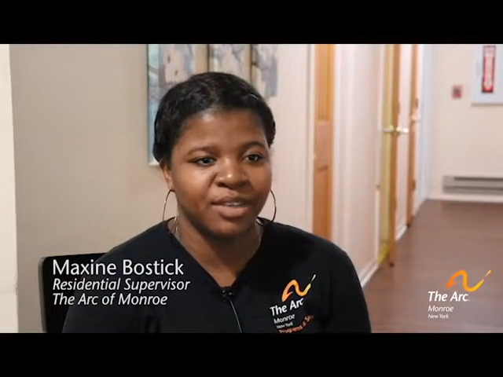
Video: RICH in Action
Closed Caption/Subtitle Version
Notes:
Show this brief video.
Explain that the video shows a support person demonstrating the power of a RICH relationship.
RC IDD Basic Manual: Day 2, Slide 122
9:35-9:50 Exercise: RICH Relationships (Slides 121-122)

Slide 16
Tending to Frame and Boundaries
Notes:
RC IDD Basic Manual: Day 2, Slide 123
A critical part of building safe and healing relationships is tending to the frame and boundaries of those relationships.
9:50-10:25 Tending to Frame and Boundaries (Slides 123-129)

Slide 17

What is the Frame?
The frame describes the conditions within which the support professional and survivor will work together.
It Includes
Roles
Rules
Guidelines
Boundaries
Notes:
RC IDD Basic Manual: Day 2, Slide 124
After reading the definition of frame, ask for examples. They could include such things as:
Rules of a program and daily schedule
Disclosure of personal information
Rules about contact with people supported outside of program
Policies related to touch
Proposed length of stay in program
Contact through social media
How information that a person supported discloses gets shared among staff and others (limits of confidentiality)
Giving and receiving gifts
Contact after staff member or person supported leaves.
Policy about what to do if you know a person you support from the community
Discussion Guide
How have you noticed us as trainers attending to frame and boundaries in this training? (Possible answers: review agenda each day; stick to general time frame and structure; create agreements on Day 1; explain an exercise in full before we do it, etc.)
How does it help you as a participant in the training? (Possible answers: You know what to expect; it creates a feeling of safety; it helps focus on learning.)
9:50-10:25 Tending to Frame and Boundaries (Slides 123-129)

Slide 18

Importance of Frame to People Suffering ACEs/Trauma
The essence of interpersonal abuse is violation of boundaries
Therefore, traumatized people often have little sense of what appropriate boundaries are
Abused people often expect to have their boundaries violated, especially
by authority figures
Notes:
The very essence of trauma and ACEs is about the violation of boundaries. An alcoholic parent violates a boundary by not staying in a parent or protective role when drinking. An older brother crosses the line when he steps out of being a sibling and sexually abuses his younger sister. A bully crosses a line of acceptable behavior when they laugh at, and make fun of, a person with a disability. A staff person violates a boundary when they yell at people they support.
There are the big boundary violations such as sexual abuse, but there can also be more subtle and chronic boundary problems like a sibling caring for a disabled younger sibling because the parent is mentally ill. A child may know too much about or observe adult sexual behavior. An adult may have learned that offering sex was a way to hold onto connections.
Boundary violations also can happen between staff or between supervisors and those they supervise. You can use an example of a time a supervisor made critical comments about a co-worker. This violation of boundaries might make you uneasy, but might also make you feel special or privileged.
Traumatized people grow up with confused boundaries and often expect their boundaries to be violated. They frequently test boundaries and can be unhappy when staff stick to agreed boundaries. But, over time, adhering to boundaries creates a feeling of safety in the relationship.
Attending to boundaries and teaching about boundaries is so critical because that’s how traumatized people begin to feel safe and gain trust in others.
RC IDD Basic Manual: Day 2, Slide 125
9:50-10:25 Tending to Frame and Boundaries (Slides 123-129)

Slide 19
Factors Impacting Boundaries for People with IDD
No or limited understanding of boundaries
May feel uncomfortable with a boundary being crossed but don’t show or express it
Disability can make them extremely vulnerable to boundary violations
We teach them to be compliant, which can place them at risk
Desperate to be accepted and loved
Notes:
It can be hard to tease out whether boundary challenges with people we support come from their disability, a history of trauma, both, or some other reason.
Because of difficulties with communication, or shame, or shyness, they may not show their discomfort with a boundary being crossed. But, it’s always good to assume they might feel uncomfortable so be explicit about checking in with them in a situation where you may be crossing a boundary.
Disability, of course, whether it be physical, intellectual, emotional, or social makes them vulnerable.
Programs for people with IDD often stress compliance – always following what authority figures tell them. This may put them more at risk.
Finally, they are so desperate for love, attention, acceptance that this also puts them at risk.
RC IDD Basic Manual: Day 2, Slide 126
9:50-10:25 Tending to Frame and Boundaries (Slides 123-129)

Slide 20

Boundary Dilemma Brainstorm
What boundary dilemma do you experience in your work?
Notes:
Discussion Guide
Explain that we often face boundary dilemmas in our work. Give a few examples to get them thinking (a child calls you “Mom,” a person asks you to undress them before taking a shower because they are in pain, a person friends you on social media)
Ask the group to brainstorm boundary dilemmas they are been in. Write their answers on easel paper..
What was challenging about it? How has the program managed the dilemma?
Explain that we do not have time to come up with solutions to all these dilemmas, but we will talk about some basic guidelines.
If this does not come out in the discussion, point out that there are things about working with people with IDD that make boundary issues especially sticky. For example, in some settings, the goal is to treat people just as if they are members of the community. But then what if you observe drug use, or risky sexual relationships? What is our responsibility to intervene? Do we invite people to our homes for the holidays?
Staff of color are often assigned to people of color to support. But, especially in smaller communities, the staff may know or come to know information about the family which poses a dilemma about what to do with that information.
Staff may have good intentions like promising a person they support to stay in touch after they leave. But, then staff can easily end up being just one more person that breaks a promise.
RC IDD Basic Manual: Day 2, Slide 127
9:50-10:25 Tending to Frame and Boundaries (Slides 123-129)

Slide 21
The Reality about Frame and Boundaries
For many boundary issues, there’s no agreement in the field.
No boundary policy can cover all situations that arise.
Crossing boundaries often arise from good intentions of staff.
Survivors are used to boundary violations. They expect them and
may even seek them out.
Notes:
Some things everyone agrees are wrong like don’t have sex with those we support or their families.
But there are many complex issues and questions that arise where no policy could ever cover them all.
Good programs often have different policies on things like physical touch between staff and people supported, and whether staff can bring their own family to the workplace for special occasions. There is no one right answer for every agency in the field.
Having said that, your agency likely has boundary policies – know yours and follow them.
RC IDD Basic Manual: Day 2, Slide 128
9:50-10:25 Tending to Frame and Boundaries (Slides 123-129)

Slide 22
Some Basic Guidelines
Don’t assume boundaries don’t matter
Be verbally explicit when you need to cross a boundary –
ask for permission
Don’t promise to keep secrets
Teach explicitly about boundaries
Be firm and kind when setting your own boundaries
When in doubt about a boundary decision, talk about it with your team or supervisor
Notes:
Just because someone doesn’t say something or appears not to notice, don’t assume that the boundary doesn’t matter for the person.
Be verbally explicit about crossing a boundary whether it be entering someone’s room, needing to search for something in their room, needing to remove clothes if they are unable, etc. This shows respect and teaches people about respecting boundaries.
Asking for permission also shows respect
Be constantly modeling and teaching them about respect for boundaries.
If you need to set a boundary for yourself with a person you are supporting like asking them not to touch you without asking, be kind and firm at the same time.
MOST IMPORTANT, talk about it with your team or supervisor if you have doubts.
Discussion Guide
What are some signs that might alert you that you need to talk with someone about a boundary dilemma? (having strong feelings about a situation; acting in a way that is unusual for you; being aware that you want to not tell anyone about what you are thinking of doing; having confused feelings; treating different people you support differently, etc.)
RC IDD Basic Manual: Day 2, Slide 129
9:50-10:25 Tending to Frame and Boundaries (Slides 123-129)

Slide 23

Break Time
Notes:
RC IDD Basic Manual: Day 2, Slide 130
Break
10:25-10:40 Break (Slide 130)

Slide 24
Strengthening the
Body and Brain
Notes:
RC IDD Basic Manual: Day 2, Slide 131
10:40-10:50 Strengthening the Body and Brain (Slides 131-138)
No notes.

Slide 25
132
Notes:
RC IDD Basic Manual: Day 2, Slide 132
Now we’re going to talk about how to strengthen the body and brain.
10:40-10:50 Strengthening the Body and Brain (Slides 131-138)

Slide 26


Threat Response of Dysregulated Brain
Something’s Wrong? YES!
Small stressors activate the full threat response
Extreme alertness, racing heart,
underlying fear, defensive stance
Non-essential bodily functions stop
CAN’ T THINK
Survival fight, flight and/or freeze responses
Stuck in “on”
Numb, “shut down”
Rollercoaster from
“on” to “shut down”
Notes:
RC IDD Basic Manual: Day 2, Slide 133
Briefly review this slide from Day 1. It describes what happens with the brain and body where there has been significant trauma and the brain is dysregulated.
It is as if the brain has decided this is a very dangerous world and must be constantly vigilant.
The answer to the question “Is something wrong?” is usually “YES!” Often very small stressors set off a full-fledged threat response. The person’s body reacts immediately to the perceived threat.
The thinking part of the brain turns off and VERY QUICKLY the body goes into fight, flight, or freeze mode, reacting on pure emotion and instinct.
This would be great if it IS a real danger. But, often this is the response when there is not a real danger. The person cannot pause and think or talk to someone before they act.
So, a support professional raises his voice and the person supported gets aggressive and is ready to attack.
A person is asked to take a shower and has a meltdown.
People with dysregulated brains often find themselves:
Stuck on “on” in hyper-aroused self-protective mode and can’t get back to a calm state.
In a numb, shut down state because the nervous system can’t manage being the stuck on “on.”
Or they go back and forth between these two extremes.
10:40-10:50 Strengthening the Body and Brain (slides 131-138)

Slide 27


Threat Response of a Regulated Brain
The Body Reacts:
Extreme alertness
Non-essential bodily
functions stop
Focused thinking to assess
danger
Something’s
wrong!?
Am I safe?
I’ll check it out…
Safe!
Body calms, often
with help of
supportive others
Danger!
If threat is real,
body goes into fight,
flight, or freeze
Notes:
RC IDD Basic Manual: Day 2, Slide 134
When we strengthen body and brain, we want to move people closer to a more regulated threat response.
Briefly review this slide from Day 1 about the threat response of a regulated brain.
Let’s say this girl hears that there’s a new girl in the class not long after she was bullied at school. She may feel her body react wondering if she’ll be safe.
But she is more able to pause, calm down, and think rather than purely react when assessing the danger. They realize that not every new child at school is a bully. She tells her mom that she’s a little scared. When her mom reassures her, she returns to a calm regulated state.
Again, this is what we’re working toward when we strengthen the body and brain.
This can be long-term work with people with IDD because they may not have he cognitive flexibility to use the thinking part of their brain. So, body based interventions are important.
10:40-10:50 Strengthening the Body and Brain (Slides 131-138)

Slide 28
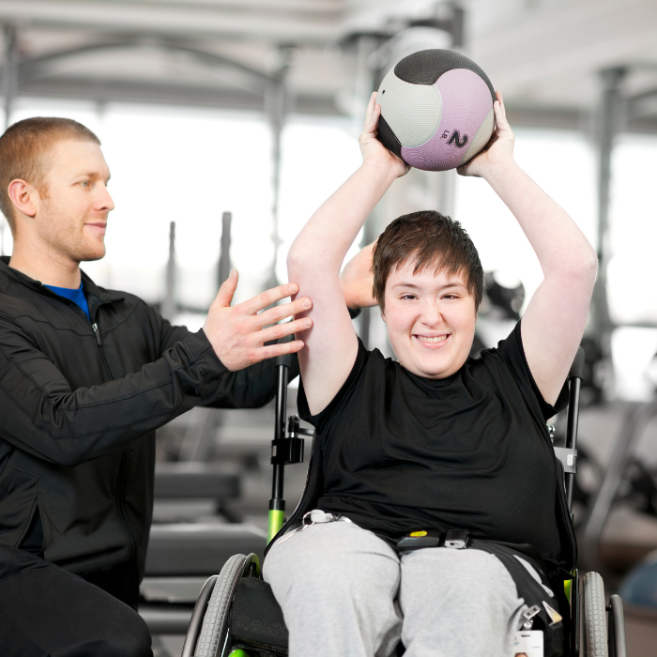

Strategies to Strengthen Body and Brain
Predictability in the environment
Sensory Interventions
Deep breathing, simplified meditation, mindfulness, and yoga,
My Regulation Card
Notes:
These are different kinds of strategies to strengthen the body, brain, and nervous system.
Especially for people with limited cognitive and language skills, a consistent daily schedule, as consistent as possible staffing, signaling transitions in the same way every time are trauma-informed practices. They signal to a nervous system used to chaos that there will be no surprises.
Sensory interventions include activities people can do to engage various senses to decrease or prevent distress. Survivors often find these strategies immensely helpful to calm, ground, and regulate their strong emotions.
Simplified meditation, yoga, mindfulness, and deep breathing can support nervous system regulation and function.
A “My Regulation card” is a simple document about what escalation looks like for this person, what strategies help, and what makes it worse. We will show an example shortly.
Each person with IDD will be different with respect to strategies that work best for them.
RC IDD Basic Manual: Day 2, Slide 135
10:40-10:50 Strengthening the Body and Brain (Slides 131-138)

Slide 29



Exercise: Deep Breathing
Credit to TSI Program Coordinator LaVerne Baker Hotep for the acronym “BIBO”
Notes:
Let’s practice a deep breathing exercise now.
We’re going to focus on extending the exhale, which activates your calming nervous system. Breathe in for 4 counts... now out for 4 counts. Now in for 4... out for 5. In for 4... out for 6. Keep going — in for 4... out for 7. One more: in for 4... out for 8.
Now let’s try square breathing. Breath in for a count of 5…now hold for a count of 5…breath out for a count of 5…and hold the exhale for a count of 5.
What did you notice?
These are tools you can teach to people you support, or that you can use yourself — anywhere, anytime.
RC IDD Basic Manual: Day 2, Slide 136
10:40-10:50 Strengthening the Body and Brain (Slides 131-138)

Slide 30
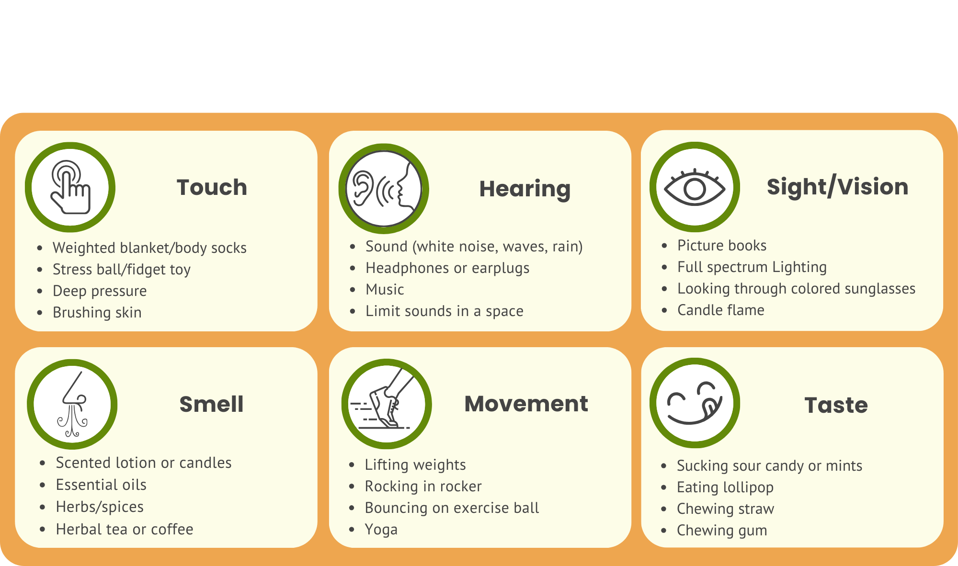
Sensory Interventions to Prevent or Decrease Distress
Notes:
RC IDD Basic Manual: Day 2, Slide 137
Sensory interventions are some of the most important interventions used for people with IDD we support.
Large percentages of people with IDD have sensory integration or sensory processing challenges. Sensory processing means the way the nervous system receives, organizes, and understands sensory information.
Here is a short list of strategies that can be used in different sensory areas to help people to calm down and ground themselves when activated.
They are effective with people with IDD because they don’t require a person to be verbal. They also are being used more and more often with trauma survivors.
This falls within the professional expertise of Occupational Therapists (OTs).
OTs can do assessments to determine which strategies are most effective for a particular person. These strategies can be taught to staff and then the people supported can be taught to do it themselves. Every one of us has particular sensory areas that we find especially soothing, comforting, and calming on the one hand, and irritating or activating on the other.
Give an example of what areas soothe you and which do not. Ask participants what sensory areas are most irritating for them? What areas are most calming?
These strategies should always be used with the person’s approval and not forced upon anyone.
Often, adults with IDD are seen more as children and we use sensory strategies for kids like stuffed animals or toys. This can feel demeaning to adults with IDD.
10:40-10:50 Strengthening the Body and Brain (Slides 131-138)

Slide 31
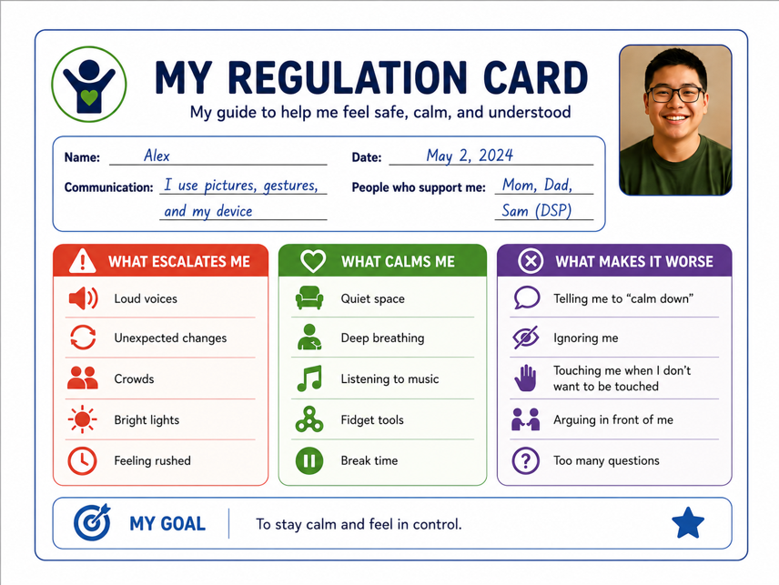
My Regulation Card
Notes:
As mentioned, a “My Regulation Card” is a simple document that can be laminated and answers the questions what escalation looks like for this person, what strategies help, and what makes it worse. Here is an example.
For non-verbal people, it can include photos showing answers to these three questions.
A person can take it from setting to setting so other professionals are on the same page about what works and doesn’t work for that individual.
RC IDD Basic Manual: Day 2, Slide 138
10:40-10:50 Strengthening the Body and Brain (Slides 131-138)

Slide 32
Strengthening Feelings Management
Notes:
RC IDD Basic Manual: Day 2, Slide 139
No notes.
10:50-11:10 Strengthening Feelings Management (Slides 139-148)

Slide 33
140
Notes:
RC IDD Basic Manual: Day 2, Slide 140
10:50-11:10 Strengthening Feelings Management (Slides 139-148)

Slide 34
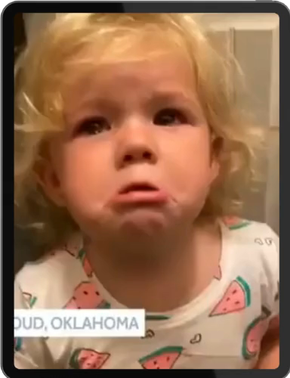
Video: “I’m strong, I’m beautiful, I’m Loved”
Closed Caption/Subtitle version
Notes:
Show video (about 1 minute).
While this is likely a neurotypical child, what did you notice specifically about how this parent strengthened feelings management? (Possible answers: she intentionally taught her child deep breathing; she acknowledged her hurt feelings; she paired it with love and affirmation).
This may be more difficult with a child with IDD but certainly possible with many.
How have you seen people with IDD learn skills to manage their feelings?
What message did you get about expressing feelings in your culture? For example, did you learn to express or repress feelings? What messages did you get about expressing anger, especially toward your elders?
How might our cultural beliefs about feelings management affect our reaction to others including those we support? (Possible answers: if we learned to hold in feelings, we might view expression of any anger as rage; if we easily express any and all feelings, we could not notice the hurt of someone who holds their feelings in).
RC IDD Basic Manual: Day 2, Slide 141
Discussion Guide
10:50-11:10 Strengthening Feelings Management (Slides 139-148)

Slide 35

Feelings Management: Co-regulation
Specific feelings management skills are taught –
usually within relationships.
A person becomes regulated in the presence of regulated others
Support professional must keep themselves calm and model feelings management
Image courtesy of Beth Tyson Trauma Consulting, www.bethtyson.com
142
Notes:
RC IDD Basic Manual: Day 2, Slide 142
We can’t forget the idea of co-regulation. In the same way that very young kids learn to calm down when we scoop them up and calm them down thousands and thousands of time, people we support learn by us repeatedly helping them calm down.
If we are upset and irritated, they will escalate also. If we stay calm and regulated, this will help them calm down.
For someone who is largely non-verbal, that might look like: sitting next to them quietly when they’re escalated — not talking, not directing, just present. Match their breathing and then slow yours down. Offer a weighted blanket without saying a word. Hum a familiar tune. Your calm nervous system is literally teaching their nervous system what “settled” feels like.
10:50-11:10 Strengthening Feelings Management (Slides 139-148)

Slide 36
Feelings Management
Feelings Management
Feeling Awareness
Feeling Identification
Feeling Modulation
Feeling Expression
Awareness of bodily signs and sensations of distress and calm
Learning the words associated with feelings
Using strategies to move from high to low distress
Using skills to express feelings constructively
Notes:
Remember, here are the four feelings management skills we talked about on Day 1. We are briefly going to talk about each one.
There are other ways people have organized the elements of feelings management including comprehensive programs for teaching feelings management for people with IDD which we will mention later.
RC IDD Basic Manual: Day 2, Slide 143
10:50-11:10 Strengthening Feelings Management (Slides 139-148)

Slide 37
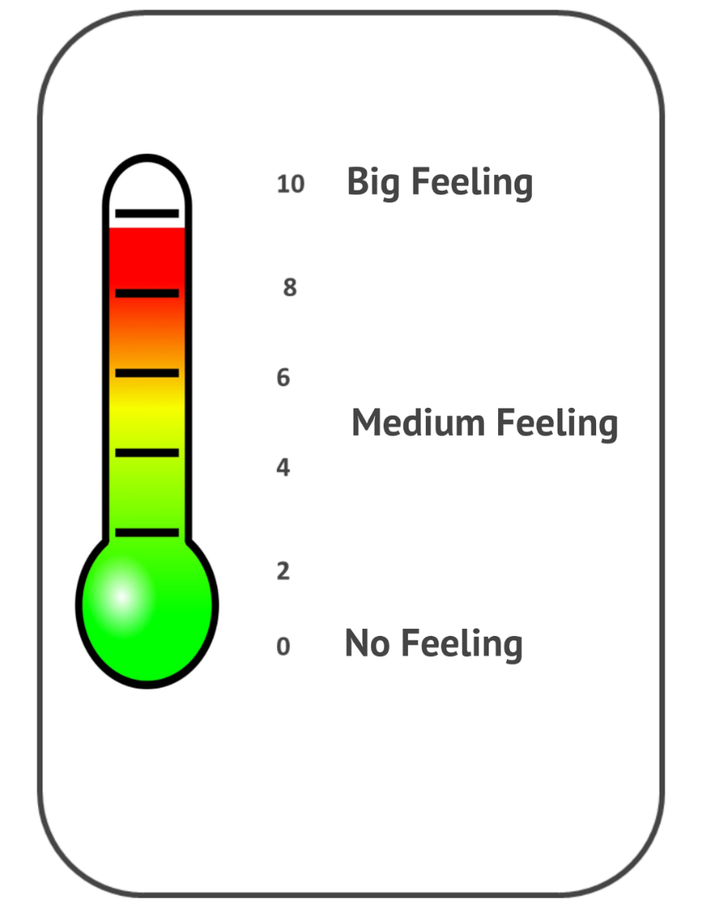
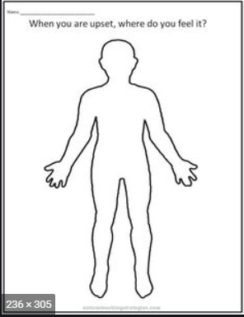
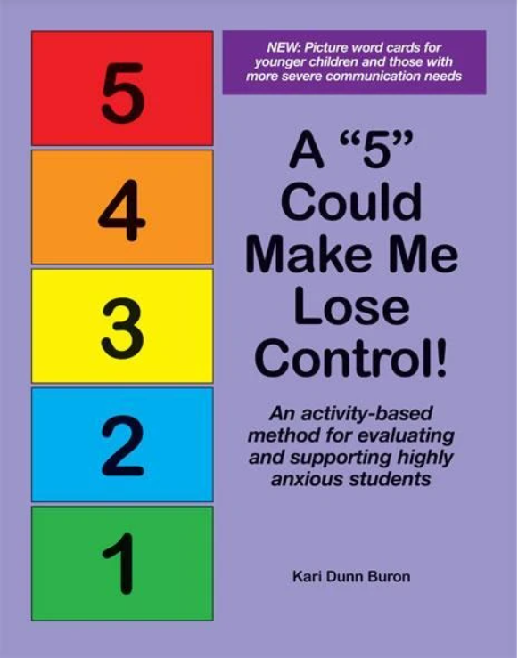
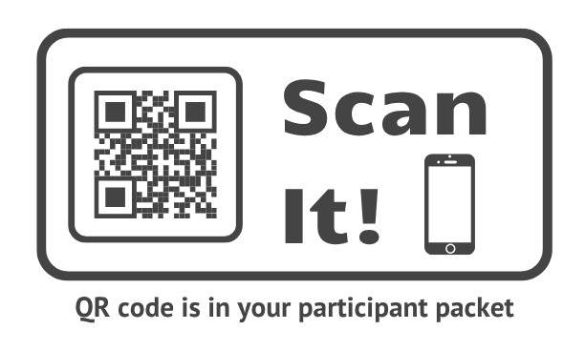
Strategies to Build Feeling Awareness
Teach the person to
rate the intensity of
the feeling
Teach the person to identify where in the body they feel
the feeling
Notes:
RC IDD Basic Manual: Day 2, Slide 144
Who can describe what the first signs of escalating looks like for a specific person you support?
What if the person is non-verbal, what might you see? (Possible answers: picking at their skin, rocking faster, covering their ears, going very still).
Staff can learn to better read these signals and respond before a full escalation happens. They can teach those we support to begin identifying when their feelings are starting to get bigger and how to notice this in their bodies in the moment.
Here are a few examples of worksheets to teach feelings awareness.
What strategy could you use for people that have less verbal skills? (Possible answers: person could point to where they are on the thermometer; they could have color flash cards; you could use their body – standing up and reach high for “’big, overwhelming feelings” and crouching down for “small feelings or no feelings;” You can ask yes or no question about where in the body they feel the feelings – “do you feel it in your stomach? In your head? In your neck? - pointing to those parts of your body)
Boardmaker Online (now tobiidynovox) is a subscription service that offers a variety of picture symbols that limited-speaking or non-speaking persons can use for communicating. The materials are primarily for children. Find them at https://us.tobiidynavox.com/. There are many examples of feelings thermometers and body maps online.
10:50-11:10 Strengthening Feelings Management (Slides 139-148)

Slide 38
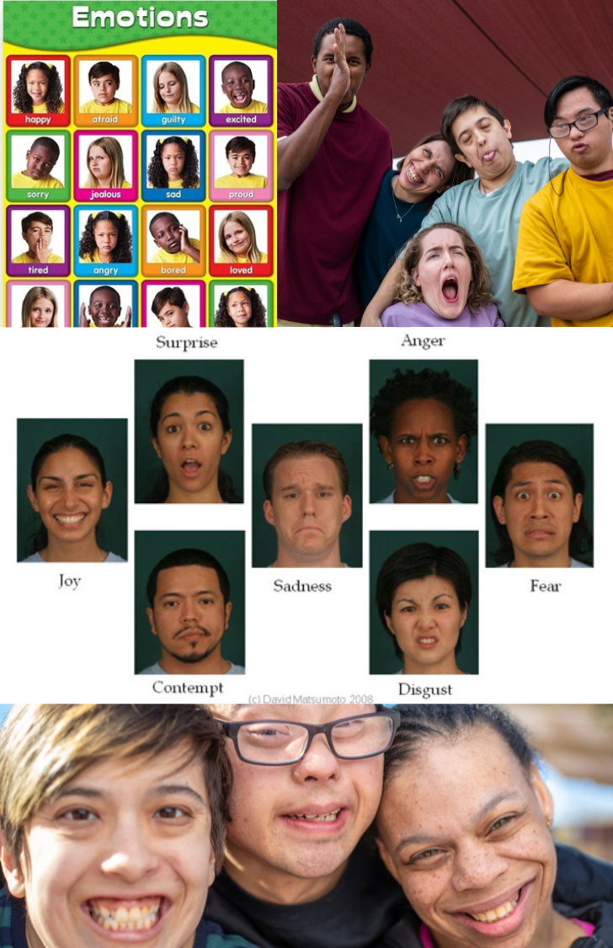
Strategies to Build Feelings Identification
Help survivors learn feeling words and connect them to bodily sensations.
Teach people that feelings are different from actions.
Notes:
RC IDD Basic Manual: Day 2, Slide 145
This, of course, helps people you support learn about the words to describe feelings.
Here are some simple feelings charts that teach feeling words.
These skills must be taught repeatedly and continuously to people with IDD. Creating visual prompts and charts and hanging on the walls can be very useful.
Discussion Guide
10:50-11:10 Strengthening Feelings Management (Slides 139-148)
What other strategies do you use? How could you adapt for people with low verbal skills? (Possible answer: have a simple chart with a green circle [calm] and red circle [upset] and ask person to point to whether they are green or red).

Slide 39

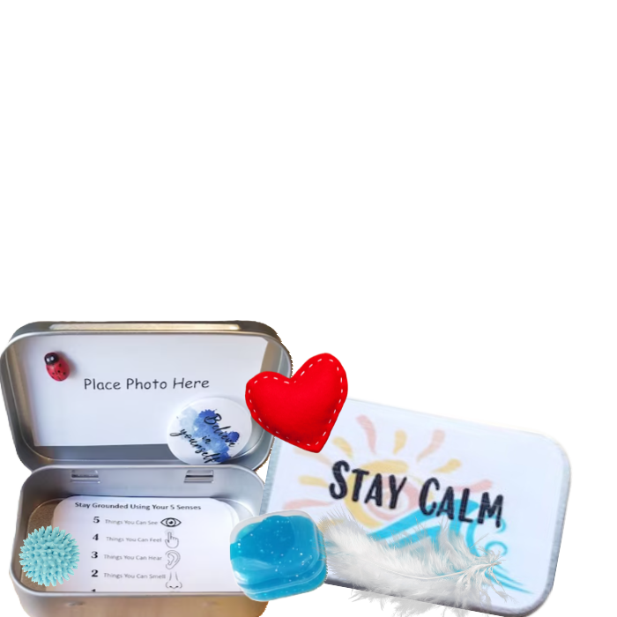
Strategies to Build Feelings Modulation
Deep breathing
Progressive muscle relaxation
Use sensory objects
Draw feelings
Designate a “Chill Room” or “Sensory Room”
Help person create a personalized “Calm Down Kit”
or “Sensory Kit”
Distract oneself
Notes:
RC IDD Basic Manual: Day 2, Slide 146
These are strategies for making big, intense feelings feel smaller or more manageable.
For people with limited verbal skills, one can use a laminated card with photos of them doing calming strategies. This can serve as a visual prompt when they are starting to escalate.
Give an example of how using feeling skills is a process with survivors. You may identify calming strategies with a survivor. Then, in a crisis when staff suggest the strategy, they say, “F that.” This will often happen many times. But once they say, “Okay, give me that f..ing music,” this is a triumph. It shows that they are beginning to have some awareness of distress, pause enough to use a strategy, and maybe use it more often. Once they do it once or ten times, it does not necessarily mean they will always be able to do it.
Again, be sure to use strategies with adults that don’t make them feel like children unless they choose those strategies themselves.
10:50-11:10 Strengthening Feelings Management (Slides 139-148)

Slide 40

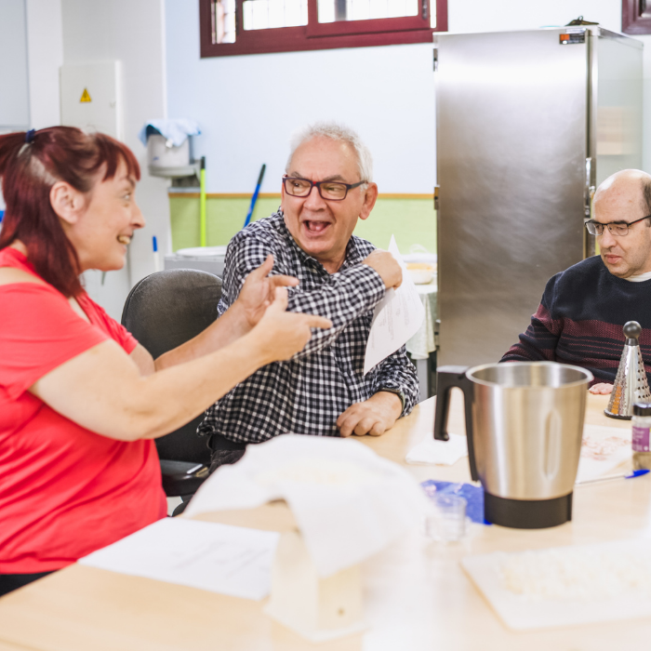
Strategies to Build Feelings Expression
Teach many ways to express feelings – draw, write, talk
Teach person to use words, not actions, to express their feelings
Practice with role play
Help person to use “I” statements
Notes:
RC IDD Basic Manual: Day 2, Slide 147
This is often difficult for traumatized people because they assume that if they express their feelings, no one will care and they will get hurt, rejected, or humiliated.
Often the only way they use their words to express feelings is blowing up at someone, which results in a relationship rupture. They have little experience with constructive expression of feelings and believing that working through conflict can actually strengthen relationships.
For people with IDD, especially those with limited verbal skill or social skills, this can be difficult. You can use cards with faces on them for basic feelings to point to or the hold up to express themselves. Or they can point to numbers to show how strong the feeling is. Be creative.
10:50-11:10 Strengthening Feelings Management (Slides 139-148)

Slide 41
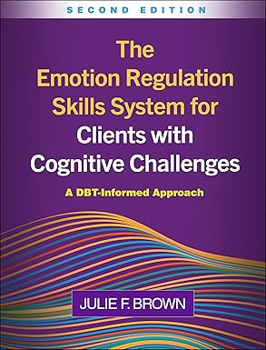
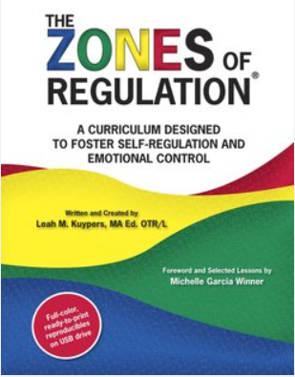
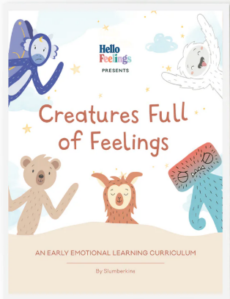
Comprehensive Systems for Teaching Feelings Management
Notes:
Most programs piece together different materials from different places to teach feeling management. One staff may be teaching one set of skills, another different skills, and some none at all. There is no overarching model for training staff or making sure people being supported learn these skills.
These are three widely used comprehensive systems or models for teaching people with IDD and special education students about feelings management. They include a framework and concrete skills that a program can implement and teach people they support. They have worksheets, posters, and training resources to support the model. In the same way that Risking Connection is a whole-system way to embed trauma-informed care, these are well-designed and evidenced-informed methods to teach these critical skills as an organization.
The Skills System is used for all ages and disabilities. It is informed by Dialectical Behavior Therapy (DBT) which is a highly regarded model for teaching feelings management skills to people with severe behaviors.
The Zones of Regulation and Slumberkins are models used with children.
RC IDD Basic Manual: Day 2, Slide 148
10:50-11:10 Strengthening Feelings Management (Slides 139-148)

Slide 42

Exercise: Strengthening Attachment, Body and Brain, and Feelings Management
Notes:
RC IDD Basic Manual: Day 2, Slide 149
Ask participants to turn to the Worksheet: Assessing and Strengthening Attachment, Body and Brain, and Feelings Management in their Participants Packet.
Review the directions for the Worksheet.
If possible, form small groups of 4 or 5 with people that work in the same program and all know the people they support.
In small groups, have participants choose a person they support that had a recent crisis.
Use Worksheet to identify which areas need strengthening and what strategies they would use to strengthen them.
In large group, have several groups report on what they discussed.
Discussion Guide
What was it like to use this form? How might it be used in your program?
11:10-11:40 Exercise: Strengthening Attachment, etc. (Slide 149)

Slide 43
RC and Crisis Management
Notes:
RC IDD Basic Manual: Day 2, Slide 150
11:40-11:50 RC and Crisis Management (Slides 150-151)
No notes.

Slide 44

A Brief Word About Crisis Management
Many of the major failures in support for trauma survivors occur in response to crisis
During the Crisis:
Stay calm yourself
Remember that symptoms are adaptations
Stay RICH®
Focus only on calming, not on consequences
Notes:
Because most organizations have de-escalation and crisis management models, we are only going to very briefly address it here.
The big idea here is, when managing crisis, don’t forget about what we have learned so far.
In crisis, our anxiety understandably is at its peak. It is very easy to go into a controlling and punitive mode which can end of repeating the trauma that people have experienced in their lives. This includes unnecessary holds, rigid and punitive consequences, forced isolation, blaming those we support. These can all be re-traumatizing for people.
So, we want to keep these things in mind:
Behavior is adaptation – it is often a way people have learned to survive, it meets a need in the moment, it is a communication that we need to try to understand.
Stay RICH – your interactions in a crisis should display respect, providing information, offering connection, and holding onto hope.
Stay calm yourself. Remember the idea of co-regulation. People stay calm in the presence of calm others. Even if we have to fake it, stay calm.
Our main goal is to help someone calm down. In general, we don’t want to focus on consequences in the moment. Give examples of consequence statements like, “If you keep doing that, you won’t be able to go to watch TV.”
For people with limited language, reduce language to 2-3 word phrases like “slow body,” or “your safe.” Modify the environment by reducing noise, reduce people in the space, and offer familiar items.
Discussion Guide
How might a support professionals’ assumptions about race and culture influence what they perceive when they arrive at a crisis? (Possible answers: they might see people of color that are loud as more likely to be aggressive and be afraid for their safety).
RC IDD Basic Manual: Day 2, Slide 151
11:40-11:50 RC and Crisis Management (Slides 150-151)

Slide 45
Noticing Our Reactions
Notes:
Ask participants, “If a scientist’s primary tool is a microscope and a carpenter’s is a tape measure, what is our primary tool as support professionals? What tool to we use to gauge what people we support need from us” (Answer: ourselves). We use our responses to people to learn how they are feeling, what they need, and how we might help.
Ask people to call out the initials of a person you supported that stole your heart; one who really got under your skin and irritated you; one who you wanted to adopt; one who made you feel helpless?”
For people that are clinicians, the term to describe these often strong reactions to individuals is countertransference. But, we’re going to just call it “noticing our reactions.”
This is not just a concept that applies to people who work face-to-face with individuals. Ask, “Who’s had a co-worker with whom you feel impatient because they seem needy and whiny?” “Who’s had a supervisee that wanted to hang out with as a friend?” “Who’s had a boss that feels intimidating because they seem overly critical?” These situations are somewhat different because we are not providing a support to them. But, we can still have strong feelings that are important for us to notice.
RC IDD Basic Manual: Day 2, Slide 152
Key Points
11:50-12:20 Noticing Our Reactions (Slides 152-161)

Slide 46

What Reactions We Must Notice
Our feelings, thoughts, and body sensations in reaction to a person – positive and negative.
Our secondary reactions to the uncomfortable feelings evoked by that person.
Our reactions are a normal part of the work.
Notes:
RC IDD Basic Manual: Day 2, Slide 153
Key Points
Here we are talking about all of the feelings, thoughts, and body sensations WE as support workers have to particular people we support – and also those with work with.
Feelings – positive (caring, warmth, loving, worry) and negative (anger, fear, disgust, dread)
Thoughts – “this story can’t be true,” “this kid is so cute,” “this guy is dangerous,” etc., etc., etc.
Body sensations – tight stomach, sleepiness, knot in the throat, clenched teeth, etc.
And then, we can have secondary reactions or reactions to our reactions (sometimes without even realizing it) – “I’m so frustrated with her, but that’s not cool. I’m supposed to be empathic.” “I don’t like this kid, but I know I’m supposed to like him.” “I don’t know what to do, but I’m supposed to have an answer.”
These reactions in professionals have historically been viewed as negative or a sign that someone is not good at their job. Our view is that these reactions are normal and inevitable – feelings aren’t good or bad, they just are. BUT, what you do with them can help your work or get in the way.
People we support may have feelings about us based on our race, ethnicity, gender or other groups we belong to. For example, a BIPOC person that has been treated poorly by White people may assume a White staff is going to do the same. A female domestic violence victim abused by a man may not trust a male staff.
Read the scenario of Jackie and Yolanda (youth setting) OR Sonja and Dot (adult setting), on following pages, to illustrate the concepts presented here.
11:50-12:20 Noticing Our Reactions (Slides 152-161)

Slide 47
Exercise: Noticing Our Reactions
Option 1 - Jackie and Yolanda (youth setting)
Notes:
Staff Scenario: Jackie and Yolanda (Youth Setting)
READ THIS (ALOUD) FIRST: Jackie had been working as a direct support professional (DSP) for six months when a ten-year-old girl, Yolanda, was admitted. As Jackie heard about Yolanda’s history, she was struck by how much Yolanda reminded her of herself when she was little. They were both bi-racial, raised by single mothers involved with violent men, and trapped in poverty. Yolanda, who had autism, had only ragged hand-me-down clothes for which she was often teased by the other kids. Her mom was always late to visits and seemed exhausted. Boy, was that all familiar. Jackie had managed to pull herself out of poverty, kick a cocaine addiction, get an associates degree, and land a solid job in a non-profit. She felt so sad for Yolanda. What could it hurt to buy Yolanda a new t-shirt, pair of shorts, or a treat when she was going shopping anyway. The other kids had those things – it seemed only fair.
Ask the group here: What are possible outcomes?
READ THIS (ALOUD) SECOND: Jackie was shocked and embarrassed when her supervisor asked to see her and told her that Yolanda’s mom had complained to the program. The supervisor saw a lot of potential in Jackie as a DSP and knew this would be a critical learning experience. She helped Jackie to understand that her actions actually made Yolanda feel scared and unsafe because a family friend actually bought Yolanda gifts before he started sexually touching her. The supervisor helped Jackie think about other options to consider when she is feeling sad for, and protective of, kids in this way. She suggested some ways that Jackie could rebuild trust with Yolanda.
Discussion Guide
Discuss the outcome with the group. How might Jackie have used her reactions in a more helpful way in the work with Yolanda?
RC IDD Basic Manual: Day 2, Slide 154
11:50-12:20 Noticing Our Reactions (Slides 152-161)

Slide 48
Exercise: Noticing Our Reactions
Option 2 - Sonja and Dot (adult setting)
Notes:
Staff Scenario: Sonja and Dot (Adult Setting)
READ THIS FIRST: Sonja (they, them) had worked at the day program for about six months when a person, Dot, started attending. From the moment they met, Dot, who had Downs Syndrome, reminded Sonja of her sister who also had Downs Syndrome. They even had the same favorite TV show. Sonja had been her sister’s protector all her life and saw it as her duty to make her sister feel special in a harsh world. In fact, her sister was the reason that Sonja decided to work at an organization that supported people with IDD. Dot often seemed so sad and talked about the kids on the city bus that would imitate the way she walked and laugh. Sonja started regularly buying Dot some small gifts and treats just to cheer her up and make sure she knew someone cared about her. What could be harm in that?
Ask the Group: What are possible outcomes?
READ THIS SECOND: Sonja was shocked and embarrassed when their supervisor asked to see them and told them that Dot had complained about Sonja’s behavior. The supervisor saw a lot of potential in Sonja as a DSP and knew that this would be a critical learning experience. She helped Sonja to understand that their actions actually made Dot feel scared and unsafe because a family friend actually bought Dot gifts before he started sexually touching her. The supervisor helped Sonja think about other options to consider when they are feeling sad for, and protective of, people in the program in this way. She suggested some ways that Sonja could rebuild trust with Dot.
Discussion Guide
Discuss the outcome with the group. How might Sonja might have used their reactions in a more helpful way in the work with Dot?
RC IDD Basic Manual: Day 2, Slide 155
11:50-12:20 Noticing Our Reactions (Slides 152-161)

Slide 49

Why We Have These Strong Reactions
Our responses to the person’s extreme behaviors and symptoms
The way our own personal issues overlap with that of the person we’re helping
Our own biases about gender, race, sexual orientation, class, etc.
The degree of our compassion fatigue at the time
Notes:
RC IDD Basic Manual: Day 2, Slide 156
There are many sources of the strong reactions we have.
We bear witness to awful truths that can evoke anger, protective feelings, denial, even sexual feelings/fascination.
People’s behavior is often extreme and evoke strong feelings in us. For example, they may direct anger or disappointment or fear toward us, although these feelings are not really about us.
The ways our own history overlaps with the history of those we support can make us especially reactive to particular people. A staff with their own trauma history may identify with the situation of a particular person they support and, for example, feel angry at someone acting like the person who hurt them, etc. Having a family member with a disability might lead to strong reactions.
Most of us have biases that we are not aware of (called implicit bias) that, when not examined, can influence how we perceive and interact with people we support of a particular gender, race, class, or sexual orientation.
If we are experiencing a lot of compassion fatigue at a particular time, it may be easier to feel hopeless with a difficult person or angry because they aren’t getting better quicker.
Discussion Guide
How might our own implicit bias affect how we perceive safety with a particular person we support or a colleague? Who we decide to call the police on? Who we discharge and who we keep in programs?
For example: Does the racial bias that Black men are dangerous leave us uncomfortable being alone in a room with a Black male we support? Does gender bias leave us uncomfortable sharing a bathroom with transgender staff? Might a BIPOC staff downplay the problems of people they support that are White because they have all the advantages in society?
11:50-12:20 Noticing Our Reactions (Slides 152-161)

Slide 50
Common Reactions
We can feel:
Protective or parental toward them
Helpless in face of their challenges
Angry for how the person is treated
Angry at them for their behavior
Loving toward them
Played or manipulated by them
Exhausted by them
Blaming toward them
Not caring about them
Inspired by them
Disbelieving of what they are saying
Sexually turned on by them
Having Reactions Is Not a Problem.
It’s What You Do With Them that Matters.
Notes:
Noticing Our Reactions
Read down the list of common reactions we can have toward people we support.
As you can see again, we have both positive and negative reactions. We are human and not always able to react in a compassionate way.
Which of the more positive reactions resonate for you?
Which of the more negative reactions resonate?
Some people are surprised to see “being sexually turned on” by people we support on this list. We include it because it happens, more often than we like to admit, and this reaction can be used in a way that is helpful or very damaging to people we support. Acknowledging this feeling in ourselves and, for example, modeling having sexual feelings AND maintaining boundaries by not acting on them is helpful. Acting on them of course is never ok and is a crime. But, it can be a problem to suddenly withdraw from a person you support because the feelings make you uncomfortable. If someone works with younger kids and feels sexually attracted to them often, this is not a job they should be doing and they should seek help.
Having reactions is not the problem, it’s what you do with them. Both positive and negative reactions to people we support can be used in helpful ways or lead to problems like with Jackie/Yolanda (or Sonja/Dot) scenarios.
Next, we will talk more about how our reactions can be helpful and problematic.
RC IDD Basic Manual: Day 2, Slide 157
11:50-12:20 Noticing Our Reactions (Slides 152-161)

Slide 51

How Our Reactions Help Our Work
It can help you know the person better when YOU experience strong feelings that the person can’t allow themselves
to feel or feels but can’t express.
It can help you empathize with how others in the person’s life often feel.
Our reactions are a window into
important information about the person.
Notes:
It is common for us as support professionals to experience the strong feelings that people we support can’t allow themselves to feel. It’s almost as if we are feeling the feeling for them.
A good example of this is when a person supported has just experienced something difficult (like a sexual violation or a parent no-showing for a visit) and, as they tell you about it, they seem not to care or unaffected, but you are having intense feelings (anger for the person, helpless to do anything, sad).
It is likely that you are experiencing feelings that the person cannot yet allow themselves to feel because it is too painful. Your feelings are a window into what they are experiencing inside.
If, for example, you get tricked or manipulated by a person you support and find yourself feeling angry and embarrassed in front of your peers, saying that you’re never going to trust that person again. This can be a window into how the person you support feels or has felt – let down, betrayed, and can’t trust anyone. Even though it feels bad to you, it can give you empathy into how they feel.
If you feel like you’re always irritated at a person you support, this can give you empathy for how the person’s loved ones may often feel.
RC IDD Basic Manual: Day 2, Slide 158
11:50-12:20 Noticing Our Reactions (Slides 152-161)

Slide 52

When Our Reactions Are a Problem
Our reactions are a problem when they:
Interfere with understanding the person
Prevent us from responding in a healing or RICH way
Notes:
RC IDD Basic Manual: Day 2, Slide 159
Our reactions can also be problematic and get in our way or be blind spots and trip us up in the work we do with people we support and staff. Remember the examples of the support professionals we just talked about (Jackie and Sonja).
Give examples from your own work about ways your reactions with certain people you have supported and/or your reactions to colleagues have been problematic.
11:50-12:20 Noticing Our Reactions (Slides 152-161)

Slide 53
Reactions that Can Create Problems
Over-Identification: “I understand because you’re just like me.”
Blaming: “It must have been her fault.” “He doesn’t want to get better.”
Protective/Parental: “She can’t protect herself so I must be there to protect her.”
Distancing: “He’s hopeless, people like that never change,” or, “She gets on my every nerve.”
Denial: “What they are saying couldn’t be true.”
Unexamined Bias: “He’s dangerous and can’t be helped.”
Notes:
RC IDD Basic Manual: Day 2, Slide 160
When working with people we support (or other staff), our reactions can get in the way of us understanding the person, lead us to cross boundaries, or prevent us from responding in a RICH way. Examples:
Over-identification. We assume that the person’s experience is just like ours without checking out our assumptions like was true with the example of Jackie/Sonya.
Blaming. An example would be, if we feel frustrated with a person’s pace of change and feel hopeless, it is easy to blame them. We may start finding more things wrong with them to deal with our own disappointment and frustration.
Protective/Parental: We take on more and more responsibility for protecting the person which could lead to exhausting ourselves, not allowing the person themself, or others in their life, to step up and be protective.
Distance. It may be easy to put more energy into people who we find rewarding rather than those whose change is slow and accompanied by frequent setbacks. If a staff person is physically hurt by a person they support and forced to re-engage too quickly, they may distance themselves. If staff experience sexual feelings towards teenagers or adults they support and is uncomfortable with those feelings, they may distance themselves. If a staff person feels emotionally unsafe with a supervisor, the staff person may avoid interactions with the supervisor.
Denial. We don’t believe what the person is saying because they have an intellectual disability or we think what they’re saying can’t be true because that staff or job coach or parent would never do that.
Unexamined Bias. We all have biases based on how we were socialized in our own racial, ethnic, gender group. We also learn messages from society as a whole. These biases can impact our behavior with people we support. But we can also look carefully at our biases and understand how they may impact our reactions to others.
11:50-12:20 Noticing Our Reactions (Slides 152-161)

Slide 54
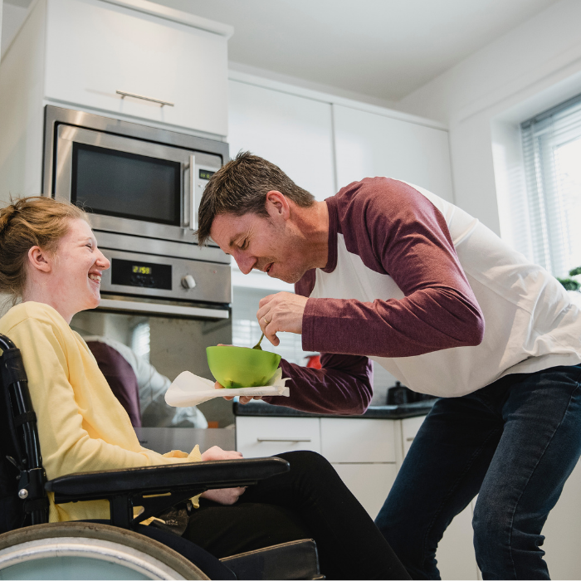

Using Our Reactions as a Tool
Three Steps:
Notice them
Understand them
Employ them to make
the relationship stronger
Notes:
Three steps can be used to build our capacity to notice our reactions. While seeming simple, they are skills that take time and effort to learn.
Notice it. This requires really believing that our reactions to people we support and other staff give us critical information and therefore learning to attend to those thoughts and feelings. Often, we only become aware of our reactions while talking with others about the people we support such as with colleagues or in supervision.
Understand it. Again, this often happens with the help of supervision or the team. Understanding our reactions often requires looking at questions such as: How much of my reactions are about me? About my biases? About the person supported or colleague? About both? What might my reaction be telling me? Who am I to the person supported or colleague? (the abusive father, non-protective mother, just another person who will leave, etc.) Who are they to me? (a little sister, the child I never had).
Employ it. This does NOT necessarily mean disclosing your reactions or doing anything in particular – although it might. In general, it means using your reactions to understand the person supported or colleague better, getting a glimpse into their inner world, and strengthening the connection in some way. If your reactions are strong, in general it is better not to act quickly on them until talking with someone about them.
Discussion Guide
What practices do you use or does your agency promote with staff to build the capacity to notice their reactions to self and others? (Possible answers: supervision, mindfulness, training, nothing at this time)
RC IDD Basic Manual: Day 2, Slide 161
11:50-12:20 Noticing Our Reactions (Slides 152-161)

Slide 55

Lunch
Notes:
RC IDD Basic Manual: Day 2, Slide 162
12:20-1:20 Lunch (Slide 162)
Let’s eat!

Slide 56

Exercise: Noticing Our Reactions
Notes:
Divide into small groups of 4. There are 3 different versions of the Worksheet: Noticing Our Reactions for this exercise – one about youth, one about adults, and one about peers we work with (for staff that do NOT do direct service work). You can choose to have all small groups discuss one version which is the simplest way to do the exercise, or you can break small groups up by who works with youth, adults, and don’t do direct service work.
Have participants find the appropriate Worksheet in their Participant Packet.
Assign 2 scenarios on the Worksheet to each group to discuss. If more than one group is discussing that version of the Worksheet, assign them different scenarios. They can discuss the others if they have time in their small group. With larger trainings, more than 1 group will have the same scenarios which is fine. Instruct groups to discuss the questions at the top of the Worksheet as they pertain to their scenario.
Reassemble as a large group. Have someone from a group read a scenario they discussed out loud and discuss how they answered he questions. Have all the groups who had that particular scenario contribute to the discussion. Then have a different group read a different scenario and discuss.
Remember, if you are using more than one version of the Worksheet, you will not have time to review every scenario. You will have to pick and choose.
RC IDD Basic Manual: Day 2, Slide 163
Instructions
1:20-1:45 Exercise: Noticing Our Reactions (Slides. 163-164)

Slide 57


Critical Importance of Supervision
Supervision should:
Be for all staff, not just clinicians
Happen regularly – not just when there’s a problem
Discuss actual people served, not just administrative tasks
Be RICH
Be a safe, confidential place to talk about your reactions to people you support (and those you work with)
Attend to compassion fatigue and give support for self-care
Notes:
RC IDD Basic Manual: Day 2, Slide 164
Many organizations supporting people with IDD do not offer or require supervision for staff. It is difficult to embed trauma-informed care in an organization without providing supervision, at minimum for staff that work directly with individuals supported.
Supervision should be about more than checking in about scheduling, time off, and program routines. It should focus on the people being supported and staff people themselves and include things like: what’s working and not working for the person, education about best practices, what reactions staff if having to individuals and how to understand those reactions, and checking in about the emotional and physical impact of the work (compassion fatigue).
Work with individuals with IDD can be extremely difficult and evoke feelings of hopelessness, loss, sadness, and guilt. Supervision provides an outlet to talk about an manage those feelings.
It also builds skills in workers, promotes mentorship, and fosters buy-in to the organization’s mission.
These are all important factor in reducing turnover and increasing job satisfaction.
1:20-1:45 Exercise: Noticing Our Reactions (Slides. 163-164)

Slide 58
Addressing and Transforming Compassion Fatigue (CF)
Notes:
RC IDD Basic Manual: Day 2, Slide 165
1:45-2:05 Addressing and Transforming CF (Slides 165-175)
No notes.

Slide 59
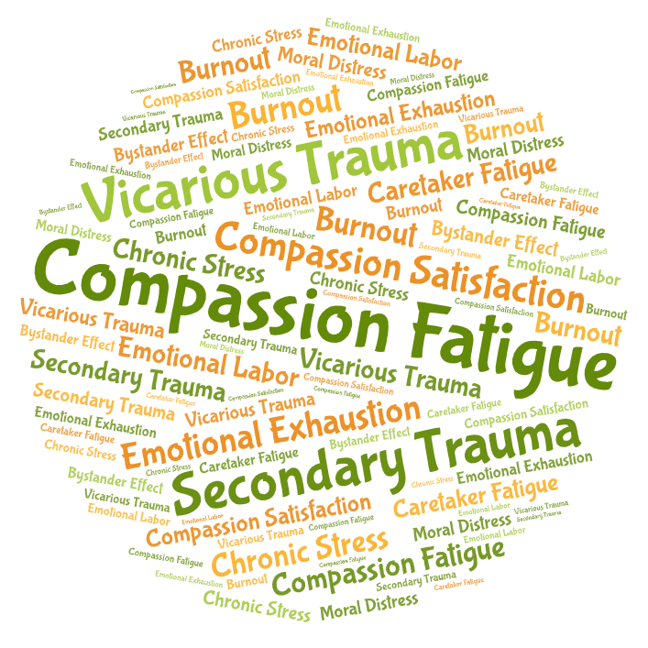
Definition
Compassion Fatigue
Emotional and physical exhaustion that can affect helping professionals and caregivers over time.
Figley, 1995
Notes:
Remind participants about the definition of compassion fatigue.
The feelings that we feel from compassion fatigue are a bit different from what we just talked about in the section on noticing our reactions. Compassion fatigue describes feelings that build up over time from doing this work. The reactions we discussed in the last section were reactions to individual people we support. They are related – for example, if you work with a lot of individuals with challenging behaviors and are having strong reactions, it can increase your compassion fatigue.
We’re going to talk about the reasons for compassion fatigue and ideas for how to address it.
RC IDD Basic Manual: Day 2, Slide 166
1:45-2:05 Addressing and Transforming CF (Slides 165-175)

Slide 60
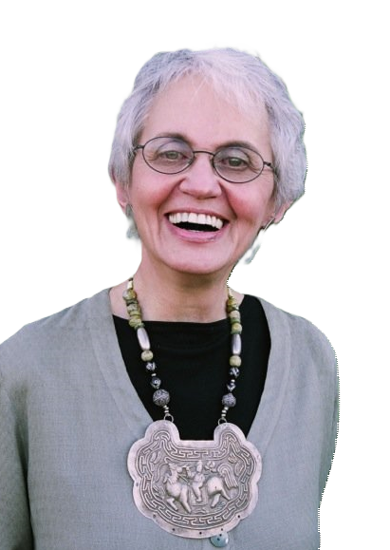


CF: How this Work Will Change You
“The expectation that we can be immersed in suffering and loss daily and not be touched by it is as unrealistic as expecting to be able to walk through water without getting wet…We burn out not because we don’t care but because we don’t grieve. We burn out
– Rachel Naomi Remen, M.D.
Physician, clinical professor of family and
community medicine at the University of California
because we’ve allowed our hearts to be so filled with loss that we have no room left to
care.”
Notes:
Ask a volunteer to read this quote out loud.
Discussion Guide
This quote suggests a denial by our field, our organizations, and us of the pain and loss of our work – like we can do this incredibly hard work, not be affected, and plow forward. How do you make sense of that denial? (Possible answers: the feelings are so big that we push them away; we fear that if means we are weak and unprofessional; there no place to process the grief and not models for how to do so)
What are the implications for our organizations and us of pushing away loss in this way?
RC IDD Basic Manual: Day 2, Slide 167
1:45-2:05 Addressing and Transforming CF (Slides 165-175)

Slide 61
Reasons We Experience CF
In Us
(as Support Professionals)
In Environment
CF
Notes:
RC IDD Basic Manual: Day 2, Slide 168
Explain that our level of compassion fatigue depends on both factors in the environment (our program, our agency, the wider system) and factors about us as people.
How those combine at any particular time contribute to how we feel compassion fatigue.
1:45-2:05 Addressing and Transforming CF (Slides 165-175)

Slide 62
Reasons We Experience CF
In Environment
In Us
Examples:
Funding of the IDD sector
Staffing levels
Exposure to trauma stories
Support of peers
Nature of supervision
Org culture that promotes discussion of CF
Salary level
Bias (i.e. racism, sexism, homophobia)
Examples:
Current life stressors
Person’s own history of
ACEs and trauma
Shared trauma
Interests outside of work
Investment in the mission
of the work
Self-care
How we manage our feelings
Longevity doing this work
CF
Notes:
Click (Environment) - The factors in the environment include ones like these which are present in our organizations, the wider IDD sector, and society as a whole.
Read through the bullets on the slide and expand with examples.
The low level of funding in the IDD sector of course impacts others on the list such as salaries, staffing levels, and availability of supervision.
To staff of color, the experience of racism at work compounds the bias they feel all around them.
Click (in Us as Support Professionals) - The factors listed here under “In Us” are examples of what your story is, what you bring with you to the job.
Elements of our work environment will inevitably overlap with our own personal history, including our history of trauma. Remember that a large percentage of support professionals are trauma survivors themselves. How much work you have done on yourself to heal can greatly impact how much compassion fatigue you experience.
“Shared trauma” refers to staff being exposed to the same type of trauma as the people they support (e.g., racial violence, school shootings, natural disasters). So, staff feel the impact both at work and at home.
Life happens to us also. We may have a parent who is sick, we could be going through a divorce, or have kids who are having problems. This can leave us more vulnerable to compassion fatigue.
Most believe that to really last in this line of work it has to be a mission on some level – your little part of changing the world for the better. While we often don’t have control of what life presents us, we do have control of many things on this list that can minimize compassion fatigue’s toll.
Click – (Intersection of the Environment and Us) - How the environment and factors in us merge together determine how a support professional experiences compassion fatigue.
Discussion Guide
Which of the factors on the environment side help to ease their compassion fatigue? What factors on the environment side make their compassion fatigue worse?
What could you add to the list?
What factors on the “In Us” side help to ease their compassion fatigue? Which make it worse?
RC IDD Basic Manual: Day 2, Slide 169
THIS SLIDE IS ANIMATED
1:45-2:05 Addressing and Transforming CF (Slides 165-175)

Slide 63
What To Do About CF
In Environment
In Us
Examples:
Organization communicates that CF is normal, inevitable, and should be discussed
Staff recognition and celebration
Control for overtime worked
Regular supervision
Foster teams that give
and accept help
Address organizational bias
Themes to Address:
Anticipate CF and build in protection
Address signs of CF when they arise
Transform the pain of CF
CF
decreas ing
Notes:
RC IDD Basic Manual: Day 2, Slide 170
There are many ways that organizations and we as support professionals can address and transform compassion fatigue.
Click - We put actions by the organization to change the environment first because it is very easy for an organization to say, “Yes, we think compassion fatigue is important, so go get exercise, eat well, and have a massage.” This does not help the problem. Organizations must create the conditions where staff are more likely to take care of themselves. They must also create a climate where staff feel supported and challenged.
Organizations can convey the message that is important for staff to have outlets to discuss and share their compassion fatigue. Since BIPOC staff may be reluctant for good reason to be vulnerable about their CF at work, organizations can suggest other ways to get support such as using the Employee Assistance Program (EAP), seeking out faith-based leaders, using community resources like barber shops, salons, recreation centers.
Because staff of color likely have endured racial bias in previous employment settings, explicit organizational efforts to address racial bias will increase trust and decrease compassion fatigue.
Click – These are the areas where we as support professionals can take actions to address compassion fatigue. We’re going to talk specifically about these areas in the following slides.
Discussion Guide
Why might organizations be reluctant to communicate that compassion fatigue is normal and inevitable?
To what extent is there a culture at your organization where staff feel supported and encouraged to practice self-care?
THIS SLIDE IS ANIMATED
1:45-2:05 Addressing and Transforming CF (Slides 165-175)

Slide 64
Anticipate Compassion Fatigue and Build in Protection (The ABCs)
Awareness
    Be attuned to our needs, limits, emotions, resources
    Heed all sources of information—thoughts, feelings, bodily signs, intuition
    Practice mindfulness and acceptance
Balance
    Between work, play, and rest
Connection
    To oneself, to others, and to something larger
Notes:
First, we must learn how to anticipate compassion fatigue and build in protection into our everyday lives. We call this the ABC’s:
Awareness. See discussion questions below.
Mention that we may get feedback from others before we even notice ourselves that we are being affected by the work. It is important to be open to that feedback.
Balance is important and difficult to achieve because the demands of the work are infinite. There is always something more we can do and it would probably help. We have to set limits and support each other in doing so. The best way to do this is to have things outside of work that are important to us such as relationships and activities that matter so that we will not feel overwhelmed by the work.
Connection can be to oneself - noticing what you are feeling and needing; to other people via the relationships in our lives; to something larger such as a higher power, a political movement, nature, volunteering in your community. Healing so often happens with community - within family, friends, and community – and especially in BIPOC communities where the concept of what happens to one happens to all is prevalent.
Discussion Guide
Awareness. Ask people where in their body do they experience the stress of the job. What physical signs would they first notice?
What emotional reactions would be a clue that they need a break?
What thoughts might signal cynicism or exhaustion are developing?
RC IDD Basic Manual: Day 2, Slide 171
1:45-2:05 Addressing and Transforming CF (Slides 165-175)

Slide 65

Addressing Signs of Compassion Fatigue When They Build Up
Self-care
Self-nurture
Escape
Community
Celebration
Notes:
Despite everyday prevention, there are times when one can especially feel the cumulative impact of compassion fatigue.
As we mentioned, awareness is important to identify when this is happening so you can take action to address.
Spend time brainstorming in the large group strategies that participants already use in each of the areas listed on the slide to address compassion fatigue when it arises.
RC IDD Basic Manual: Day 2, Slide 172
1:45-2:05 Addressing and Transforming CF (Slides 165-175)

Slide 66
Transforming the Pain of Compassion Fatigue
The pain of compassion fatigue often leads us to search for hope and meaning.
Working with people who have suffered teaches us about:
    Courage and human resilience
    Possibility of transformation
    Gratitude in our own lives
    Power of hope
Creating meaning in our lives and work helps us
endure and transform compassion fatigue.
Notes:
RC IDD Basic Manual: Day 2, Slide 173
Human beings often deal with pain by finding the good that comes of it.
Have you ever heard someone say, “I didn’t want to have that cancer scare last year, but it helped me realize my priorities and I went back to school.”
Some people who experience tragedies are able to turn their pain into positive actions. An example of this is Mothers Against Drunk Driving. These mothers experience a terrible loss, but instead of becoming bitter they developed a social action movement that radically changed the way we think about drinking and driving.
We see daily how the world is imperfect and not the way we would like it to be. Any actions we take to make the world a better place, such as coaching, mentoring, recycling, engaging in social justice advocacy, and more are all ways we can use our pain to improve the greater good.
We also must realize that the very intensity of our work, the very pain we experience, is what helps us grow and change as people.
Just as compassion fatigue can erode our sense of meaning and make us wonder what kind of world this is, doing this important work can increase our connection to the meaning of life, increase our connection with things larger than ourselves whether that be nature, God, or spirit.
We define spirituality as a connection with that which is larger than ourselves. Doing this work often deepens our sense of spirituality.
1:45-2:05 Addressing and Transforming CF (Slides 165-175)

Slide 67

Transforming the Pain of Compassion Fatigue
From compassion fatigue
To compassion satisfaction
“Compassion satisfaction is the satisfaction you get from being able to work as a helping professional or caregiver.”
– Charles R. Figley, Ph.D.
Professor Emeritus, researcher, author
238
Notes:
RC IDD Basic Manual: Day 2, Slide 174
Yesterday, we talked about the positive growth and transformation of us as people from doing the work we do.
Addressing compassion fatigue involves more than just self-care strategies. Many who have done this work for a long time, can point to specific ways in which their life has been richly enhanced by this most challenging work and feel immensely appreciative of the opportunity it provided them to grow as people.
Daily work pressures can make transformation more difficult so it is important to notice and appreciate positive experiences (big and small) each day.
Discussion Guide
What brings you particular satisfaction about the work you do?
How do you think you’ve grown as a person as a result of your work?
1:45-2:05 Addressing and Transforming CF (Slides 165-175)

Slide 68
Transforming the Pain of Compassion Fatigue
“There is a privilege working with people
on the edge of life. The view from the edge of life
is so much clearer.”
– Rachel Naomi Remen, M.D.
Kitchen Table Wisdom: Stories that Heal
Notes:
Ask a volunteer to read a quote on the slide.
Discussion Guide
Discuss what people think this means. If they are having trouble, explain that people generally understand this to mean that exposure to people who are in pain, makes us aware and grateful for the good things and blessings we have in our lives. Without that reminder, we might take our blessings for granted.
Give an example from your own life about how doing this difficult work increases your gratitude for things in your life.
How does this example fit with your experience?
RC IDD Basic Manual: Day 2, Slide 175
1:45-2:05 Addressing and Transforming CF (Slides 165-175)

Slide 69


Video: Success Stories
Promo for Patrice: The Movie
Closed Caption/Subtitle Version
Notes:
RC IDD Basic Manual: Day 2, Slide 176
One important way to address compassion fatigue is to recognize successes, even If they are small. In the same way we can set the bar unrealistically high for ourselves, we can do that with people we support as well. It may be a win that a child stayed in their classroom 2 days in a week rather than zero. We don’t talk about these small and big wins enough.
Ask if anyone would be willing to share a success story, even if it is very small.
Show the video of Patrice. She is a big success story. Enjoy her!
2:05-2:15 Exercise: Success Stories (Slide 176)

Slide 70
Training Evaluation
Please complete before the end of the training!
Notes:
RC IDD Basic Manual: Day 2, Slide 177
Direct participants to the Risking Connection Training Evaluation at the end of their Participant Packet. This is the evaluation for the entire training, not just today. It is the last page of their Participant Packet.
Allow participants time to complete.
2:15-2:25 Training Evaluation (Slide 177)

Slide 71
Break Time
Notes:
RC IDD Basic Manual: Day 2, Slide 178
2:25-2:40 BREAK (Slide 178)
Break.

Slide 72
Putting It All Together
Notes:
RC IDD Basic Manual: Day 2, Slide 179
2:30-3:30 Putting It All Together (Slide 179)
No notes.

Slide 73

Exercise: Indicators of Trauma-Informed Staff Behavior
Notes:
Explain that this training has talked a great deal about what trauma-informed interactions with people look like. In this exercise, you will evaluate some concrete indicators of trauma-informed staff behavior within your program.
As you do this, think about staff behavior with people you support AND staff behavior with each other whether they be supervisors, supervisees, or co-workers.
Direct participants to find Worksheet: Indicators of Trauma-Informed Staff Behavior in their Participant Packet.
Review the directions at the top of the Worksheet.
Ask participants to complete the Worksheet individually.
Break into small groups (ideally by people who work together) and have participants discuss their individual answers with their group.
Discuss as a large group using the questions below.
Discussion Guide
Which items do you think staff does best in your programs? Which items do staff display least often? What factors promote these behaviors and what gets in the way?
Which items would be the most difficult for staff to learn?
If admin or other support staff are present, ask what key items might you add for support staff behavior?
How might you imagine using this list?
What are one or two things you/your team will do in the short term to move your practice in this direction?
RC IDD Basic Manual: Day 2, Slide 180
2:30-3:00 Exercise: Indicators of TI Staff Behavior (Slide 180)

Slide 74
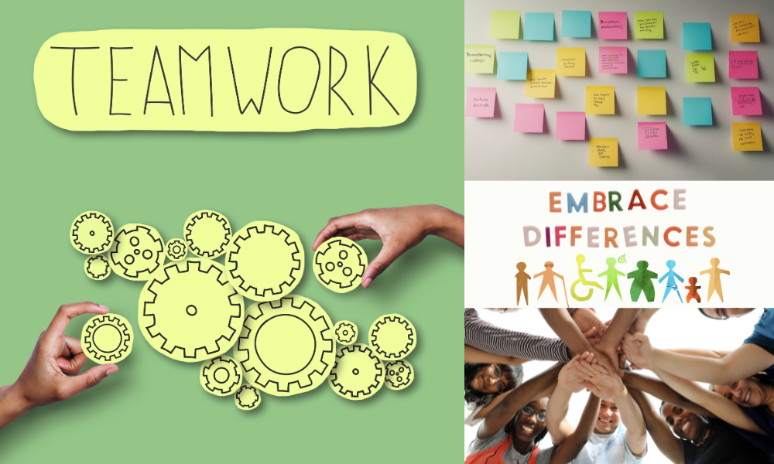
Exercise: Option 1
Implementing RC as an Organization
Notes:
Note: Option 1 for this exercise tends to be most appropriate in the early years of implementing trauma-informed care. Because it is about organizational changes, it is important to take the ideas that come up in the exercise and implement those that are feasible. Option 2 (next slide) is meant as an alternative when Option 1 no longer feels relevant.
To the extent possible, break into small groups based on program or department so that people are with others with whom they work closely.
Pass out a large sheet of newsprint and a marker to each group.
Ask the groups to brainstorm what they would need to make their program and agency an ideal setting to work with traumatized people and practice trauma-informed care. Encourage them to list things that are both “pie in the sky,” very realistic, or anything in between. Have one group member record all ideas on the newsprint.
Ask participants to include things that would help the organization address equity such as strategies to encourage discussion about racism and hiring practices to ensure the staff and Board reflect the population served.
After 10-15 minutes, ask them to place a circle around those ideas that could be accomplished in the short term and a square around those ideas that are longer term. Finally, ask each group member to identify one step toward one of the goals that they personally could work on.
When finished, have each group hang their newsprint around the room with tape. Ask everyone to walk around the room and look at the various lists.
Discussion Guide
Discuss as a large group:
What was it like to do this exercise?
What did people notice when looking at other groups’ lists?
To what extent were the ideas on the lists doable?
What were some of the first steps you came up with?
If possible, share the ideas with senior leadership at the agency. If even one small thing can be implemented, it can help staff to feel valued and heard.
RC IDD Basic Manual: Day 2, Slide 181
3:00-3:30 Exercise: Implementing RC as an Organization (Slide 181-182)

Slide 75

Exercise: Option 2
My Personal Contribution to a Trauma-Informed
Work Environment
Notes:
RC IDD Basic Manual: Day 2, Slide 182
NOTE: The Option 2 exercise has participants examine their own behavior. It may be more appropriate to RC trainings for new staff in the years after trauma-informed care is first implemented.
Direct participants to the Worksheet: My Personal Contribution to a Trauma-Informed Work Environment in the participant packet.
Ask participants to complete the Worksheet individually. Explain that they will only share parts of their answers that they are comfortable sharing. This exercise is primarily for them. Give them 10-15 minutes to complete.
Ask them to discuss any parts of the Worksheet with one other person. Urge them to make sure they talk about what they learned about ways they might contribute more to building a trauma-informed work environment.
Discussion Guide
With respect to feelings management, did people recognize any challenges they have that parallel (even on a much lower level) those of the people they support? (i.e. getting flooded with feelings, not expressing feelings directly, etc.)
What gets in the way of us expressing our feelings directly?
What behavior does and does not contribute to healthy conflict resolution in a workplace? By leaders? By workers? By the wider organizational culture?
Doing this worksheet, what did you learn about how you might contribute to trauma-informed work environment?
3:00-3:30 Exercise: Implementing RC as an Organization (Slide 181-182)

Slide 76
Summary and Closing
Notes:
RC IDD Basic Manual: Day 2, Slide 183
3:30-3:40 Summary of the Training (Slides 183-185)
No notes.

Slide 77
Summary of the Training
Disabilities make people with IDD vulnerable to trauma
Trauma is common and negatively impacts health
Trauma-informed care aims to make our organizations places where people can heal and not be re-traumatized
The RC Trauma Framework is a map that explains how present behavior may connect to past trauma
Trauma impacts three important areas: attachment, body and brain, and feelings management
Problem behavior is adaptative. It helps people in the moment (even if it also creates more problems)
Notes:
RC IDD Basic Manual: Day 2, Slide 184
With passion, summarize these critical themes of the overall training, trying to tie them together into a coherent argument.
3:30-3:40 Summary of the Training (Slides 183-185)
THIS SLIDE IS ANIMATED

Slide 78
Summary of the Training (Cont.)
Strengthening attachment, body and brain, and feelings management make extreme behaviors less necessary
RICH relationships are critical to healing all areas impacted by trauma
We must notice our reactions to the people we support to maintain RICH relationships
Compassion fatigue is real. We can address it and transform it to experience more compassion satisfaction.
An organization-as-a-whole must change to be truly trauma-informed
Notes:
RC IDD Basic Manual: Day 2, Slide 185
With passion, summarize these critical themes of the overall training, trying to tie them together into a coherent argument.
3:30-3:40 Summary of the Training (Slides 183-185)
THIS SLIDE IS ANIMATED

Slide 79

Exercise
Goodbye and Closing Ritual
Notes:
Offer a few words of inspiration, thank participants, then co-trainers thank each other.
Closing exercise
Have participants form a circle.
Holding the ball of yarn, a Trainer begins by offering an appreciation, learning, or enduring understanding to the group. Be brief so that others will be brief. Then roll or toss the yarn to someone across the circle who then offers their appreciation. The “tosser” HOLDS ONTO the yarn while tossing the ball to the next person. This continues until everyone in the circle has had an opportunity. As each toss is done, a “web of connectedness” begins forming.
When everyone has spoken, each will be holding a point of the web or star made of yarn.
After everyone in the circle has spoken, the ball returns to the Trainer who spoke first. They speak last, saying whatever inspirational words of closing that are appropriate to the training and the mood of the group.
After the last words, pause and instruct the group that on the count of three, you will all release the yarn. This represents the final closing of the training. “One, two, three.”
Bid your participants goodbye.
Adaptation for a Large Group To Save Time. Participants talk in groups of 3 (the groups being in a circle) about what they appreciated about the training. Each group picks a representative to step forward and say one appreciation on behalf of their small group. The trainer then begins the yarn process. This takes less time because there are fewer people speaking.
RC IDD Basic Manual: Day 2, Slide 186
3:40-4:00 Goodbye and Closing Ritual (Slides 186-187)

Slide 80
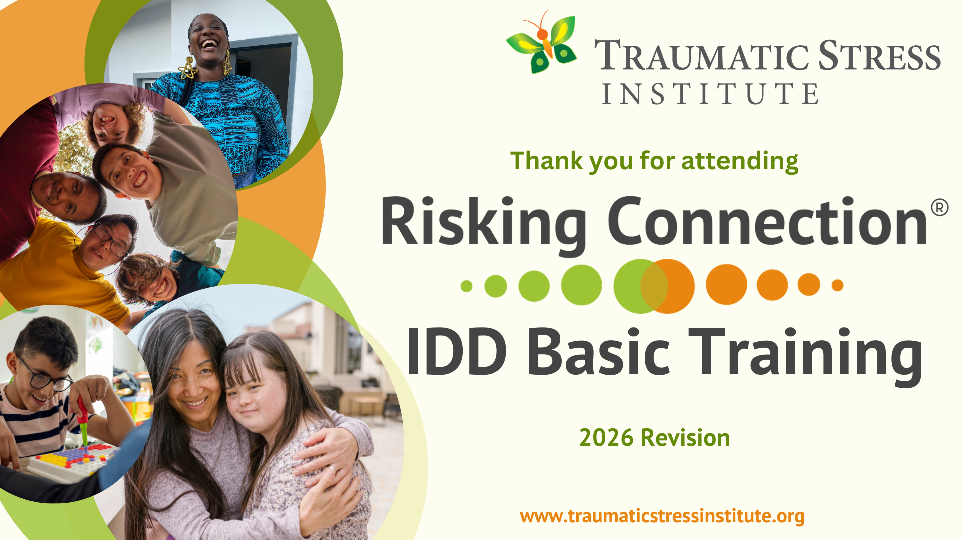
Notes:
RC IDD Basic Manual: Day 2, Slide 187
No notes.
3:40-4:00 Goodbye and Closing Ritual (Slides 186-187)

