Slide 1

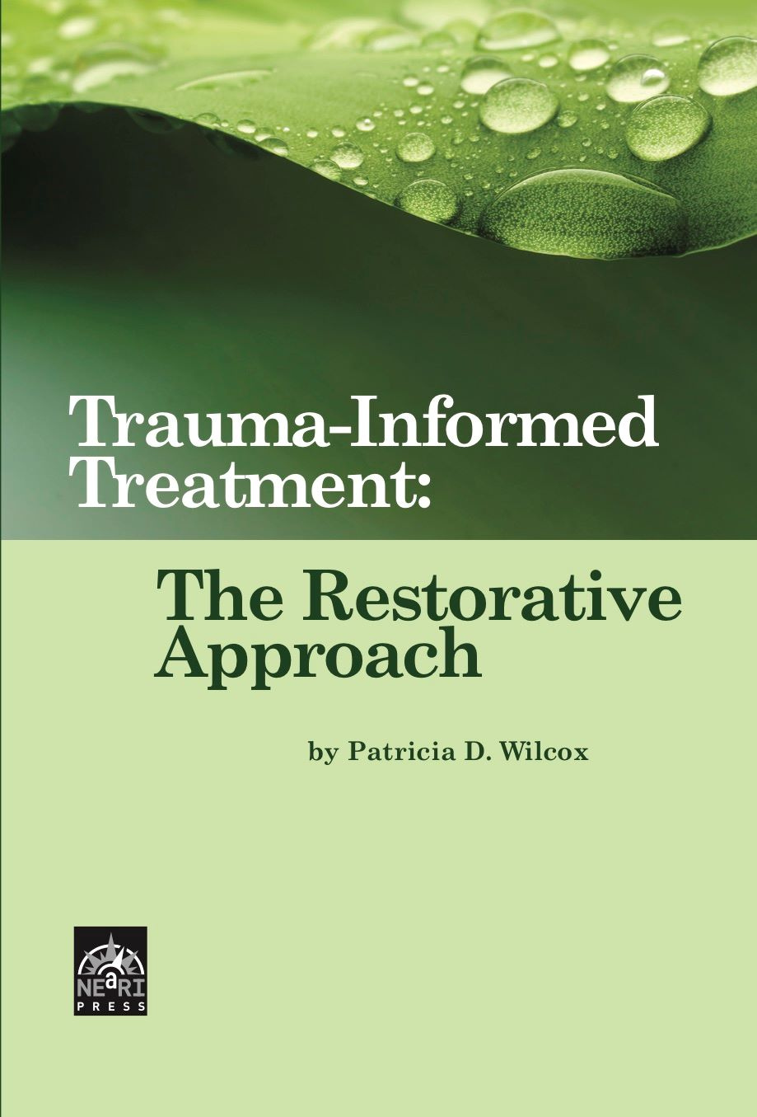

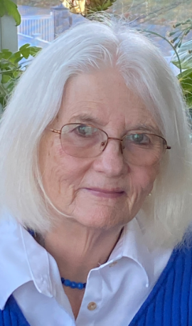
The Restorative Approach
Basic Training
2026 Revision
Notes:
9:00-9:45 Introduction
Introductions and overview (15 min.)
Exercise: My Teenager (30 min.)
Welcome participants to the training.
Trainers introduce themselves. As the Trainer, consider identifying your own race and other identities in your introduction. Naming one’s identities and modeling inclusive language in trainer introductions can both model and set a tone that all are truly welcome (see example below). You can then refer back to this when introducing the Day 3 opening activity: “What Makes Us Who We Are.”
Consider offering a land acknowledgement. Scan QR code for a resource on land acknowledgements.
Creating a space that is inclusive and welcoming for all
(especially for those of historically marginalized and
oppressed identities) is vitally important.
Sample Trainer Intro: My name is Darrell and I am a
Risking Connection (RC) trainer at our agency. I am a
social worker with experience in residential and outpatient
programs and have been an RC trainer for 3 years.
My mother is white and my father is Black. I identify as
biracial and male. I mention this because, while this is
not an anti-racism training, we cannot separate
trauma from racism; to support trauma healing, we
must also support anti-racism efforts.
RA Basic Manual: Slide 1

Slide 2
The Restorative Approach
The Restorative Approach® (RA) is a trauma-informed alternative to traditional “point and level” systems for child congregate care settings.
Based on the book Trauma-Informed Care: The Restorative Approach by Patricia Wilcox, LCSW, VP of Klingberg and TSI Faculty Trainer, it answers the question: “Now that I understand how trauma affects children, what should I actually do on Monday?,” translating what we know about trauma, the brain, and how children heal into specific strategies that all treatment providers can use.
Notes:
Introductions
You may optionally want to briefly mention the text on the slide, acknowledging the reason for the creation of the Restorative Approach training.
Ask each participant to say their name, role, and two words that describe them when they were an adolescent.
Discuss
Do you continue to exhibit behaviors now that would have described you as adolescents?
Did you have adults in your life who were concerned about your behaviors as adolescents?
Why did you turn out to be productive adults?
Link their responses to the youth they are currently working with.
Points to make: How someone is as an adolescent does not predict how they will be as an adult. With connection and sincere engagement, these kids can become productive and successful as well.
9:00-9:45 Introduction
Introductions and overview (15 min.)
Exercise: My Teenager (30 min.)
RA Basic Manual: Slide 2

Slide 3

Overview of the Training
Introduction and Overview
Definitions and Assumptions
Theory Behind the Restorative Approach (RA)
Building an RA-Informed Milieu
Responding to Problem Behavior When Children Hurt Others
Steps to Creating Restorative Tasks
Resistance to RA
Vicarious Trauma and RA
Summary, Wrap-Up, Evaluations
When you see this icon, there’s more to see in the Resources section’s Implementation Tip Sheets
Notes:
Overview
Review the agenda above.
Review the inset box: When you see the “tips” icon, there’s more to see in the Resource section’s Implementation Tip Sheets. (These are toward the end of the RA Basic participant packet and RA Manual).
9:00-9:45 Introduction
Introductions and overview (15 min.)
Exercise: My Teenager (30 min.)
RA Basic Manual: Slide 3

Slide 4

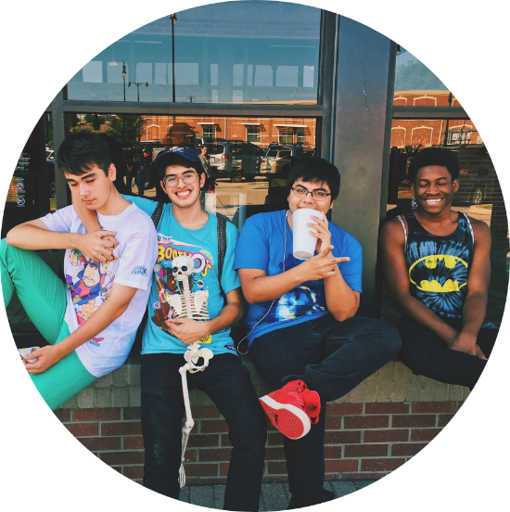

Exercise: My Teenager
Write down the name of a teenager you know in your personal life….
…maybe your child, yourself as a teen, a friend…
Notes:
Exercise: My Teenager
Part I
Print out 8 ½ x 11 sheets/cards from the Word file named “My Teenager Exercise”, available with the RA materials on the RC Trainers’ Corner, or alternatively, as a list on pages 85-86 of this manual. This includes two sheets/cards that say: “More Likely to Stay” and “More Likely to Go.”
Tape the “More Likely to Stay” and “More Likely to Go” cards up before you start the training. Place them far enough apart that you can place the individual cards in between them, on a continuum. Reserve the rest of the pages for the exercise.
Say: Imagine the teen you are thinking of is hanging out after a school dance. One of the other kids says, “Hey, I have some spray paint. Let’s decorate this school.” Another says, “I know a door that is unlocked. Let’s go in and see what we can do.”
Ask: What would your teenager do? Would he stay or find a way to get out of it?
Vote with a show of hands:
Whose teenager would say “no” and leave?
Whose teenager would join in?
Who doesn’t know for sure what the teen would do?
Part 2
Now we will begin to look at the factors which could influence a teenager to either join in or say “no” and leave.
We are no longer thinking about the person whose name you wrote down, but teenagers in general.
Explain that you are going to break into groups and give each of group some sheets of paper which list factors in someone’s life.
As a group, decide whether you think that factor would influence a teenager to be more likely to:
Stay and participate
More likely to say “no” and leave
Could go either way
Please note: exercise instructions for this slide are
on this and next page
9:00-9:45 Introduction
Introductions and overview (15 min.)
Exercise: My Teenager (30 min.)
RA Basic Manual: Slide 4

Slide 5
Definitions and Assumptions
Notes:
9:45-10:00 Definitions and Assumptions
RA Basic Manual: Slide 5

Slide 6
What is the Restorative Approach?
A blueprint to operationalize trauma-informed care in group care settings – what to actually do
A method to increase the healing power of the daily moments in programs
A system for responding when children hurt others (not minor behaviors)
An alternative to traditional behavior modification systems such as “points and levels”
Notes:
Definitions and Assumptions
Review the slide above using the information below.
Emphasize that RA is a way to put trauma-informed care into action in the daily moments of our programs.
We will build on the principles learned in the Risking Connection Basic training.
Wilcox (2012). Trauma-Informed Care: The Restorative Approach, pp. 29-52.
9:45-10:00 Definitions and Assumptions
RA Basic Manual: Slide 6

Slide 7
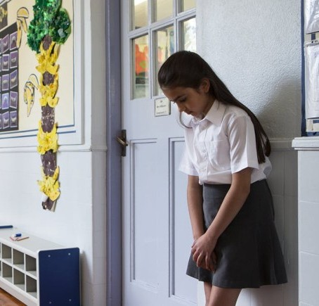

Assumptions
Not Trauma-Informed vs. RA-Informed Milieu
Not Trauma-Informed
RA-Informed
Consequences are essential
to changing behavior
Consequences may increase motivation. Healing relationships change behavior
Notes:
Assumptions
Review the slide above using the information below.
Non Trauma-Informed Model
Children are less likely to act badly because of fear of punishment.
This is the most powerful tool we have.
Restorative Approach
Healing relationships are a more powerful tool. Children are less likely to act badly when they care about pleasing adults they are close to.
When children feel seen, cared about, and feel that they belong, they have less need for extreme behaviors.
9:45-10:00 Definitions and Assumptions
RA Basic Manual: Slide 7

Slide 8


Assumptions
Not Trauma-Informed vs. RA-Informed Milieu
Not Trauma-Informed
RA-Informed
Saying that negative behavior is adaptive excuses the behavior
Understanding that negative behavior is adaptive helps us figure out ways to change it
Notes:
Definitions and Assumptions
Review the slide above using the information below.
Non Trauma-Informed Model
If you say that a negative behavior is the child’s best effort to meet a need in the moment or that they child is doing the best they can in the moment, then you are excusing the behavior.
Then they will use it as an excuse and keep doing it.
They need to be held accountable.
Restorative Approach
Understanding what needs a child is trying to meet is NOT the same as excusing the behavior. We can search for why they do what they do and still say that it’s not ok.
Understanding deeply why a child engages in negative behavior gives us the opportunity to help them learn ways to meet those needs in a healthier way with less negative consequences.
Understanding the impact of childhood racial trauma on behavior.
9:45-10:00 Definitions and Assumptions
RA Basic Manual: Slide 8

Slide 9
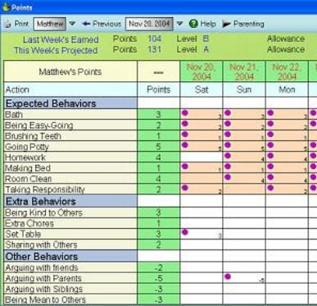

Assumptions
Not Trauma-Informed vs. RA-Informed Milieu
Not Trauma-Informed
RA-Informed
Things children want must be earned through good behavior
Provide good things (activities, connections) as part of life, not just when the child is “good”
Notes:
Definitions and Assumptions
Review the slide above using the information below.
Non Trauma-Informed Model
These children will try to get away with things if they can. They have not been held accountable for their behavior.
So you need to send a strong message from the very start that, if they want to get good things and privileges, they will need to earn them. There are no “give-a-ways.”
Restorative Approach
Children will attempt to do better if they can, especially when they feel safe. They deserve, and have the right to have, good things which we should provide from the outset.
This does not mean that there are no limits and there may be circumstances where they lose privileges.
But we start with the basic assumption that children are trying to do the best they can.
9:45-10:00 Definitions and Assumptions
RA Basic Manual: Slide 9

Slide 10


Assumptions
Not Trauma-Informed vs. RA-Informed Milieu
Not Trauma-Informed
RA-Informed
Children’s behavior is influenced only by their personal experiences
Children are also influenced by their experiences of racism and oppression
Notes:
Definitions and Assumptions
We must remain aware of the experiences of oppression in the lives of our children and families, and how those relate to their current behaviors. We must also consider the systemic, societal factors that have influenced their lives.
9:45-10:00 Definitions and Assumptions
RA Basic Manual: Slide 10

Slide 11
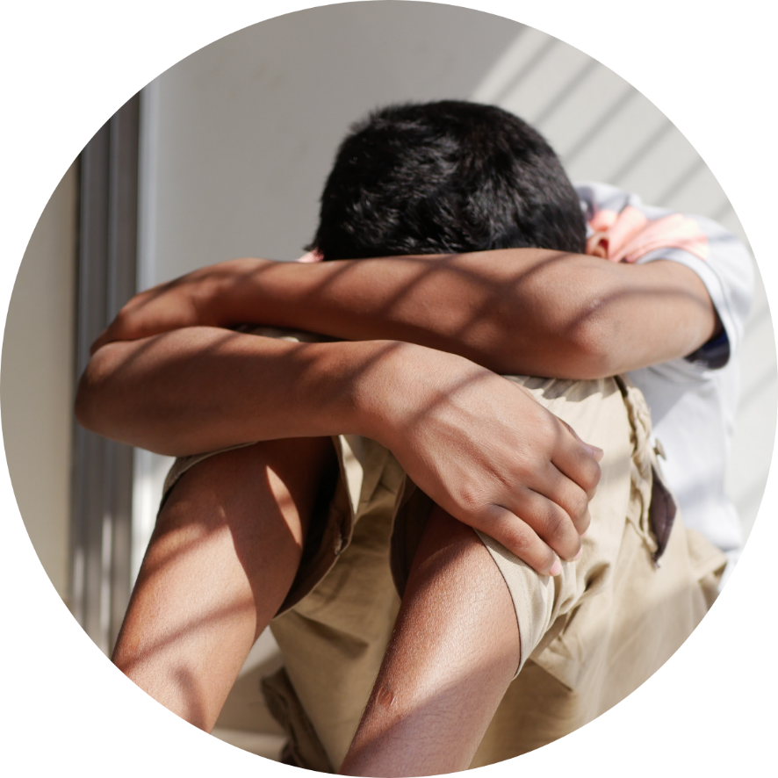
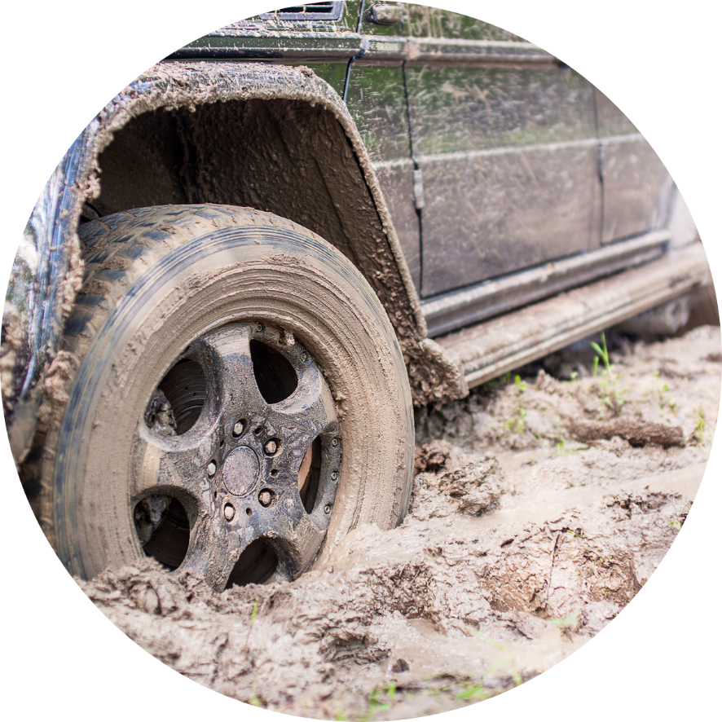
Assumptions
Not Trauma-Informed vs. RA-Informed Milieu
Not Trauma-Informed
RA-Informed
If children feel shame about bad behavior,
it will motivate them to change
Children already feel toxic shame. Shame does not change behavior; it makes it worse
Notes:
Review the slide above using the information below.
Non Trauma-Informed Model
These children often do bad, hurtful things so they should feel shame about that.
Feeling shame feels really bad. They won’t want to feel that way, so they will change their behavior and act better.
Chronic racism, othering and oppression also perpetuates shame
Restorative Approach
Our children already feel great shame – often referred to as “toxic shame.”
Rather than changing behavior, it is actually the root of a lot of negative behavior. For example, they think, “Everyone knows I’m a bad kid. I might as well act that way.”
We need to avoid as much as possible situations that could be shaming to children.
9:45-10:00 Definitions and Assumptions
RA Basic Manual: Slide 11

Slide 12
Exercise: Dahlia and the Milk
It’s a school day and Dahlia is sluggish and half awake. She scatters cereal all over the kitchen counter and leaves the milk out when she goes over to the table to eat. Mary, the morning staff, comes into the kitchen and sees the mess on the counter she
just cleaned.
  From a traditional model, what is Mary thinking and what does she say?
  From a trauma (RA)-informed model, what is Mary thinking and what does she say?
Notes:
Exercise: Dahlia and the Milk
Ask participants to work with the person sitting next to them.
Read the paragraph aloud.
Say: Think about the Non Trauma-Informed Model and the Restorative Approach slides.
Ask participants to write down answers to the 2 questions on the slides.
Pairs should actually write down Mary’s thoughts and a quote of what she says in response to Dahlia.
Ask a number of pairs to read what they wrote down to the first question, and then to the second question.
Discuss:
To what extent did they hear echoes of what is said in their programs – both from the Non Trauma-Informed and Restorative Approach side?
What is appealing about managing behavior using a Non Trauma-Informed model? What’s appealing about a model like the Restorative Approach?
If a program is using or moving toward RA, what kinds of things might contribute to a drift back to a Non Trauma-Informed model?
How might racial and cultural differences contribute?
Wilcox (2012). Trauma-Informed Care: The Restorative Approach, pp. 67-69.
9:45-10:00 Definitions and Assumptions
RA Basic Manual: Slide 12

Slide 13
The Theory Behind the Restorative Approach
Notes:
10:00-11:00 The Theory Behind the Restorative Approach
Principles of Restorative Justice (10 min.)
Safety Above All Else (5 min.)
BREAK (15 min.)
RC Trauma Framework (30 min.)
RA Basic Manual: Slide 13

Slide 14
Victim
Feels empowered
Gets vindication
Principles of
Restorative
Justice
JUSTICE
Offender
Address harm
Personal transformation
Community
Safety for victims
Enhance feeling of community
Notes:
Principles of Restorative Justice
Review the slide above using the information below.
Tell the story of the origins of Restorative Justice
Two peoples have made profound contributions to practices in the field – the First Nations people of Canada and the U.S., and the Maori of New Zealand.
It has seen worldwide growth since the 1990’s.
The model represented on the slide is used in Criminal Justice settings.
Howard Zehr’s book Changing Lenses – A New Focus on Crime and Justice, suggests that instead of looking at crime as an offense against the state, we look at crime as a violation of people and relationships.
He says we need to ask the questions: Who has been harmed? What are their needs? What are the causes? What is the appropriate process to put things right? It involves all sides of the triangle – the victim, offender and community.
It is also about supporting the Offender with acquiring the skills necessary to make amends and learn competencies to live a full and productive life.
In this model, justice is at the center as a way to empower victims to identify what they need to feel whole again.
10:00-11:00 The Theory Behind the Restorative Approach
Principles of Restorative Justice (10 min.)
Safety Above All Else (5 min.)
BREAK (15 min.)
RC Trauma Framework (30 min.)
RA Basic Manual: Slide 14

Slide 15
The Restorative
Approach
in Action
Harmed
Harm acknowledged
Hang on to hope for change
SAFETY
Harm Doer
Transform shame
with healing interactions
Make amends and learn skills
Community
Support for those harmed
Enhance feeling of community
Prevent future harm
Notes:
Restorative Approach in Action
Review the slide above with the information below.
RA uses the same framework but instead, places safety at its core, not justice. We will talk more about safety as we work through the material today.
The child, the harm doer, likely feels increased shame when they hurt others, even though they may not show it. They may also feel “all is lost” and they’ll be rejected like so many times in the past.
RA provides the opportunity for them to repair those relationships, realize that others will still support them, and learn that they are worthy of life.
RA enables the harmed, usually the Treaters but also other children, to receive acknowledgment of the harm done to them. They can experience relationships being repaired and see youth move toward believing that people can trusted to help.
It also provides treaters who are harmed opportunities for self-care that facilitates hope that change can occur.
Finally, it enhances a sense of community in the program. Treaters and youth are continually working to build a sense of safety in the community where harm doing is dealt with in an open and deliberate way. Ideally, everyone in the program becomes invested in making the community a safe and healing place.
10:00-11:00 The Theory Behind the Restorative Approach
Principles of Restorative Justice (10 min.)
Safety Above All Else (5 min.)
BREAK (15 min.)
RC Trauma Framework (30 min.)
RA Basic Manual: Slide 15

Slide 16

Safety Above All Else
Safety is a prerequisite for play, learning
and growth.
Baby Rats Experiment
Notes:
Safety Above All Else
Review the slide above using the information below.
Without safety, growth and healing cannot happen.
To further elucidate the experience of danger, consider an experiment with baby mice (Panksepp, 1998).
Some baby mice had been raised in cages.
They had never seen or heard of a cat.
Like all baby animals, they engaged in a lot of free play with each other.
The experimenters put two cat hairs in the cage.
Although the baby mice had no cat experience, the cat hairs were wired into their brains as signifying danger.
Immediately, all free play stopped.
Then, even when the cat hairs were removed, it took a few days for the mice to gradually play again, but the play never returned to the level it had before the cat hairs were introduced.
ASK: How does this relate to the youth you work with? What aspects of your program might make a youth feel unsafe? How do we make youth feel safe? How does chronic racism and oppression impact safety?
Key Points: Children with histories of trauma can be extremely reactive to reminders of danger in their environment often causing play, learning, and social engagement to stop. That’s why thinking about safety is critical. They are also more resilient than baby mice so when the “cat hairs” are removed, they can eventually learn to play again.
Wilcox (2012). Trauma-Informed Care: The Restorative Approach, pp. 20.
10:00-11:00 The Theory Behind the Restorative Approach
Principles of Restorative Justice (10 min.)
Safety Above All Else (5 min.)
BREAK (15 min.)
RC Trauma Framework (30 min.)
RA Basic Manual: Slide 16

Slide 17
BREAK
Notes:
10:00-11:00 The Theory Behind the Restorative Approach
Principles of Restorative Justice (10 min.)
Safety Above All Else (5 min.)
BREAK (15 min.)
RC Trauma Framework (30 min.)
RA Basic Manual: Slide 17

Slide 18
Healing Attachments
Notes:
Wilcox (2012). Trauma-Informed Care: The Restorative Approach, pp. 16-18.
10:00-11:00 The Theory Behind the Restorative Approach
Principles of Restorative Justice (10 min.)
Safety Above All Else (5 min.)
BREAK (15 min.)
RC Trauma Framework (30 min.)
RA Basic Manual: Slide 18

Slide 19
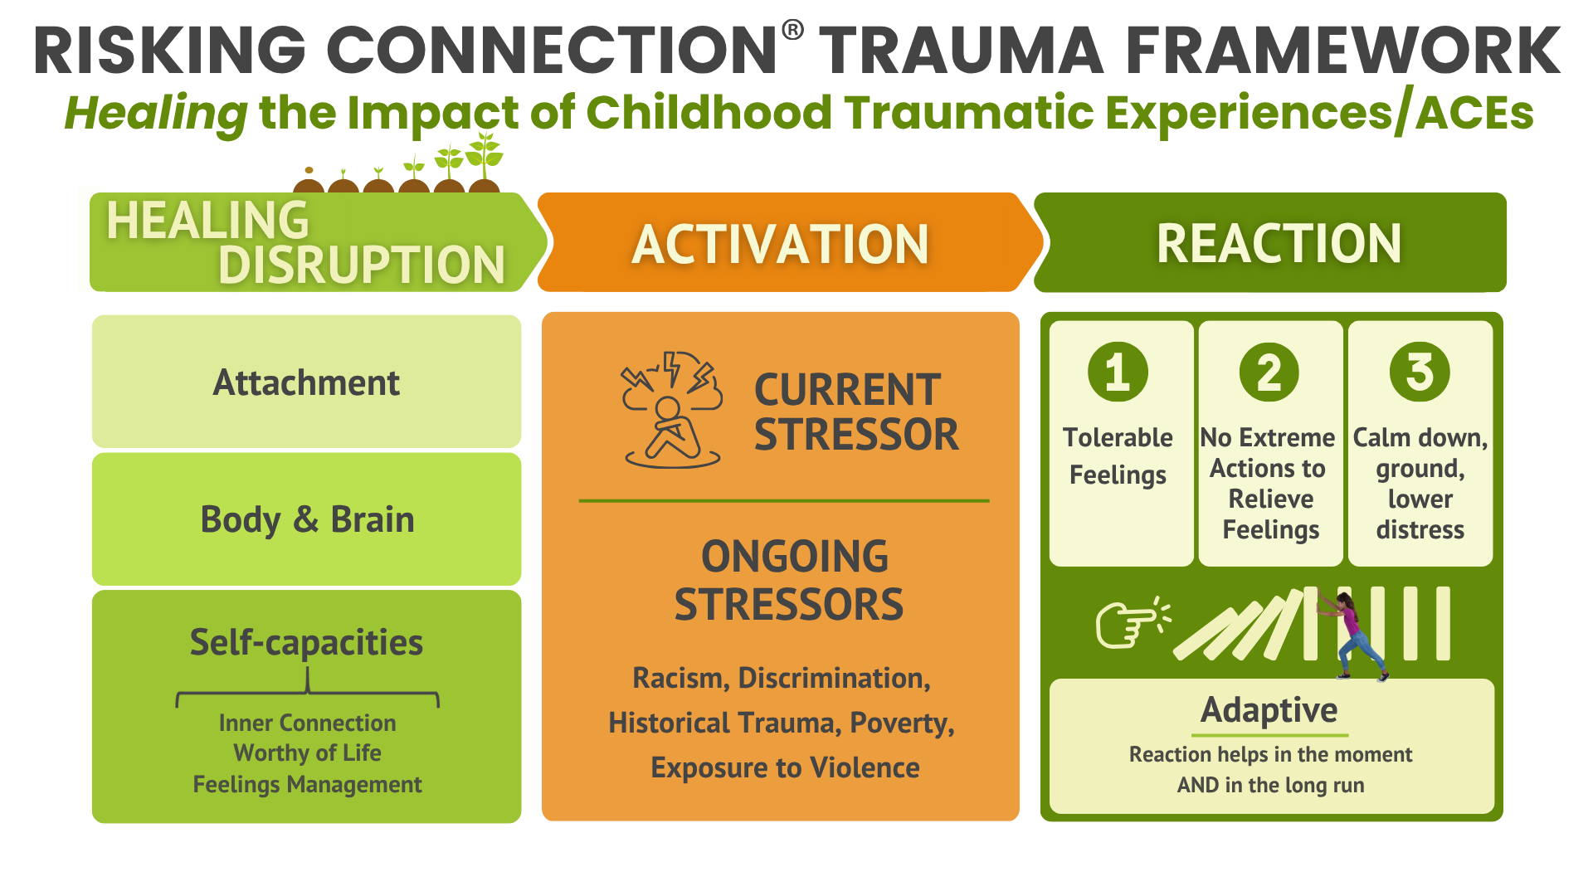
Notes:
THIS SLIDE AUTOPLAYS AN ANIMATION
Review the slide above using the information below.
In review of this healing trauma framework that we discussed in RC Basic, the premise is that when clients begin to trust that others can help (attachment), when their nervous system is more regulated (body and brain), and when they have the skills to manage strong feelings (self-capacities), current stressors now are more tolerable, people don’t need extreme behaviors to manage, and they can calm down and ground. Their behavior is adaptive both in the moment and long term without negative consequences. This makes life worth living.
Attachment heals. This is the most fundamental principle in the Restorative Approach.
We will start by looking at relationships.
10:00-11:00 The Theory Behind the Restorative Approach
Principles of Restorative Justice (10 min.)
Safety Above All Else (5 min.)
BREAK (15 min.)
RC Trauma Framework (30 min.)
RA Basic Manual: Slide 19

Slide 20

Healing Relationships
Moment-to-moment healthy interactions with children:
Change child’s expectations about relationships
Help rewire the brain
Create connections that clients can internalize
over time and use to calm themselves
Reduce shame and make clients feel worthy of life
Teach clients feelings management skills
More ideas in: Ten Tips for Building Relationships
Notes:
Attachment
Review the slide above using the information below.
Refer to the tip sheet handouts: Ten Tips for Building Relationships.
Every day we are helping a child’s brain to grow and form new connections.
When adults interact with children in RICH ways they begin to change the child’s expectations about relationships.
Remember in RC Basic, we talked about treaters as “brain surgeons,” sculpting new brains through positive interactions.
Every time a child has a positive experience with a treater, it builds new pathways in the brain. Because of the positive interaction and connection, the child does not need to activate the “reactive brain” (fight, freeze, and flee) and can begin to use the “thinking brain” to problem-solve, connect, regulate.
With consistency and frequency, the new pathway that is developed becomes the one the child uses more consistently.
As the connection grows between the treater and the child, the child internalizes the connection and can use it to calm herself.
When the treater does not abandon the child during challenging times, the child feels less shame and worthier of life.
How do you think attachment might be impacted for indigenous children whose parents and grandparents were forced to leave home to get “civilized” in residential schools?
How might attachment be impacted when a caregiver is incarcerated which happens at and unequal rate for people of color (POC)?
What has been a POC’s experience with the “system” that may influence their ability to form attachment with treaters?
How does the history of family separation due to slavery/boarding schools impact the ability to have relationships?
Wilcox (2012). Trauma-Informed Care: The Restorative Approach, pp. 16-18.
10:00-11:00 The Theory Behind the Restorative Approach
Principles of Restorative Justice (10 min.)
Safety Above All Else (5 min.)
BREAK (15 min.)
RC Trauma Framework (30 min.)
RA Basic Manual: Slide 20

Slide 21
Regulating Brain and Body
Notes:
Wilcox (2012). Trauma-Informed Care: The Restorative Approach, pp. 37-39.
10:00-11:00 The Theory Behind the Restorative Approach
Principles of Restorative Justice (10 min.)
Safety Above All Else (5 min.)
BREAK (15 min.)
RC Trauma Framework (30 min.)
RA Basic Manual: Slide 21

Slide 22
Notes:
Brain and Body
Return to the healing Trauma Framework to frame the next section:
Now we will explore in more depth how trauma affects brain development.
Wilcox (2012). Trauma-Informed Care: The Restorative Approach, pp. 18-23.
10:00-11:00 The Theory Behind the Restorative Approach
Principles of Restorative Justice (10 min.)
Safety Above All Else (5 min.)
BREAK (15 min.)
RC Trauma Framework (30 min.)
THIS SLIDE AUTOPLAYS AN ANIMATION
RA Basic Manual: Slide 22

Slide 23

Organization of the Brain
Adapted from Bruce Perry
Develops Third
Neocortex
“Thinking Brain”
thinking; learning; inhibiting; language
Develops Second
Limbic System
“Emotional Brain”
attachment; emotions;
anger response; survival −
fight, flight, and freeze
Develops First
Brainstem
“Primitive Brain”
Basic body functions
The Brain Develops from Bottom to Top
Notes:
Brain and Body
Review the slide above using the information below.
(slides animated in slide show view)
Normal development starts from the bottom of the brain and goes up, from the brainstem to the cortex. Brain development is sequential – development of each part depends on development of the parts below it.
First Click – The first part of the brain to develop is the Brainstem—Primitive Brain. It controls sensory/motor and communication in both directions between the brain and the body. Automatic things like breathing, blood pressure, heart rate.
Second Click – The second part is the Limbic system – Emotional Brain which regulates emotional development including attachment. This emotional center of the brain sends alarms and assigns a feeling to an event. The fight, flight, freeze happens here.
Third Click – The third is the Neocortex - Thinking Brain. This includes language, abstract thinking, planning, intellectual learning, and self-awareness.
Let’s continue to look now at how trauma impacts brain development.
10:00-11:00 The Theory Behind the Restorative Approach
Principles of Restorative Justice (10 min.)
Safety Above All Else (5 min.)
BREAK (15 min.)
RC Trauma Framework (30 min.)
THIS SLIDE IS ANIMATED
RA Basic Manual: Slide 23

Slide 24
Trauma’s Impact on the Child’s Brain
Adapted from Bruce Perry
Offline when stressed
Thinking Brain
Evaluate threat
Taking action to calm emotions
Pause before acting
Talking to others
Trauma
Emotional Brain
Intense (or no) emotions
Don’t trust relationships
Over-sensitive to danger triggers
Primitive Brain
Don’t notice or understand
body responses
Unable to regulate activation
Trauma
Notes:
Brain and Body
Review the slide above using the information below.
(slides animated in slide show view)
Trauma effects all parts of the brain, both in how they develop and how they function during times of stress.
First Click – Trauma disrupts communication between the brain and body. The person may not be able to interpret signals from its own body. For example, not being able to tell whether you are tired, hungry, or need to go to the bathroom. Youth may seem awkward, over active or slow.
Second part is the Limbic system. Trauma makes the brain overly sensitive to danger and threat. A person has trouble interpreting social cues and over identifies the negative.
Third Click – The third is the Thinking Brain. The thinking brain is less developed and harder to access in people who have experienced early trauma.
Fourth Click – The thinking brain is not available or often off line when the person is dysregulated or under stress. Since trauma survivors often live in a jacked up, highly activated state, they have less access to their rational, thinking brain.
Let’s look now at more implications.
THIS SLIDE IS ANIMATED
RA Basic Manual: Slide 24

Slide 25
Trauma’s Impact on the Child’s Brain: Behavioral Implications
Adapted from Bruce Perry
Thinking Brain
Can’t think, problem solve, plan – especially in crisis
Less access to language
Trauma
Emotional Brain
Intolerable feelings take over
Don’t trust relationships
Misread social cues and threat
Primitive Brain
Body highly reactive to threat
Can’t inhibit primitive responses
Trauma
Notes:
Brain and Body
Review the slide above using the information below.
(slides animated in slide show view)
Trauma affects all parts of the brain, both in how they develop and how they function during times of stress.
First Click – Trauma disrupts communication between the brain and body, manifesting as physical awkwardness, overly active or inactive, eating, toileting, and sleep problems.
Second Click – Trauma’s impact on the emotional brain can mean difficulty connecting, distrustful, easily startled, quick escalations, and difficulty relaxing enough to play. Due to chronic racism/oppression, the fight, flee, freeze response is stronger than the regulating and thinking muscle.
Third Click – When the thinking Brain is not well developed, people have trouble with planning, self-awareness, language, and seeing connections between present actions and future consequences.
Let’s look now at the implications for our work.
10:00-11:00 The Theory Behind the Restorative Approach
Principles of Restorative Justice (10 min.)
Safety Above All Else (5 min.)
BREAK (15 min.)
RC Trauma Framework (30 min.)
THIS SLIDE IS ANIMATED
RA Basic Manual: Slide 25

Slide 26
Trauma’s Impact on Child’s Brain:
What to Do
Adapted from Bruce Perry
REASON
Thinking Brain
Place less emphasis on thinking, problem-solving, language tasks.
RELATE
Emotional Brain
RICH relationships
Calm emotions first
Build self-capacity skills
REGULATE
Primitive Brain
Activities that are rhythmic, rewarding, and in relationship
Empathy, warmth, calm
Notes:
Brain and Body
Review the slide above using the information below.
(slides animated in slide show view)
Each part builds on the ones below so skills in one help develop the skills in others.
First Click – REGULATE. Rhythmic activities, which are rewarding (so the youth will want to do it), repetitive, and relational help rewire the lower brain. Examples: music, dance, drumming, walking, rocking, jump rope, throwing a ball back and forth, patty cake, etc.
Second Click – RELATE. We help through RICH relationships which build trust and help children “risk connection.” Again, we calm emotions first in a crisis so that thinking can come online. Remember co-regulation – children learn to calm their emotions by being with calm adults.
Third Click – REASON. We initially focus less here. Gradually, as the primitive and emotional brain begin to rewire, we teach problem solving, creating a narrative about the past using language, planning techniques such as lists, and self-awareness.
Over time, we help the child regulate, relate, and reason in that general order.
Add activities to our schedules that are culturally familiar and relevant to the youth.
Let’s look now at brain plasticity.
10:00-11:00 The Theory Behind the Restorative Approach
Principles of Restorative Justice (10 min.)
Safety Above All Else (5 min.)
BREAK (15 min.)
RC Trauma Framework (30 min.)
THIS SLIDE IS ANIMATED
RA Basic Manual: Slide 26

Slide 27
Brain Plasticity
Adapted from Bruce Perry
Thinking Brain
Most Plastic and
Easiest to Change
Emotional Brain
Primitive Brain
Least Plastic and
Hardest to Change
Notes:
Brain and Body
Review the slide above using the information below.
(slides animated in slide show view)
First Click—This slide shows that the Primitive Brain is hardest to change compared to the higher parts of the brain. Remember also that the Primitive Brain is the foundation of the brain on which the higher parts are built. If impaired, healing needs to start here.
Remember that the brain has evolved in a way that enhances the person’s ability to be safe. How might a person of color’s environmental experience influence their sense of safety?
What this means is that changing the Primitive brain takes many, many repetitions over a period of time. Adult caretakers, including treaters, often don’t understand this and expect change to happen more quickly leading to frustration, hopelessness, and blaming of the client.
The good news is that group care does provide the opportunity for many repetitions.
As the lower brain heals, higher brain functioning increases.
10:00-11:00 The Theory Behind the Restorative Approach
Principles of Restorative Justice (10 min.)
Safety Above All Else (5 min.)
BREAK (15 min.)
RC Trauma Framework (30 min.)
THIS SLIDE IS ANIMATED
RA Basic Manual: Slide 27

Slide 28
Strengthening Self-Capacities and Executive Functioning
Notes:
10:00-11:00 The Theory Behind the Restorative Approach
Principles of Restorative Justice (10 min.)
Safety Above All Else (5 min.)
BREAK (15 min.)
RC Trauma Framework (30 min.)
RA Basic Manual: Slide 28

Slide 29

Notes:
Skills and Self-capacities
Return to the healing Trauma Framework to frame the next section:
We will now look at the importance of strengthening self-capacities so we can teach youth the skills they need through Restorative Tasks and making amends.
Wilcox (2012). Trauma-Informed Care: The Restorative Approach, pp. 23-24.
Please note: the section of content below is for the next slide, starting here due to space)
Skills and Self-capacities
Review slide 30 using the information below.
Remember, as the lower brain heals, the upper brain—the thinking brain becomes more accessible.
Youth do well if they can. We need to give them the skills and the motivation will follow.
We discussed in the RC Basic the importance of self-capacities and how they are impaired as a result of trauma. This is another reason why it can be difficult to “hold our kids accountable”—they don’t come to us with well-developed self-capacities to control their behavior.
As we continue talking about the Restorative Approach, it will be important to consider how we will strengthen the self-capacities.
10:00-11:00 The Theory Behind the Restorative Approach
Principles of Restorative Justice (10 min.)
Safety Above All Else (5 min.)
BREAK (15 min.)
RC Trauma Framework (30 min.)
RA Basic Manual: Slide 29
THIS SLIDE AUTOPLAYS AN ANIMATION

Slide 30

Skill Building
Self-Capacities
Inner Connection Skills:
  Learn to use transitional objects
  Practice tolerating separation
  Challenge beliefs about relationships
  Acknowledging impact of racism
Worthy of Life Skills:
  Appropriate expressions of shame (drawing,
  story telling, acting)
  Experiences of success
  Take on leadership roles
  Acknowledge and resist societal devaluing
Feelings Management Skills:
  Learn body awareness of feelings
  Name feelings to regulate feelings
  Validate reactions to oppression, learn to channel anger
Notes:
ASK: What are some ways you would help a child build tolerance to separation (inner connection)?
Possible answers:
Identify the feelings they have when someone leaves.
Identify what helps them feel better when someone leaves
Keep an image of that person.
Help them identify self-soothing techniques that work for them – music, dance, walking, games, rocking etc.
Teach the concept of time – how long will the person really be gone or are they gone for good?, e.g. for a new job.
What have communities of color done to cope in healthy ways with the historical reality of family separation? (Possible answers: Extended families raising children; building close knit communities; teaching youth about cultural heritage; community healing rituals; adult mentoring; teaching native languages to youth?)
ASK: What are some ways you would strengthen Worthy of Life?
Possible answers:
Provide opportunities for self-expression and cultural expression
Teach problem solving
Provide youth opportunities to mentor other youth based on strengths and skills the youth does demonstrate.
ASK: How would you teach Feelings Management?
Possible answers:
Teach body awareness of where they feel their emotions.
Help them name the emotion – use words. If they can’t name it, they can’t regulate it.
Practice soothing those feelings through breathing, skoosh balls, walking with you, listening to music, doodling, yoga etc.
Practice self-talk that is soothing and accepting of what they are feeling.
Strengthening self-capacities with skills that the client can use is the foundation of the Restorative Approach.
It is important that we work on these skills daily, not just when the client is in crisis.
Provide examples of successful people from clients’ culture.
How can we help develop a positive racial identity?
Feelings Management: how can culture influence the expression and interpretation of emotions?
10:00-11:00 The Theory Behind the Restorative Approach
Principles of Restorative Justice (10 min.)
Safety Above All Else (5 min.)
BREAK (15 min.)
RC Trauma Framework (30 min.)
RA Basic Manual: Slide 30

Slide 31
Executive Functioning
Executive function includes a number of skills, such as:
Paying attention.
Organizing, planning and prioritizing.
Inhibiting impulses.
Starting tasks and staying focused on them to completion.
Regulating emotions.
Self-monitoring (keeping track of what you're doing and understanding yourself).
Notes:
Executive Functioning
Review the slide above using the information below.
Executive Functioning happens in the thinking part of the brain. Accessing the Executive Functioning for our youth is challenging when they spend the majority of their time in their reactive brain – fight, freeze or flee.
Ask: When you look at the list of skills Executive Function is responsible for, which of these do our youth struggle with?
Possible answers: All of them!
When we think in terms of skills, it is clear that our youth need support in acquiring these skills. For trauma survivors, remember the part of their brain that is used the most frequently is the reactive part. We need to help them build the muscle of the thinking brain – to access the thinking part of the brain we need to teach them these skills.
10:00-11:00 The Theory Behind the Restorative Approach
Principles of Restorative Justice (10 min.)
Safety Above All Else (5 min.)
BREAK (15 min.)
RC Trauma Framework (30 min.)
RA Basic Manual: Slide 31

Slide 32
Exercise: Executive Functioning
Punitive Consequences and the Thinking Brain
Notes:
Exercise: Executive Functioning
Ask participants to find a partner.
Tell them this is a 60 second activity.
Once they find a partner—decide who will be A and who will be B. Tell them that both roles are safe, painless and easy!
Ask A’s to raise their hands.
Tell A’s to think of a number between 1 and 1000.
Tell B’s they have 60 seconds to guess that number starting NOW!
Time the activity but wait until you see at least a few people get excited that they got the number.
Ask those who got the number to raise their hands.
Then ask them how they arrived at the number. Many will have used a plan, system, method.
Ask the people who did not guess the number, if yelling at them, punishing them, isolating them would have helped?
Discuss:
Point out that the participants were able to access their “higher thinking” (executive functioning) to problem solve.
Ask: Why do you think our youth have difficulty accessing their Executive Functioning?
Possible answers: Because they live in their fight, freeze or flee brain. We have to help them access their thinking brain and gain skills to problem solve, plan ahead, regulate, ask for help. Punishment does not provide them opportunities to learn new skills.
10:00-11:00 The Theory Behind the Restorative Approach
Principles of Restorative Justice (10 min.)
Safety Above All Else (5 min.)
BREAK (15 min.)
RC Trauma Framework (30 min.)
RA Basic Manual: Slide 32

Slide 33
Building a Restorative Approach Informed Milieu
Notes:
Wilcox (2012). Trauma-Informed Care: The Restorative Approach, pp. 36-40.
11:00-11:45 Building an RA-Informed Milieu
When Children Feel Better, They Act Better
(5 min.)
Creating Safety in the Milieu (20 min.)
Using the Milieu to Rebuild Brains (20 min.)
RA Basic Manual: Slide 33

Slide 34
When Children Feel Better, They Act Better
The Restorative Approach assumes that when children feel better (as a result of kind interactions), they act better.
Traditional milieus assume that when children feel worse (as a result of blame and punishment), they will act better.
Notes:
When Children Feel Better, They Act Better
Review the slide above using the information below.
We all act better when we are happier and relaxed.
Discuss:
What if our job was to help these kids have a happier day?
Do we think of our job like this or about keeping control?
Wilcox (2012). Trauma-Informed Care: The Restorative Approach, pp. 89-91.
11:00-11:45 Building an RA-Informed Milieu
When Children Feel Better, They Act Better
(5 min.)
Creating Safety in the Milieu (20 min.)
Using the Milieu to Rebuild Brains (20 min.)
RA Basic Manual: Slide 34

Slide 35

Creating Safety in the Milieu
“Steel Box with Velvet Lining”
Firm structure
Kind and compassionate relationships
More ideas in: Twelve Tips for Creating Structure and Activities
Daniel Hughes, Ph.D.
Clinical Psychologist
Notes:
Steel Box with Velvet Lining
Review the slide above using the information below.
Daniel Hughes, Ph.D., created this description of an ideal treatment environment.
Remember: People who experience trauma focus on controlling their environment and the people in it as a way to feel safe.
Having a consistent, firm structure that is predictable assists trauma survivors with calming their reactive brain and accessing their thinking brain.
When we do this in a kind and compassionate way, it builds connection.
Using our Milieu to Heal Oppression
Because our milieus give us a lot of time with our clients, and because we engage in many different types of activities with them, we have a valuable opportunity to offer healing of experiences they have had with oppression.
See Resource Section page 126 for ideas about how to do this.
11:00-11:45 Building an RA-Informed Milieu
When Children Feel Better, They Act Better
(5 min.)
Creating Safety in the Milieu (20 min.)
Using the Milieu to Rebuild Brains (20 min.)
RA Basic Manual: Slide 35

Slide 36

Exercise: Creating Safety in the Milieu
How can a program implement a
STEEL BOX (firm program structure)?
How can a program implement a VELVET LINING (kind and compassionate relationships)?
Notes:
Exercise: Creating a Steel Box with Velvet Lining
Ask participants to work with the person sitting next to them.
Ask pairs to brainstorm answers to the 2 questions on the slides.
Ask pairs to volunteer answers to each question as you write a master list on newsprint.
Possible answers re: Steel Box
Program routines
Rules and expectations written and explained
Deliberate, planful transitions
Multiple communication channels with youth
Individual time between staff and youth
Continuous attention to community building
Staff job role clarity
Communication systems between staff
Paperwork integrating RA ideas
Possible answers re: Velvet Lining
RICH relationships
Welcome baskets
Colorful pictures on the wall
RICH relationships
Home baked cookies at night
Pictures of family members
Non-institutional feel
Culturally diverse art and music
Culturally diverse food
11:00-11:45 Building an RA-Informed Milieu
When Children Feel Better, They Act Better
(5 min.)
Creating Safety in the Milieu (20 min.)
Using the Milieu to Rebuild Brains (20 min.)
“The Attitude” describes all staff interaction with clients (from Daniel Hughes)
PACE:
Playfulness
Acceptance
Curiosity
Empathy
RA Basic Manual: Slide 36

Slide 37


Using the Milieu to Rebuild Brains
Rhythmic Activities
Targets lower brain
Mirrors early caretaking of babies
Mirrors healing rituals
3 R’s
  Rhythmic
  Rewarding
  In Relationship
More Ideas in: “Adding Rhythmic Activities to the Milieu”
Notes:
Use Every Opportunity to Build Brains
Review the information above using the information below.
When a child has been damaged early in life, the child needs interventions which target healing the lower parts of the brain.
This means increasing the child’s ability to stay calm, calm down when upset, relax, have normal activation rhythms (like sleeping at night and being awake in the day), increase balance, regulate hunger.
When these lower brain functions are working better, the child will be more able to use verbal and cognitive interventions.
Rhythmic activities mirror the way babies are taught, and reflects the human use of rhythm in all relationships.
It also mirrors healing rituals and ceremonies all over the world that includes singing, dancing, drumming, call and response, etc.
The activities should be RYTHMIC, REWARDING, and IN RELATIONSHIP. This can change deep held templates about human relationships (expectations that relationships will hurt and can’t be trusted) by pairing the physical activities with warm, engaged human relationships.
Point out p. 56 of the RA Basic Participant Packet “Adding Rhythmic Activities to the Milieu” for many ideas about how to do this.
Sensory interventions such as use of music, weighted blankets, scented candles, fidget toys, hard candy to help youth self-soothe also heal the lower brain.
Body based practices such as yoga, meditation, and mindfulness do as well.
Wilcox (2012). Trauma-Informed Care: The Restorative Approach, pp. 37-39.
11:00-11:45 Building an RA-Informed Milieu
When Children Feel Better, They Act Better
(5 min.)
Creating Safety in the Milieu (20 min.)
Using the Milieu to Rebuild Brains (20 min.)
RA Basic Manual: Slide 37

Slide 38
Exercise: Using the Milieu to Rebuild Brains
Create an activity using rhythm
Each group will get ONE of the following modalities
  Rap song
  Dance
  Drumming
  Marching
  Stretching
  Mindfulness exercise
  Yoga pose
  Patty cake
Notes:
Exercise: Create an Activity Using Rhythm
Break participants into small groups.
Assign each group one of the modalities on the slide. Don’t let them choose. It will take too long.
Give 5 minutes to design an activity that integrates rhythm in some way. Encourage them to have fun, generate laughter, and take a risk.
Ask each group to demonstrate their activity for one to two minutes.
Ask each group to describe when in the day they might use this activity – during recreation time, during transitions, at bedtime, other times?
11:00-11:45 Building an RA-Informed Milieu
When Children Feel Better, They Act Better
(5 min.)
Creating Safety in the Milieu (20 min.)
Using the Milieu to Rebuild Brains (20 min.)
RA Basic Manual: Slide 38

Slide 39
Responding to
Problem Behaviors:
When Children Hurt Others
Notes:
11:45-12:00 Responding to Problem Behavior: When Children Hurt Others
How Does Change Happen? (15 min.)
RA Basic Manual: Slide 39

Slide 40


How Does Change Happen?
Think of a time in your life in which you successfully made a change.
Examples: you lost weight, stopped smoking, started exercising, did something else in a new way
What made it hard?
What made it possible?
Notes:
How Does Change Happen?
Ask participants to think about the questions on the slide above.
Discuss
Ask: What started their change effort?
Ask: What factors made it possible to make the change at that time?
Ask: What helped?
Ask: What role did other people and relationships have in making the change?
Ask about some examples: If you are on a diet does it help to have another person remind you of it? If you go to a restaurant and bread is placed on the table, what is helpful for your companion to do? If you mess up and over eat, what response would you want from another?
Ask: How can you relate these insights to the youth making changes?
Ask: What are some of the culturally related barriers to change?
Possible answers:
feeling unsafe
going along with dominant culture
lack of trust in the treater
negative experiences with the system
peer/cultural pressure against pro-social change
Wilcox (2012). Trauma-Informed Care: The Restorative Approach, pp. 113-118.
11:45-12:00 Responding to Problem Behavior: When Children Hurt Others
How Does Change Happen? (15 min.)
RA Basic Manual: Slide 40

Slide 41
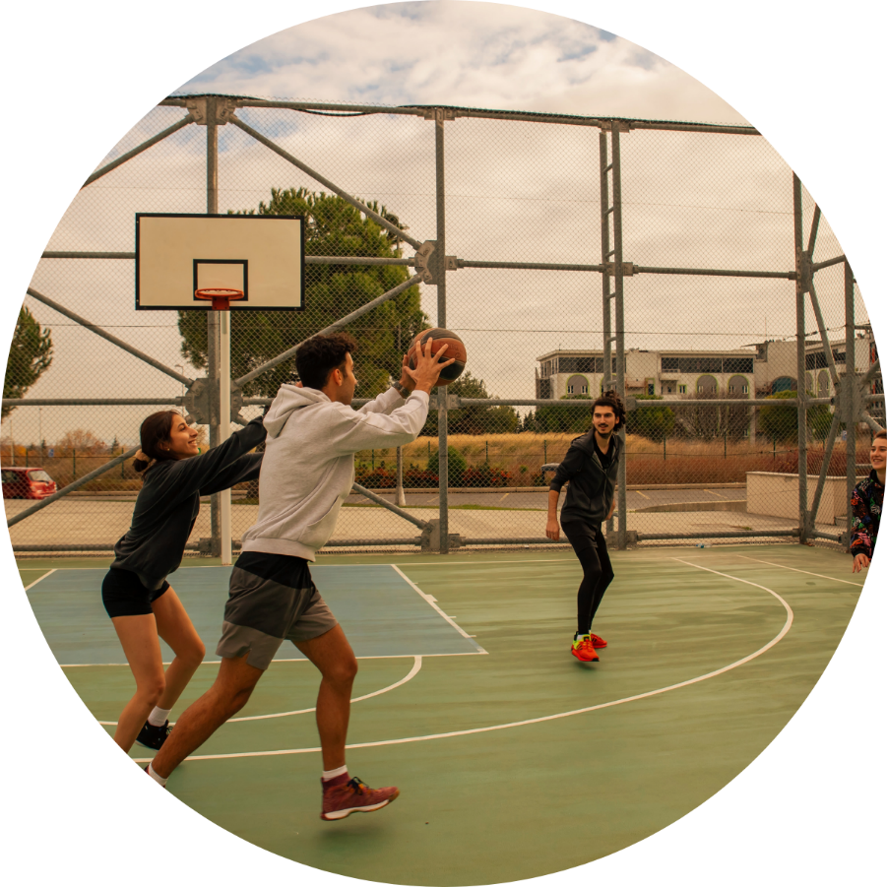
How Does Change Happen?
Joquim Plays Basketball
A bunch of the guys from the program were playing a pick-up game of basketball. Marvin was mercilessly taunting Joquim about his poor basketball skills, making fun of him every time
he missed a shot.
Finally, Joquim had had enough and he turned and punched Marvin. Now Joquim is in trouble, restricted, and about to
miss a trip to the movies that he was looking forward to.
Have you ever been taunted or teased?
What did you do?
What does Joquim need to be more like you?
Notes:
How Does Change Happen?
Ask a participant to read the scenario on the slide.
Discuss
Ask: Can you imagine playing a game of basketball and someone is making fun of you? What would you do?
Possible answers: Stop playing, be mean back, try to win, ignore them, make fun of them, hit them, trash talk.
Ask: What would you have to do to be able to do anything other than hit them?
Possible answers: believe you are more than your basketball skills; do self- talk saying, “it’s not worth hitting him” or “I’m not going to let him get me in trouble;” trust an adult to intervene; when you feel rage, leave the situation.
Review the role of self-worth. You have to believe there is more to you than whether you can play this game. There are other things you can do. Basketball is not all there is to your life.
Ask: What do we need to teach Joquim that will assist him with building self-worth so he could stay in control of his behavior? Help him feel less awful about himself?
Ask: If he does the same thing next week, will experience help or punishment?
Ask: how do you address the need for some youth to remain “tough” in order to survive in their home/neighborhoods?
11:45-12:00 Responding to Problem Behavior: When Children Hurt Others
How Does Change Happen? (15 min.)
RA Basic Manual: Slide 41

Slide 42
LUNCH
Notes:
12:00-12:45 LUNCH
RA Basic Manual: Slide 42

Slide 43
Creating a Working Theory for Each Client
A Working Theory Answers these Questions:
What has happened to them?
What have they learned about other people?
What biological changes have they experienced?
What skills have they learned to survive?
How do those skills help them now?
How do those skills now have negative consequences?
What skills do they need to learn?
How has racism, oppression or othering influenced their behavior?
Notes:
How to Create a Working Theory
Review the slide above with the information below.
For all clients we should have a working theory about how we understand this youth overall. The clinical term for this is “a formulation” for each client.
Many agencies using Risking Connection will complete RC Trauma Frameworks on each youth as their working theory.
These questions accomplish the same thing.
When we first work with the child, our working theory will be a hypothesis. It will change as you get to know the child better over time. It should be continually updated.
This is critical to the Restorative Approach because your working theory on a child helps to design specifically how you will respond to behaviors that hurt others.
Review questions on the slide.
Wilcox (2012). Trauma-Informed Care: The Restorative Approach, pp. 160-163.
12:45-2:15 Responding to Problem Behaviors: When Children Hurt Others (Continued)
Creating a Working Theory (20 min.)
Steps to Creating Restorative Tasks (5 min.)
Manage the Negative Behavior (10 min.)
Return to Working Theory (15 min.)
Create Restorative Tasks for Skill Building (25 min.)
Create Restorative Tasks to Make Amends (15 min.)
RA Basic Manual: Slide 43

Slide 44

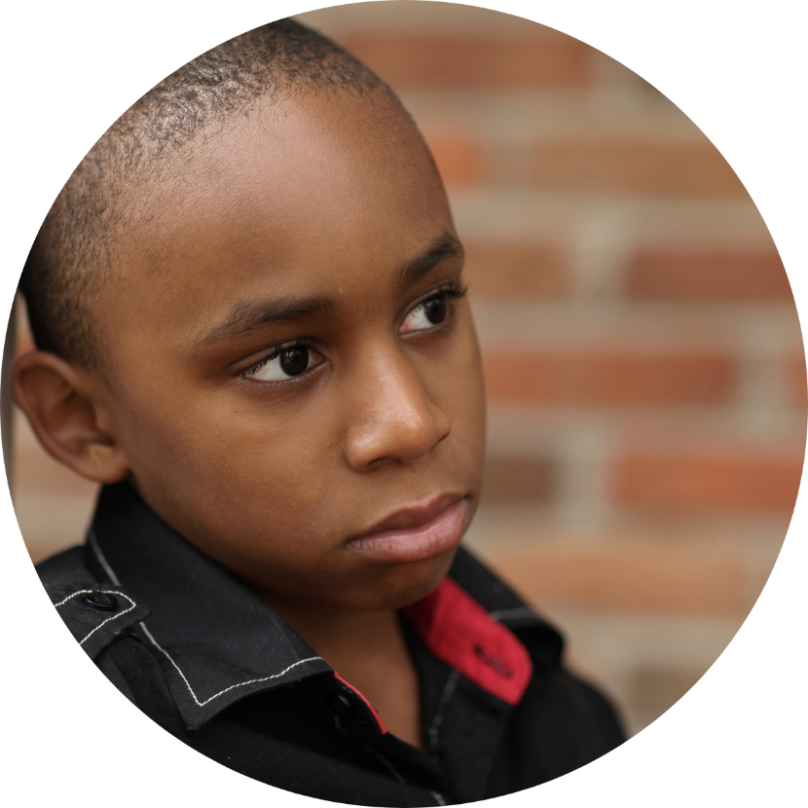
Exercise: Creating a Working Theory
Alexandra and Jeffrey
Notes:
Exercise: Creating a Working Theory
Explain that they are going to practice the steps involved in responding to youth’s behavior that hurts others.
Choose the case example of Alexandra or Jeffrey that best matches the client you serve.
Ask a participant to read the scenario.
Break participants up into groups of 3 or 4.
Ask the groups to complete the handout “Exercise: Creating a Working Theory” in their Participant Packet for the case example.
Review the first question with the large group so they understand the activity.
Discuss:
How do answers to these questions impact how you might respond to a behavior that hurts others?
Ask participants to stay in their groups because they will be continuing to work together on this example.
12:45-2:15 Responding to Problem Behaviors: When Children Hurt Others (Continued)
Creating a Working Theory (20 min.)
Steps to Creating Restorative Tasks (5 min.)
Manage the Negative Behavior (10 min.)
Return to Working Theory (15 min.)
Create Restorative Tasks for Skill Building (25 min.)
Create Restorative Tasks to Make Amends (15 min.)
RA Basic Manual: Slide 44

Slide 45
Creating Restorative Tasks
Notes:
Creating Restorative Tasks
Introduce the next section with the information below.
In the Restorative Approach, we respond to behaviors that hurt others with restorative tasks.
Since this is the real practical part of this training, we are going to spend quite a bit of time teaching you about how to design restorative tasks.
12:45-2:15 Responding to Problem Behaviors: When Children Hurt Others (Continued)
Creating a Working Theory (20 min.)
Steps to Creating Restorative Tasks (5 min.)
Manage the Negative Behavior (10 min.)
Return to Working Theory (15 min.)
Create Restorative Tasks for Skill Building (25 min.)
Create Restorative Tasks to Make Amends (15 min.)
RA Basic Manual: Slide 45

Slide 46
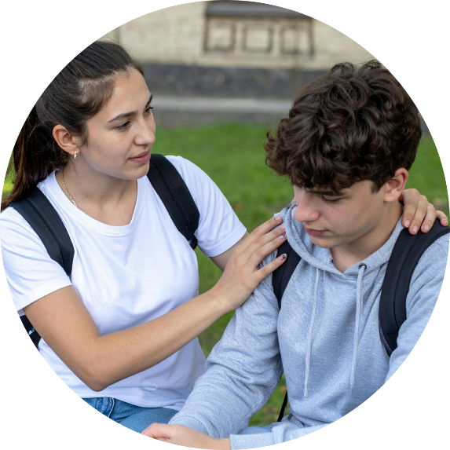

What is a Restorative Task?
There are 2 kinds of restorative
tasks:
Restorative Tasks for Skill Building
Restorative Tasks to Make Amends
Notes:
What is a Restorative Task?
Review the slide above using the information below.
We will be talking about 2 kinds of restorative tasks.
The first are tasks for skill building. They are used, for example, to help a child learn how to discover patterns in their behavior or help practice stepping away from a situation when they are angry or to identify emotion words.
The second are tasks to make amends with those they hurt. These help the child repair relationships they hurt, learn that relationships don’t end after major incidents, and realize that mistakes can be fixed.
Wilcox (2012). Trauma-Informed Care: The Restorative Approach, pp. 113-142.
12:45-2:15 Responding to Problem Behaviors: When Children Hurt Others (Continued)
Creating a Working Theory (20 min.)
Steps to Creating Restorative Tasks (5 min.)
Manage the Negative Behavior (10 min.)
Return to Working Theory (15 min.)
Create Restorative Tasks for Skill Building (25 min.)
Create Restorative Tasks to Make Amends (15 min.)
RA Basic Manual: Slide 46

Slide 47




Steps to Creating Restorative Tasks
Manage the negative behavior until all (child and staff)
are regulated.
Return to your Working Theory about the client.
Create your Restorative Task for Skill Building.
Create your Restorative Task to Make Amends.
Notes:
Steps to Creating Restorative Tasks
Introduce the steps to creating a Restorative Task by reviewing the slide above.
Click – Underlines - Manage the negative behavior until all (children and staff) are regulated. The first step is to calm the primitive brain and the emotional brain. This is essential before you create and assign a restorative task.
12:45-2:15 Responding to Problem Behaviors: When Children Hurt Others (Continued)
Creating a Working Theory (20 min.)
Steps to Creating Restorative Tasks (5 min.)
Manage the Negative Behavior (10 min.)
Return to Working Theory (15 min.)
Create Restorative Tasks for Skill Building (25 min.)
Create Restorative Tasks to Make Amends (15 min.)
RA Basic Manual: Slide 47

Slide 48


Manage the Negative Behavior Until All Are Regulated
Remember: symptoms are adaptations
Stay RICH®
Stay calm yourself
Focus only on calming and grounding (not consequences)
More ideas in: Eighteen Hints for Managing a Crisis
Notes:
Manage Behavior until All Are Regulated
Review the slide above using the information below.
Remember your RC Basic information on handling crisis. Believe that the symptom is helping the child in the moment somehow, stay RICH, stay regulated yourself, and focus on calming.
If the adult treater is not yet regulated, it is fine to tell the youth that you will get back to him the next day about the task. However, this should not be prolonged. If the adult involved is not going to be present for more than a day, or is too dysregulated, arrangements should be made for other staff to work out the task with the youth.
12:45-2:15 Responding to Problem Behaviors: When Children Hurt Others (Continued)
Creating a Working Theory (20 min.)
Steps to Creating Restorative Tasks (5 min.)
Manage the Negative Behavior (10 min.)
Return to Working Theory (15 min.)
Create Restorative Tasks for Skill Building (25 min.)
Create Restorative Tasks to Make Amends (15 min.)
RA Basic Manual: Slide 48

Slide 49
Steps to Creating Restorative Tasks
Manage the negative behavior until all (child and staff)
are regulated.
Return to your Working Theory about the client.
Create your Restorative Task for Skill Building.
Create your Restorative Task to Make Amends.
Notes:
Return to Working Theory Exercise
Introduce the next step to Creating a Restorative Task
Click – Underlines - Return to your Working Theory about the client.
When responding to a specific behavior, we need to go back to our working theory. It can help remind us how to understand the current behavior and figure out how to design the most effective restorative tasks in response to the behavior.
12:45-2:15 Responding to Problem Behaviors: When Children Hurt Others (Continued)
Creating a Working Theory (20 min.)
Steps to Creating Restorative Tasks (5 min.)
Manage the Negative Behavior (10 min.)
Return to Working Theory (15 min.)
Create Restorative Tasks for Skill Building (25 min.)
Create Restorative Tasks to Make Amends (15 min.)
RA Basic Manual: Slide 49

Slide 50
Apply your Working Theory to this Event
Use your Working Theory to answer these questions:
How does the child’s behavior relate to the skills they have learned
in the past?
What are the child’s beliefs and expectations about relationships?
How is the negative behavior adaptive? What need does it meet?
How might the child meet that need with fewer negative consequences?
What deficits in self-capacity skills does the child have now that contribute to the problem behavior?
What might be the next small step in self-capacity skills that the child would need to learn in order to act differently?
Notes:
Review the questions on the slide.
12:45-2:15 Responding to Problem Behaviors: When Children Hurt Others (Continued)
Creating a Working Theory (20 min.)
Steps to Creating Restorative Tasks (5 min.)
Manage the Negative Behavior (10 min.)
Return to Working Theory (15 min.)
Create Restorative Tasks for Skill Building (25 min.)
Create Restorative Tasks to Make Amends (15 min.)
RA Basic Manual: Slide 50

Slide 51
Exercise: Return to Your Working Theory
Alexandra and Jeffrey
Notes:
Exercise: Return to Your Working Theory
Refer participants to the worksheet “Return to Your Working Theory” for either Alexandra or Jeffrey.
Tell participants that the second paragraph has been added to describe a particular event that happened when the child hurts others.
Read the paragraph to the group for the case example.
Read the answer filled in at the bottom of the page about how to make sense of the behavior. (This answer is pre-populated to save time.)
Discuss what would they add to what is written here about the current behavior?
12:45-2:15 Responding to Problem Behaviors: When Children Hurt Others (Continued)
Creating a Working Theory (20 min.)
Steps to Creating Restorative Tasks (5 min.)
Manage the Negative Behavior (10 min.)
Return to Working Theory (15 min.)
Create Restorative Tasks for Skill Building (25 min.)
Create Restorative Tasks to Make Amends (15 min.)
RA Basic Manual: Slide 51

Slide 52
Steps to Creating Restorative Tasks
Manage the negative behavior until all (child and staff)
are regulated.
Return to your Working Theory about the client.
Create your Restorative Task for Skill Building.
Create your Restorative Task to Make Amends.
Notes:
Create Restorative Tasks for Skill Building
Introduce the next step Create your Restorative Task for Skill Building.
Click – Underlines- Restorative Task for Skill Building.
We will now look at how we can create restorative tasks to help the child develop more skills.
12:45-2:15 Responding to Problem Behaviors: When Children Hurt Others (Continued)
Creating a Working Theory (20 min.)
Steps to Creating Restorative Tasks (5 min.)
Manage the Negative Behavior (10 min.)
Return to Working Theory (15 min.)
Create Restorative Tasks for Skill Building (25 min.)
Create Restorative Tasks to Make Amends (15 min.)
RA Basic Manual: Slide 52

Slide 53
A NOTE about All Restorative Tasks
Restorative Tasks Are NOT
  Boring, tedious, and aversive (i.e. a punishment in disguise)
  A task beyond the child’s current capability
  Something a staff person creates while still angry about the negative behavior
  A task that does not teach or strengthen skill the child’s needs
Notes:
What Restorative Tasks Are Not
Review the slide above.
This is really important because it is very easy to drift into restorative tasks being another form of punishment or very repetitive, no longer addressing the needs of the particular child.
Restorative tasks work through teaching skills and strengthening relationships, not by being aversive.
It is important to be sensitive to cultural mores when developing restorative tasks.
Examples: eye contact, eating with hands versus utensils, gender interactions.
12:45-2:15 Responding to Problem Behaviors: When Children Hurt Others (Continued)
Creating a Working Theory (20 min.)
Steps to Creating Restorative Tasks (5 min.)
Manage the Negative Behavior (10 min.)
Return to Working Theory (15 min.)
Create Restorative Tasks for Skill Building (25 min.)
Create Restorative Tasks to Make Amends (15 min.)
RA Basic Manual: Slide 53

Slide 54
Restorative Tasks for Skill Building
WHY?
So that children shift beliefs and learn skills to meet their needs without hurting others.
HOW TO CREATE?
By answering a series of questions
More ideas in: Creating a Restorative Task to Build Skills
Notes:
Why, How, and What of Restorative Tasks
Review the slide above using the information below.
Restorative tasks for Skill Building are aimed at changing beliefs and learning skills so that children can meet their needs without hurting others.
Thoughtful targeted restorative tasks are designed by answering a series of questions about he the child’s behavior and the child.
Refer participants to the “Handout: Creating Restorative Tasks for Skill Building”.
Wilcox (2012). Trauma-Informed Care: The Restorative Approach, pp. 119-120.
12:45-2:15 Responding to Problem Behaviors: When Children Hurt Others (Continued)
Creating a Working Theory (20 min.)
Steps to Creating Restorative Tasks (5 min.)
Manage the Negative Behavior (10 min.)
Return to Working Theory (15 min.)
Create Restorative Tasks for Skill Building (25 min.)
Create Restorative Tasks to Make Amends (15 min.)
RA Basic Manual: Slide 54

Slide 55


Restorative Tasks for Skill Building (cont.)
WHAT?
Anything that contributes to child’s
understanding of:
  what triggered the event
  what happened inside themselves
  another way to respond to upsetting events
  a pattern of behavior
  how others respond to similar events more positively
Anything that gives the child a feeling of:
  Competence
  Self-efficacy
  Mastery of skills
  Connection to others
Notes:
Why, How, and What of Restorative Tasks
Review the slide above using the information below.
The summary points on the slide describe further the kinds of restorative tasks that can be created in response to behaviors that hurt others.
Wilcox (2012). Trauma-Informed Care: The Restorative Approach, pp. 119-120.
12:45-2:15 Responding to Problem Behaviors: When Children Hurt Others (Continued)
Creating a Working Theory (20 min.)
Steps to Creating Restorative Tasks (5 min.)
Manage the Negative Behavior (10 min.)
Return to Working Theory (15 min.)
Create Restorative Tasks for Skill Building (25 min.)
Create Restorative Tasks to Make Amends (15 min.)
RA Basic Manual: Slide 55

Slide 56
Exercise: Creating a Restorative Task for Skill Building
Alexandra and Jeffrey
Notes:
Exercise: Creating a Restorative Task for Skill Building
Ask participants to stay in their same small group.
Ask participants to complete the worksheet “Exercise: Creating Restorative Tasks for Skill Building” as it applies to the case example.
Refer groups to look at the handout “Ideas for Restorative Tasks for Skill Building” to see more ideas broken into categories by what kind of skill they are building.
Discuss:
Review group answers.
Highlight the range of tasks that the groups come up with, pointing out the importance of creativity.
Remind participants that they can use the worksheet to expand options.
12:45-2:15 Responding to Problem Behaviors: When Children Hurt Others (Continued)
Creating a Working Theory (20 min.)
Steps to Creating Restorative Tasks (5 min.)
Manage the Negative Behavior (10 min.)
Return to Working Theory (15 min.)
Create Restorative Tasks for Skill Building (25 min.)
Create Restorative Tasks to Make Amends (15 min.)
RA Basic Manual: Slide 56

Slide 57
Steps to Creating Restorative Tasks
Manage the negative behavior until all (child and staff)
are regulated.
Return to your Working Theory about the client.
Create your Restorative Task for Skill Building.
Create your Restorative Task to Make Amends.
Notes:
Creating a Restorative Task for Making Amends
Introduce the next step Create your Restorative Task for Making Amends.
Click – Underlines - Create your Restorative Task for Making Amends.
We will now look at how we can use restorative tasks to help youth learn how to repair relationships when there has been difficulty or harm.
12:45-2:15 Responding to Problem Behaviors: When Children Hurt Others (Continued)
Creating a Working Theory (20 min.)
Steps to Creating Restorative Tasks (5 min.)
Manage the Negative Behavior (10 min.)
Return to Working Theory (15 min.)
Create Restorative Tasks for Skill Building (25 min.)
Create Restorative Tasks to Make Amends (15 min.)
RA Basic Manual: Slide 57

Slide 58
Restorative Tasks to Make Amends
GOAL:
For the child to make amends to people they hurt and restore the relationship.
ANSWERS THESE QUESTIONS:
Whom did the child’s behavior hurt?
Based on your Working Theory, what are important themes evident
in the child’s negative behavior?
How can the child make life better for the person or group of people they hurt? (Integrate Working Theory theme if possible)
Notes:
Creating a Restorative Task for Making Amends
Review the slide above using the information below.
The first question explores who was hurt, inconvenienced, upset, or insulted. This could be an individual person or a group of people like a whole unit or whole classroom.
The second question helps you go back to your working theory about this child: What challenges, themes, deficits were revealed by the child’s behavior? If possible, the task should relate to these themes.
Ideally, the child would repair the harm he did - i.e. if he punched a hole in a wall, he should fix it. Often this is not possible. So, for example, instead can he do something nice for the maintenance person who did fix it.
Why is it important to be aware of biases, racism, oppression when teaching to make amends? What barriers might there be?
Possible answers:
no adult ever apologized to them
they have often been unfairly blamed and subject to racial profiling
Making amends may feel vulnerable and like losing power
What could be especially difficult for children of color about the vulnerability of saying they were wrong?
Wilcox (2012). Trauma-Informed Care: The Restorative Approach, pp. 121.
12:45-2:15 Responding to Problem Behaviors: When Children Hurt Others (Continued)
Creating a Working Theory (20 min.)
Steps to Creating Restorative Tasks (5 min.)
Manage the Negative Behavior (10 min.)
Return to Working Theory (15 min.)
Create Restorative Tasks for Skill Building (25 min.)
Create Restorative Tasks to Make Amends (15 min.)
RA Basic Manual: Slide 58

Slide 59
Exercise: Create a Restorative Task to Make Amends
Alexandra and Jeffrey
Notes:
Exercise: Creating a Restorative Task to Make Amends
Ask participants to stay in their same small groups.
Refer groups to the worksheet for “Exercise: Creating Restorative Tasks to Make Amends” as it applies to the case example.
Refer groups to the handout “Ideas for Restorative Tasks to Make Amends.”
Discuss their answers as a large group.
12:45-2:15 Responding to Problem Behaviors: When Children Hurt Others (Continued)
Creating a Working Theory (20 min.)
Steps to Creating Restorative Tasks (5 min.)
Manage the Negative Behavior (10 min.)
Return to Working Theory (15 min.)
Create Restorative Tasks for Skill Building (25 min.)
Create Restorative Tasks to Make Amends (15 min.)
RA Basic Manual: Slide 59

Slide 60
BREAK
Notes:
2:15-2:30 BREAK
RA Basic Manual: Slide 60

Slide 61


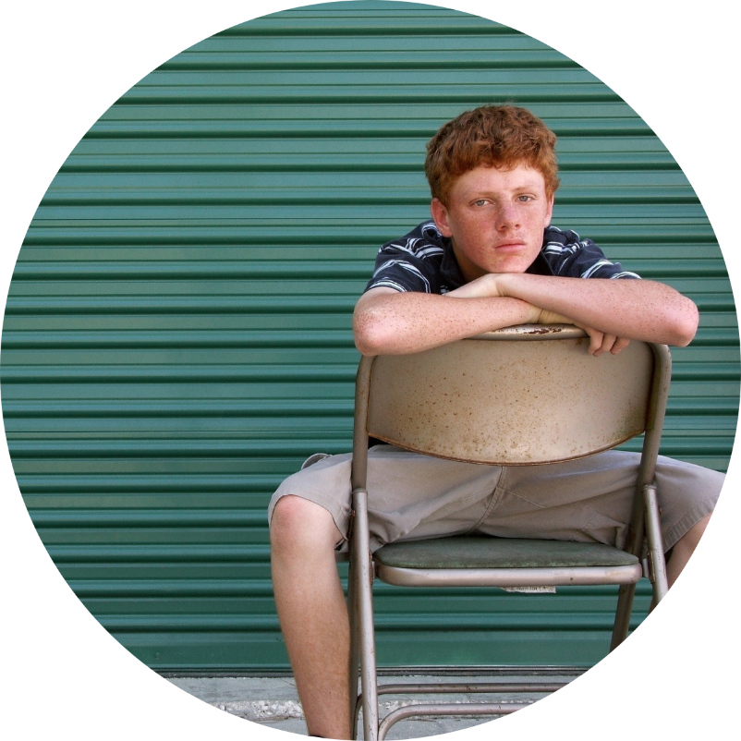
Exercise: Applying the Steps to Creating Restorative Tasks to a Child in Your Program
Notes:
Exercise: Applying the Steps to Creating Restorative Tasks to a Youth in Your Program
Break participants into new groups of 3 or 4 by program so group members will know the same client.
Explain that they should quickly choose a youth in their program and a recent behavior they engaged in that hurt others.
Complete the steps in the process using the worksheet “Questions to Consider to Understand Behavior” on page 44 of participants’ packets.
Discuss:
Ask: How did you find the process of doing this about a real-life youth in your program?
Ask: What flowed easily about the process?
Ask: What challenges did you experience?
Ask: What advantages and challenges do you anticipate about working this way?
Ask: What questions and “yes buts” do you anticipate coming up for your peers?
2:30-3:15 Responding to Problem Behaviors: When Children Hurt Others
Applying the Steps to Creating Restorative Tasks to a Youth in Your Program
RA Basic Manual: Slide 61

Slide 62
Common Questions about Restorative Tasks
  How much is enough?
  What if the youth won’t do it?
  How do we continue to think of new tasks?
  What if the tasks aren’t serious enough?
Notes:
Common Questions about Restorative Approach
Review the questions on this slide. Use the information below for group discussion. Note to Trainer: It is useful to review discussion of these questions in Wilcox (2012). Trauma-Informed Care: The Restorative Approach, p.126-142.
How much is enough?
Restorative tasks are not punishments in disguise. The notion “how much is enough” is based in the belief that the more aversive the task is, the more effective it will be and the task must be as big as the offense. Remember, the healing aspect of tasks is about skill building and repairing relationships.
Ask: Think if a friend hurts us? What do we need? Possible answer: Acknowledgement, understanding of how the behavior affected you, that moving forward they will act differently to avoid hurting you. This is what we need to teach our youth.
What if the client won’t do it?
Do not engage in power struggles. We cannot force a child to do a restorative task. If the client is not ready to do the task, say, “Sometimes, it takes time to work through a problem. I’m confident you can get there. So, until you are ready, we are going to keep you closer to us.” They are not allowed to go on fun outings with the group until the task is finished.
Create structural supports such as Restorative Task time blocks. Example: From 3:00-4:00 restorative tasks will be completed. If the youth does not complete during this time—the task is carried over to the next time block designated for tasks. There will be a fun activity for any youth who do not have restorative tasks to do.
The task should not be difficult—it is not punishment—it is a vehicle for reconciliation.
How do we continue to think of new tasks, especially if kids don’t take them seriously?
Remember the basic premise that symptoms are adaptations, that youth are doing the best they can.
Restorative Approach responds to behavioral problems with tasks that are designed to help the youth learn new skills and to repair damaged relationships.
Think about what concrete skills and beliefs that the youth need. Think about what you would do in their situation. What does the youth need to learn to be more like you?
What if the tasks are not serious enough?
Start by looking at your assumptions. Do you believe the task needs to be difficult or that the child shouldn’t enjoy the task? If so, this is power based or punishment in disguise.
Think about the youth’s capacities. Do something that is a little more than what is easy for them, enough that they take it seriously.
3:15-3:30 Common Questions about the
Restorative Tasks
RA Basic Manual: Slide 62

Slide 63


Exercise
Resistance to the Restorative Approach
Chaos will break out
Its not the “real world“
This trauma stuff is just an excuse
What about consistency?
It will take too much time
It’s too nice
"My parents were strict with me..."
Its harder to learn
It demands more of your true self
Notes:
Exercise: Common Resistance to Restorative Approach (Optional)
OPTIONAL. Decide whether this is important and relevant. This is more likely if the agency is at the beginning of the implementation process or stalled. If less relevant, spend the extra time on the VT exercise in the next section.
Briefly summarize the information on the slide about resistances.
Ask if there are resistances that have come up or might come up other than the ones on the slide.
Ask participants to form small groups by team and choose a resistance to discuss.
Brainstorm as a group how the resistance can be addressed – how would you respond?
Ask participants to report how they responded to the resistance.
Discuss:
How was it to come up with your responses?
Are there any concerns that you would like the trainers to talk more about?
When these worries arise in the team (and they will), how should the team respond?
Refer participants to handout “Responding to Staff Resistance” for additional answers.
3:30-3:50 Common Resistances to the
Restorative Approach
RA Basic Manual: Slide 63

Slide 64
Vicarious Trauma and the Restorative Approach
Notes:
Vicarious Trauma and the Restorative Approach
Introduce the next section with the information below.
In this next section, as we did during our 3-day Risking Connection Basic, we will look at you the treater and how this work can impact you.
3:50-4:15 Vicarious Trauma and the
Restorative Approach
VT and the Restorative Approach (5 min.)
Exercise: Life Time Line (20 min.)
Resilience (5 min.)
RA Basic Manual: Slide 64

Slide 65


Vicarious Trauma and the Restorative Approach
The perils of opening your heart
Meaning in our work
Special awareness for treaters of color
More ideas in: 37 Ways to Manage Vicarious Traumatization
Notes:
Vicarious Trauma and the Restorative Approach
Review the slide above using the information below.
When we use the Restorative Approach to heal youth, open-heartedness is a key quality. Deeply knowing the hurt children have endured, understanding how negative behavior helped them survive, and using our relationship to promote change can make us vulnerable to being hurt.
Youth often don’t appreciate our efforts, they refuse to trust despite our best efforts, and they can lash out in cruel ways, especially right when we begin to make progress. This can add to our vicarious trauma.
Additionally, BIPOC staff often feel they must show up for work as strong, ultra-competent, and never complain in order to represent their community well and progress in their careers.
These are the inevitable perils of opening our heart. Doing so offers tremendous rewards, but it has risks as well. This is why we need to attend to VT and self-care and why our organizations must make this a priority.
The next exercise examines how personal challenge and hardship often leads to resilience and personal growth. Similarly, hardship and challenges in our work can lead to personal growth.
Wilcox (2012). Trauma-Informed Care: The Restorative Approach, pp. 241-247
3:50-4:15 Vicarious Trauma and the
Restorative Approach
VT and the Restorative Approach (5 min.)
Exercise: Life Time Line (20 min.)
Resilience (5 min.)
RA Basic Manual: Slide 65

Slide 66
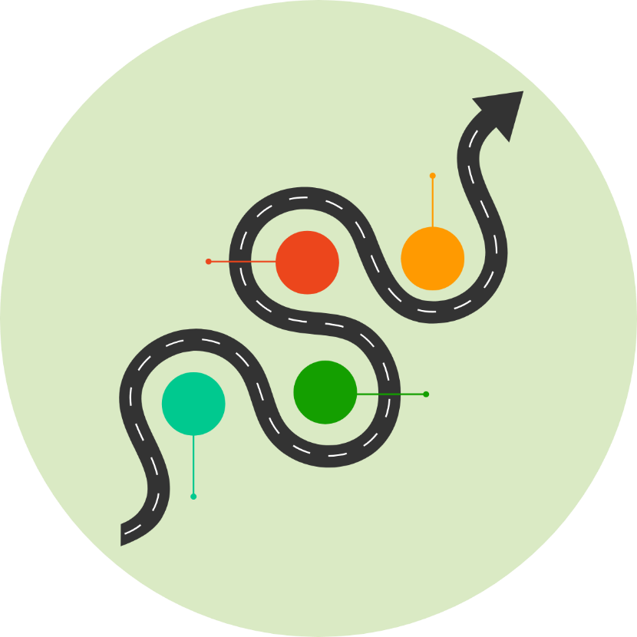

Exercise: Life Time Line
Draw a time line
Plot key events in your life that were challenges, disappointments, losses, unexpected changes
What got you through?
Was there personal growth or positive outcomes?
Notes:
Vicarious Trauma and the Restorative Approach
Exercise: Time Line
Pass out a piece of paper to each participant.
Say: One resource we have for self-care is our own history.
Say: You will have approximately 5-7 minutes for this exercise.
Say: You will work alone on this exercise. No one will see this exercise except you.
Instruct participants to draw a line on the piece of paper in front of them.
Say: This line represents your “life time line”.
Instruct them to plot key events in their life that were: challenging, disappointments, losses, unexpected changes etc. whatever they are comfortable acknowledging.
Instruct them to place an inverted V under each significant event. On one prong of the V describe what got them through that situation—it can be a word, phrase or description. On the other prong of the inverted V write if there was a positive outcome of that experience or personal growth that they experienced.
Ask them to identify any feelings, reactions or thoughts that accompanied them when thinking about the event.
Discuss:
Ask participants to describe what got them through − NOT what the event was about.
List the things that got them through on tag board.
Ask participants how the event changed them positively. What reactions they had.
List reactions and changes on tag board.
Point out that the characteristics many of them listed are characteristics of resilient people.
3:50-4:15 Vicarious Trauma and the
Restorative Approach
VT and the Restorative Approach (5 min.)
Exercise: Life Time Line (20 min.)
Resilience (5 min.)
RA Basic Manual: Slide 66

Slide 67


Resilience
Developing Resilience:
Build strong support system
Nurture a positive view of yourself and of life
Maintain perspective -- crises are surmountable, problems can be solved
Stay flexible and curious
Use humor
Exercise forward thinking
Believe in something greater than self
Stay connected to values
Be responsible for self-care
SAMHSA 2009: http://mentalhealth.samhsa.gov/schoolviolence/part1chp2.asp
Notes:
Resilience
Review the slide above using the information below.
These are characteristics of resilient people.
Ask: Do they look familiar? Many of the characteristics listed here is what you all identified as what got you through your challenging times.
These characteristics are available to you when you are vulnerable and open your heart to the youth you work with and get hurt.
Resilience is more than “bouncing back.” It is about building new neuropathways for yourselves. When you come up with new, healthier ways to digest your vicarious trauma, you build a new pathway—new ways to think and respond to life’s stressors and challenges.
3:50-4:15 Vicarious Trauma and the
Restorative Approach
VT and the Restorative Approach (5 min.)
Exercise: Life Time Line (20 min.)
Resilience (5 min.)
RA Basic Manual: Slide 67

Slide 68

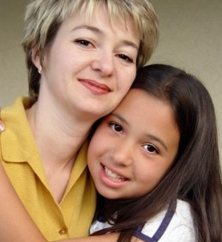
Summary
Current treatment approaches assume consequences are essential to change behavior
RA holds that relationships, rebuilding brains, and skill-building are more essential
Programs must build these elements into all aspects of their work
When children hurt others, they are given restorative tasks to build skills and make amends
RA requires attending to staff’s vicarious trauma
Notes:
Summary
Review the slide above.
4:15-4:30 Summary, Closing, Evaluation, and Goodbye
RA Basic Manual: Slide 68

Slide 69
Evaluations, Closing, and Goodbye
Closing
Write down:
One characteristic of resilience that you draw on most
One example of how you use daily life
Notes:
Evaluation, Closing, and Goodbye
Collect the evaluation forms.
Closing
Pass out a piece of scratch paper to each participant.
Tell them not to put their name on it because you are going to collect the papers and redistribute them.
Ask participants to briefly write down one characteristic of resilience that they draw on most and one example of how they use it in daily life.
Collect the statements that they wrote on their paper.
Randomly pass out the statements to different individuals so that everyone has someone else’s statement. Have them read the statements to the group.
Discuss reactions to hearing people read the statements.
Thank participants and say goodbye.
4:15-4:30 Summary, Closing, Evaluation, and Goodbye
RA Basic Manual: Slide 69

Slide 70
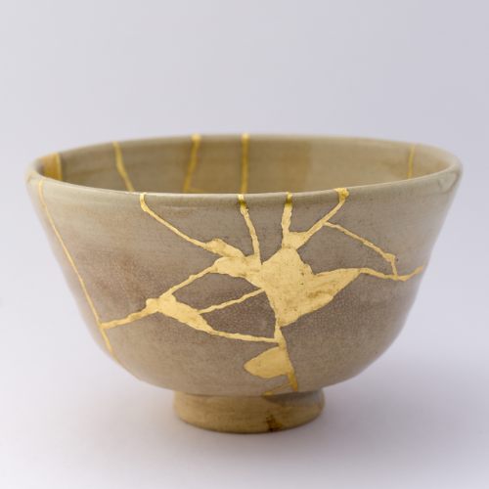
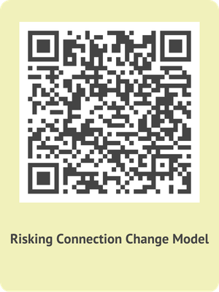
For More Information, Contact:
Traumatic Stress Institute of Klingberg Family Centers
www.traumaticstressinstitute.org
370 Linwood Street
New Britain, CT 06052
tsisupport@klingberg.org
860-832-5523
Kintsugi Pottery: What is broken can be healed; we all have cracks and imperfections
Notes:
RA Basic Manual: Slide 70

