Slide 1
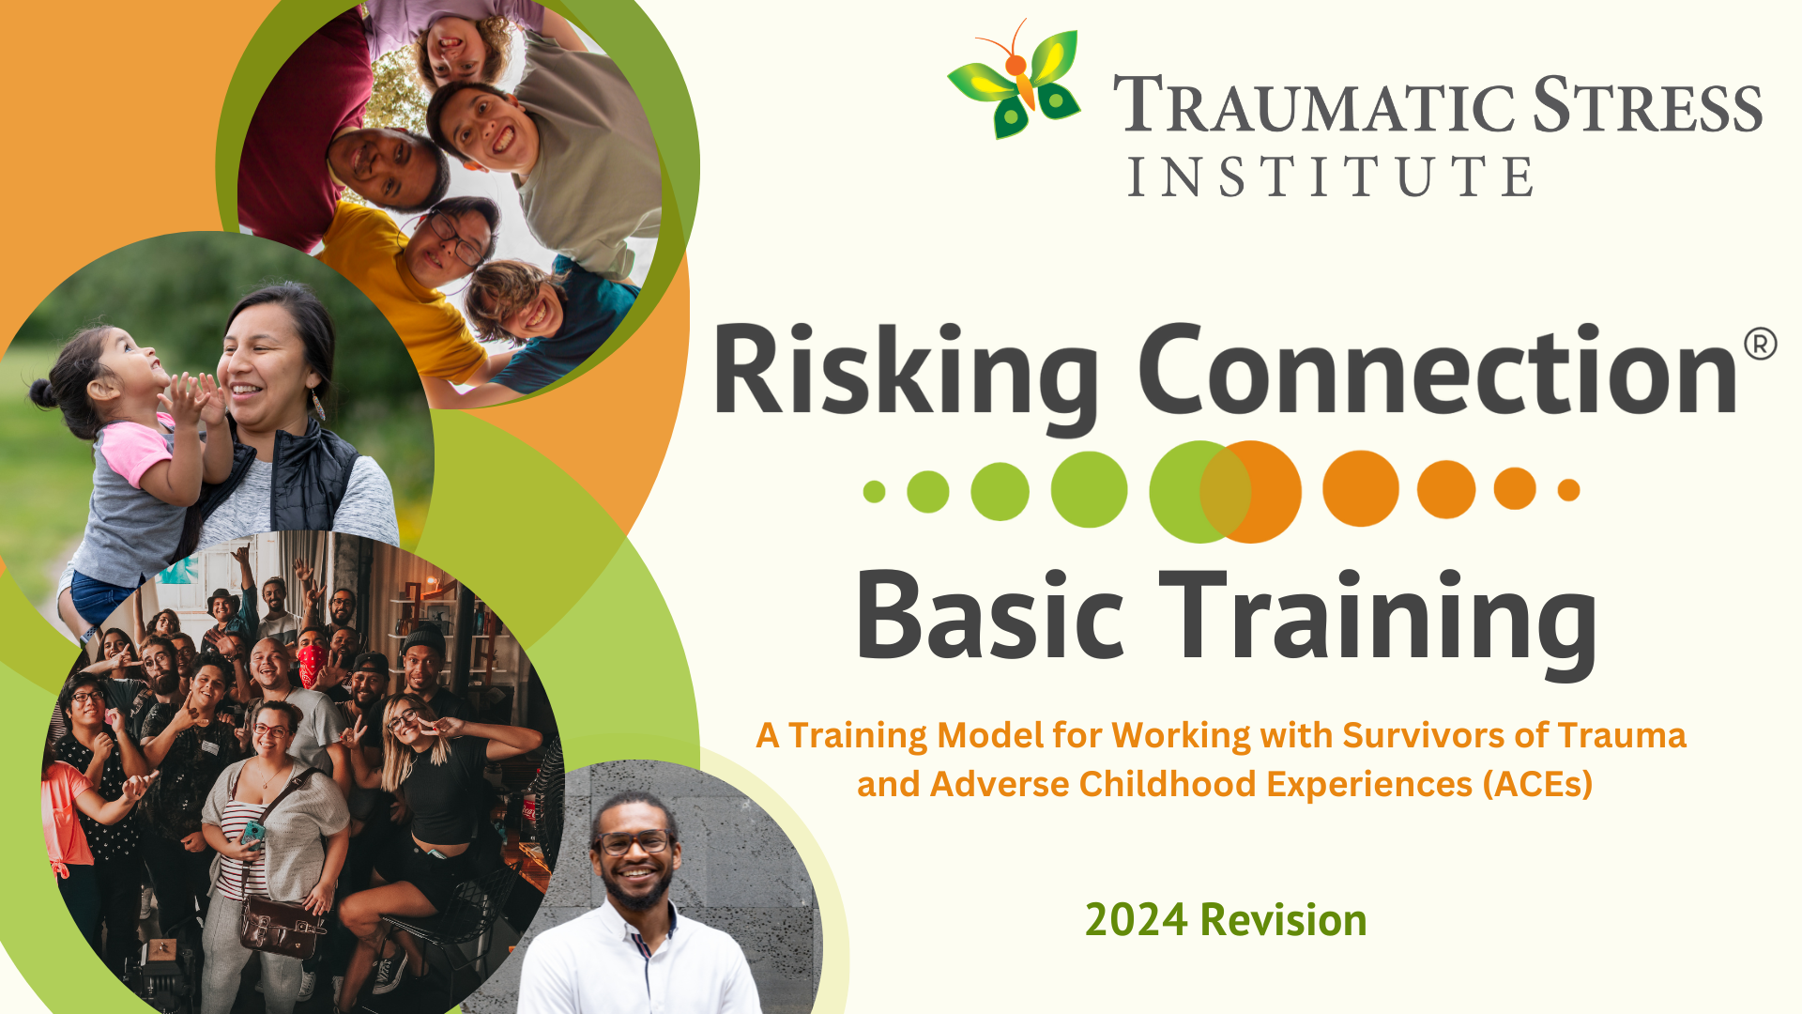
Notes:
Welcome participants to the training.
Trainers introduce themselves. As the Trainer, consider identifying your own race and other identities in your introduction. Naming one’s identities and modeling inclusive language in trainer introductions can both model and set a tone that all are truly welcome (see example below). You can then refer back to this when introducing the Day 3 opening activity: “What Makes Us Who We Are.”
Consider offering a land acknowledgement. Scan QR code for a resource on land acknowledgements.
RC Basic Manual: Day 1, Slide 1
Creating a space that is inclusive and welcoming for all (especially for those of historically marginalized and oppressed identities) is vitally important.
Ask participants to introduce themselves: name, roles, and one brief reason they chose to do this work. If you have a large group (30 or more), ask them to share the reason for doing this work “in one breath” to ensure it is brief.
Sample Trainer Intro: My name is Darrell and I am a Risking Connection (RC) trainer at our agency. I am a social worker with experience in residential and outpatient programs and have been an RC trainer for 3 years. My mother is white and my father is Black. I identify as bi-racial and male. I mention this because, while this is not an anti-racism training, we cannot separate trauma from racism; to support trauma healing, we must also support anti-racism efforts.
Discussion Guide
9:00-9:30 Introductions (slides 1-4)
Please Note: Timing and Slide Numbers above correspond to the full version of RC, not the NEO version. We’ve left them here for your reference.

Slide 2
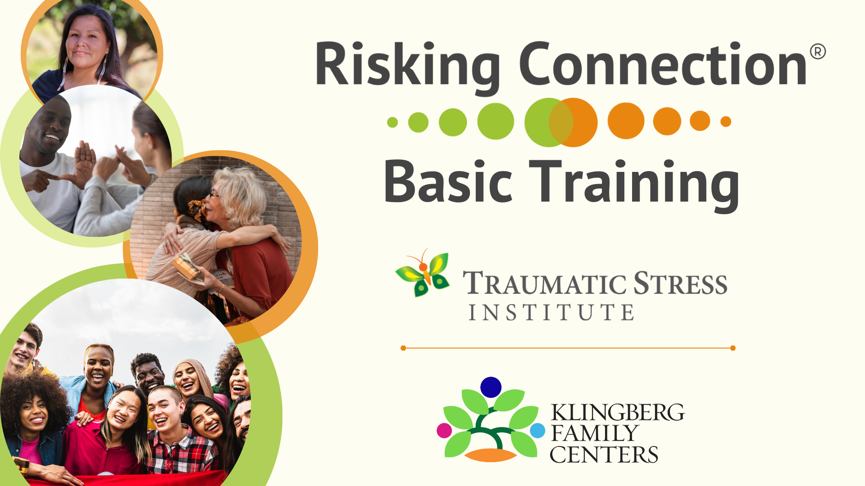
Notes:
RC Basic Manual: Day 1, Slide 2
Explain that the Traumatic Stress Institute is a department of Klingberg (pronounced cling-berg) Family Centers, a family service agency in New Britain, CT.
Klingberg is the owner of Risking Connection.
No discussion on this slide.
Discussion Guide
9:00-9:30 Introductions (slides 1-4)

Slide 3
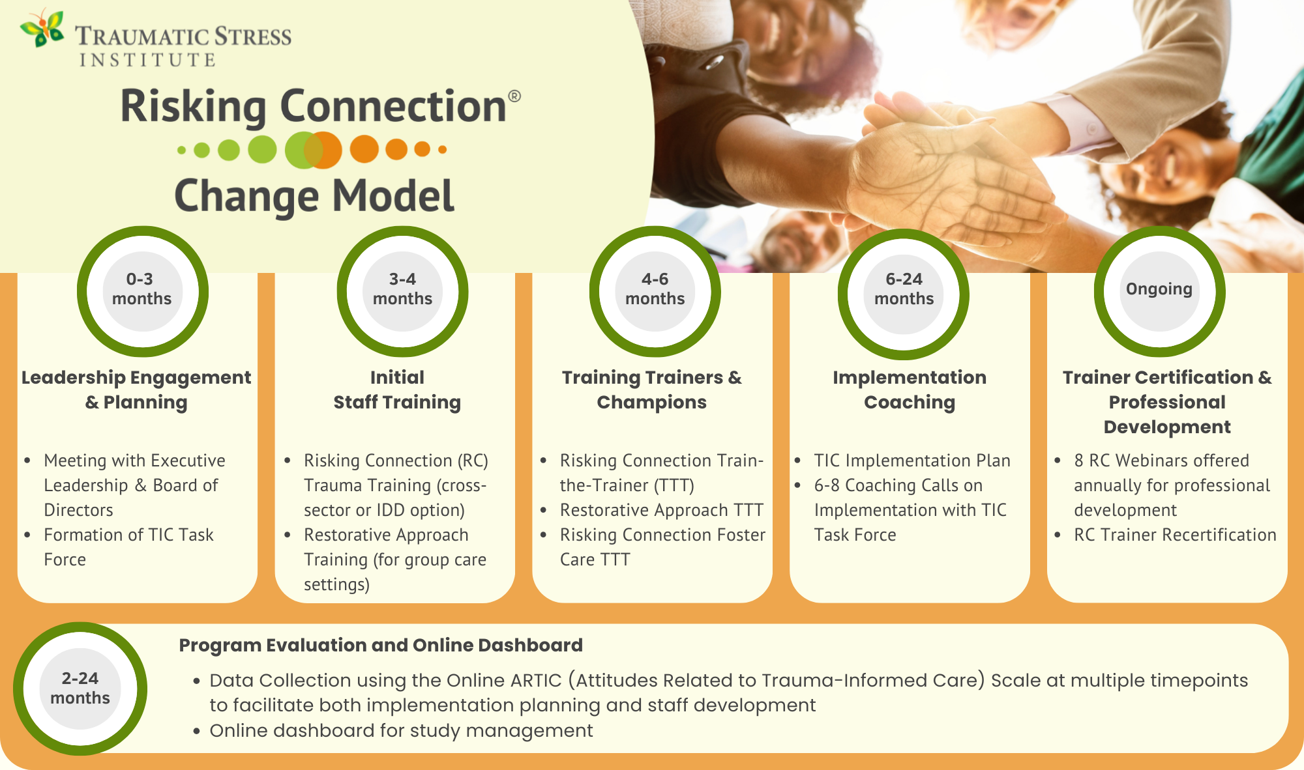
3
Notes:
RC Basic Manual: Day 1, Slide 3
SKIP THIS SLIDE IF YOUR FORMAL RISKING CONNECTION CHANGE MODEL INITIATIVE WITH TSI HAS BEEN COMPLETED
Explain that Risking Connection training is the core curriculum in the Traumatic Stress Institute’s Risking Connection Change Model.
Point out the components of the model including the RC Basic training, the RC Training of Trainers, Coaching, Trainer Certification, and Program Evaluation. If applicable, note RC for Foster Care, Restorative Approach, and Restorative Approach TTT, too. It involves all levels of the organization.
Point out where the organization is in the process.
Ask those in the room who are members of the client agency’s TIC Task Force to stand-up (be identified); identify others on Task Force who are not in the room.
Note that the TIC Task Force will be working directly with TSI to guide this initiative.
In addition to the Task Force, TSI will train Trainers and Champions at your agency to help spread Risking Connection and trauma-informed practices throughout the agency and to train new staff for years to come.
Note that the Program Evaluation (ARTIC – Attitudes Related to Trauma-Informed Care) is administered to staff before the RC Basic training, after the TTT, and near the end of the initiative, as a way of measuring progress toward TIC goals at the agency.
9:00-9:30 Introductions (slides 1-4)

Slide 4
Setting the Frame When Talking About Trauma
4
Notes:
RC Basic Manual: Day 1, Slide 18
Discussion Guide
10:00-10:10 Definitions of Psychological Trauma (slides 18-22)

Slide 5
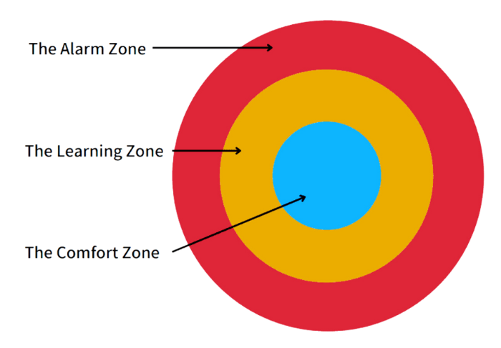
Being Comfortable with Discomfort
The Learning Zone Model
Source: The Commons Social Change Library
5
Notes:
RC Basic Manual: Day 1, Slide 11
9:30-10:00 Frame of Training (slides 5-17)
To maximize learning, we are inviting each of you to join the trainers by moving out of the Comfort Zone: the zone where it feels good, comfy, and maybe even a bit boring – the kind of place that is good for slowing down and recharging.
And, we invite you to join us in the Learning Zone where it feels challenging, exciting, engaging, and, at times, uncomfortable – a place where we can learn and grow.
We also want to avoid the Alarm Zone - where it feels stressful and overwhelming - and where learning is blocked.
So, we encourage you to monitor your experience, take movement breaks, stay hydrated, use fidgets or doodle, and seek support, as needed, so that if you start to hear the alarm bells going off in yourself, you can take steps to get back into the learning zone.
Be sure to reach out to a trainer or colleague to let someone know that you are experiencing the Alarm Zone.
Again, this training will address issues about trauma and racism, which can be uncomfortable, and so this training offers an opportunity to grow one’s capacity to be comfortable with discomfort.
For some, this can be similar to what you ask of your clients when teaching them a new skill or asking them to consider a different point of view. Give yourself the grace you would give your clients as they learn to be comfortable with discomfort.

Slide 6
The Why and What of
Risking Connection
6
Notes:
RC Basic Manual: Day 1, Slide 18
Discussion Guide
10:00-10:10 Definitions of Psychological Trauma (slides 18-22)

Slide 7

Why the Name “Risking Connection?”
7
Notes:
Discussion Guide
Ask participants why they think the program is named “Risking Connection?”
What’s risky about relationships? (If you allow yourself to get close to others, you can get hurt)
What’s especially risky for clients we work with? (Because they’ve been betrayed and hurt by others in the past)
Given the risks, why do people still pursue relationships? (Because we are social beings and yearn for connection)
What’s risky for us (as treaters) about engaging in relationships with people we help? (We open our hearts to clients and it doesn’t always go well so we can get hurts also)
Since survivors of trauma are hurt in relationships, the healing happens through relationships.
Creating a culture where clients and colleagues can risk connection is central to RC.
See Discussion Guide below.

Slide 8
What is Risking Connection?
Philosophy of work with people with histories of trauma.
Internationally recognized trauma training model.
Provides a trauma lens (the Risking Connection Trauma Framework) to help understand and respond to challenging behavior.
Creates a common language across all staff.
8
Notes:
RC Basic Manual: Day 1, Slide 16
No discussion in this slide.
Discussion Guide
9:30-10:00 Frame of Training (slides 5-17)
RC is not a type of therapy or treatment technique. It is a philosophy or approach to working with trauma survivors.
As of 2024, there are over 90 agencies across the world that teach RC to staff.
It helps to provide a common language and a common lens to understand and respond in a healing way to trauma survivors.

Slide 9
What a Risking Connection Approach is NOT:
Does NOT mean an absence of limits or rules
Does NOT mean that staff don’t have or use their authority
Does NOT mean that staff ignore challenging behaviors
Is NOT a model that can only be employed when things are calm and we have plenty of time to intervene
9
Notes:
RC Basic Manual: Day 1, Slide 16
No discussion in this slide.
Discussion Guide
9:30-10:00 Frame of Training (slides 5-17)
People often have misunderstandings about what trauma-informed care and Risking Connection are and are not. Risking Connection does not mean these things.
State that a healthy environment for people to heal and grow must include boundaries that are both firm and compassionate. Similarly, we can describe a healthy family as one that has firm (yet flexible) limits with love and compassion.

Slide 10
Definition of
Psychological Trauma
10
Notes:
RC Basic Manual: Day 1, Slide 18
Discussion Guide
10:00-10:10 Definitions of Psychological Trauma (slides 18-22)

Slide 11
What is psychological trauma?
The “Three E’s”
Event | An event, series of events, or enduring condition
Experience | Unique individual experience where the person’s ability to integrate the experience emotionally is overwhelmed and they feel it as harmful or life-threatening
Effect | It negatively effects the person’s mental, physical, social, emotional, and spiritual well being
SAMHSA, 2023
11
Notes:
Review the “three Es” definition.
Stress that trauma is about the individual’s experience, not the event. This means that two people can experience the same event or type of event and experience it very differently.
See example and discussion below.
RC Basic Manual: Day 1, Slide 19
You can give the example of two people driving in a car together and having an accident. For one person, it feels very traumatic. For the other, no big deal. Or, give the example of two children in the same family experiencing domestic violence. For one there is a lasting impact and the other not.
What factors could influence these different reactions? (Possible answers: age it occurred, history of attachment, support systems, temperament, what was happening at the time of the accident, other stressors in the person’s life or family, experience when disclosed, severity of trauma, who is the perpetrator).
Discussion Guide
10:00-10:10 Definitions of Psychological Trauma (slides 18-22)

Slide 12

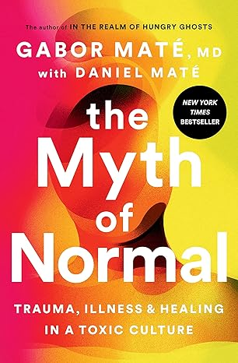
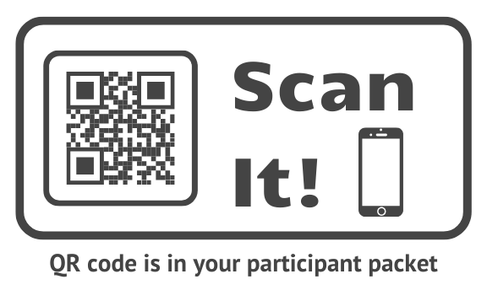
What is Psychological Trauma?
“Trauma is not what happens to you, it’s what happens
inside you as a result of what happened to you.”
– Dr. Gabor Maté
Physician, author
12
Notes:
Gabor Mate (pronounced Ga-bor Ma-te as in a latte) is an addiction expert with expertise in trauma, addiction, and childhood development.
This quote nicely reinforces the three E’s of psychological trauma from the previous slide: event, experience, and effect.
No discussion on this slide.
RC Basic Manual: Day 1, Slide 20
Discussion Guide
10:00-10:10 Definitions of Psychological Trauma (slides 18-22)

Slide 13
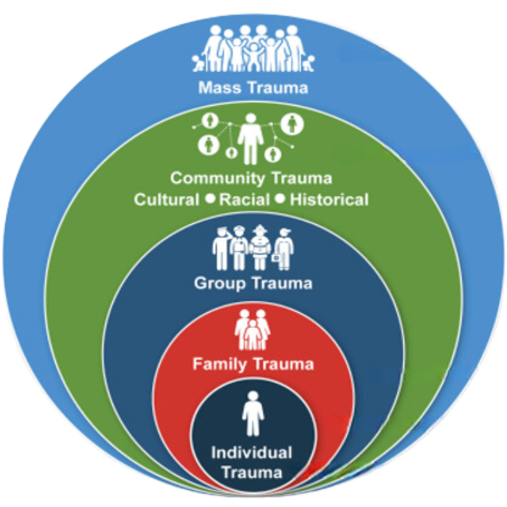
Levels of Trauma Experience
SAMHSA, 2023
13
Notes:
Traumatic events are experienced individually or collectively. Trauma can occur at many levels and the context makes a difference to how people respond, its impact, and what people need to heal.
Historical trauma is widespread trauma that happens to an entire culture or group and influences the generations of the group beyond who experienced it directly. Slavery, the forced migration of Native Americans, and the murder of Jews in the Holocaust are examples.
Racial trauma results from discrimination based on someone’s race.
RC Basic Manual: Day 1, Slide 21
No discussion on this slide.
Discussion Guide
10:00-10:10 Definitions of Psychological Trauma (slides 18-22)

Slide 14

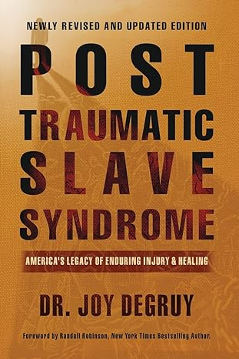
Racial Trauma
Definition
  Racial trauma, or race-based traumatic stress, is the
  cumulative effect of racism on an individual’s
  mental and physical health.
Examples
  Vacant esteem
  Ever present anger
  Constant hypervigilance
  Racial identity confusion
  Weathering
– Dr. Joy Angela DeGruy
Researcher, educator, author
Source: Dr. Joy Angela DeGruy
14
Notes:
No discussion on this slide.
RC Basic Manual: Day 1, Slide 22
Discussion Guide
10:00-10:10 Definitions of Psychological Trauma (slides 18-22)
A couple slides back, we have a quote by Gabor Mate in which he says: “Trauma is not what happens to you, it’s what happens inside you as a result of what happened to you.”
As a result of experiencing racial trauma, individuals can internalize and experience the following:
Vacant esteem: believing oneself to have little or no worth exacerbated by the group and societal pronouncement of inferiority
Ever present anger can be a response to chronic discrimination
Constant hypervigilance – on high alert in response to verbal and physical attacks, micro aggressions, and being heavily policed. We will talk more in the body and brain section about the nervous system when chronic trauma has been experienced.
Racial identity confusion…pulled between one’s own racial identity that is devalued and the idealized identity of dominant culture
Weathering is the cumulative negative impact of racism on the bodies of people of Color; we will show a video on this near the end of this section.

Slide 15
Adverse Childhood Experiences
(ACEs) Study
The Lifelong Impact of Adversity and Trauma
15
Notes:
RC Basic Manual: Day 1, Slide 23
Discussion Guide
10:10-10:35 The ACEs Study: Lifelong Impacts (slides 23-39)

Slide 16

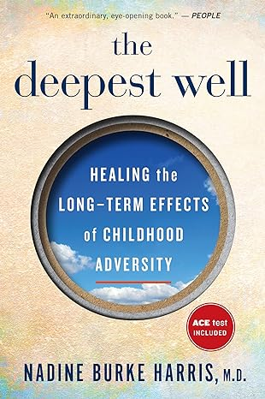
The ACEs Study
[The day I read the Adverse Childhood Experiences study] “it was like a bolt of lightning…that changed my clinical practice and ultimately my career.”
– Dr. Nadine Burke Harris, M.D.
Former California Surgeon General
16
Notes:
Ask how many people have heard of the ACE study?
This was often described as “the most important study you never heard of” because for almost 20 years after it was published, no one knew about it. This IS now changing and many more people know about it.
As you can see by the quote, the study has profoundly changed how health professionals think about their work. The findings have also fostered what is now an international movement for trauma-informed care.
Alert people that this can be upsetting information to listen to since so many of us have experienced adversity and trauma.
What is important is that, although this study talks about the profound impact of adversity and trauma in childhood, it does not talk about all the positive childhood experiences that buffer or reduce the impact of trauma. We’ll talk about that in a moment.
RC Basic Manual: Day 1, Slide 24
No discussion on this slide.
Discussion Guide
10:10-10:35 The ACEs Study: Lifelong Impacts (slides 23-39)

Slide 17

TED Talk – Nadine Burke Harris, M.D.
17

Slide 18
The RC Trauma Framework
18
Notes:
RC Basic Manual: Day 1, Slide 49
Discussion Guide
11:15-11:20 Introduction to the RC Trauma Framework (s. 49-51)

Slide 19

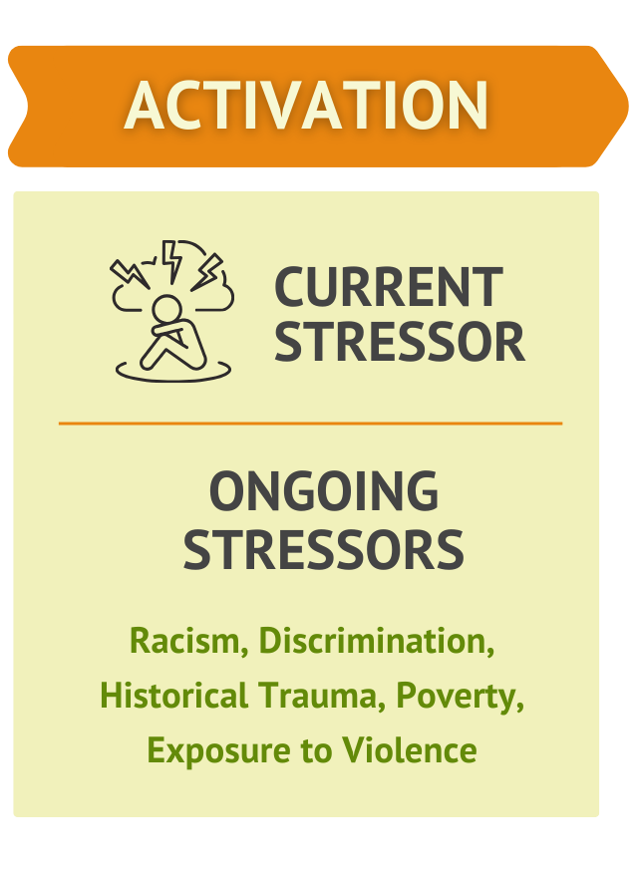
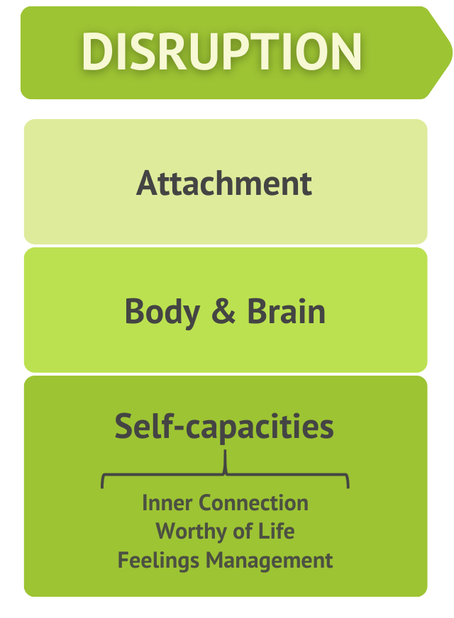
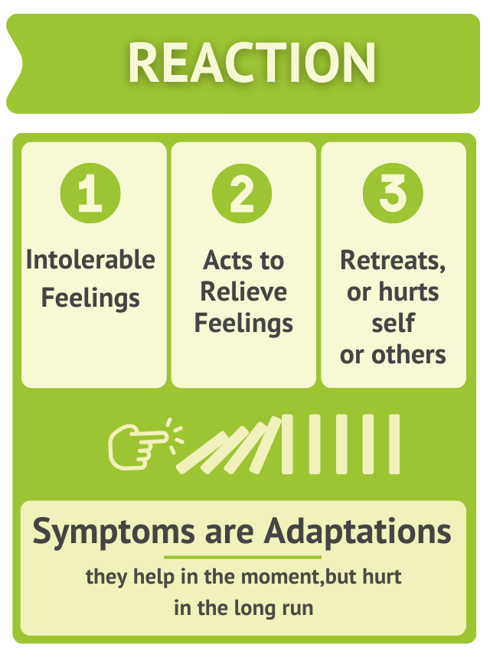
19
Notes:
THIS SLIDE IS ANIMATED
CLICK: Traumatic childhood experiences and ACEs, especially when they are chronic, disrupt the trajectory of the child’s development.
RC discusses three important domains of development that are disrupted -- attachment, body and brain, and self-capacities.
This is the history of many clients that enter our programs and the history continues to impact clients in the present.
CLICK: Then, stressors in the present – even very small stressors – echo back to the past history and can activate a very strong threat response.
These stressors can be layered on top of other ongoing stressors such as racism, discrimination, poverty, or community violence.
CLICK: Because the person struggles to rely on others for help (attachment), their body and brain are either on high alert or numb (body and brain), and they lack skills to calm and sooth themselves (self-capacities), the stressors feel intolerable.
Nobody wants to feel that way, so people turn to things, often anything, that will make the intolerable feelings tolerable -- at least in the moment (e.g., retreating: such as staying by themselves, becoming depressed, playing video games constantly; hurting themselves: such as risky sex, cutting, substance use, driving fast; and hurting others: such as fighting, sexual offending, gang violence).
These extreme behaviors or symptoms actually work -- in the short term. They are adaptive by helping the person survive in the moment, although the behaviors have many negative long-term consequences.
This RC Trauma Framework helps us see that we need to spend most of our time on the left part of the graphic for longstanding change, rather than on the right of the graphic getting rid of behavior in the short-term. This is because the more clients can trust relationships, calm their body and brain, and learn self-capacities, then the feelings that before felt intolerable now feel tolerable and they no longer need to resort to extreme behaviors.
RC Basic Manual: Day 1, Slide 50
11:15-11:20 Introduction to the RC Trauma Framework (s. 49-51)

Slide 20
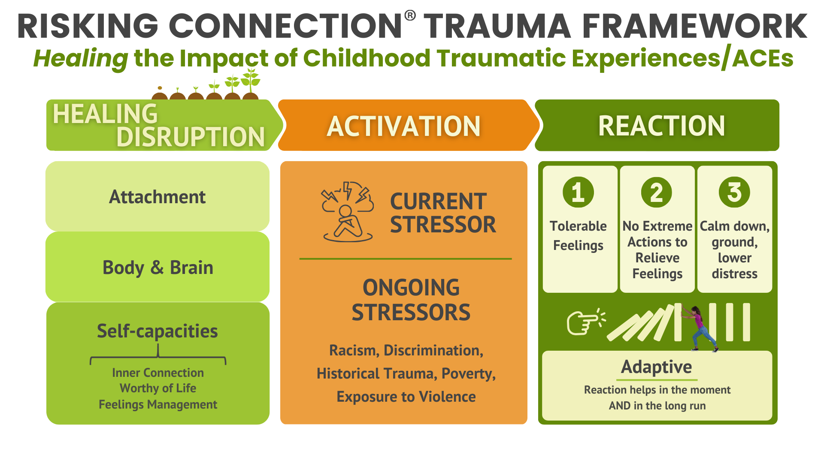
20
Notes:
RC Basic Manual: Day 2, Slide 128
No discussion on this slide.
In contrast to the last slide, this show the trauma framework when healing is happening.
On the left, the areas that were previous disrupted or impaired are healing. So, the premise is that when clients begin to trust that others can help (attachment), when their nervous system is more regulated (body and brain), and when they have the skills to manage strong feelings (self-capacities), current stressors now are more tolerable, people don’t need extreme behaviors to manage, and they can calm down and ground. Their behavior is less extreme and adaptive both in the moment and long term without negative consequences. This makes life worth living.
Discussion Guide
9:30-9:35 Strengthening Domains (slides 126-128)

Slide 21
Symptoms as Adaptations
21
Notes:
No discussion in this slide.
RC Basic Manual: Day 1, Slide 105
Discussion Guide
2-2:30 Trauma Framework: Symptoms as Adaptations (s. 105-112)

Slide 22
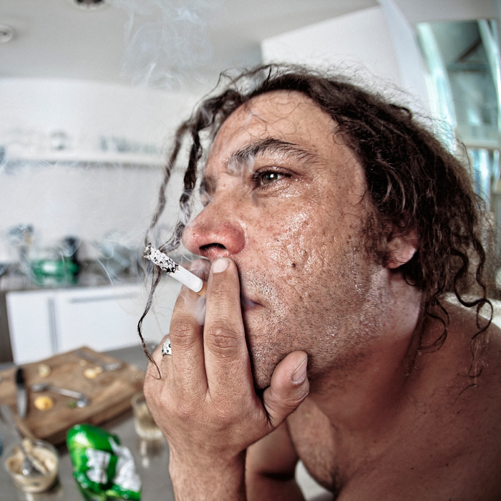
Symptoms/Behaviors are Adaptations
Symptoms/behaviors are ways clients have learned to adapt to (survive) intolerable feelings and memories.
Symptoms/behaviors help the person
in the moment ­­­­­­-­­­­­­­ despite
long-term negative consequences.
22
Notes:
RC Basic Manual: Day 1, Slide 107
2-2:30 Trauma Framework: Symptoms as Adaptations (s. 105-112)
This is a central premise of Risking Connection.
The behavior that we view as a problem are solutions for survivors, ways they have developed to survive past abuse. So, behavior in the present actually represents a learned survival skill to deal with abuse in the past.
The behavior solves a problem, it serves some important function for the person that we need to find out.
If we find out the purpose it serves and the need it meets, then we are in the best position to help the person come up with other ways of meeting those needs that don’t have so many negative consequences.
Give examples how a symptom/behavior can be adaptive:
Staying in a violent relationships helps a person avoid the despair of being alone
Rage by a person of color provides an outlet for their feeling of being devalued by the world around them.
People may go quiet and disengage when race is discussed as a way of avoiding discomfort
When the statement is made “I don’t see color!” this can dismiss or deflect the idea that I have racial bias.
A staff of color acting “on guard” or “reserved” at work compared to home and/or community helps them avoid being judged as unprofessional according to White norms.
Smoking marijuana helps a person manage anxiety
Code-switching, meaning the way in which a member of an underrepresented group (consciously or unconsciously) adjusts their language, grammar, behavior, and appearance to fit into the dominant culture, help the person function and succeed in dominant culture spaces.

Slide 23

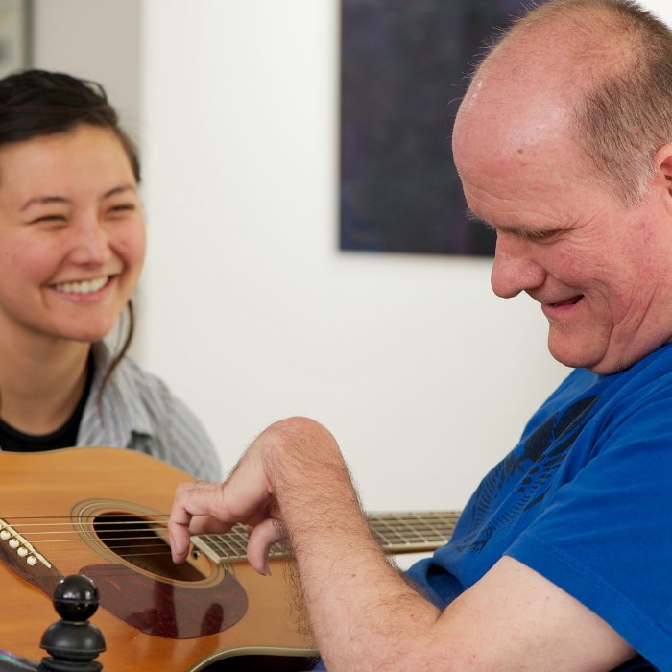
Implications of Viewing Symptoms as Adaptations
Strength-based
Helps treater not take negative behavior personally
Reduces shame and blame
Allies treater with person to solve problems together
Assumes that at any moment, person is doing the best they can
23
Notes:
No discussion on this slide.
RC Basic Manual: Day 1, Slide 109
Strength-based means we hold the perspective that there’s an important reason people do what they do; it makes sense on some level.
If a treater believes that the behavior is adaptive, they are less likely to take it personally. Even if it is directed at the treater, it’s not about the treater.
Survivors expect to be blamed, so it’s often shocking to them when we ask them how the behavior helped them in the moment. It’s also very comforting to people to know that there are understandable reasons they do things. Their behaviors are not crazy and off-the-wall, they make sense.
This perspective says, “let’s look at this behavior together and figure out why you do what you do” – as opposed to, “you are doing this bad behavior and my job is to stop you from doing it.” We’re trying to get “on the same side of the fence.” This reduces power struggles.
It comes from a fundamental belief that a person is doing the best they can in the moment.
Discussion Guide
2-2:30 Trauma Framework: Symptoms as Adaptations (s. 105-112)

Slide 24

Video: Why I am Rude
24
Notes:
Here is a video of youth talking about the underlying needs that are being met by the behavior of acting rude (about 2 ½ minutes).
What did you hear in the video that fit with the underlying reason clients you work with do what they do?
RC Basic Manual: Day 1, Slide 110
Discussion Guide
2-2:30 Trauma Framework: Symptoms as Adaptations (s. 105-112)

Slide 25
Healing Relationships
25
Notes:
No discussion in this slide.
RC Basic Manual: Day 1, Slide 105
Discussion Guide
2-2:30 Trauma Framework: Symptoms as Adaptations (s. 105-112)

Slide 26


Healing Relationships
These are positive connections between the treater and
the person.
The relationship is your major healing tool
Your interaction can be healing
whether the contact is one-time
or long-term, frequent
or infrequent
Without a relationship, techniques will not work.
26
Notes:
RC Basic Manual: Day 2, Slide 131
No discussion in this slide.
Since the relationship is the primary agent of change, building and sustaining the relationship is essential.
Give examples of times a treater was able to defuse a situation because they had a relationship with the person.
Emphasize that because the person has been hurt within relationships, a critical source of healing is through relationships.
Building a person’s connection to their culture and history, especially for those whose ties to their history has been severed, also strengthens attachment.
Racial bias can be a barrier to treaters’ relationships with clients. For example, it could lead to a treater misperceiving and over-reacting to a client of color.
Racial bias experienced by clients of color often lead them to come into relationships distrusting White people in authority. This is adaptive and White treaters need to expect this and work to build trust.
Techniques such as Cognitive Behavioral Therapy (CBT), Trauma-focused Cognitive Behavior Therapy (TF-CBT), Dialectical Behavior Therapy (DBT) and others generally don’t work without a relationship.
Discussion Guide
9:35-9:55 Strengthening Attachment (slides 129-136)

Slide 27


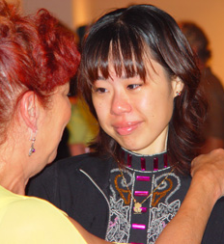
Why is a Healing Relationship So Important?
It contradicts traumatized persons’ basic assumptions about relationships
It rewires brain pathways
It decreases a person’s sense of isolation
27
Notes:
No discussion on this slide.
RC Basic Manual: Day 2, Slide 132
People with trauma histories form early expectations or patterns of what the world and other people are like based on what their early experiences are. Then, this is what they continue to expect and often experience from the world.
Give an example of how someone expecting to be treated badly could draw that response from others.
Our job is to provide new and different experiences in which people are helpful, safe, and trustworthy so that those early expectations/patterns can change.
Brain PET scans now show us that repetitive, healthy interactions with treaters can literally change the connections in peoples' brains. So by working together, clients and treaters can help create new neural connections in clients’ brains.
Clients will often say that what was worse than the abuse itself was the fact that they were all alone with the trauma, that they couldn’t tell anyone, like they were the only one.
Discussion Guide
9:35-9:55 Strengthening Attachment (slides 129-136)

Slide 28

Why is a Healing Relationship So Important?
People with trauma/ACE histories can learn that the present is different from the past
It is the treater’s most important
source of influence
People can learn about Rupture and Repair.
Inevitable breaks in relationships can be repaired.
28
Notes:
No discussion on this slide.
RC Basic Manual: Day 2, Slide 133
We acknowledge that the present is influenced by the past. But, the present doesn’t need to be dictated by the past. Our relationships give hope that the present can differ from the past.
If a person cares what you think about them, if they care that you’ll be disappointed, if they know you’ll be proud of them – then your close connection supports the client’s behavior change. It makes all aspects of your job – and client’s experience – richer.
We all pay more attention to what someone says when we like them.
When a client is upset, if you know them well, you’ll have a better understanding about what they are going through and what provides them with hope.
It is a challenge to form relationships with survivors and to maintain those relationships. Just like in early attachment relationships, the constant cycle of rupture and repair builds trust that relationships can make things better. In the same way, rupture and repair in the relationship between treater and survivors builds trust that relationships help. This is critical to healing.
Discussion Guide
9:35-9:55 Strengthening Attachment (slides 129-136)

Slide 29
A RICH® Relationship: The Key to Healing
These four components define a relationship that is healing, whether it lasts five minutes or five years.
Respect
Information
Connection
Hope
29
Notes:
No discussion on this slide.
RC Basic Manual: Day 2, Slide 134
Summarize RICH.
Respect encompasses all the ways we view people in their full humanity, worthy of our care and attention, and generally doing the best they can.
Information encompasses the ways we provide information and resources that people need to advance healing and make the best use of services.
Connection is about opening our hearts, working to form and sustain relationships with survivors.
Hope means ways we try to hold onto hope for survivors that so often feel hopeless.
You can give the example of how an emergency room doctor, who you only interact with for ten minutes, can treat you with respect or not, and how much of a difference it makes.
When conversations are difficult – including conversations about race and other inequities – staying RICH will help provide connection and foster hope.
Organizations and community institutions can be RICH also. They can do so by, for example, having celebrations, practicing rituals, appreciating community members, honoring leaders, etc.
Discussion Guide
9:35-9:55 Strengthening Attachment (slides 129-136)

Slide 30
Introduction to
Vicarious Trauma (VT)
30
Notes:
RC Basic Manual: Day 1, Slide 115
Discussion Guide
3:15-3:50 Introduction to Vicarious Traumatization (slides 115-122)

Slide 31
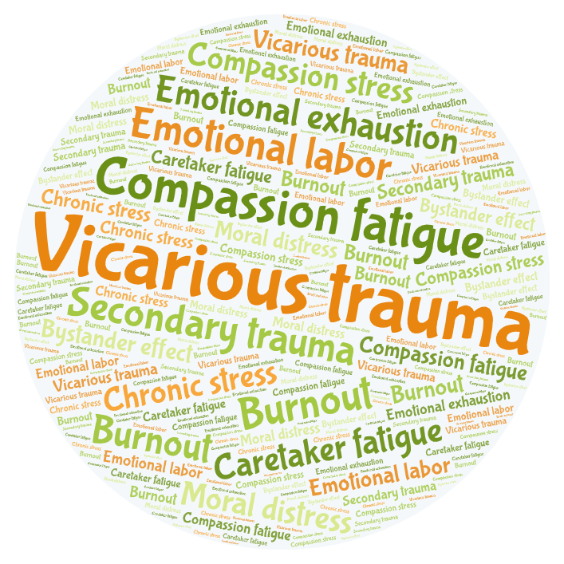
Vicarious Trauma
31
Notes:
Many of the terms represented in this Word cloud may be familiar to you; they express the difficulty that all kinds of professional treaters and caregivers experience as a result of working to support others.
Many of these terms have a specific context or sector in which they are most readily used.
In the Word cloud, we have made Compassion fatigue the second largest word as this is commonly referenced in many sectors and organizations where Risking Connection is used.
Vicarious Trauma is the largest term in the Word cloud, however, because it uniquely describes what professional treaters and caregivers experience when working with trauma survivors.
So, while it is important to recognize the usefulness of each of the terms in the Word cloud, we will specifically address Vicarious Trauma in this training and in one of the training videos, Compassion Fatigue will also be addressed.
RC Basic Manual: Day 1, Slide 116
No discussion on this slide.
Discussion Guide
3:15-3:50 Introduction to Vicarious Traumatization (slides 115-122)

Slide 32


VT: How this Work will Change You
Vicarious Trauma (VT) refers to the negative changes in the helper as a result of empathically engaging with and feeling responsible for traumatized clients.
The hallmark of VT is a disrupted sense of hope and meaning.
Originators of the VT Concept
Kay Saakvitne, Ph.D.
Laurie Pearlman, Ph.D.
32
Notes:
RC Basic Manual: Day 1, Slide 117
Vicarious Trauma is a term coined in 1990 by Laurie Pearlman (woman on the right) who is one of the authors of the RC curriculum. The concept was further developed by Kay Saakvitne (on the left), the first author of RC.
At that time, it was very unusual to talk about the impact of trauma work on treaters. In many settings, it still is.
VT is a result of giving our hearts in our work. If we didn’t invest in those we help and risk our hearts, but instead protected ourselves, we probably wouldn’t have VT AND we wouldn’t be very effective.
Originally, VT was a term that was used to describe treaters that directly cared for survivors. But, now we recognize that other kinds of helpers can be affected also. The VT might not be as intense, but it can have a negative effect.
Examples: A maintenance worker who gets to know a survivor can be negatively impacted by finding out that the person is now homeless. Senior leaders may feel hopeless if they need to cut services due to budget cuts.
VT is really about the cumulative impact on us as treaters over time.
No discussion on this slide.
Discussion Guide
3:15-3:50 Introduction to Vicarious Traumatization (slides 115-122)

Slide 33

How VT Changes Us
VT can impact:
Our core sense of meaning and hope
Our identity and worldview
Our core beliefs about safety, trust,
esteem, control, and intimacy
Our own ability to manage feelings
Our bodily feelings including our sexuality
VT may impact BIPOC staff (staff from marginalized groups) differently.
33
Notes:
RC Basic Manual: Day 1, Slide 120
With survivors of trauma there are certain areas or domains that are impacted. Many of the exact same domains in treaters are impacted by VT.
A core feature of VT is it’s impact on our basic sense of hope and our belief that our work and life has meaning. For some, this means cynicism about the world and the future. For others, it means a disrupted sense of spirituality, a questioning of their beliefs about God or a higher power.
Give specific personal examples (if possible) about the impact of VT on you in these areas. See “Vicarious Trauma Examples” in the Resource section of this Manual for examples of treaters impacted by VT. These examples can help you think of your own VT examples.
BIPOC staff often feel they must show up for work as strong, ultra-competent, and never complain in order to represent their community well and progress in their careers.
They are more likely to be living in the communities with high rates of violence similar to their clients.
They may have less access to the resources needed for self-care like mental health services, parks and open spaces, and healthy nutritious food near where they live.
All of these factors may be sources of extra stress and they may be reluctant to talk about it with colleagues because of fear of being seen as not good at their jobs.
3:15-3:50 Introduction to Vicarious Traumatization (slides 115-122)

Slide 34
Addressing and Transforming Vicarious Trauma
34
Notes:
RC Basic Manual: Day 3, Slide 229
Discussion Guide
11:40-11:55 Definition & Contributing Factors Slides (slides 229-234)

Slide 35
What To Do About VT
Environment
Treater
Examples:
Organization communicates that VT is normal, inevitable, and should be discussed
Staff recognition and celebration
Control for overtime worked
Regular supervision
Foster teams that give
and accept help
Address organizational bias
Themes to Address:
Anticipate VT and build in protection
Address signs of VT when they arise
Transform the pain of VT
VT
decreas ing
35
Notes:
RC Basic Manual: Day 3, Slide 234
There are many ways that organizations and treaters can address and transform VT.
Click - We put actions by the organization to change the environment first because it is very easy for an organization to say, “Yes, we think VT is important, so go get exercise, eat well, and have a massage.” This alone does not help VT. Organizations must create the conditions where staff are more likely to take care of themselves. They must also create a climate where staff feel supported and challenged.
Organizations can convey the message that is important for staff to have outlets to discuss and share their VT. Since BIPOC staff may be reluctant for good reason to be vulnerable about their VT at work, organizations can suggest other ways to get support such as: using the Employee Assistance Program (EAP), seeking out faith-based leaders, using community resources like barber shops, salons, recreation centers.
Because staff of color likely have endured racial bias in previous employment settings, explicit organizational efforts to racial address bias will increase trust and decrease VT.
Click – These are the areas where treaters can take actions to address their treater factors that contribute to VT. We’re going to talk specifically about these areas in the following slides.
Why might organizations be reluctant to communicate that VT is normal and inevitable?
To what extent is there a culture at your organization where staff feel supported and encouraged to practice self-care?
THIS SLIDE IS ANIMATED
Discussion Guide
11:40-11:55 Definition & Contributing Factors Slides (slides 229-234)

Slide 36
The ABCs of Protecting Against VT
Awareness
    Be attuned to one’s needs, limits, emotions, resources
    Heed all sources of information—thoughts, feelings, bodily signs, intuition
    Practice mindfulness and acceptance
Balance
    Between work, play, and rest
Connection
    To oneself, to others, and to something larger
36
Notes:
First, we must learn how to anticipate VT infuse protection into our everyday lives. We call this the ABC’s:
Awareness. See discussion questions below
Mention that we may get feedback from others before we even notice ourselves that we are being affected by the work. It is important to be open to that feedback.
Balance is important and difficult to achieve because the demands of the work are infinite. There is always something more we can do and it would probably help. We have to set limits and support each other in doing so. The best way to do this is to have things outside of work that are important to us such as relationships and activities that matter so that we will not feel overwhelmed by the work.
Connection can be to oneself - noticing what you are feeling and needing; to other people via the relationships in our lives; to something larger such as a higher power, a political movement, nature, volunteering in your community. Healing so often happens with community - within family, friends, and community – and especially in BIPOC communities where the concept of what happens to one happens to all is prevalent.
RC Basic Manual: Day 3, Slide 235
Awareness. Ask people where in their body do they experience the stress of the job. What physical signs would they first notice?
What emotional reactions would be a clue that they need a break?
What thoughts might signal cynicism or exhaustion are developing?
Discussion Guide
11:55-12:15 What to Do about VT Slides (slides 235-239)

Slide 37

Addressing VT When It Builds Up
Self-care
Self-nurture
Escape
Community
Celebration
37
Notes:
Despite everyday prevention, there are times when one can especially feel the cumulative impact of VT.
As we mentioned, awareness is important to identify when this is happening so you can take action to address.
Spend time brainstorming in the large group strategies that staff already use in each of the areas listed on the slide to address VT when it arises.
RC Basic Manual: Day 3, Slide 236
Discussion Guide
No discussion on this slide.
11:55-12:15 What to Do about VT Slides (slides 235-239)

Slide 38
Transforming the Pain of VT
The pain of VT often leads us to search for hope and meaning.
Working with people who have suffered teaches us about:
    Courage and human resilience
    Possibility of transformation
    Gratitude in our own lives
    Power of hope
Creating meaning in our lives and work helps us
endure and transform VT.
38
Notes:
RC Basic Manual: Day 3, Slide 237
Human beings often deal with pain by finding the good that comes of it.
Have you ever heard someone say, “I didn’t want to have that cancer scare last year, but it helped me realize my priorities and I went back to school.”
Some people who experience tragedies are able to turn their pain into positive actions. An example of this is Mothers Against Drunk Driving. These mothers experience a terrible loss, but instead of becoming bitter they developed a social action movement that radically changed the way we think about drinking and driving.
We see daily how the world is imperfect and not the way we would like it to be. Any actions we take to make the world a better place, such as coaching, mentoring, recycling, engaging in social justice advocacy, and more are all ways we can use our pain to improve the greater good.
We also must realize that the very intensity of our work, the very pain we experience, is what helps us grow and change as people.
Just as VT can erode our sense of meaning and make us wonder what kind of world this is, doing this important work can increase our connection to the meaning of life, increase our connection with things larger than ourselves whether that be nature, God, or spirit.
We define spirituality as a connection with that which is larger than ourselves. Doing this work often deepens our sense of spirituality.
Discussion Guide
No discussion on this slide.
11:55-12:15 What to Do about VT Slides (slides 235-239)

Slide 39
Summary of the Training
Adversity and trauma are common and can have a lifelong impact. But hope exists for trauma survivors.
One can’t discuss trauma without including the trauma of racism and other isms.
Symptoms and behaviors are adaptations clients use to survive current problems (even if they also create more problems).
RICH relationships are critical to healing.
When clients learn to rely on others, calm their body and brain, and manage feelings, symptoms and crises lessen.
Effective treaters are self-aware and notice their reactions to clients.
Vicarious trauma changes the person of the treater; we must work to transform the negative impact of trauma work
39
Notes:
RC Basic Manual: Day 3, Slide 250
With passion, summarize these critical themes of the overall training, trying to tie them together into a coherent argument.
Discussion Guide
No discussion on this slide.
3:25-3:35 Summary of the Training (slides 249-250)

